Slide 1
Flood Risk and Prevention in Carteret County, NC
Whitney Yaniero
2 December 2014
GEOG 591 Final Project

Slide 2
Project Outline
The objective of this project is to analyze flood risk in Carteret County using a variety of data sources.
What areas are most at risk and why?
Emerald Isle, NC after a rainstorm
Notes:
The objective of my project is to …
And my main goal is to find the areas most at risk and try to determine why
My aunt owns a house in Emerald Isle, a city on one of the southern barrier islands in the county.
Here’s a picture I took this summer while visiting. This is after a rainstorm.
With any large amount of rain, the roads always flood.
We had a car last year wash into a ditch. So yeah it can get pretty intense.

Slide 3
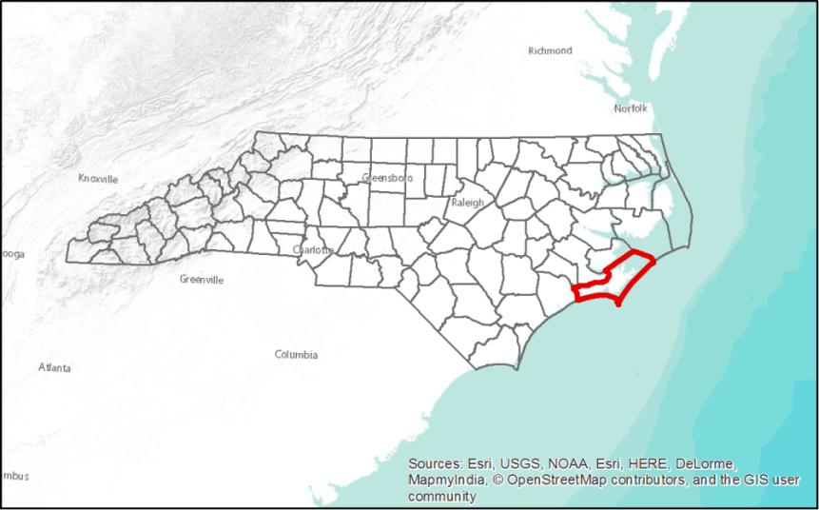
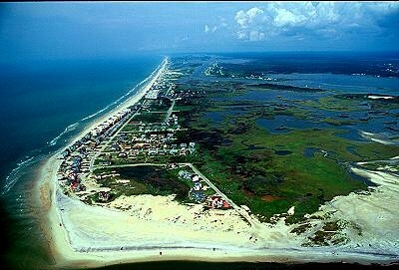
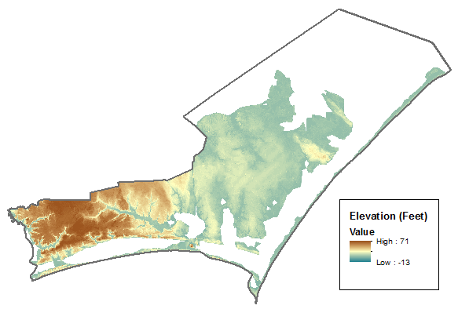
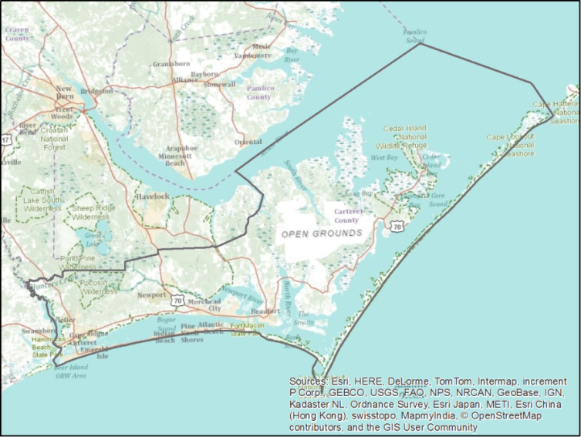
Carteret County, NC
Image from http://www.boguewatch.com
Notes:
For those of you who don’t know, this is where Carteret County is located.
It’s pretty flat, especially to the north east.
There are many flat areas of wetland that bump up right next to development, as you can see.

Slide 4
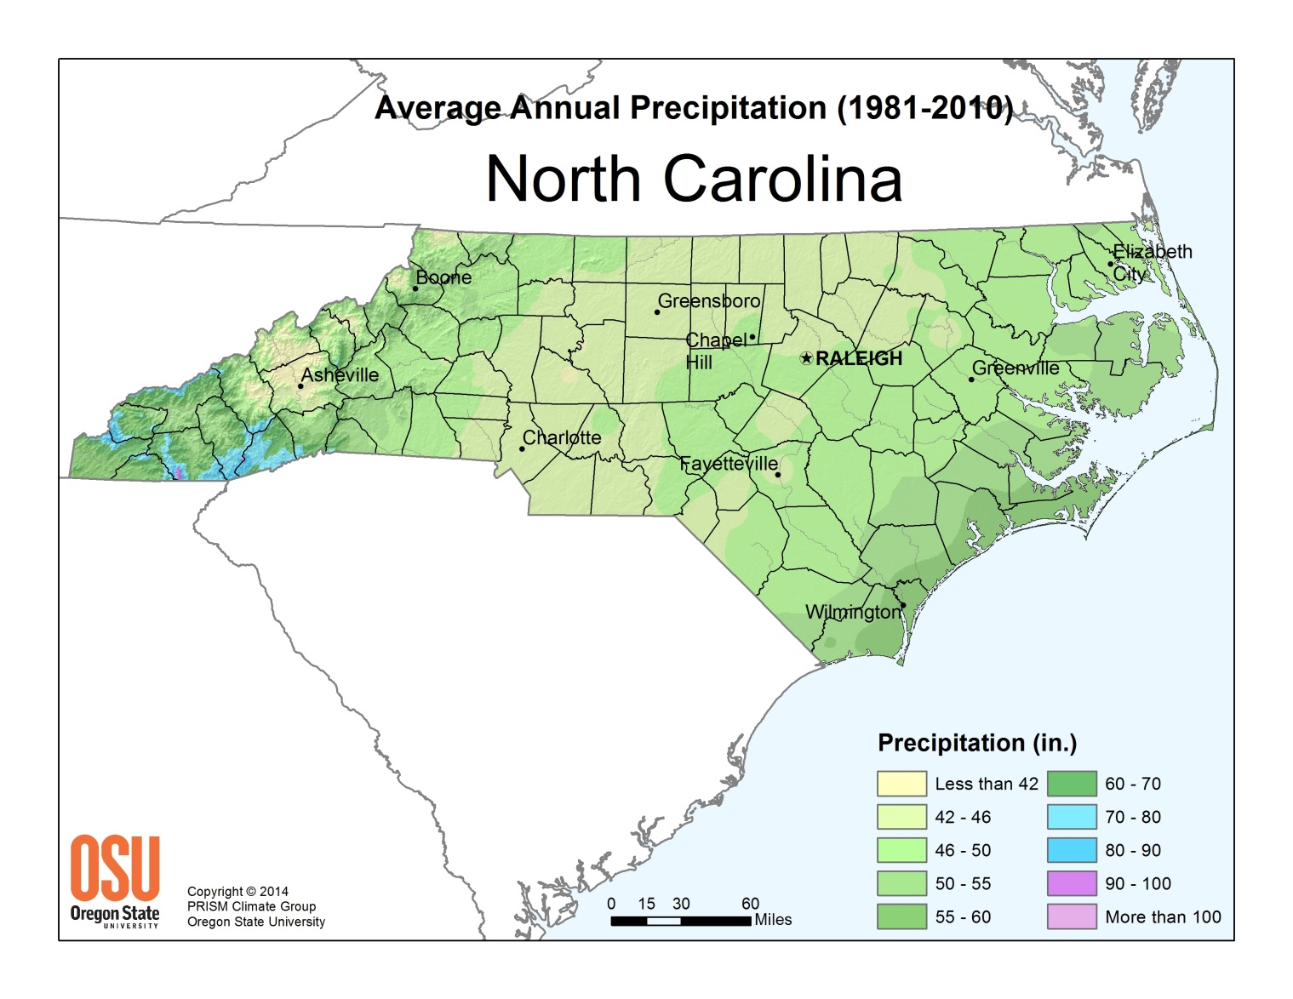
Precipitation
60-70 in/year
Notes:
Hard to find specific precipitation data over a long period of time.
PRISM data gave me an average for the county – about 60-70 inches per year

Slide 5
Wetness Index
$ln⁡(\frac{"fac"}{tan⁡("slope")}$)
Not very useful
Two areas of note
Notes:
Next, I tried topographic wetness index. I created this using LiDAR data.
Unfortunately, it didn’t really tell me all that much.
No region really stands out.
(Click) But here’s an interesting feature where you have these parallel lines.
This is due to agriculture, as we’ll see in a moment.
(click) Then you have this very high spot here.
A river empties out here.

Slide 6
Land cover
Most terrain is forest or wetland
Agriculture in NE
Most development in SW
On barrier islands
Along the edge of Bogue Sound

Slide 7
Water storage and water table depth
Higher storage volume inland, north
Lowest storage volume in barrier islands
Deepest depth along land edges (next to water)

Slide 8
Flood risk map
Flood Hazard Areas as defined by Flood Insurance Rate Map
Levels:
0.2% Annual Chance
AE (1% AC, mandatory flood insurance)
AO (1% AC shallow flooding)
Open Water
VE (1% AC with wave action)
X (less than 0.2% AC)
*Special Flood Hazard Areas (SFHA) have a 0.2% or greater AC

Slide 9
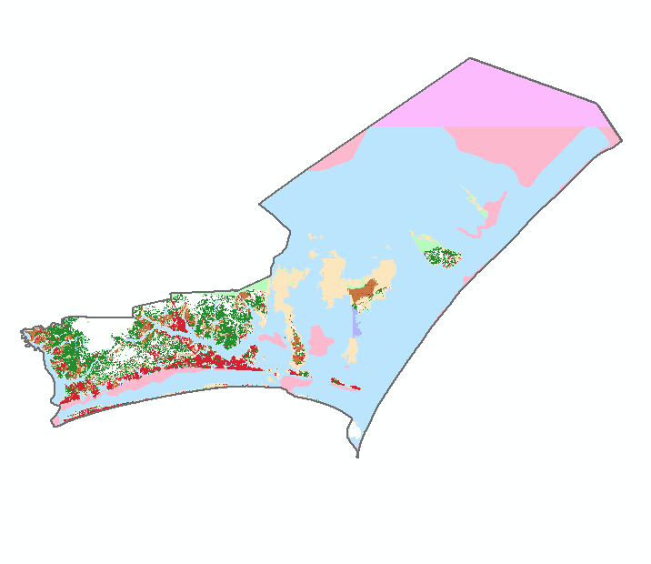
SFHA contain
33% of population
47% of land area
24% of critical facilities
39% of roads

Slide 10
Hurricane Storm Surge
Hurricane Storm Surge Inundation Areas (1993)
Based on SLOSH (Sea, Lake, and Overland Surges from Hurricanes)
From 1851 to 2005, North Carolina has been hit by 47 hurricanes*
22 category 1
13 category 2
11 category 3
1 category 4
* ~3 hurricanes a year

Slide 11
Nearly all Cat 1 and Cat 2 zones are in a flood hazard area
Most development is in Cat 4/5 zone

Slide 12
Conclusion
Hurricane storm surge greatest contributor to flood risk
For outlying barrier islands, lack of water storage capacity in the soil is also important
Heavy rain/storms
Type of land
As expected, low lying regions, especially the barrier islands and land to the NE, are most prone to flooding

Slide 13
Questions?

Slide 14
Sources and Data
North Carolina Department of Transportation – GIS Resources
NCDOT Hurricane Storm Surge Info http://services.nconemap.com/arcgis/rest/services/NC1Map_Hurricanes/MapServer
National Land Cover Dataset
North Carolina Flood Risk Information System – Carteret County Data http://fris.nc.gov/fris/Download.aspx?FIPS=031&ST=NC&user=General%20Public
PRISM Climate Group, Oregon State University
Carteret County Government Website - http://www.carteretcountync.gov/244/Carteret-County-Flood-Information
North Carolina Department of Public Safety - https://www.ncdps.gov/Index2.cfm?a=000003,000010,000025,000185,001329
ESRI ArcGIS online services
FEMA Flood Zone Information - https://www.fema.gov/floodplain-management/flood-zones#

