Slide 1
Risk of Eutrophication due to Hog Farms in Neuse River Watershed
Nolan Kirkwood
GEOG 591
November 25, 2014

Slide 2
Introduction
What is Eutrophication?
Why does it matter?
What have I done?
What will I do?

Slide 3
Eutrophication
“An increase in the rate of supply of organic matter to an ecosystem”
  Nixon, 1995
Specifically Nitrogen and Phosphorus

Slide 4
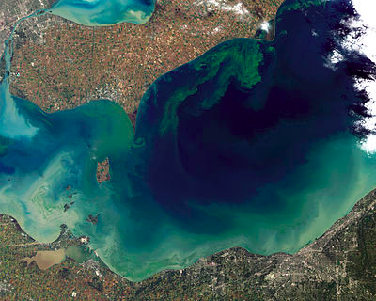
Environmental Degradation
Turbidity
Harmful Algal Blooms
Hypoxia
Fish Kill Events

Slide 5
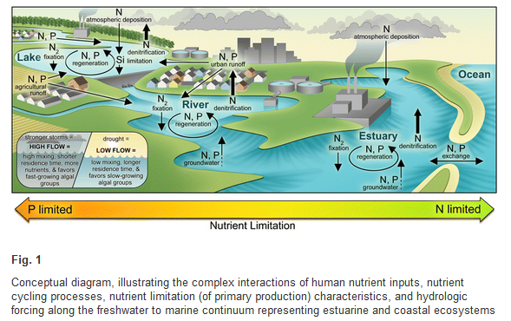

Slide 7
Goal of My Project
Use ArcGIS and readily-available information to assess which hog farming operations in the Neuse River Watershed have the most potential to cause eutrophication events in the Neuse River Estuary.

Slide 8
My Project
Information from NC One Map
  River Basins in North Carolina
  National Elevation Data Set
  Animal Operations Permits
  National Hydrography Data Set

Slide 9
My Project
Information from NC One Map
  River Basins in North Carolina
  National Elevation Data Set
  Animal Operations Permits
  National Hydrography Data Set

Slide 10
My Project
Information from NC One Map
  River Basins in North Carolina
  National Elevation Data Set
  Animal Operations Permits
  National Hydrography Data Set

Slide 11
Moving Forward
Method for assessing potential interaction between Swine Operations and waterways in the Neuse River watershed
  Buffer?
  Floodplain?
  Stream Ordering?
Base risk analysis on size of operation (by animal #) and proximity to water bodies

Slide 12
Conclusion
What is Eutrophication?
Why does it matter?
What have I done?
What will I do?

Slide 13
Questions?

Slide 14
References
Nixon, SW. Coastal Marine Eutrophication – A Definition, Social Causes, and Future Concerns. 1995
Paerl, Hans. Evolving Paradigms and Challenges in Estuarine and Coastal Eutrophication Dynamics in a Culturally and Climatically Stressed World. 2014
National Elevation Dataset – United States Geological Survey
National Hydrography Data Set – United States Geological Survey
North Carolina River Basins - http://data.nconemap.com/geoportal/catalog/search/resource/details.page?uuid={8E5FD464-F93D-4130-B93E-33E02940909F}
North Carolina Animal Operations Permits - http://data.nconemap.com/geoportal/catalog/search/resource/details.page?uuid={10EE021B-DFC1-47B1-92D4-CD37972CB38C}

