Slide 1
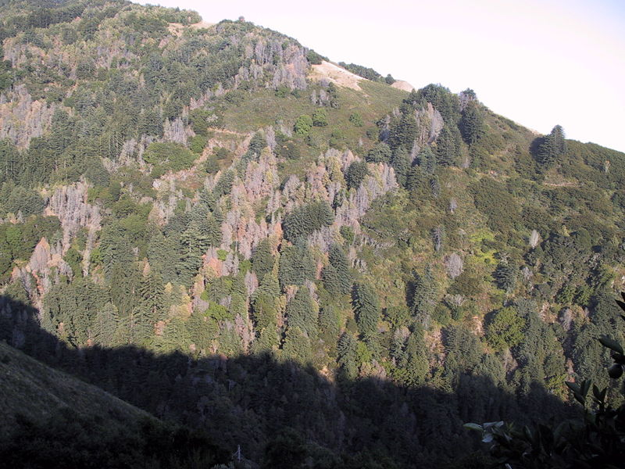
Topographic influence on the distribution of Phytophthora ramorum
US Forest Service
Chris Jones 11/25/2014

Slide 2
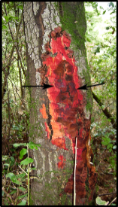
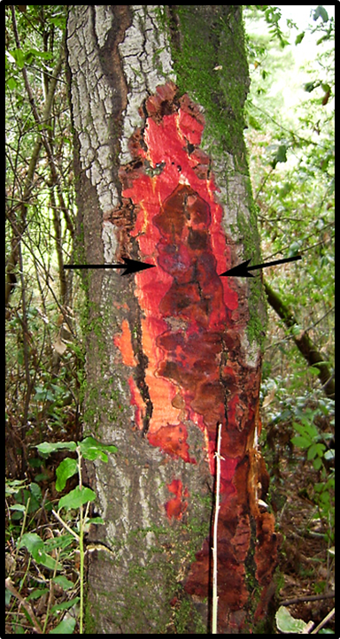
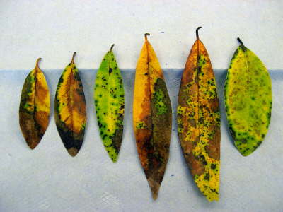
Phytophthora Ramorum
Oomycete
2 types of diseases:
Canker (Sudden Oak Death)
Foliar (Ramorum Blight)

Slide 3
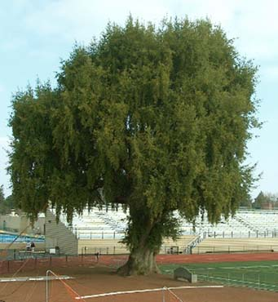
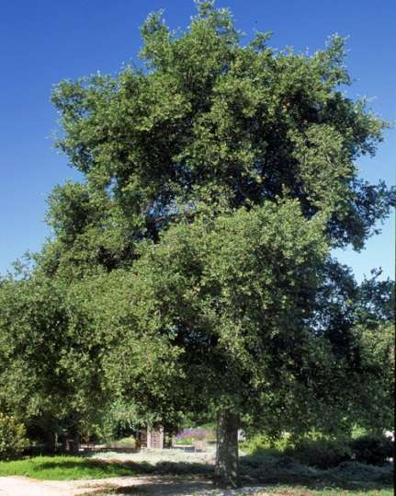
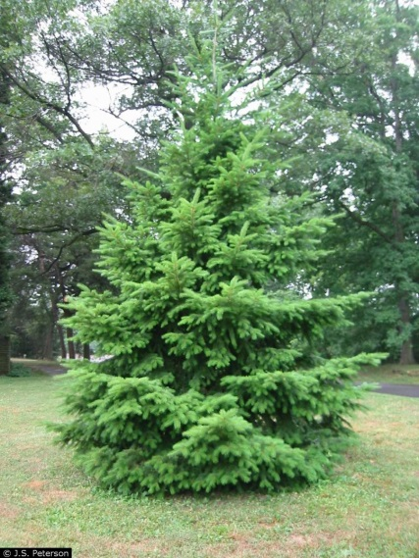
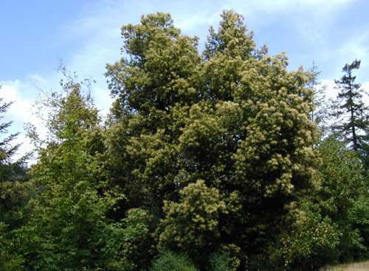
Phytophthora Ramorum Hosts
Quercus agrifolia | Rubus spectabilis
Quercus kelloggii | Aesculus californica
Quercus parvula var. shrevei | Rhamnus californica
Quercus chrysolepis | Rhamnus purshiana
Lithocarpus densiflorus | Corylus cornuta
Arbutus menzeisii | Lonicera hispidula
Vaccinium ovatum | Viburnum spp.
Arctostaphylos spp. | Toxicodendron diversilobum
Rhododendron spp. | Trientalis latifolia
Umbellularia californica | Sequoia sempervirens
Acer macrophyllum | Pseudotsuga menziesii
Heteromeles arbutifolia
Q. agrifolia
U. californica
L. densiflorus
P. menziesii

Slide 4
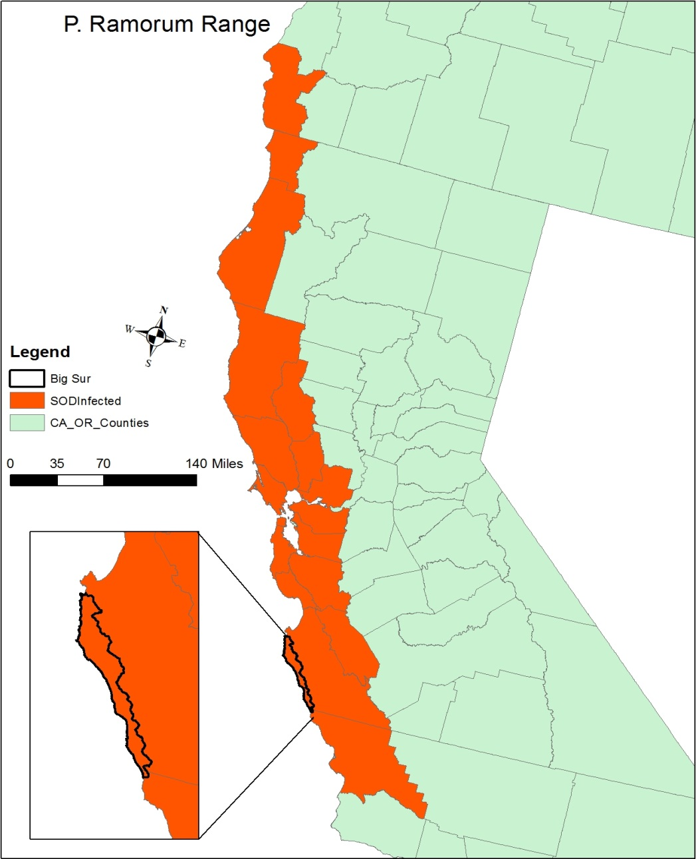
P. Ramorum Range and Data
Data
PRISM
DEM 30 meter
Interpolated FIA and CALVEG tree data
P. ramorum plot data

Slide 5
Topographic Calculations
Elevation
Fill
$$TWI=Ln\left(\frac{\left(FAC+1\right)∗Cell Size}{Tan\left(slope\right)}\right)$$
Flow Direction
Slope (Degrees)
TWI = Topographic Wetness Index
FAC = Flow accumulation
Flow Accumulation
TWI

Slide 6
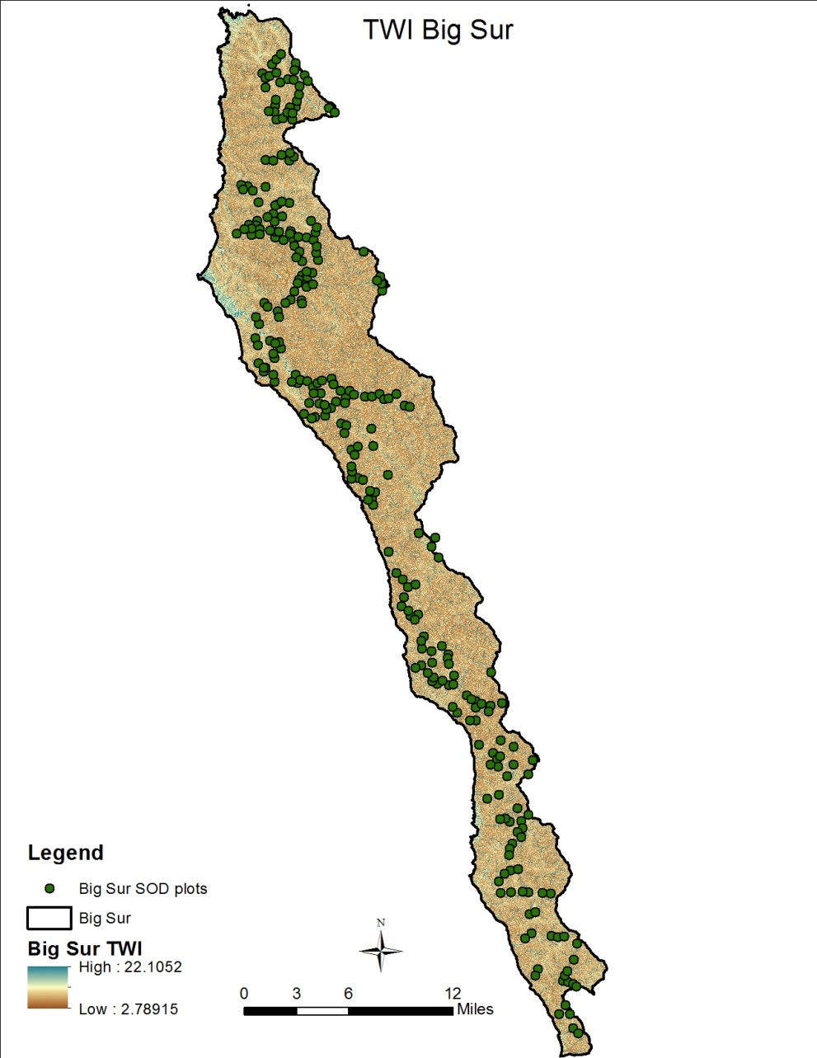
Topographic Wetness

Slide 7
Potential Model Variables
RF | Topographic | Climate
California laurel | TWI | Monthly Average PPT
California live oak | Slope | Monthly Mean TMAX
California black oak | Elevation | Monthly Mean TMIN
redwood
tanoak
Pacific Madrone
Douglas Fir

Slide 8
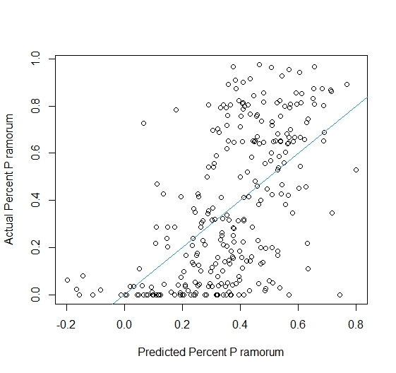
Significant Model Variables
Variable | Estimate | Pr(>|t|)
(Intercept) | 2.139 | 0.022
TWI | 0.008 | 0.022
TMAX3 | -0.364 | <0.001
TMAX8 | -0.215 | 0.001
TMAX9 | 0.278 | 0.001
TMAX12 | 0.156 | 0.002
TMIN1 | -0.318 | 0.048
TMIN2 | 0.380 | 0.048
PPT4 | -0.004 | 0.044
PPT5 | 0.018 | 0.036
PPT7 | -0.855 | <0.001
California Bay Laurel | 0.501 | 0.030
AIC = 60.0051
Adj. R^2 = 0.456

Slide 9
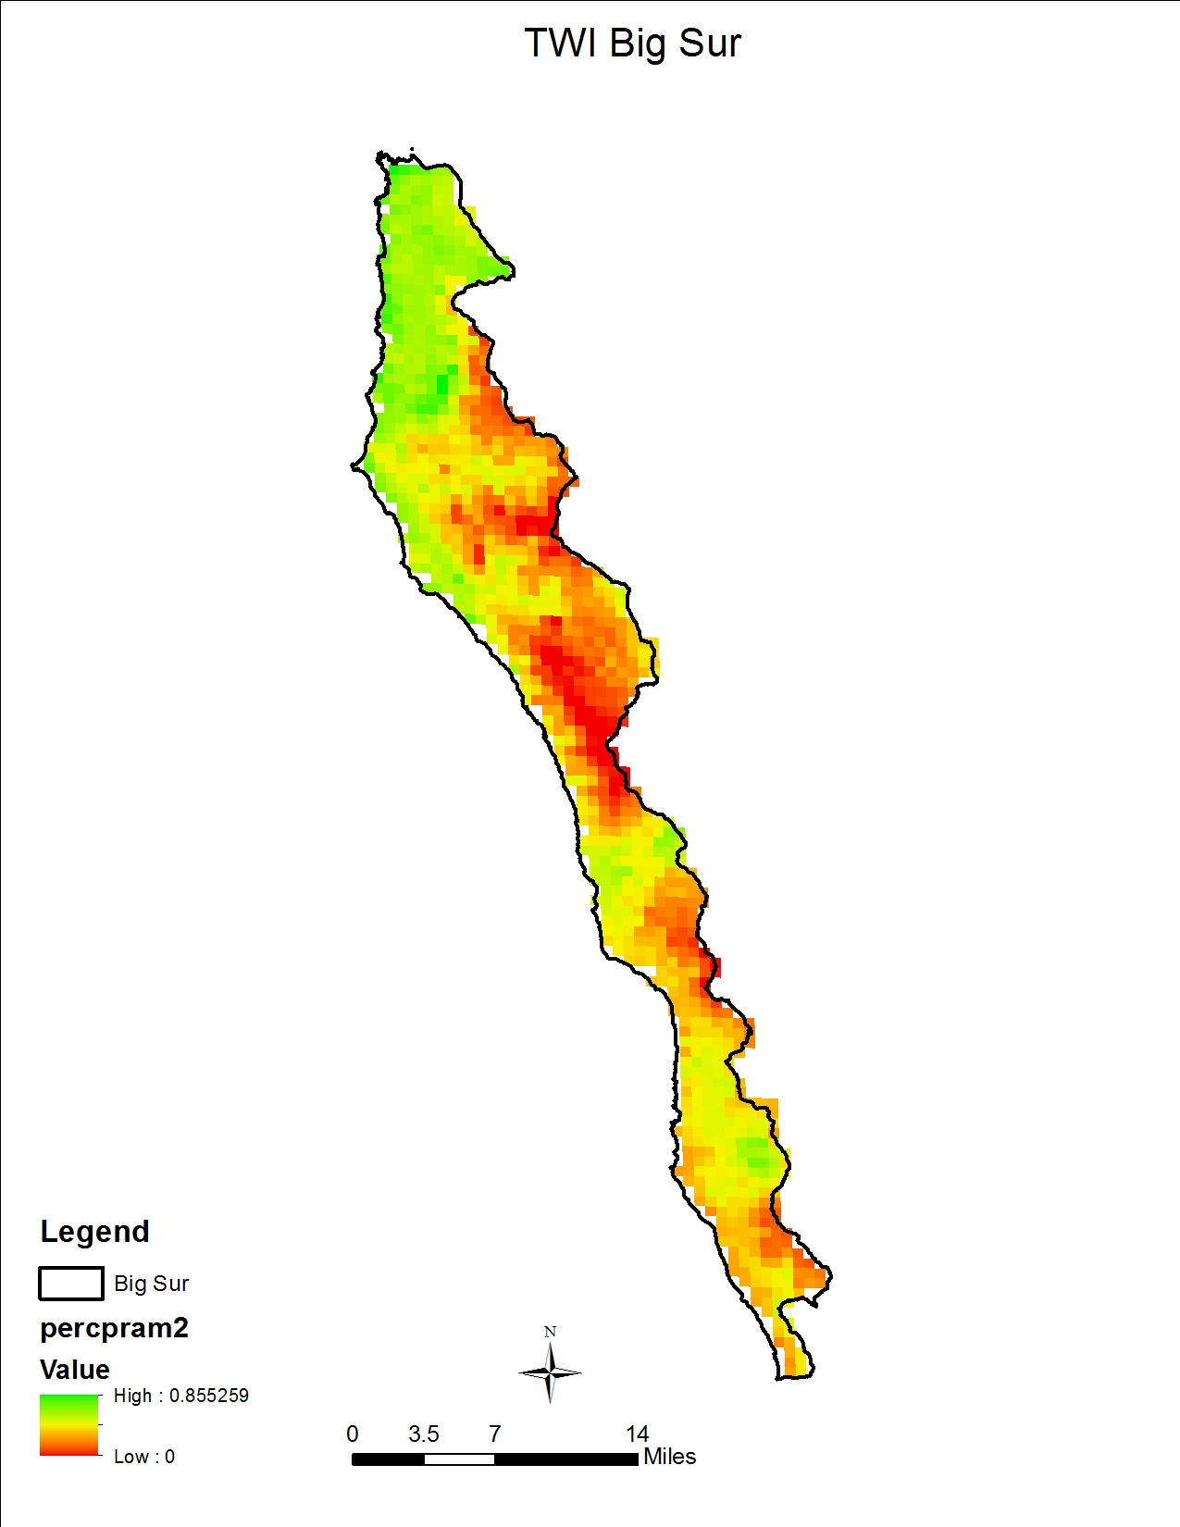

Slide 10
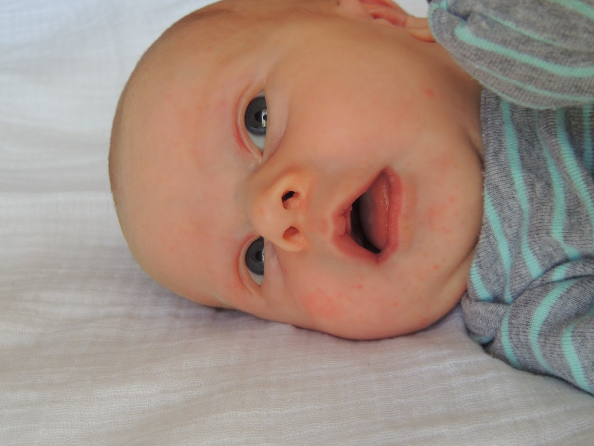
Acknowledgements
Aaron Moody
Ross Meentemeyer
David Tarboton
Oliver Lucas Jones

Slide 11
Questions

