Slide 1
Charlotte, NC: Growth and The Resulting Impact on Water Resources
Amanda Gaffey
UNC Chapel Hill
November 2014

Slide 2
NC and Charlotte Intro
Notes:
Charlotte metro- Cabarrus, Gaston, Lincoln, Mecklenburg, Rowan, Union and Alexander, making up the largest metro area in the state (est pop at 1.58million in 2007).

Slide 3
Question
How has urbanization and growth affected the watersheds in the Charlotte area- specifically Mecklenburg county?
Drinking water
Nutrients
Population
Impervious Surfaces

Slide 4
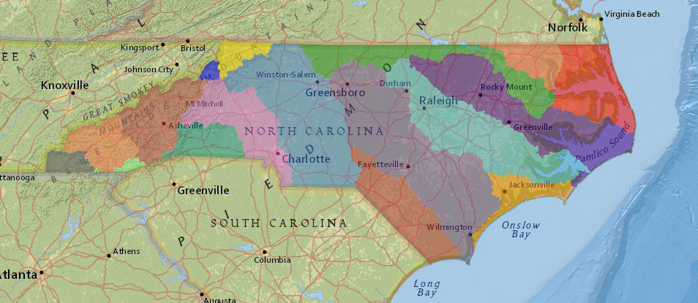
Focus Watersheds
Catawba
Yadkin
Notes:
http://www.eenorthcarolina.org/riverbasins-gis-map.asp
In 2012, the Catawba River was named the 5th most endangered river in the US

Slide 5
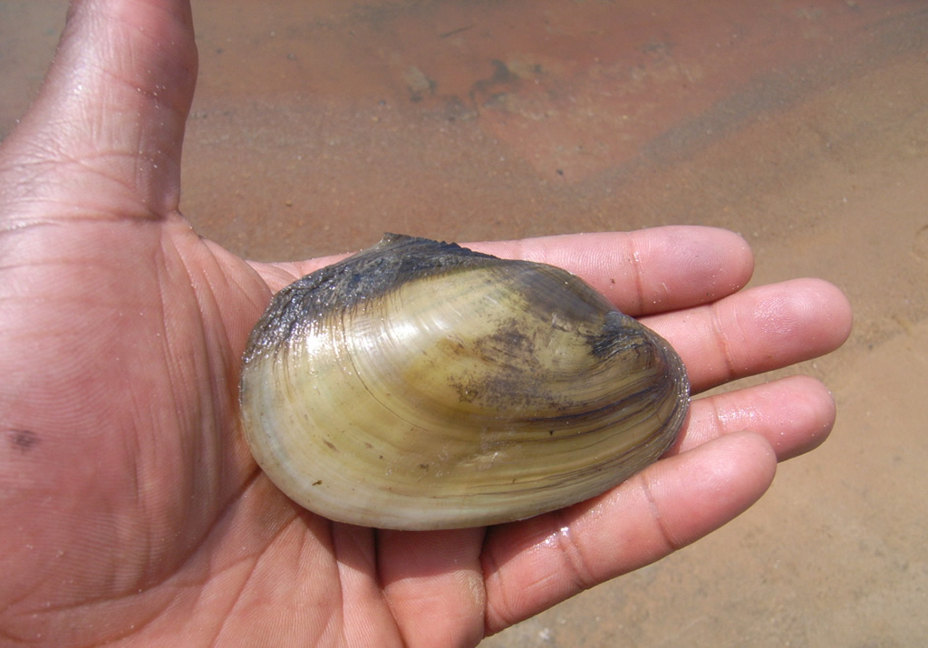
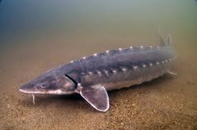
Why It’s Important
-- Heelsplitter freshwater muscle and shortnose sturgeon
-- Man-made lakes that provide recreation, drinking water, and electricity for the expanding Piedmont area including Charlotte
-- Several lakes in the basin show signs of stress from excessive amount of nutrients and other contaminants in storm water runoff
Notes:
most of the 224-mile river is comprised of several man-made lakes that provide recreation, drinking water, and electricity for the expanding Piedmont area including Charlotte
Several lakes in the basin show signs of stress from excessive amount of nutrients and other contaminants in storm water runoff

Slide 6
Mecklenburg County
Notes:
NC OneMap Data of Impaired watersheds
Purple= ORW Special Management Strategy Area and Local Stormwater Program
Red= impaired
Blue= supporting

Slide 7
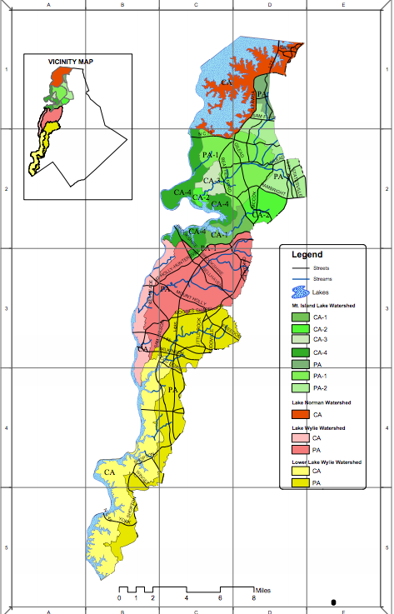
Watershed Protection Overlay Districts
Notes:
Drinking waterheds according to Charlotte Meck. made up of the Mountain Island Lake, Lake Norman, Lake Whylie, and Lower Lake Whylie Watershed
http://charmeck.org/stormwater/regulations/Documents/Water%20Supply%20Watershed%20Documents/WaterSupplyWatersheds.pdf
http://charmeck.org/stormwater/regulations/pages/watersupplywatershedregulations.aspx

Slide 8
Clipping Intersection of Watersheds and Drinking Water Sources
Notes:
Blue Water Supply watersheds made up of the Mountain Island Lake, Lake Norman, Lake Whylie, and Lower Lake Whylie Watershed.

Slide 9
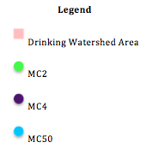
Charlotte Mecklenburg Data Points compared to Water-sheds
Notes:
Relevant:
-80.8771 35.4431 decimal degrees or -9003197.6868 4224256.3169 meters (Green): MC2
-80.9211 35.3896 decimal degrees or -9008091.0823 4216956.2235 meters (Purple): MC4
-80.8977 35.3614 decimal degrees or -9005486.9855 4213099.6527 meters (Light Blue): MC50

Slide 12
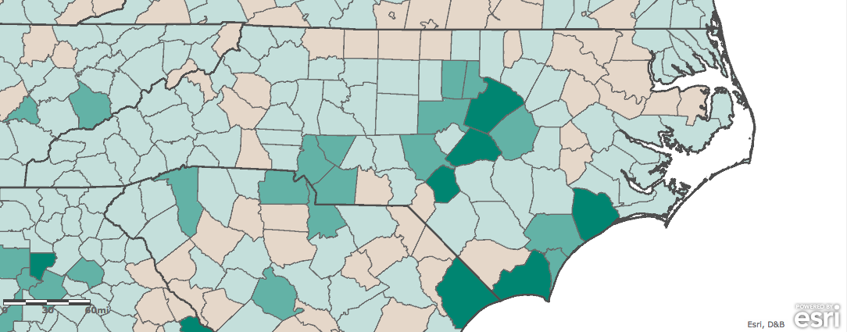
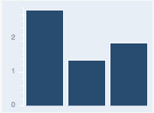
Population
2.8
1.9
1.4
2000s 00-10 10-14 14-19
Notes:
The current population here is 974,119 and is estimated to be 1,067,913 in 2019. The estimated annual rate of change is 1.9%.

Slide 13
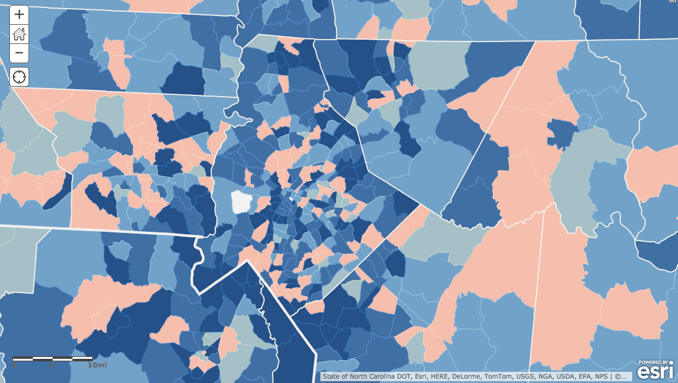
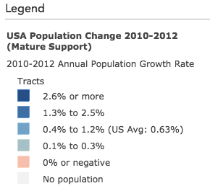
Population
Notes:
ArcGIS online map of population change

Slide 14
Notes:
Spikes in 2102

Slide 15
Commercial Impervious and Charlotte Mecklenburg Sites

Slide 16
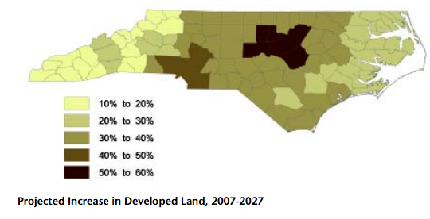
Losing Our Natural Heritage Report
“The Charlotte area will lose 30% of is natural areas, including nearly a quarter of its forest land, the highest rate of forest loss in the state”
Notes:
The Charlotte area will lose 30 percent of is natural areas, including nearly a quarter of its forest land, the highest rate of forest loss in the state.
Source: file:///Users/amandagaffey/Desktop/GIS/Land%20Development%20-%20Losing_Our_Natural_Heritage.pdf

Slide 17
Report cont…
Notes:
In the last 20 years ,Charlotte the state’s largest metropolitan area, lost 25% of it’s total cropland and forest land for a total of 270,000 acres, highest percentage loss in the state
It has also added 321,000 acres of developed land, an increase of 88% from 1987 to the present.
Over the same amount of time, the population has grown by 40% and growth of development acreage has increased 65%
file:///Users/amandagaffey/Desktop/GIS/Land%20Development%20-%20Losing_Our_Natural_Heritage.pdf

Slide 18
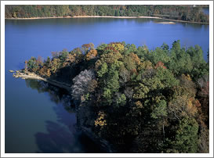
Conclusion
Growing population and increase in impervious surfaces are putting a strain on local watersheds
This change is projected to increase, so methods for care and maintenance need to remain or be put in place and strictly regulated
Continue to look at more factors and sites in the area and monitor
Notes:
Conclusion

Slide 19
Sources and Data
Catawba Riverkeeper (2014). Water Quality Facts. Retrieved at: http://www.catawbariverkeeper.org/News/waterqualityfacts
Environment North Carolina Research & Policy Center (2007). Losing Our Heritage: Development and Open Space Loss in North Carolina. Retrieved at: file:///Users/amandagaffey/Desktop/GIS/Land%20Development%20-%20Losing_Our_Natural_Heritage.pdf
N.C. Office of Environmental Education (2011). Catawba River Basin. State of North Carolina. Retrieved at: http://charmeck.org/stormwater/whatsmywatershed/Documents/CatawbaWatershed.pdf.
N.C. Office of Environmental Education (2011). Yadkin River Basin. State of North Carolina. Retrieved at: http://charmeck.org/stormwater/whatsmywatershed/Documents/YadkinWatershed.pdf
ESRI ArcGIS Online
NC OneMap
MRLC layer of the National Land Cover Dataset
Charlotte Mecklenburg Storm Data—Charlotte Storm water Services

