Slide 1
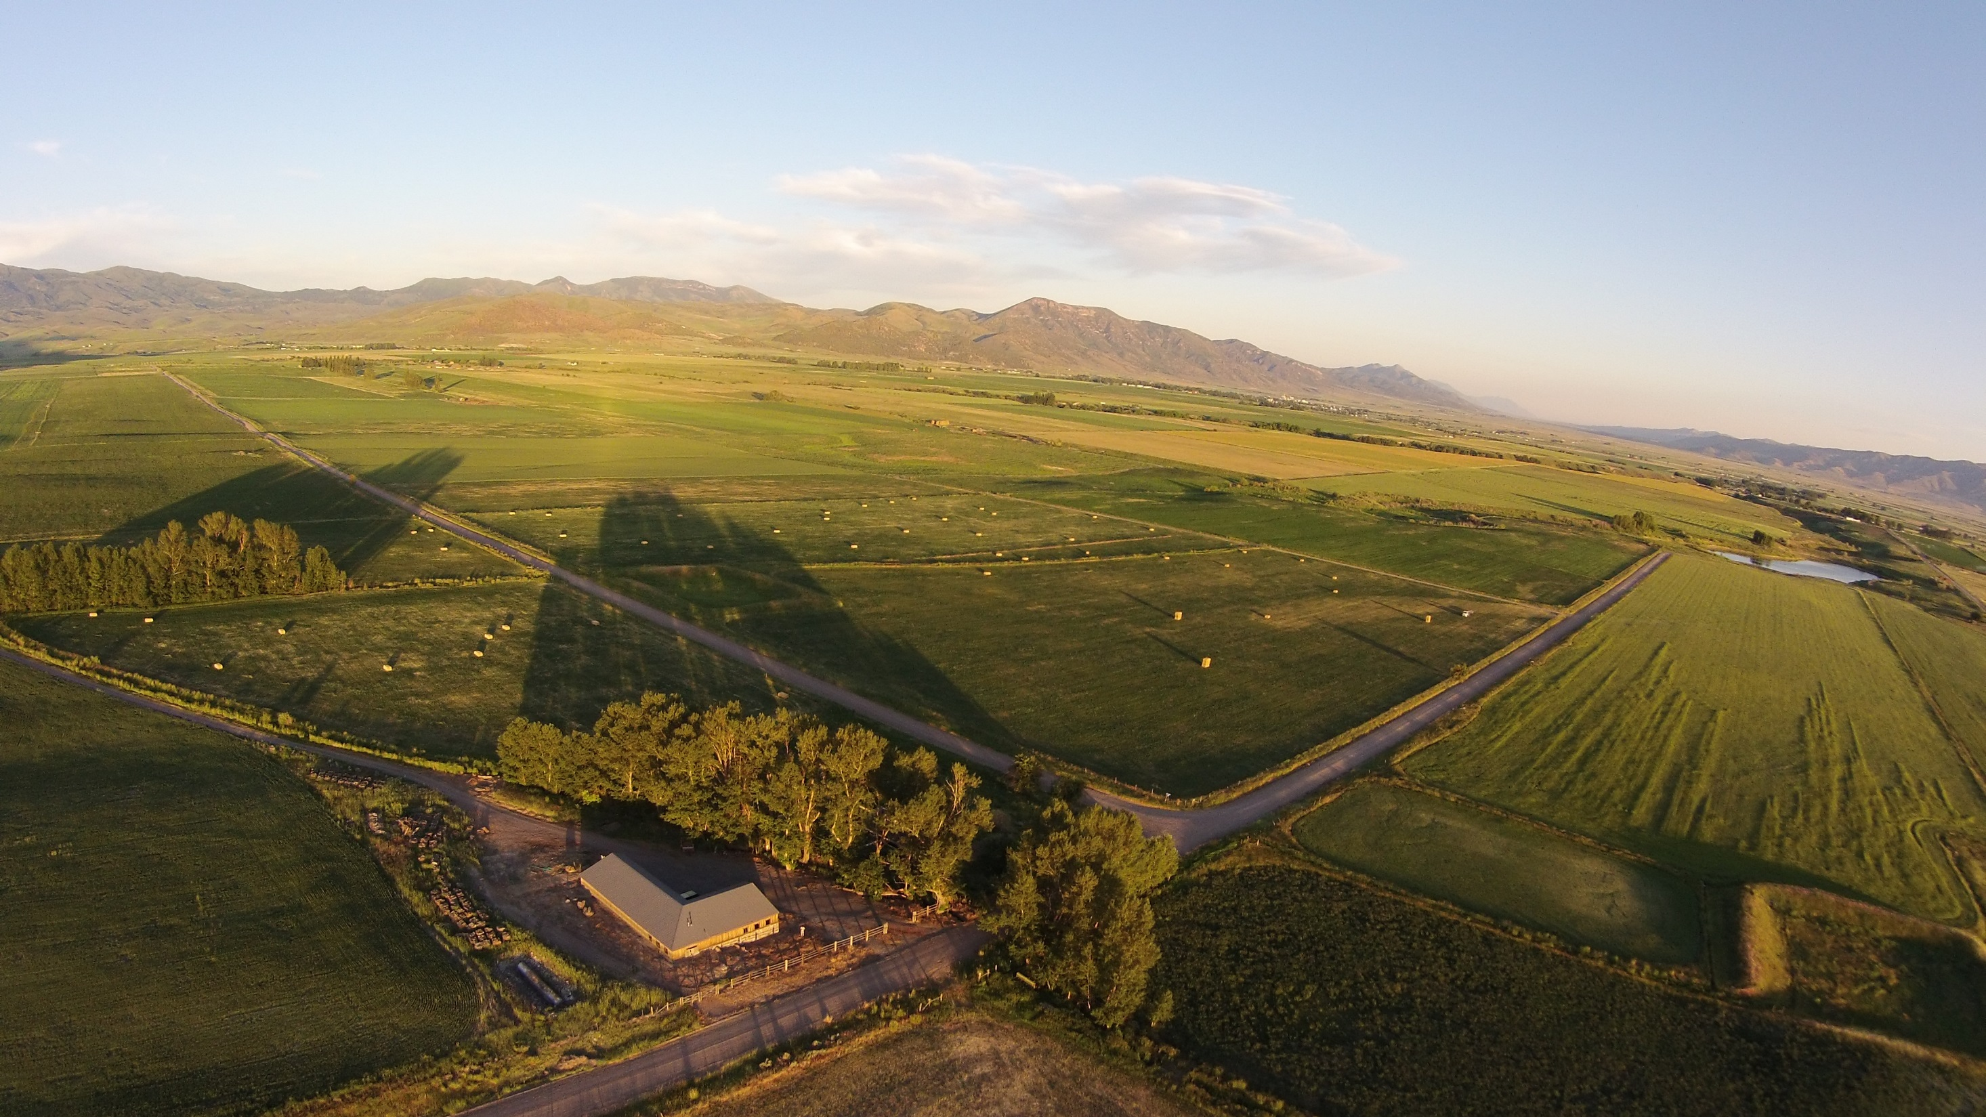
GIS Analysis of
Secret Canyon Ranch
Colin Bagley
2014

Slide 2
Overview
Purpose:
  Digital Mapping of Ranch Extent
  Basic Modeling of Potential Reservoir
Methods
  Data Collection
  ArcGIS Processing and Modeling
Results
  Digital and Hard copy reference Maps
  Reservoir Model

Slide 3
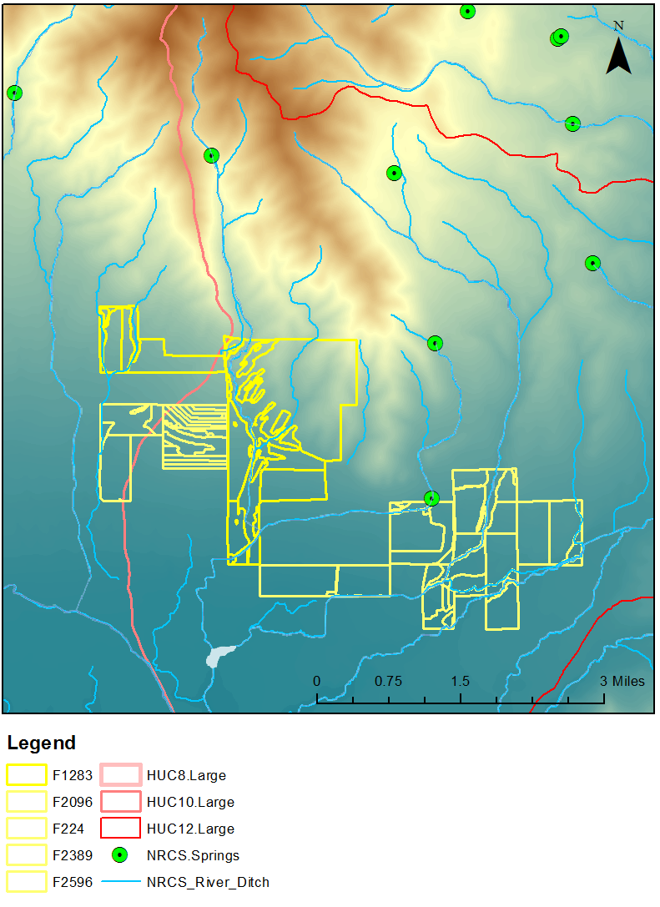
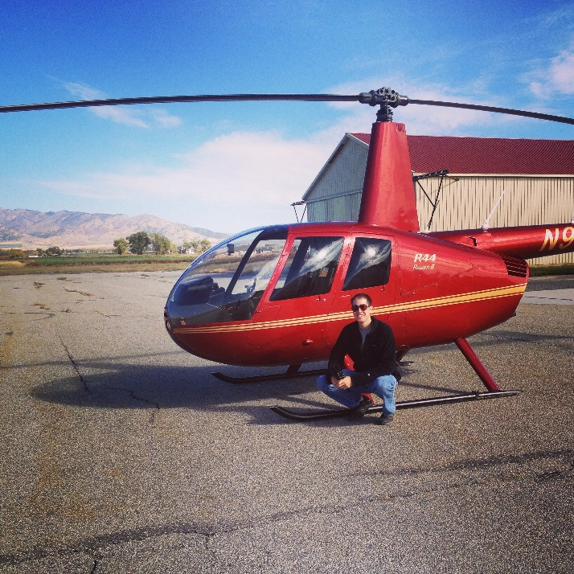
Reference Maps: Data Collection

Slide 4
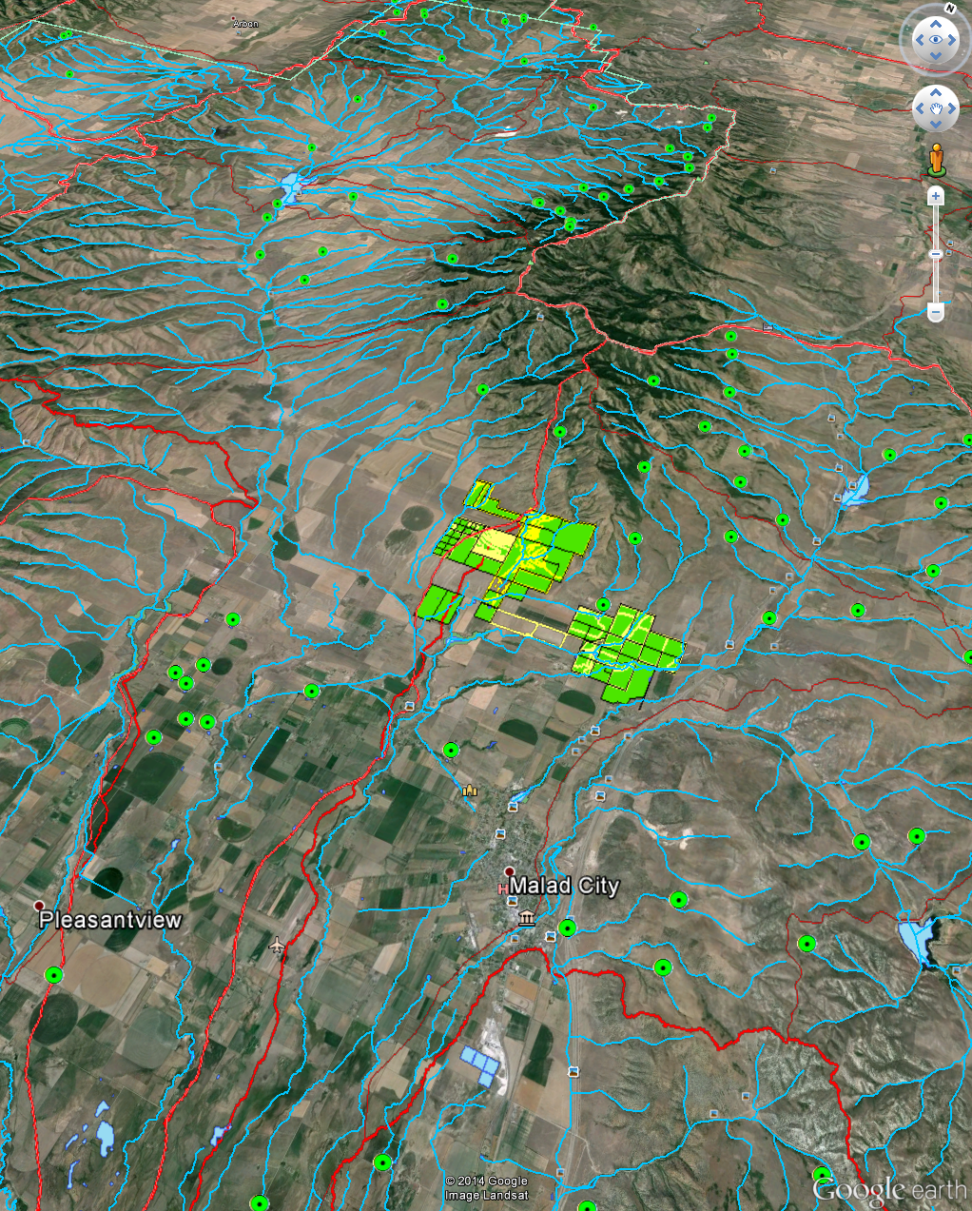
Reference Maps: Results
CRP and Legal Records
National Datasets
Converted to KMZ
Identified Minor Fixes for
  County Assessor

Slide 5
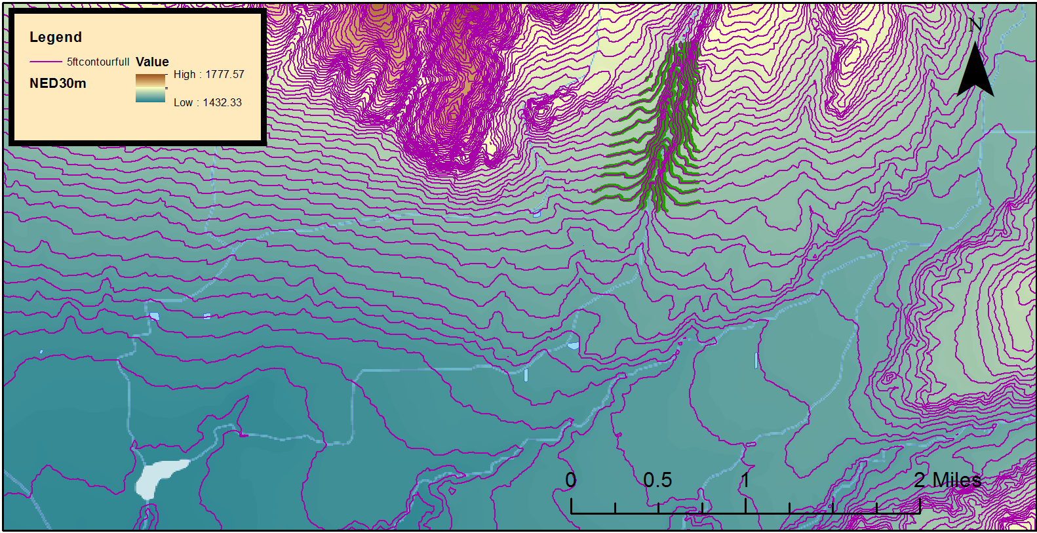
Reservoir Analysis: Location
St John’s Reservoir

Slide 6
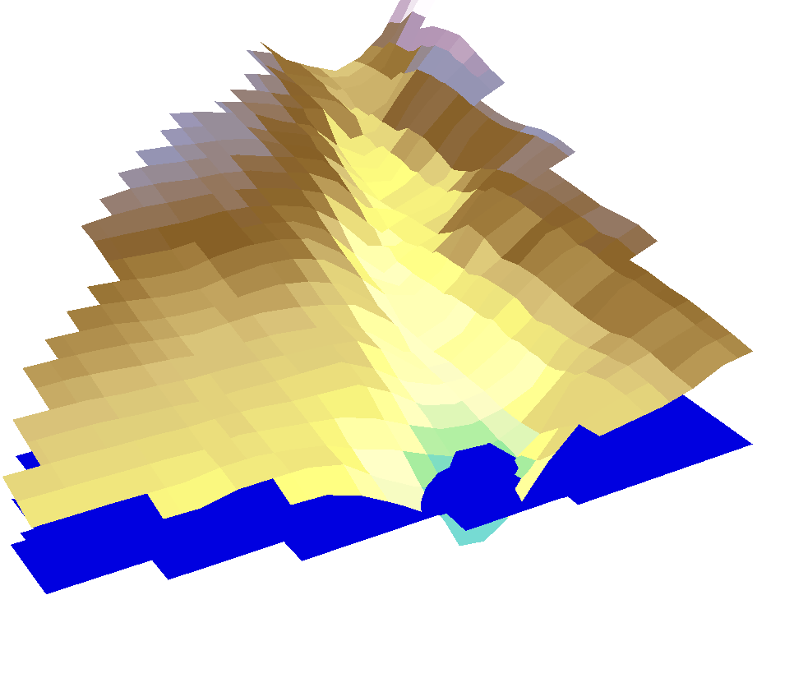
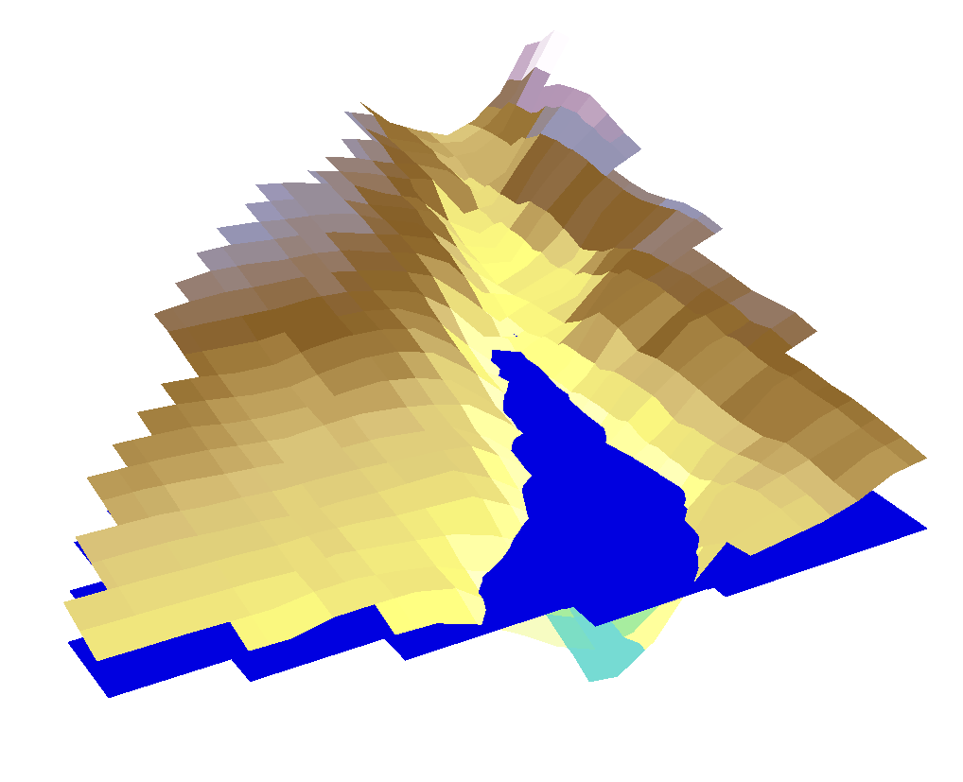
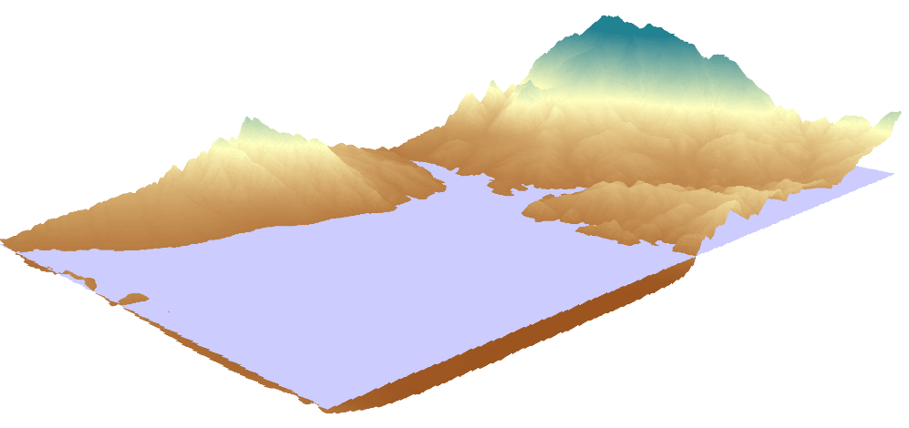
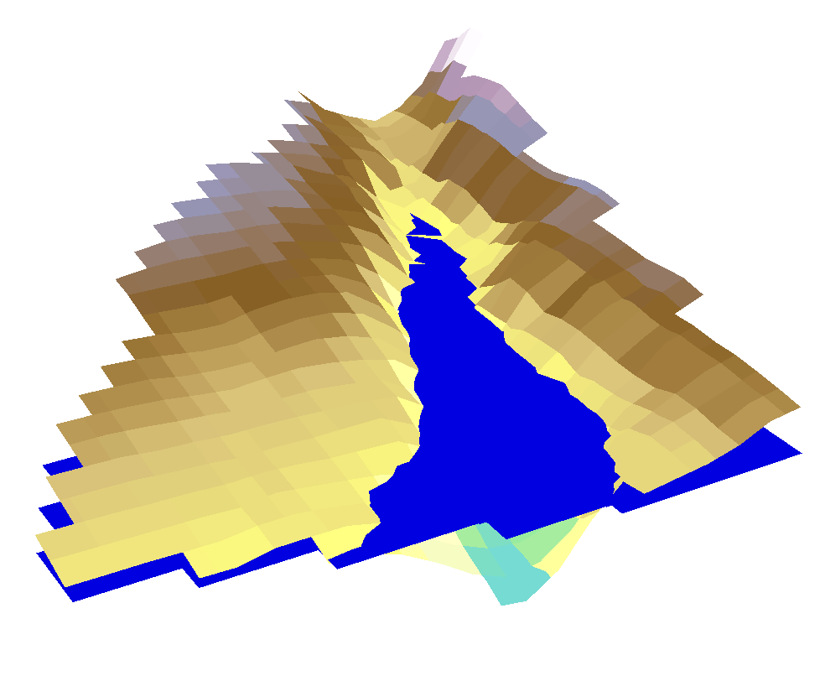
Reservoir Analysis: Calculation
10 m
20 m
25 m

Slide 7
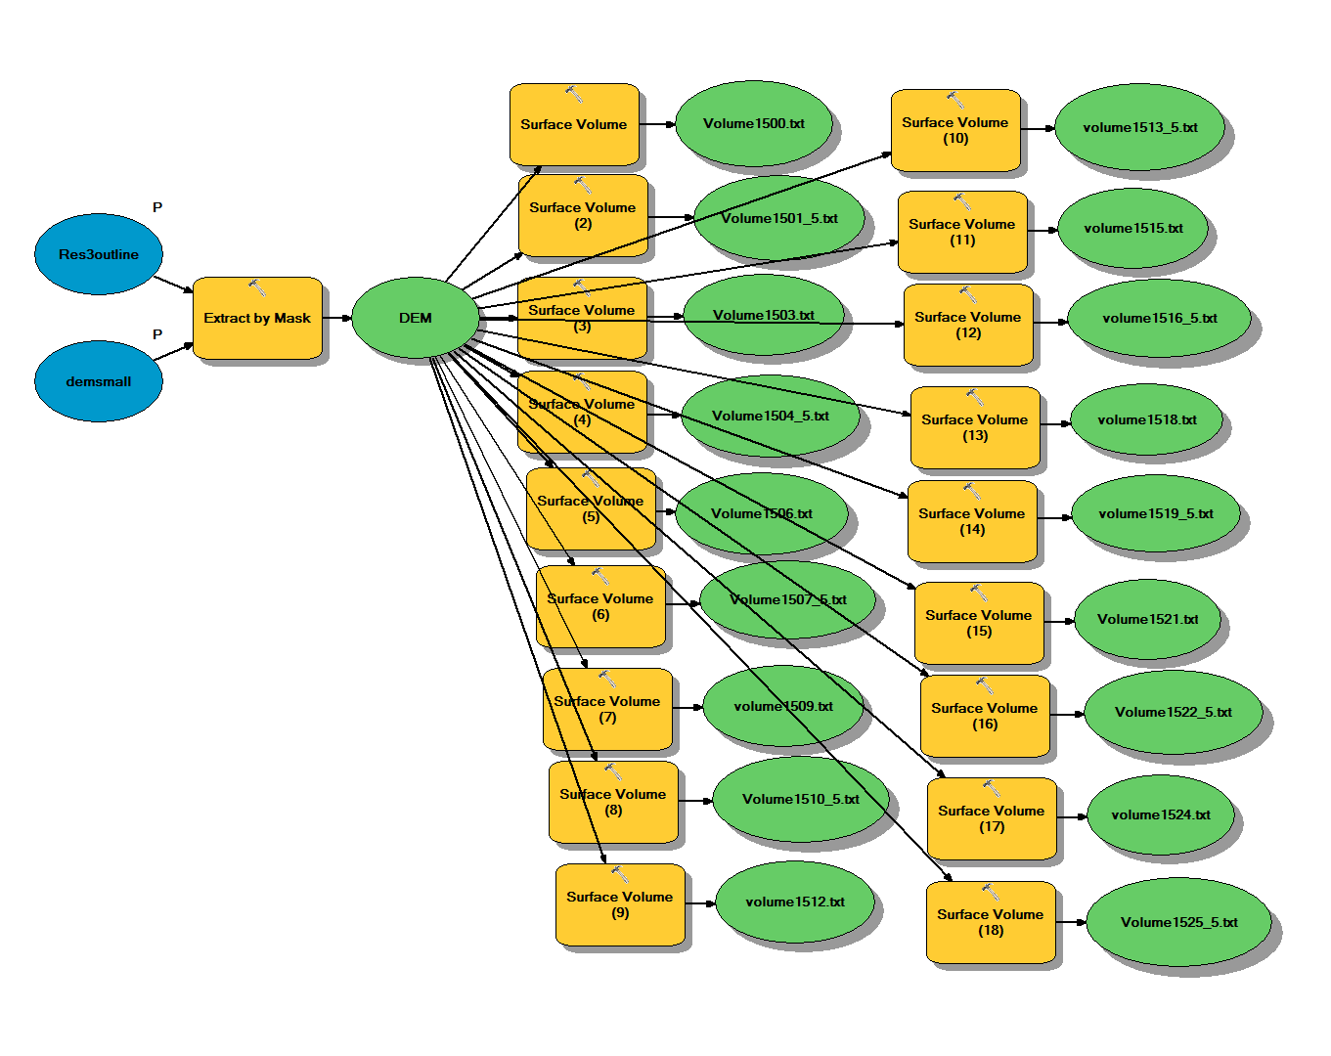
Reservoir Analysis: Tool

Slide 8
Reservoir Analysis: Results

Slide 9
Future Work
Divide to usage Polygons
Python scripting to enhance tool
Identify additional sites to apply tool

