Slide 1
Evaluation of So. Utah Aquifers
Riley Bradshaw
GIS for Water resources term project

Slide 2
Background
St. George, Washington County, Utah

Slide 3
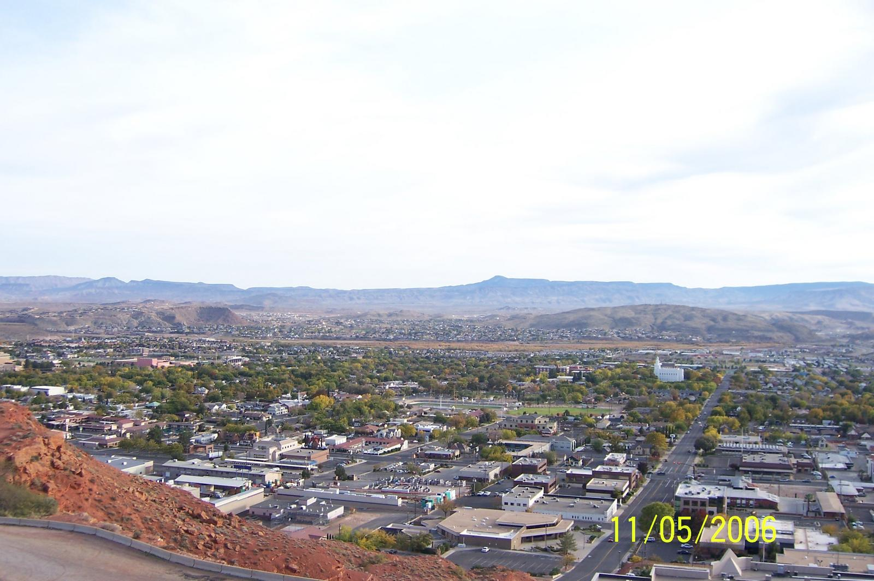
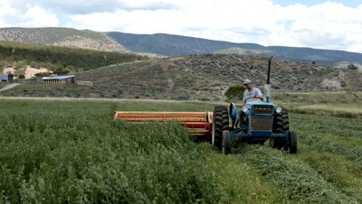
Rapid urban development
Strong agricultural presence
Arid Climate

Slide 4
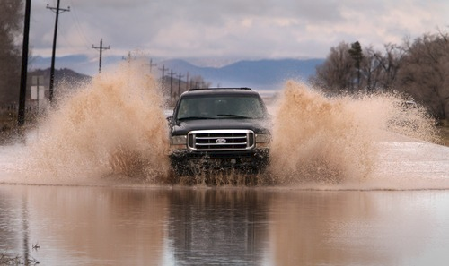
Located in the Virgin River Basin
Frequent flooding in recent years
Are there possibilities for ASR?

Slide 5
Term Project Objectives
Use GRACE data to identify historic ground water trends
Identify possible locations for ASR
Better understand groundwater issues in an area of rapid growth

Slide 6
GRACE
Satellite measurements of gravitational anomalies
Correlates to soil water
Monthly data spanning ten years
Goal: Obtain spatial average

Slide 7
Extract GRACE rasters
Conduct zonal average
Examine results to identify trends

Slide 8
Automate through Python code
Extract
Process

Slide 10
GRACE results

Slide 13
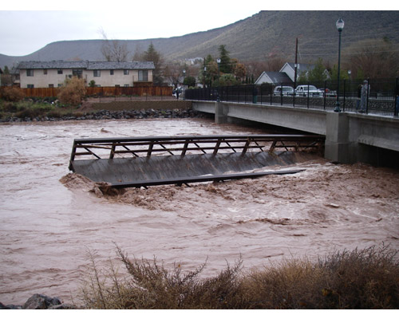
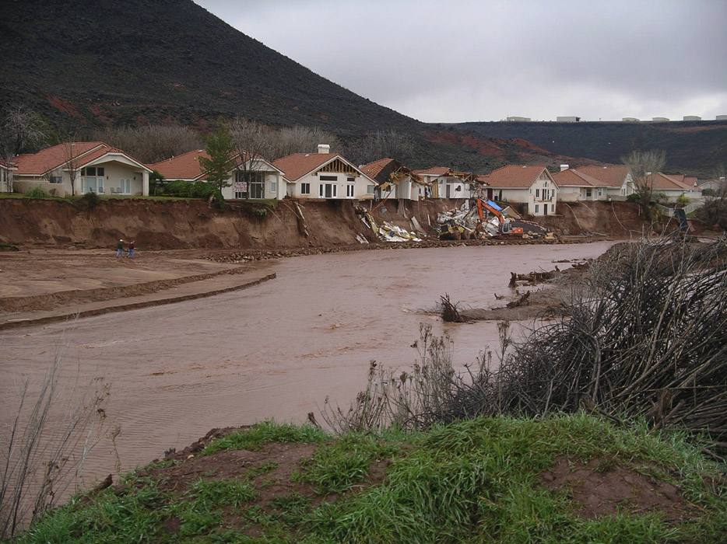
Flood of 2005

Slide 14
Problems
No well data to validate GRACE results as they relate to aquifer levels
Unexpected trends
Limited time frame of data set

Slide 15
A New Direction
Search for connections to other hydrologic data:
Precipitation
Surface Water
Consider GRACE results in a broader hydrologic context

Slide 16
Identifying Base Flows
Virgin River
Santa Clara River

Slide 17
Precipitation
PRISM Data

Slide 18
Acknowledgments
Dr. David Tarboton
Jesse Pope
Gonzolo Espinoza Davalos

Slide 19
Questions?

