Slide 1
EROSION PREDICTION
for the Moca River Watershed, Dominican Republic
Term Project. CEE6440. Marleny Santana
Teachers David Tarboton David R. Maidment

Slide 2
CONTENT
Introduction
Objectives
Methodology
Description of the study area
Calculation of erosion factors
Results
Conclusions

Slide 3
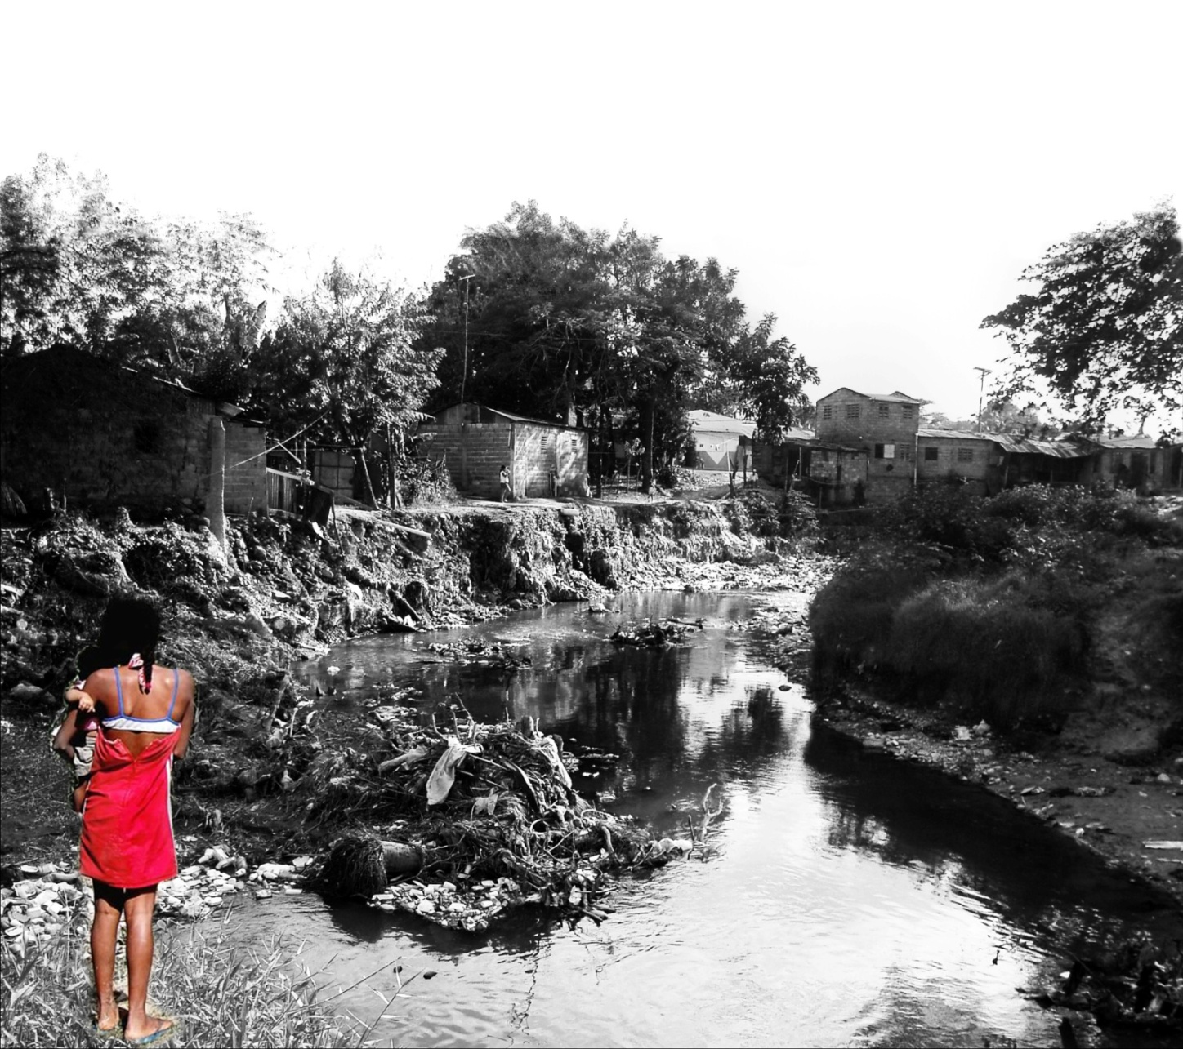
INTRODUCTION
Part of a master thesis:
“Restoring the Moca River:
an exploration through sustainable strategies for developing countries. “
Notes:
This project represents a part of my master's thesis, which is focused on developing an integral framework for river restoration in developing countries that identifies three strategies:

Slide 4
INTRODUCTION
Part of a master thesis:
“Restoring the Moca River:
an exploration through sustainable strategies for developing countries. “
Flooding Control
Water Quality Improvement
Informal Settlement Upgrading
Notes:
flooding control, water quality improvement and informal settlement upgrading.

Slide 5
INTRODUCTION
Part of a master thesis:
“Restoring the Moca River:
an exploration through sustainable strategies for developing countries. “
Flooding Control
Water Quality Improvement
Informal Settlement Upgrading
Erosion Control
Notes:
As part of this, erosion control plays an important role, since it causes channel and bank instability that eventually leads to flooding disasters. Therefore, knowing the patterns of sediment erosion and deposition is crucial to know what technique of erosion control to apply.

Slide 6
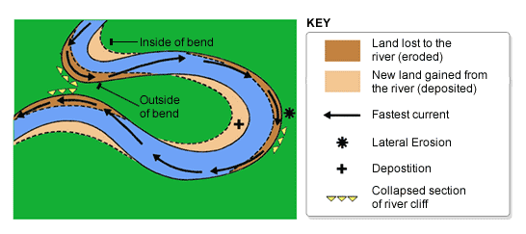
OBJECTIVE
Identify locations of erosion rates using ArcGIS and the Revised Universal Soil Loss Equation (RUSLE) in the Moca River Watershed.

Slide 7
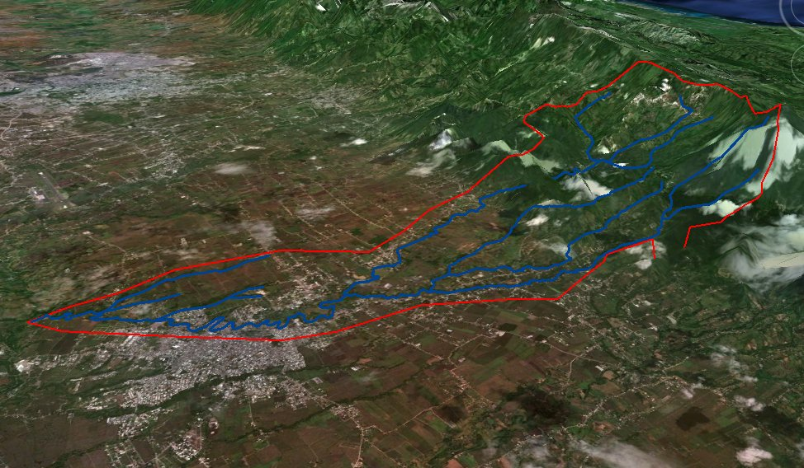
METHODOLOGY
1. Data gathering
2. Watershed Delineation
3. Inventory Maps
4. Revised Universal Soil Loss Equation (RUSLE):
A = RKLSCP
A = soil loss per unit area (t/ha)
R = Rainfall-Runoff erosivity (Mj*mm/ha*h*yr)
K = Soil erodibility (t*ha*h/ha*Mj*mm)
LS = Slope length and steepness factor
C = Cover management factor
P = Erosion control factor
Notes:
So, the first step was data gathering from various agencies and organizations. A 30m DEM for the Dominican Republic was downloaded from the LP DAAC Global Data Explorer website. Shapefiles containing streams, soil type, land cover and precipitation gages location of the whole country were obtained through The Nature Conservancy, Caribbean Program. As the gages did not have any precipitation values within their attribute table, excel files were downloaded from Brigham Young University HydroServer (http://byuhydro.byu.edu/).
Then I did the watershed delineation process that we learned in class. Then inventory maps were made by clipping all the data to the watershed boundary and these were converted to rasters by adding or calculating the correspondent factor value. Then these rasters were multiplied following the Rusle Equation, which basically is the product of six factors:

Slide 8
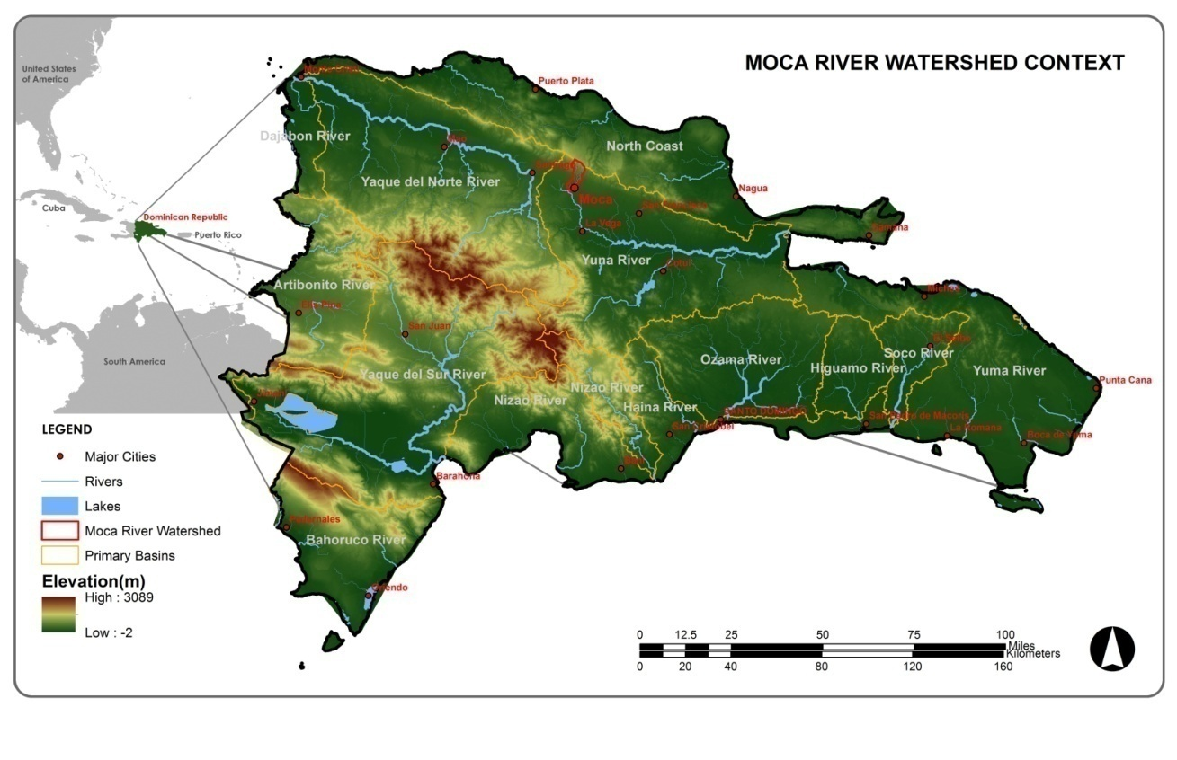
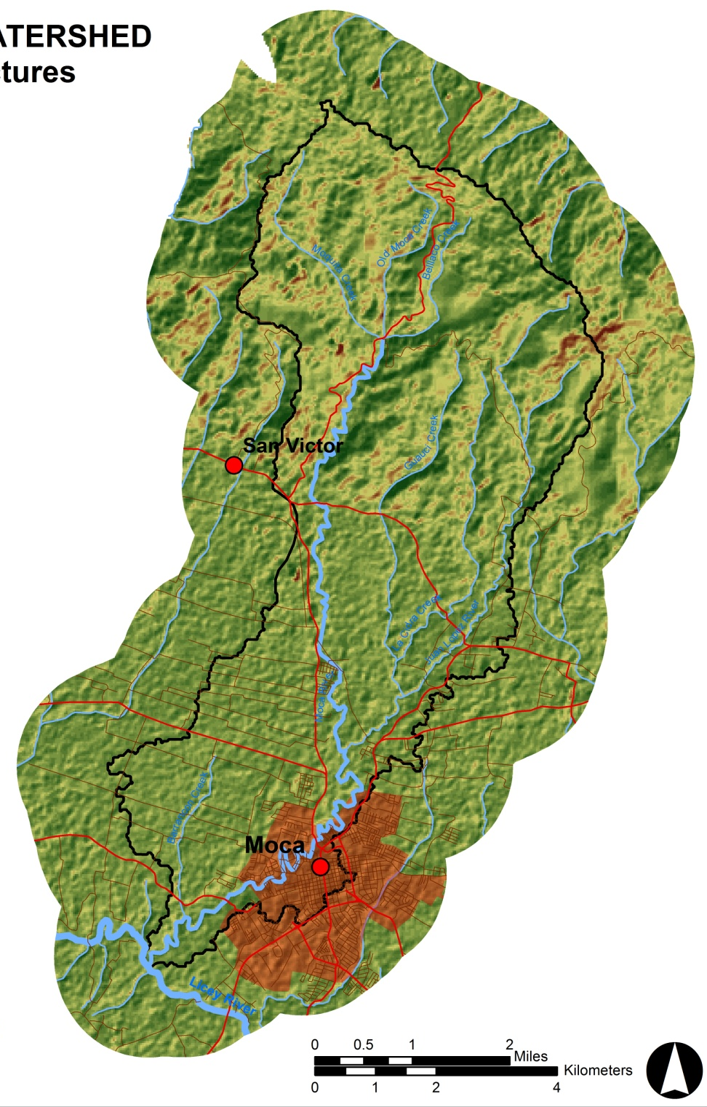
DESCRIPTION OF THE AREA
Moca River : 21.63 km ( 13.44 miles)
Watershed: 58 sqkm (22.40 sqmi)
Elevation: 900 mamsl (2952 ft) (max), 100 mamsl (min)
Seven tributaries
Average temperature of 25.3°C
Notes:
The Moca River watershed is about 23 sqmiles with an elevation ranging from 328 feet to 3,000 feet. The city of Moca is located south of the watershed, almost in the confluence with the Licey River.

Slide 9
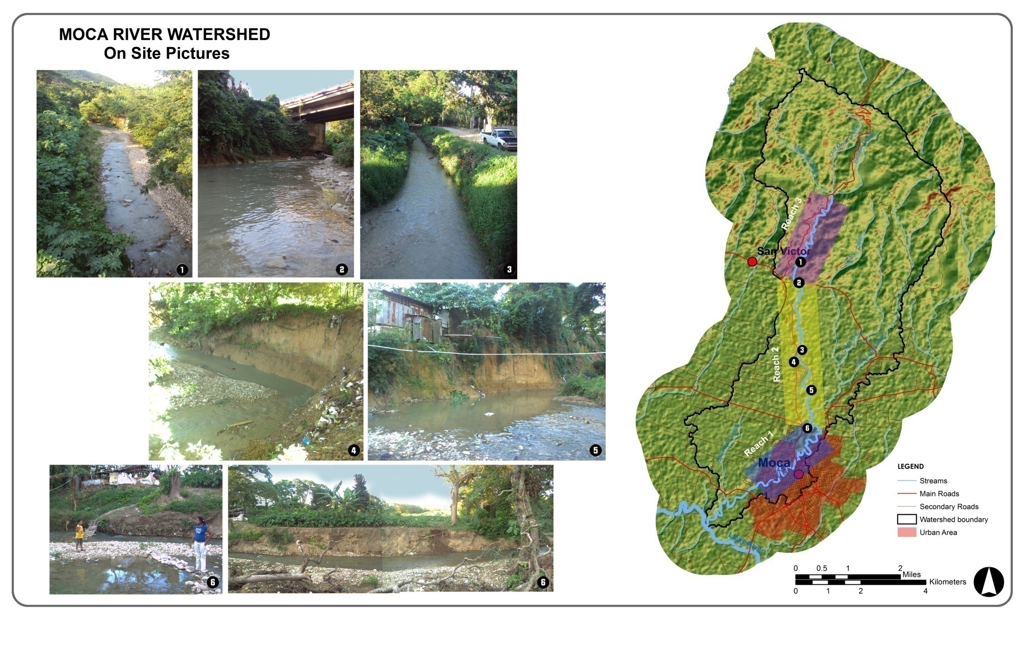
DESCRIPTION OF THE AREA
Notes:
Some of the main factors influencing erosion in this watershed are:
High rainfall amount (approximately 50 inches)
High amount of sandy-silty soils
Steep slopes at the upper watershed (ranging from 18%-63%)
Deforestation
Mineral extraction
Wastewater, stormwater and solid waste disposal

Slide 10
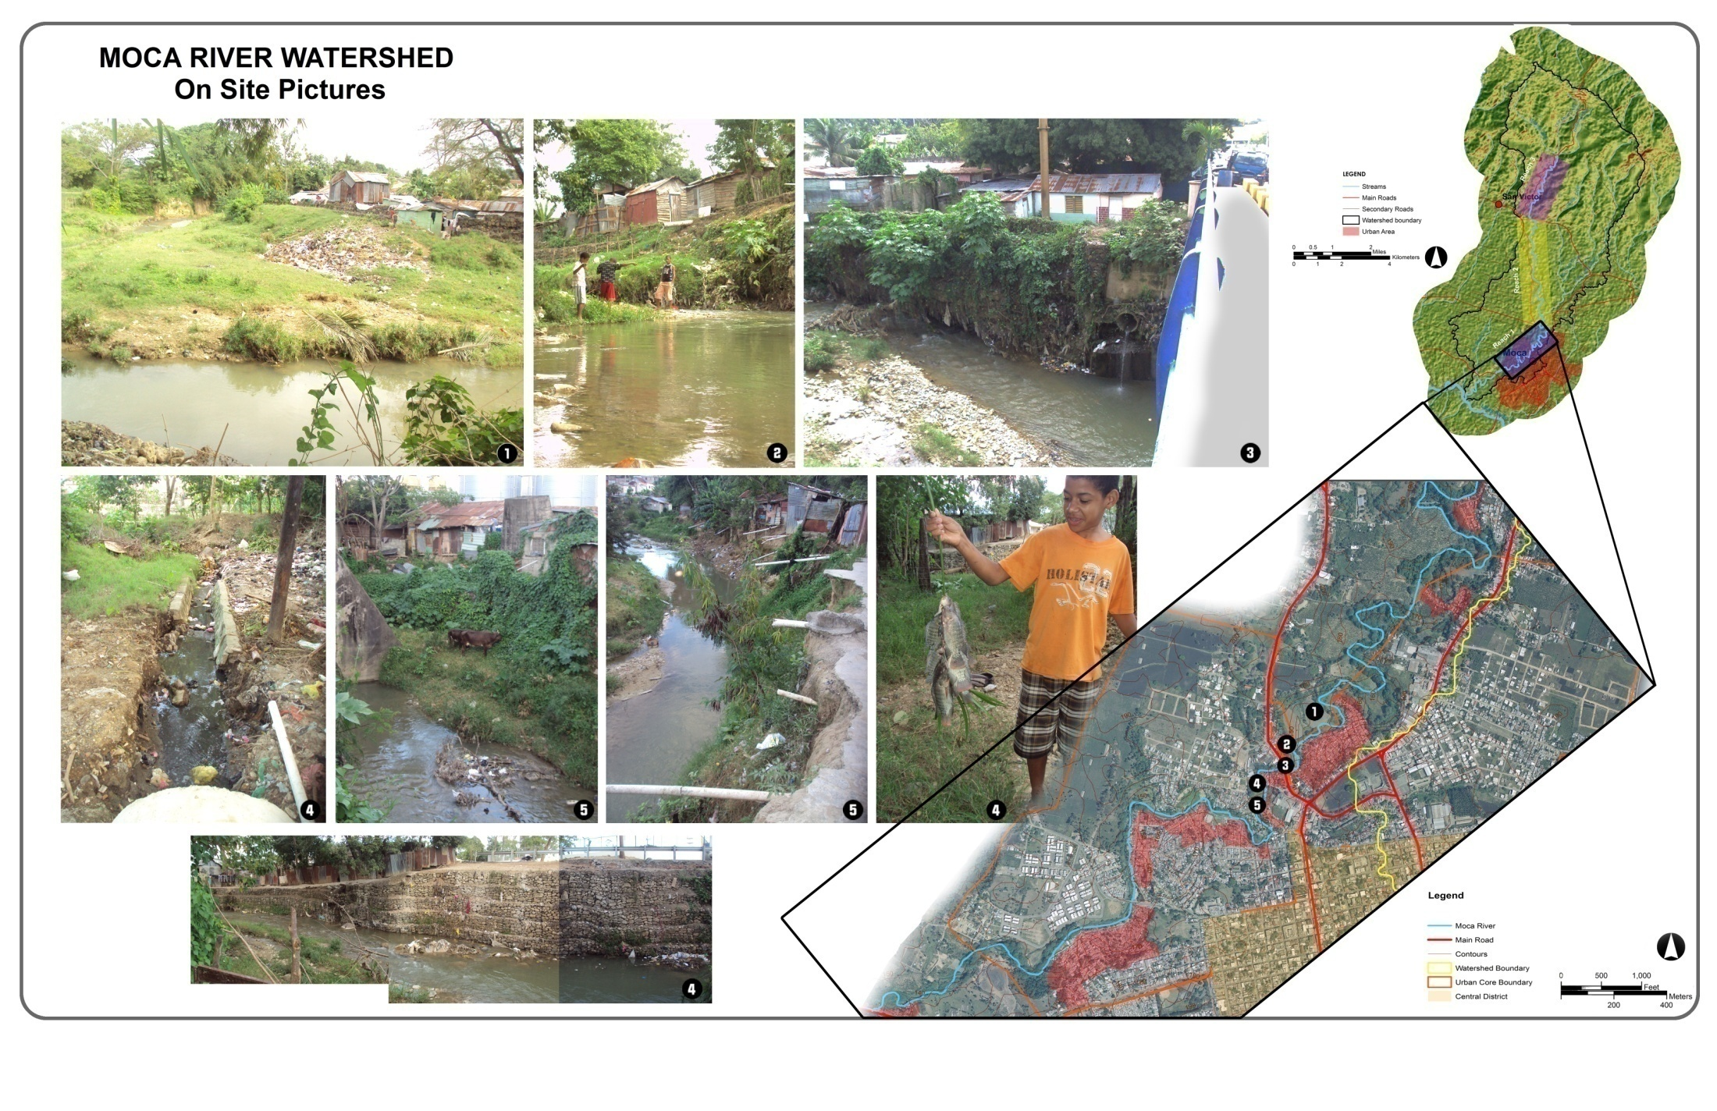
DESCRIPTION OF THE AREA

Slide 11
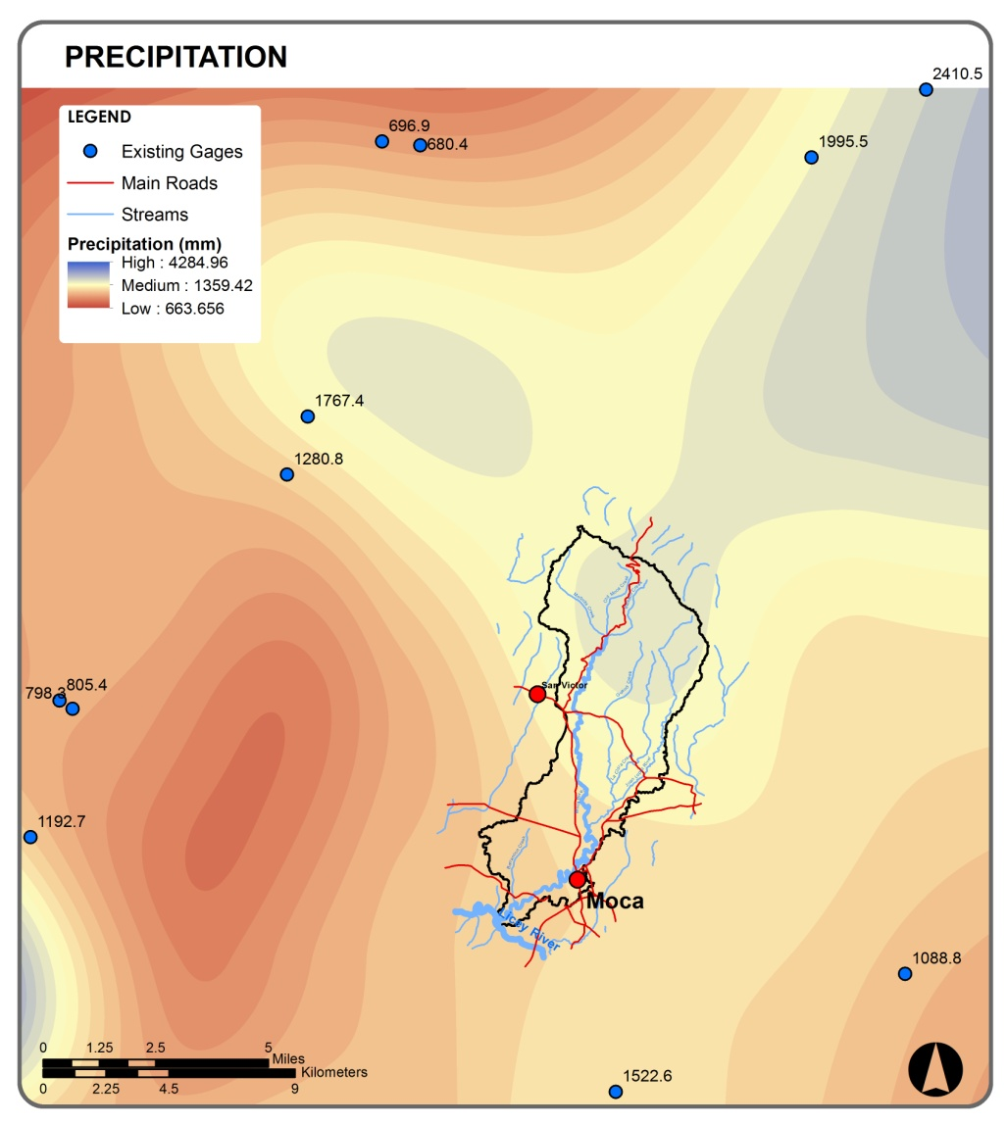
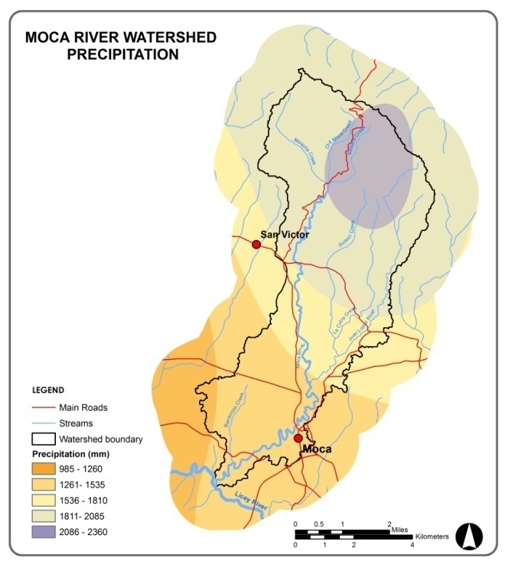
RAINFALL EROSIVITY (R)
CONCLUSIONS
SUMMARY
Effect of rainfall intensity and total storm energy.
Notes:
So, to calculate the factor to use in the Rusle equation, I begun with rainfall erosivity factor which is the Measure of the effect of rainfall intensity and total storm energy.
I had to interpolate the precipitation values from the BYU’s gages in order to have more accurate precipitation values forthe whole watershed.

Slide 12
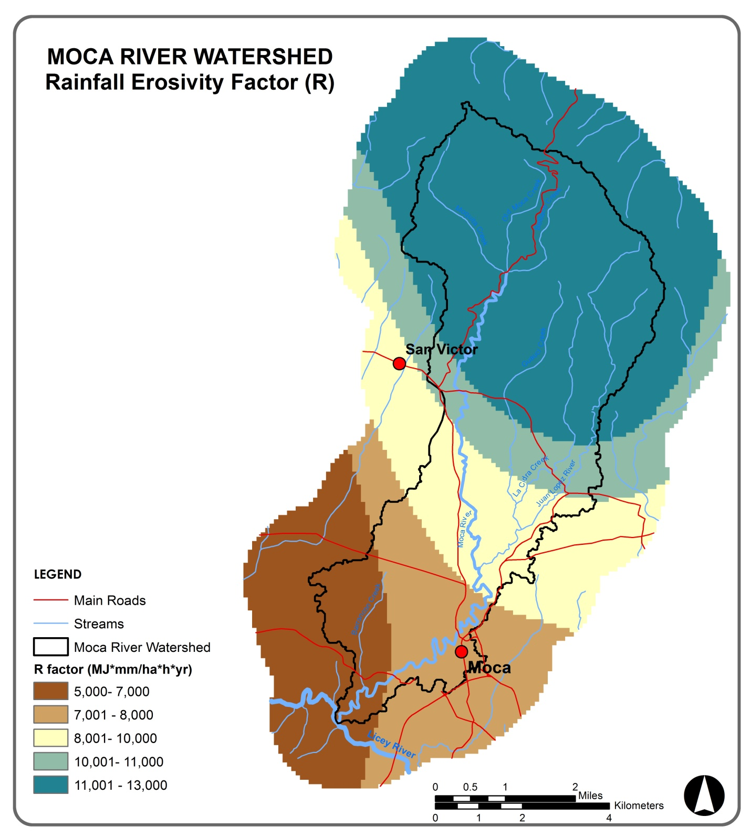
RAINFALL EROSIVITY (R)
CONCLUSIONS
SUMMARY
R= -3172 + 7.562 (P)
P= annual precipitation in mm
Notes:
Then I used raster calculator to get the factor by using this equation, which is normally used in the Caribbean area, and this is the map we get, lower values in the south higher values in the mountains with higher elevations. I added those values in a new filed in the attribute table of the precipitation layer and then I converted the polygon to a raster keeping only the rainfall factor values. This same process was used for all the coming maps.

Slide 13
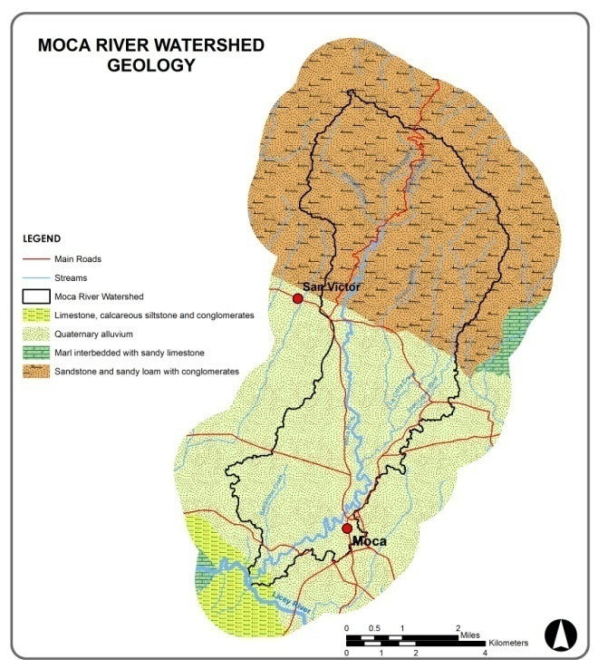
SOIL ERODIBILITY (K)
CONCLUSIONS
SUMMARY
Resistance of the soil particles to detachment and transport
(OEA, 1967)
Notes:
For the soil erodibility factor I used the factors given by the OEA for each type of soil. This factor measures the resistance of the particles to detachment and transport by runoff. The watershed has limestone and conglomerates in the south, quaternary alluvium in the middle and sandstone and sandy loam in the north.

Slide 14
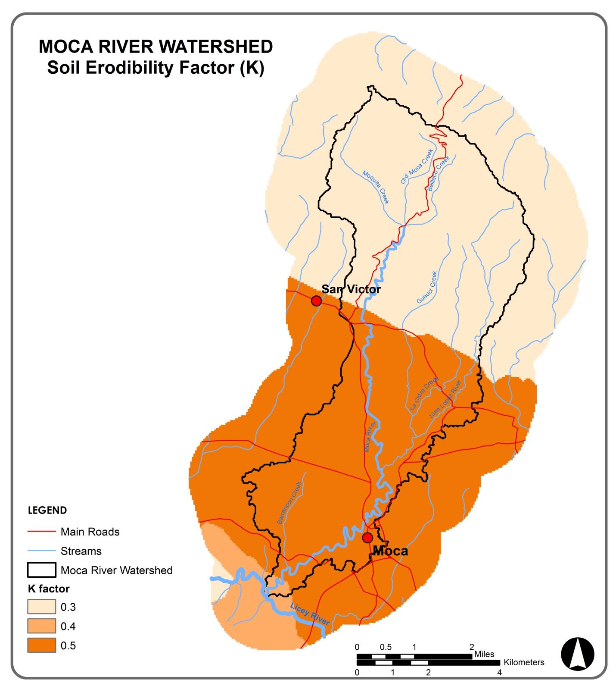
SOIL ERODIBILITY (K)
CONCLUSIONS
SUMMARY
Notes:
And this is what we get, quaternary alluvium, which is basically sand and gravel, has the highest factor, which is not that different form the other two values.

Slide 15
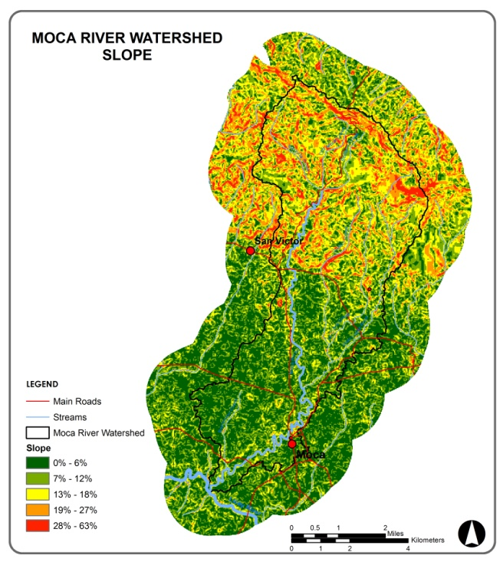
CONCLUSIONS
SUMMARY
SLOPE LENGTH
AND STEEPNESS (LS)
Effects of slope length on the rate of erosion.
(Wischmeier and Smith, 1978)
Notes:
The slope length and steepness factor measures the effects of slope on the erosion. According to these authors, these are the correspondent values for each slope range, the higher the slope the higher the factor. By following the same process as in the previous maps…

Slide 16
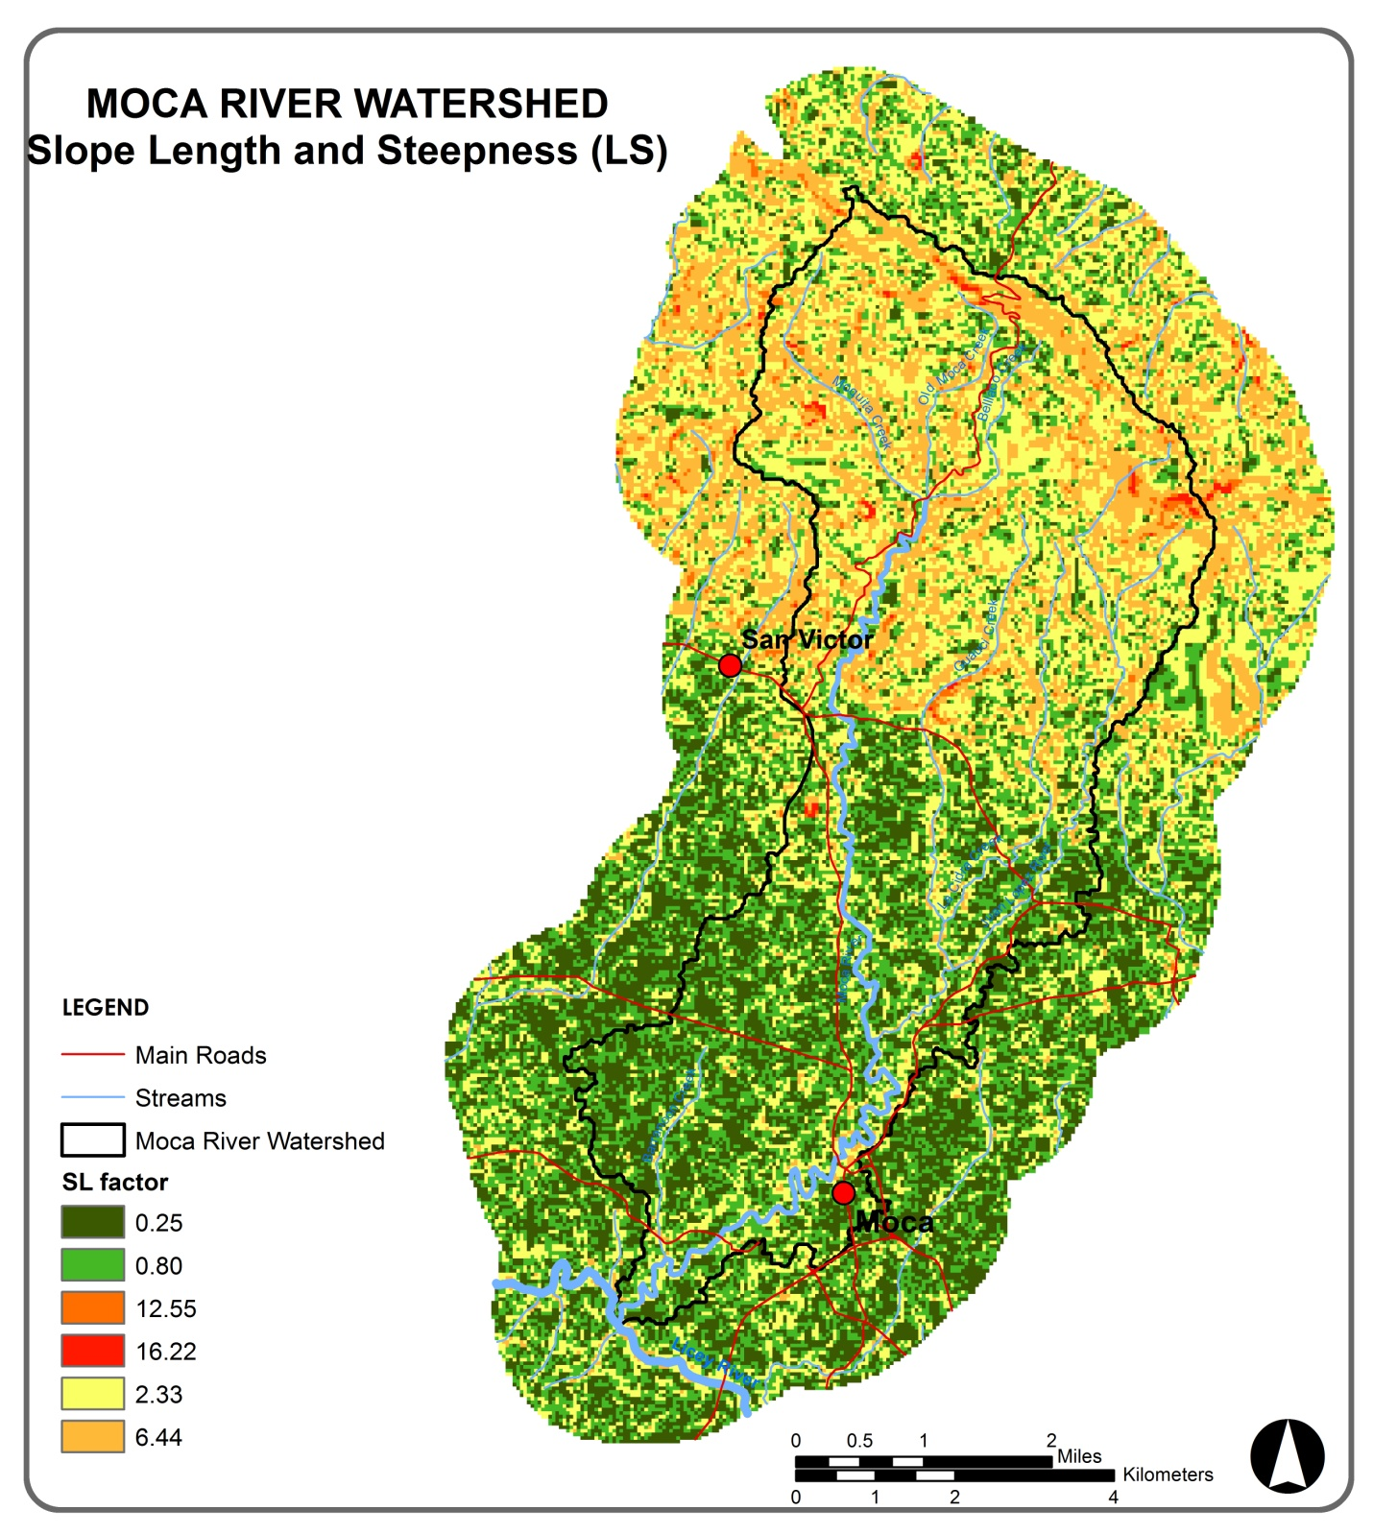
CONCLUSIONS
SUMMARY
SLOPE LENGTH
AND STEEPNESS (LS)
Notes:
This is what we get.

Slide 17
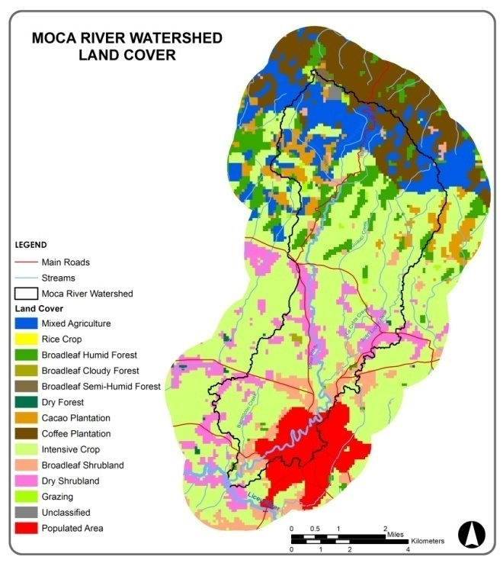
LAND COVER FACTOR (C
CONCLUSIONS
SUMMARY
Influence of soil and cover management
(INDRHI, IICA, BID, 1992 after Wischmeier and Smith, 1978; Santana, 1961; ICONA, 1967; Fadón, 1991.)
Notes:
The land cover factor Measures the influence of soil and cover management, such as tillage practices, cropping types, crop rotation, and so on. By merging some references, this table shows the factor values for each type of land cover, the highest being intensive crops and grazing.

Slide 18
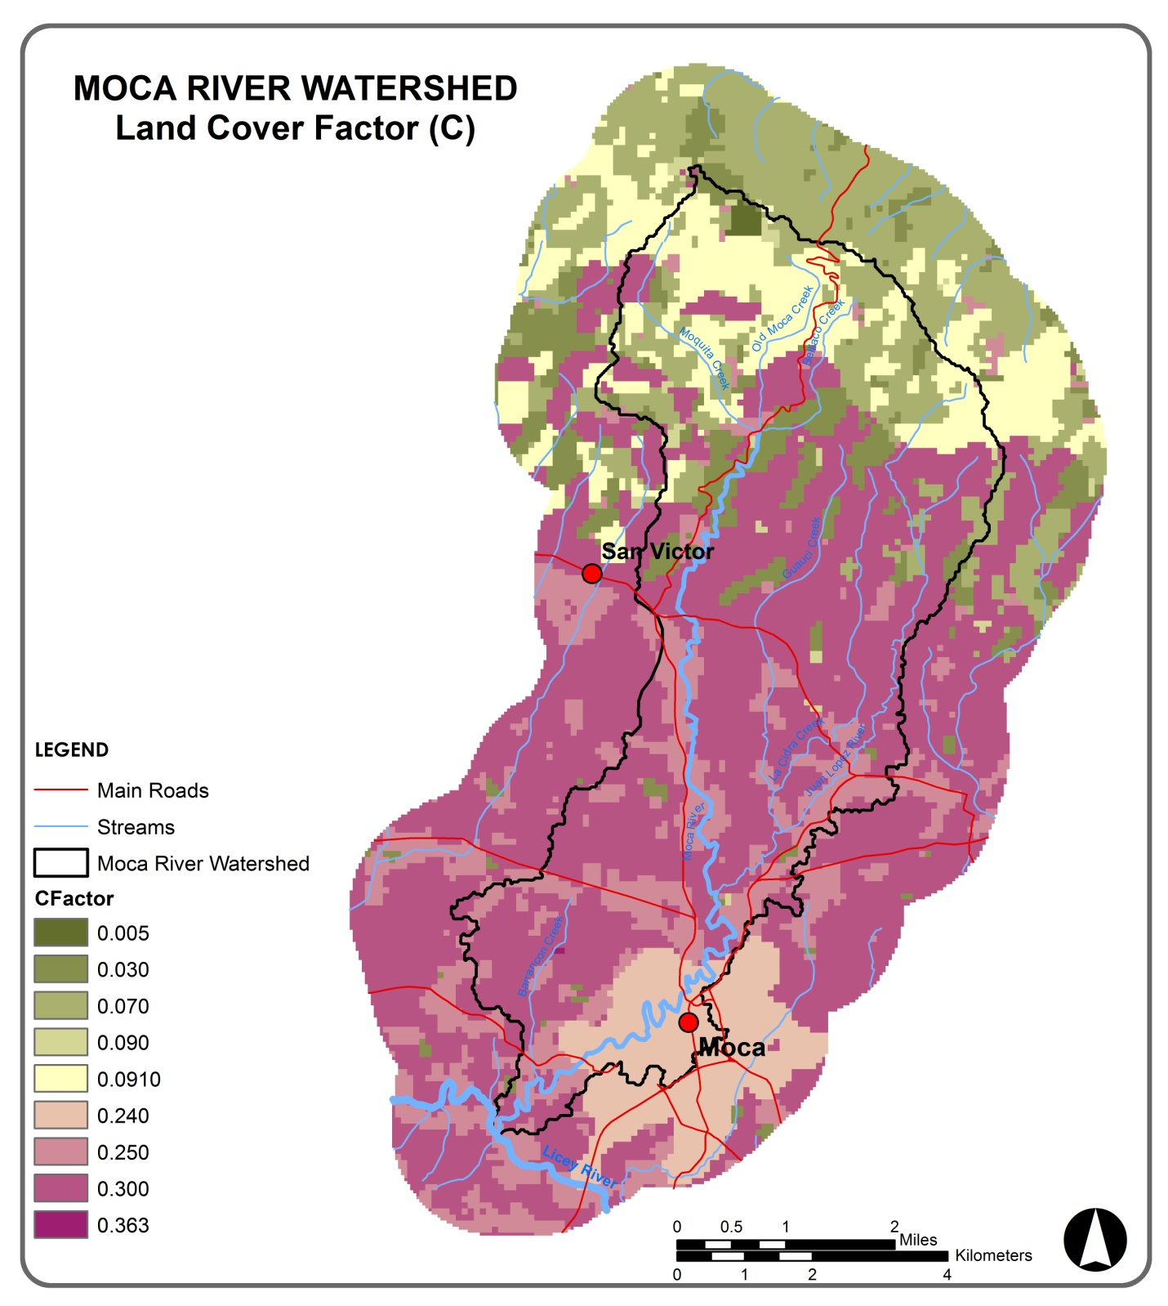
LAND COVER FACTOR (C
CONCLUSIONS
SUMMARY
Notes:
And this what we get, all the southern portion of the watershed has the highest values in terms to land cover.

Slide 19
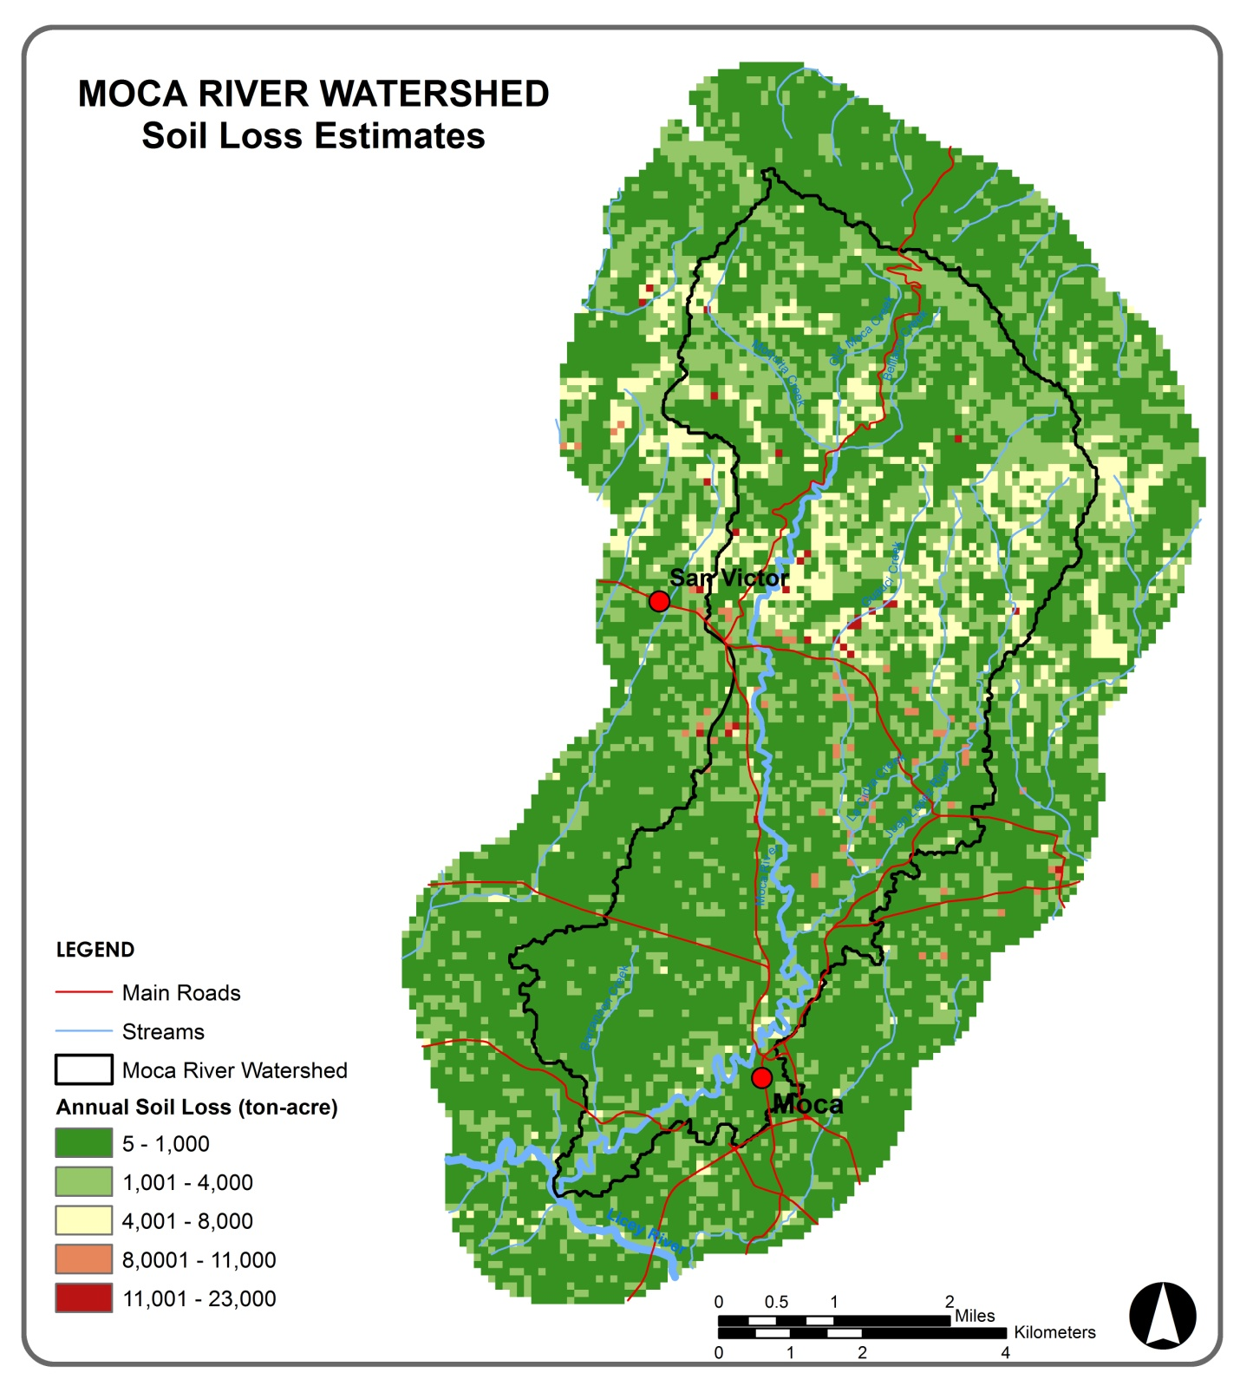
CONCLUSIONS
SUMMARY
SOIL LOSS (A)
A = RKLSCP
Notes:
By running the equation, this is the result. Most of the watershed loses from 5 to a 1000 tons of soil-acre per year, with exception of the middle area in here that loses from 4,000 to 8,000 tons a year, and some random points along the tributaries losses more than 10000 a year. When I did this I thought that I would get higher erosion rates by where the city is, but that tells me that maybe erosion rate depends more on the rainfall and the slope, that is where this maps is showing, rather than on the urban land cover.

Slide 20
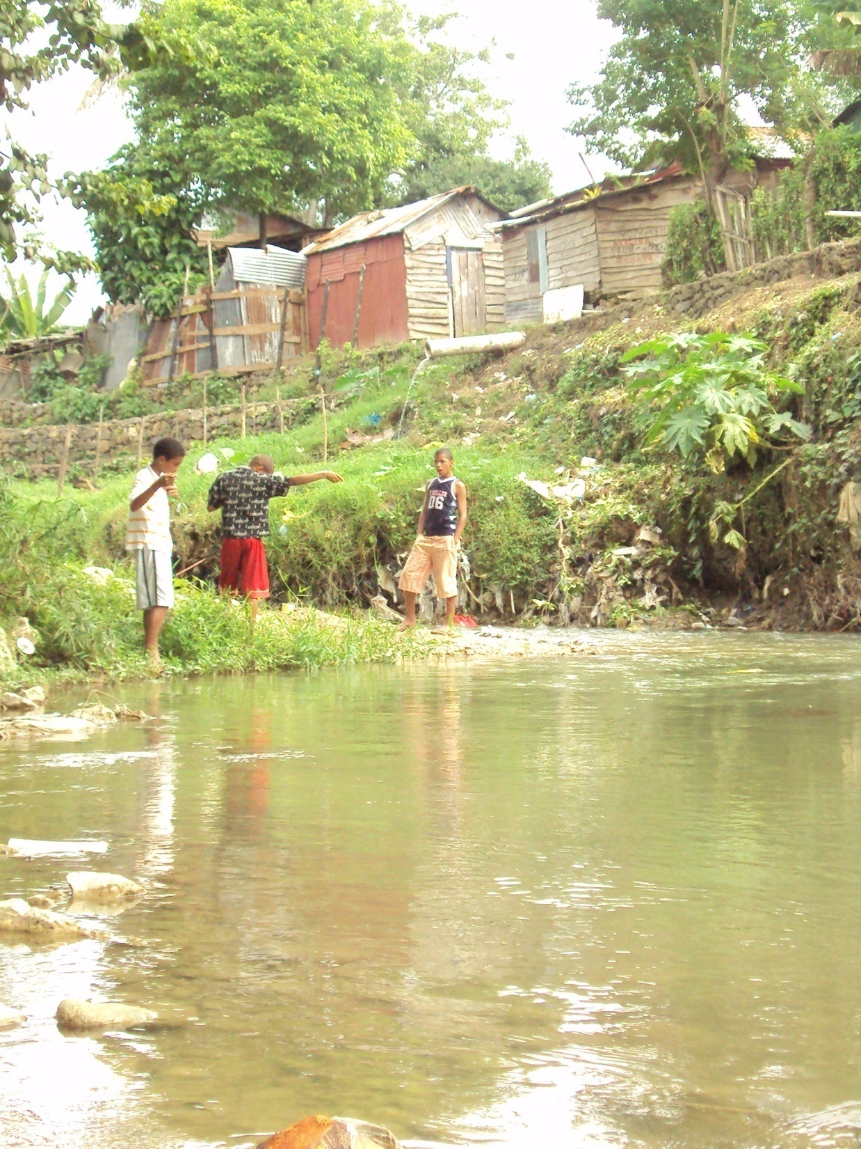
CONCLUSIONS
SUMMARY
CONCLUSIONS
-Erosion Quantification
-uncertainty lies in some
of the factors.
- sources may be outdated.
Notes:
Well, in conclusion the objective of this project was to identify quantitatively the areas in the Moca River watershed that have high erosion potential, to suggest land practices or erosion control techniques.
Some of the limitations includes uncertainty in some of the factors, such as the rainfall interpolation.
And some sources may be outdated (for instance the rainfall dates or the land cover which are from previous decades)

