Slide 1
Effects Of Climate and Location on Traffic Signs Deterioration: A LiDAR-Based Study In Utah
Majid Khalilikhah
GIS in Water Resources Term Project

Slide 2
Mobile Lidar in Transportation?
Moving Ahead for Progress in the 21st Century Act (MAP-21) was signed into law by President Obama on July 6, 2012. It funds surface transportation programs at over $105 billion for FY 2013 and 2014 .
USDOT is demanded to announce performance measures by approximately spring 2015 in the areas of:
National Highway Performance Program (NHPP)
Highway Safety Improvement Program (HSIP)
Congestion Mitigation and Air Quality Improvement Program (CMAQ)
National Freight Movement (Freight)
Thus, MAP-21 performance measures for asset management are driving the need to data informed decisions.

Slide 3
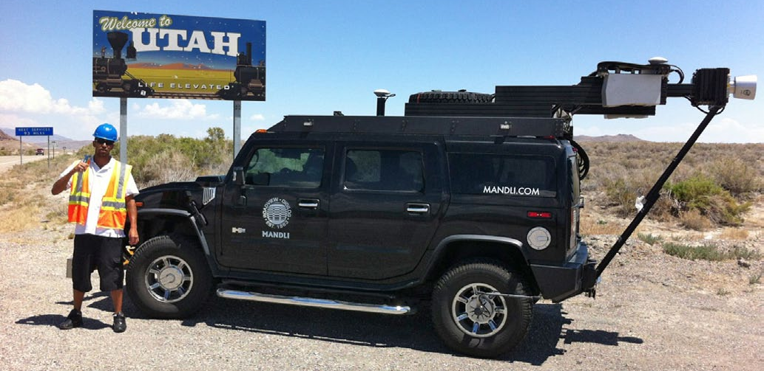
How to Address the Sign Data Collection Challenge?
Utah Department of Transportation (UDOT) has sponsored an effort to have comprehensive information about its road assets in a cost effective manner. To do so, mobile LiDAR (light detection and ranging) was investigated and chosen to record traffic signs under UDOT’s jurisdiction.
Lidar Equipped Vehicle Used for UDOT Sign Data Collection

Slide 4
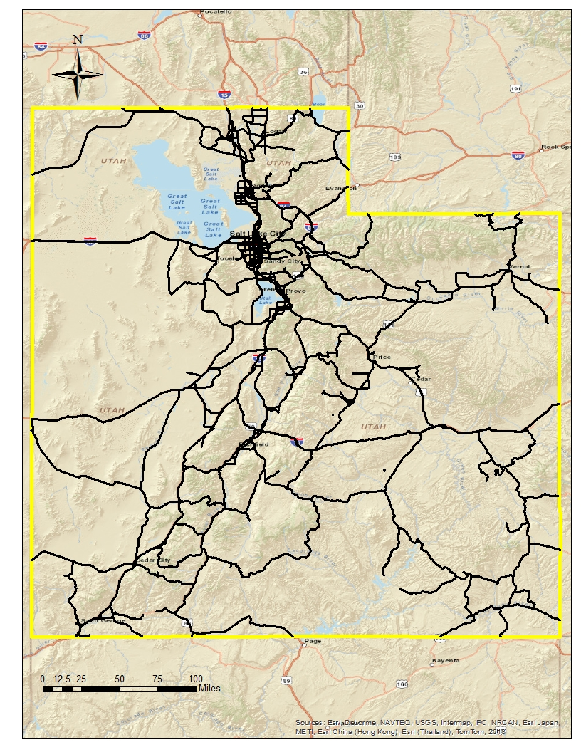
The collected data included the following attributes of the signs:
Location
Condition (Good, Fair, Poor)
Condition Comment
MUTCD Code
Size
Orientation
Mount Height
Collected Date
Facing Direction

Slide 5
Over 97,000 traffic signs under UDOT’s jurisdiction were recorded.
The Mobile LiDAR classified the sign condition into three groups called as good, fair, and poor.
At the conclusion, 6.7 percent of the surveyed signs were recorded in fair or poor conditions.
Different Forms of Deterioration
Comment Regarding Sign Condition | Sign Condition
 | Fair |  | Poor |  | Total | Percentage
 | # of signs | Percentage | # of signs | Percentage
Bent | 527 | 10.75 | 58 | 3.58 | 585 | 8.97
Damaged | 1750 | 35.69 | 362 | 22.36 | 2112 | 32.38
Delaminated | 0 | 0.00 | 563 | 34.77 | 563 | 8.63
Dents | 800 | 16.32 | 33 | 2.04 | 833 | 12.77
Dirty | 617 | 12.58 | 6 | 0.37 | 623 | 9.55
Faded Paint | 795 | 16.21 | 101 | 6.24 | 896 | 13.74
Fallen | 1 | 0.02 | 77 | 4.76 | 78 | 1.20
Graffiti | 4 | 0.08 | 241 | 14.89 | 245 | 3.76
Obstructed View | 1 | 0.02 | 126 | 7.78 | 127 | 1.95
Rusty | 27 | 0.55 | 1 | 0.06 | 28 | 0.43
Sticker | 367 | 7.49 | 35 | 2.16 | 402 | 6.16
Temp Obstructed | 3 | 0.06 | 4 | 0.25 | 7 | 0.11
Unknown | 11 | 0.22 | 12 | 0.74 | 23 | 0.35
Total | 4903 |  | 1619 |  | 6522
To classify different forms into deterioration categories:
Vandalism; The most varied category of damage forms that includes damage caused by humans on the face of the sign such as paintballs, ballistic damage from firearms, glass bottle impacts, eggs, stickers, dents, graffiti, over painting, and bullet holes
Hit by vehicle; For example getting bent or knocked down by vehicles running off the road
Relocated and/or adjusted by private individuals
Environmental; Damage caused by weather or other natural factors
Aging; Deterioration due to reaching its useful life; for example the colors have faded

Slide 6
Research Objective
To determine the contributing factors affecting sign deterioration through utilizing Geographic Information System (GIS).
With considering the climate and environment data and combining them with the known location of each sign
Weather Observation:
Average Annual Precipitation, thirty year average (1981-2010)
Average Annual Temperature, thirty year average (1981-2010)
Average Wind Power
Location Data:
Elevation
Land Cover
Municipalities

Slide 7
ArcGIS Tools:
Select by Attributes and Locations
Project Raster (Data Management)
Joins and Relates Tables
Spline (Spatial Analyst)
Extract By Mask (Spatial Analyst)
Extract Multi Values to Points (Spatial Analyst)

Slide 8
Online Data Sources:
Parameter-elevation Regressions on Independent Slope Model (PRISM)
United State Geological Survey (USGS) National Elevation Dataset
National Land Cover Database (NLCD)
Utah Automated Geographic Reference Center (UTAH AGRC)
National Renewable Energy Laboratory (NREL)
United States Census
Bureau of Economic and Business Research (BEBR) at the University of Utah
Lumina Foundation

Slide 9
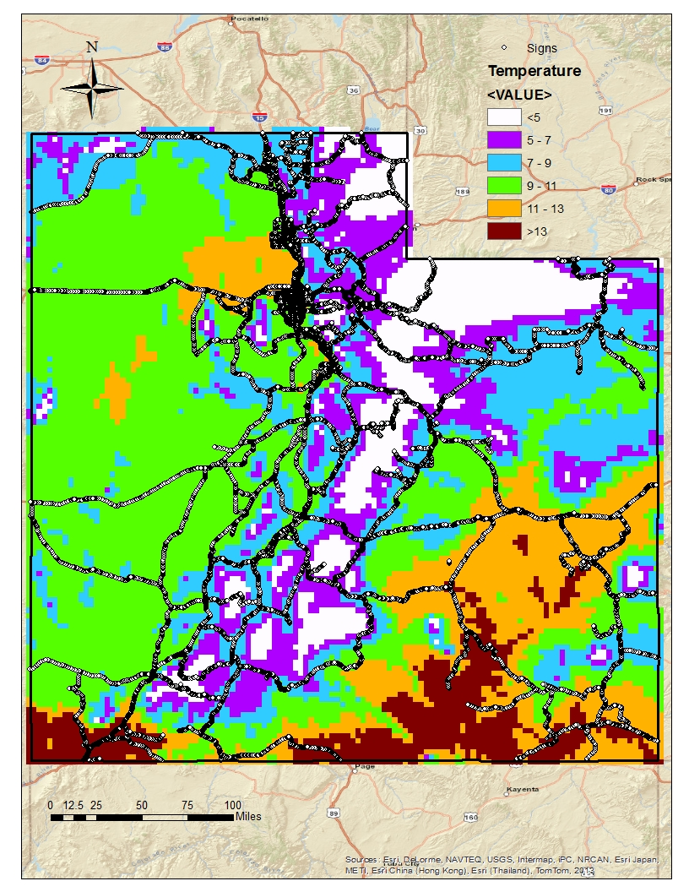
Mean Temperature (°C) | # of Signs | Sign Condition |  |  | % Good
 |  | Good | Fair | Poor
<5 | 4339 | 3745 | 451 | 143 | 86
5-7 | 10326 | 9223 | 911 | 192 | 89
7-9 | 21382 | 19453 | 1462 | 467 | 91
9-11 | 36167 | 34388 | 1285 | 494 | 95
11-13 | 20112 | 19226 | 628 | 258 | 96
>13 | 4988 | 4767 | 158 | 63 | 96

Slide 10
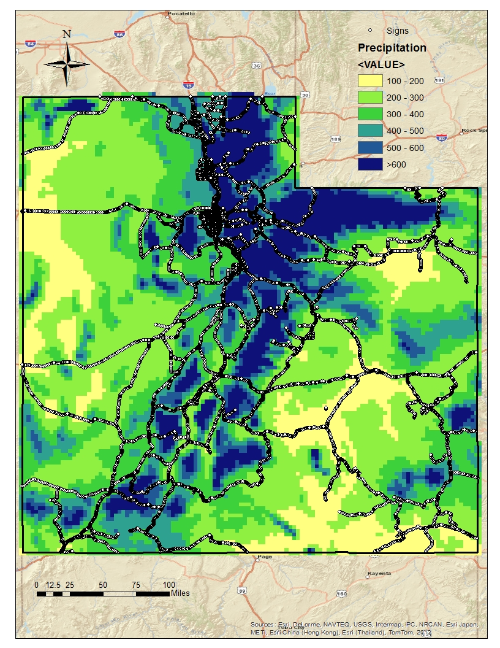
Mean Precipitation (mm) | # of Signs | Sign Condition |  |  | % Good
 |  | Good | Fair | Poor
100-200 | 5447 | 5133 | 250 | 64 | 94
200-300 | 19395 | 17910 | 1149 | 336 | 92
300-400 | 21163 | 19725 | 1074 | 364 | 93
400-500 | 28486 | 26984 | 1105 | 397 | 95
500-600 | 11357 | 10558 | 586 | 213 | 93
>600 | 11466 | 10492 | 731 | 243 | 92

Slide 11
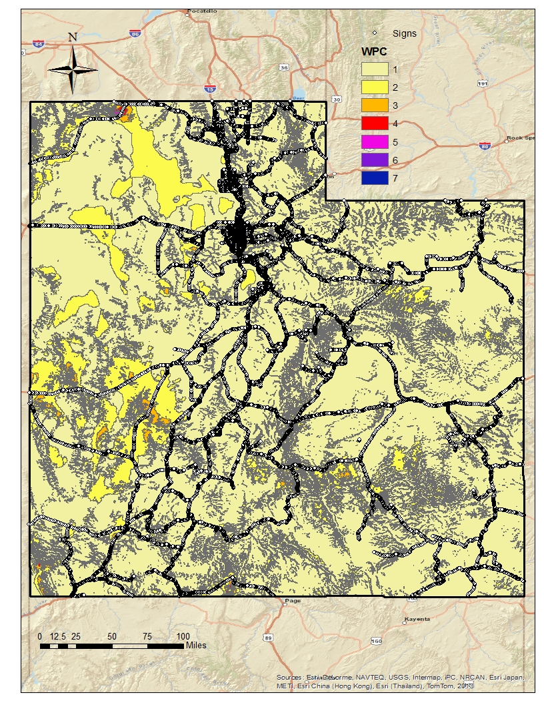
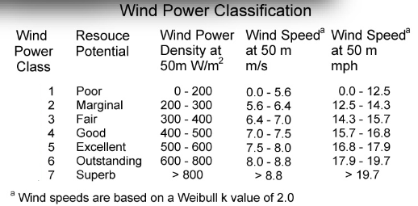
Wind | # of Traffic Signs | Sign Condition |  |  | % Good
 |  | Good | Fair | Poor
1 | 89887 | 83795 | 4577 | 1515 | 90
>1 | 7427 | 7007 | 318 | 102 | 94

Slide 12
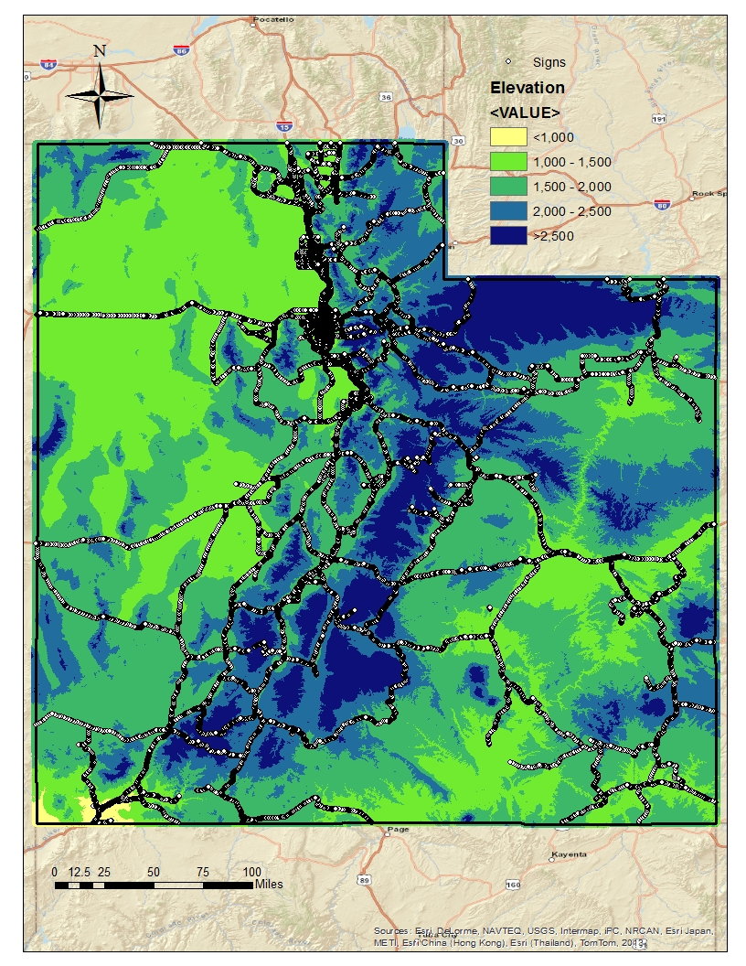
Elevation (m) | # of Signs | Sign Condition |  |  | % Good
 |  | Good | Fair | Poor
<1000 | 1870 | 1822 | 34 | 13 | 97
1000-1500 | 49165 | 46800 | 1714 | 651 | 95
1500-2000 | 34198 | 31569 | 1982 | 647 | 92
2000-2500 | 9728 | 8630 | 881 | 217 | 89
>2500 | 2353 | 1980 | 284 | 89 | 84

Slide 13
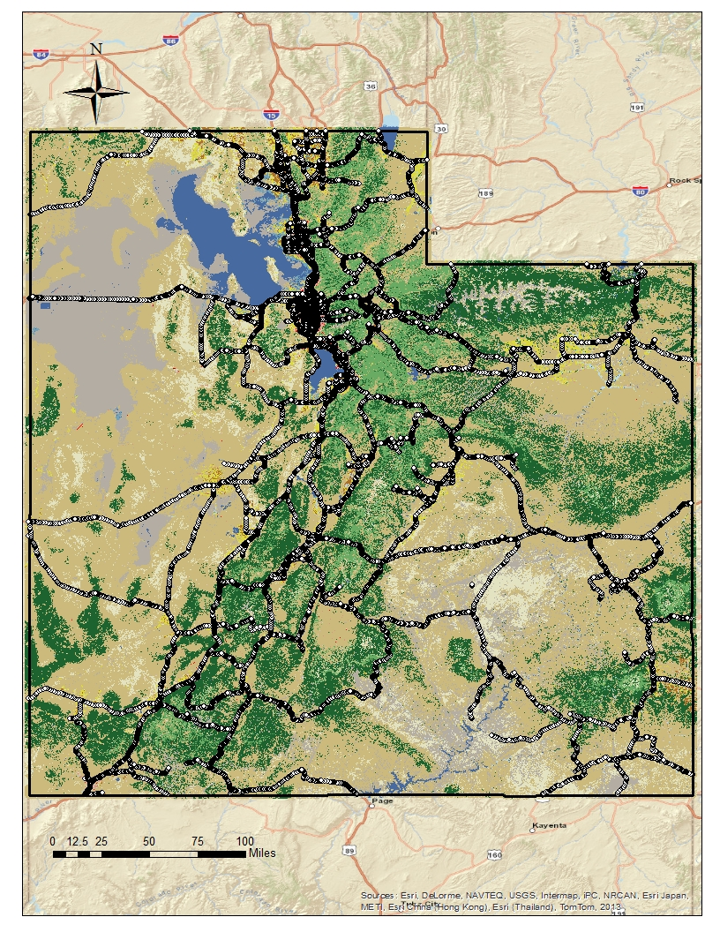
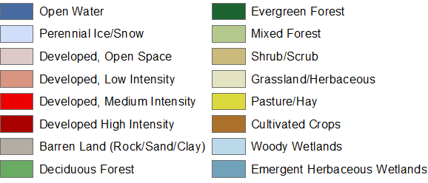
Land Cover | # of Signs | Sign Condition |  |  | % Good
 |  | Good | Fair | Poor
Low Intensity Residential | 26956 | 24381 | 2030 | 545 | 90
High Intensity Residential | 24560 | 22898 | 1288 | 374 | 93
Commercial/Industrial/Transportation | 19777 | 18996 | 530 | 251 | 96
Developed High Intensity | 10843 | 10487 | 207 | 149 | 97
Bare Rock/Sand/Clay | 194 | 187 | 6 | 1 | 96
Forest | 1585 | 1456 | 82 | 47 | 92
Shrub/Scrub | 9980 | 9228 | 556 | 196 | 92
Grasslands/Herbaceous | 553 | 525 | 20 | 8 | 95
Planted/Cultivated | 2183 | 2084 | 70 | 29 | 95
Wetlands | 610 | 560 | 33 | 17 | 92

Slide 14
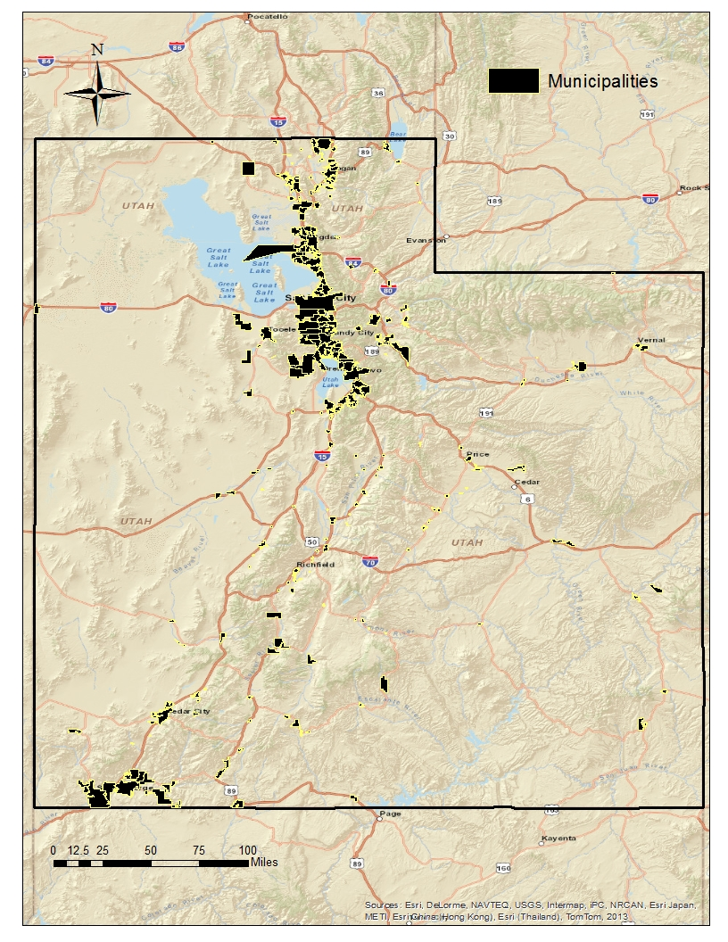
Municipalities | # of Signs | Sign Condition |  |  | % Good
 |  | Good | Fair | Poor
Yes | 46611 | 44861 | 1211 | 539 | 96
No | 50703 | 45941 | 3684 | 1078 | 91

Slide 15
Research Conclusions
This research determined that that the major contributing climate and location factors affecting sign deterioration rate include:
Mean Temperature
Elevation
Exposure
Therefore, the routes with capable signs of deterioration are determined and traffic agencies might focus on them and perform more frequent assessment..

Slide 16
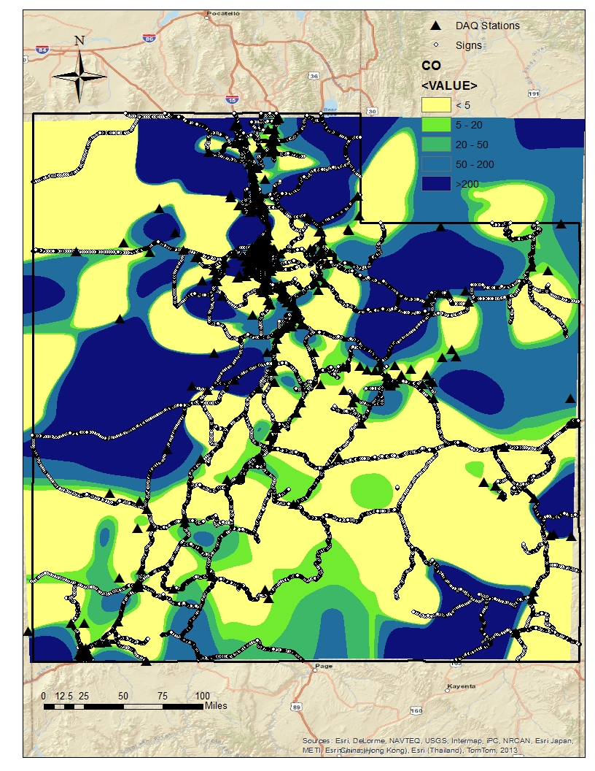
CO (Carbon Monoxide), tons per year | # of Signs | Sign Condition |  |  | % Good
 |  | Good | Fair | Poor
<5 | 43602 | 40590 | 2238 | 774 | 93
5-20 | 15582 | 14608 | 753 | 221 | 94
20-50 | 12919 | 12093 | 632 | 194 | 94
50-200 | 13482 | 12717 | 544 | 221 | 94
>200 | 11729 | 10794 | 728 | 207 | 92

Slide 17
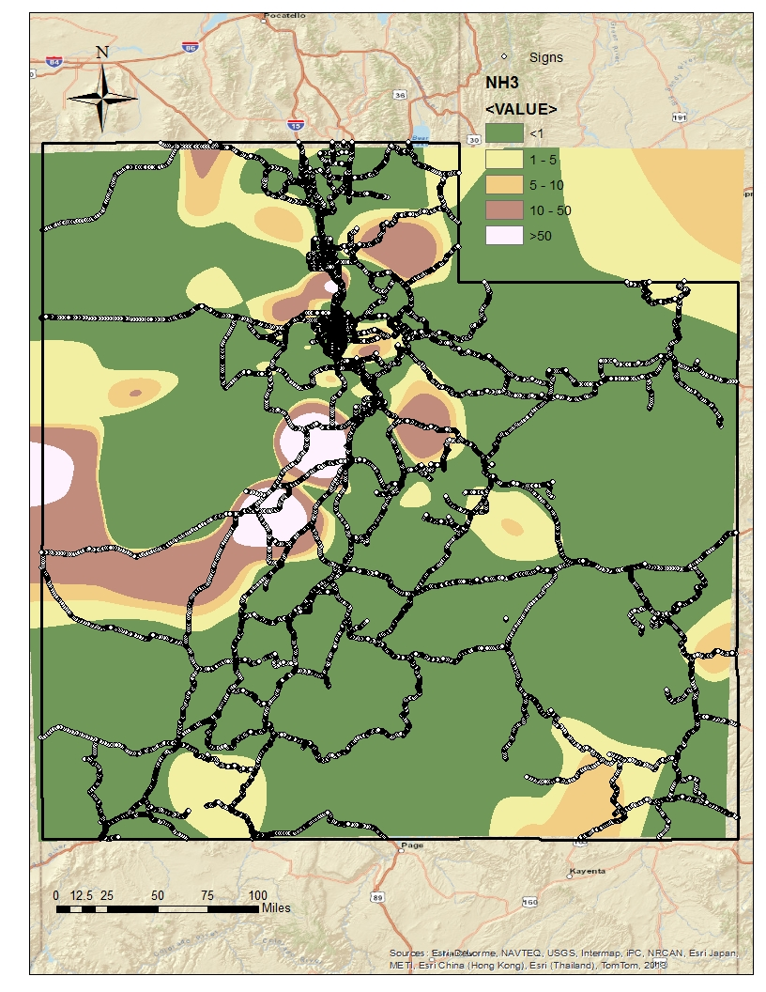
NH3 (Ammonia Hydroxide), tons per year | # of Signs | Sign Condition |  |  | % Good
 |  | Good | Fair | Poor
<1 | 74142 | 68998 | 3912 | 1232 | 93
1-5 | 14079 | 13248 | 584 | 247 | 94
5-10 | 2711 | 2554 | 114 | 43 | 94
10-50 | 4714 | 4466 | 176 | 72 | 95
>50 | 1668 | 1536 | 109 | 23 | 92

Slide 18
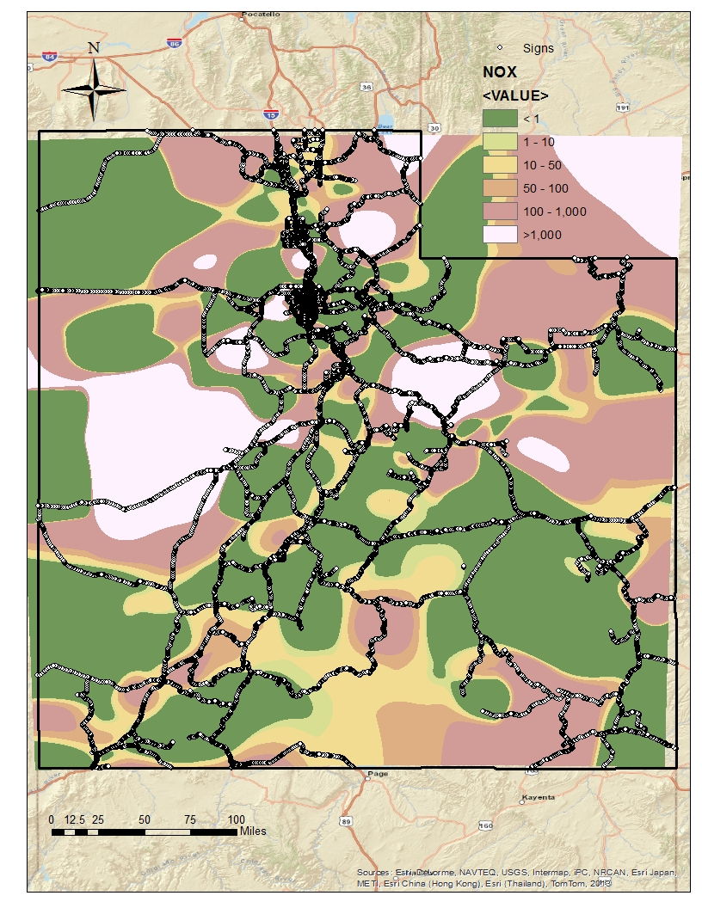
NOX (Nitrogen Oxides), tons per year | # of Signs | Sign Condition |  |  | % Good
 |  | Good | Fair | Poor
<1 | 40330 | 37488 | 2085 | 757 | 93
1-10 | 8433 | 8018 | 304 | 111 | 95
10-50 | 17732 | 16760 | 736 | 236 | 95
50-100 | 8311 | 7692 | 488 | 131 | 93
100-1000 | 16908 | 15769 | 850 | 289 | 93
>1000 | 5600 | 5075 | 432 | 93 | 91

Slide 19
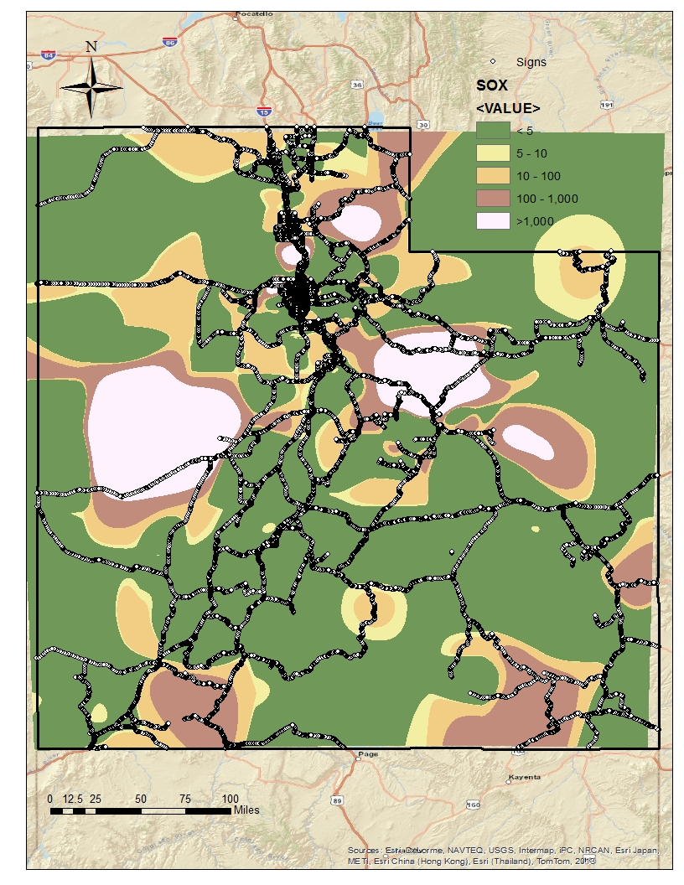
SOX (Sulfur Dioxide), tons per year | # of Signs | Sign Condition |  |  | % Good
 |  | Good | Fair | Poor
<5 | 59480 | 55282 | 3170 | 1028 | 93
5-10 | 6834 | 6366 | 367 | 101 | 93
10-100 | 16693 | 15869 | 600 | 224 | 95
100-1000 | 9890 | 9240 | 449 | 201 | 93
>1000 | 4417 | 4045 | 309 | 63 | 92

Slide 20
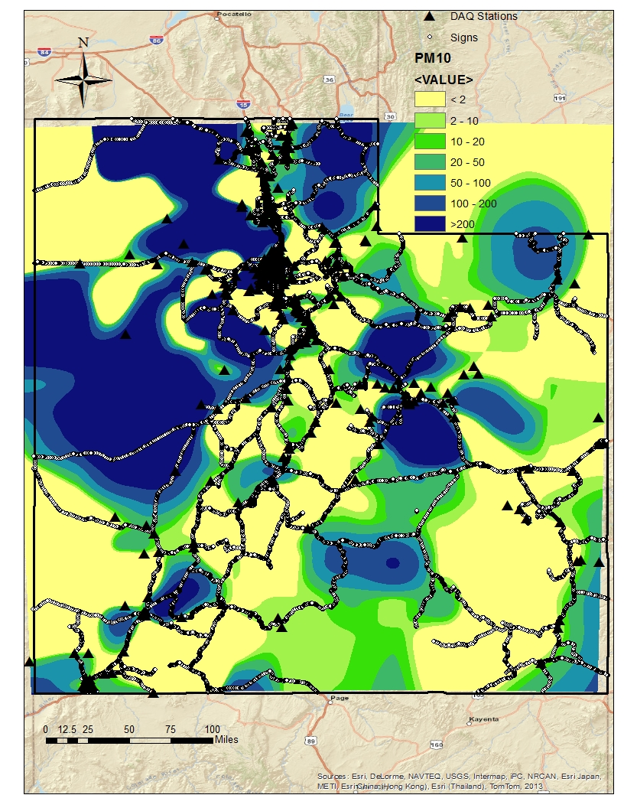
PM10 (Coarse Particles), tons per year | # of Signs | Sign Condition |  |  | % Good
 |  | Good | Fair | Poor
<2 | 39453 | 36693 | 2012 | 748 | 93
2-10 | 12967 | 12232 | 571 | 164 | 94
10-20 | 8684 | 8195 | 343 | 146 | 94
20-50 | 13774 | 13042 | 514 | 218 | 95
50-100 | 8946 | 8240 | 562 | 144 | 92
100-200 | 5696 | 5325 | 292 | 79 | 93
>200 | 7794 | 7075 | 601 | 118 | 91

Slide 21
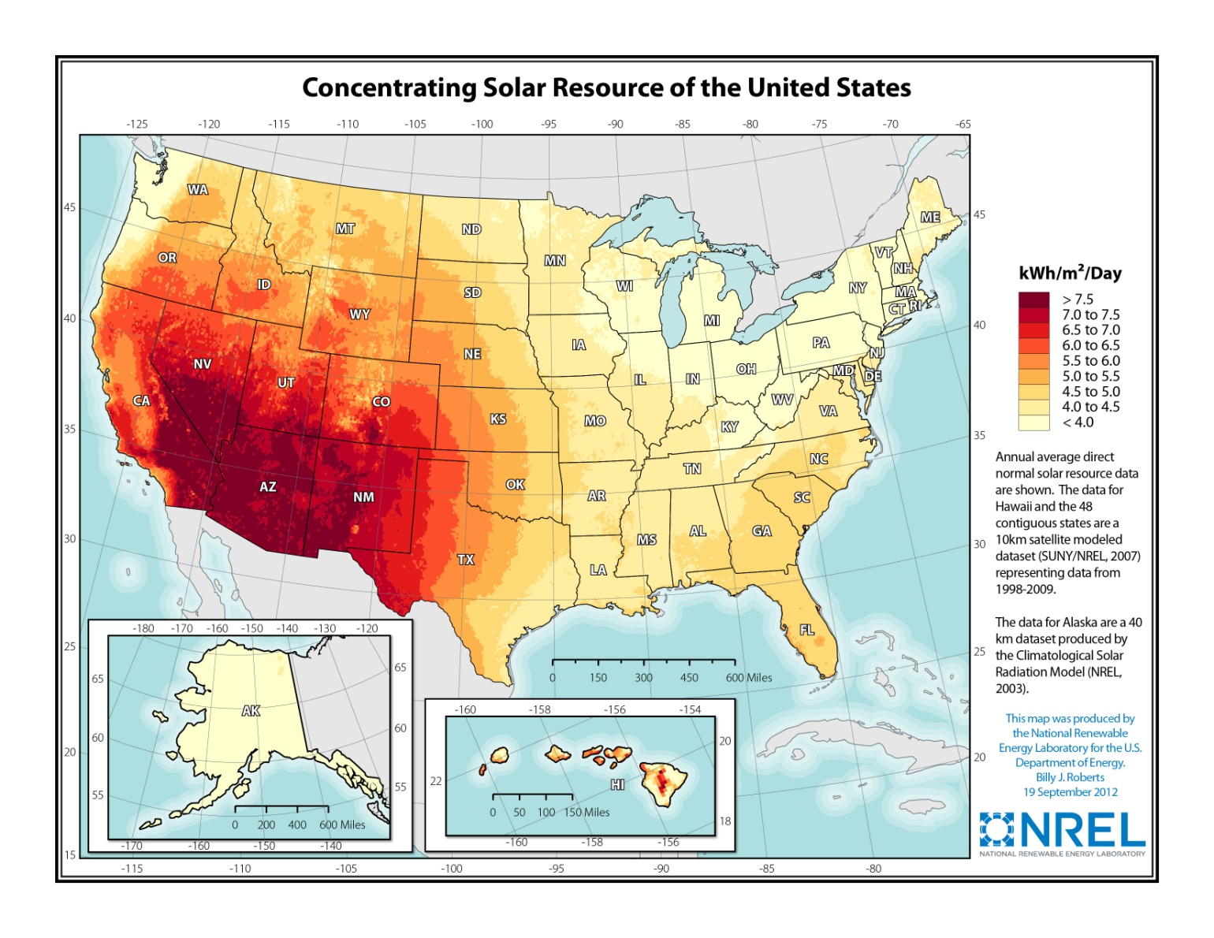
Solar (kWh/m^2/Day) | # of Traffic Signs | Sign Condition |  |  | % Good
 |  | Good | Fair | Poor
<6 | 45439 | 43031 | 1725 | 683 | 95
>6 | 51875 | 47771 | 3170 | 934 | 92

Slide 22
Sign Height above Road (m) | # of Signs | Sign Condition |  |  | % Good
 |  | Good | Fair | Poor
<1 | 2384 | 2191 | 107 | 86 | 92
1-2 | 31648 | 28835 | 2182 | 631 | 91
2-3 | 49225 | 46015 | 2427 | 783 | 93
3-4 | 6547 | 6375 | 110 | 62 | 97
>4 | 6845 | 6750 | 48 | 47 | 99
Sign Facing Direction | # of Signs | Sign Condition |  |  | % Good
 |  | Good | Fair | Poor
North | 16129 | 15337 | 597 | 195 | 95
Northeast | 9044 | 8414 | 527 | 103 | 93
Northwest | 8662 | 8105 | 424 | 133 | 94
East | 14672 | 13760 | 673 | 239 | 94
West | 14441 | 13469 | 729 | 243 | 93
Southeast | 8458 | 7770 | 502 | 186 | 92
Southwest | 9076 | 8329 | 573 | 174 | 92
South | 16860 | 15636 | 878 | 346 | 93
Road | # of Traffic Signs | Sign Condition |  |  | % Good
 |  | Good | Fair | Poor
Major | 84423 | 78431 | 4528 | 1464 | 93
Ramp | 12891 | 12371 | 367 | 153 | 96

Slide 23
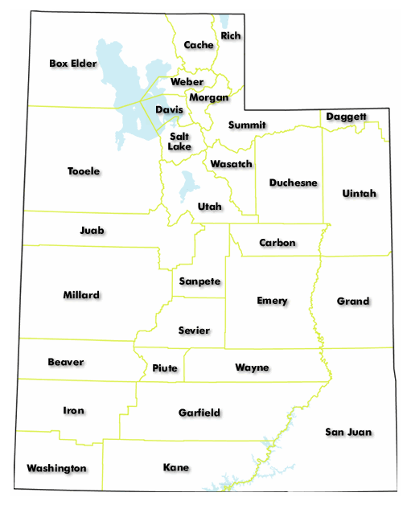
County | # of Signs | Sign Condition |  |  | % Good
 |  | Good | Fair | Poor
Beaver | 1585 | 1399 | 134 | 52 | 88.265
Box Elder | 5152 | 4744 | 340 | 68 | 92.0807
Cache | 2821 | 2541 | 226 | 54 | 90.0744
Carbon | 2130 | 1928 | 163 | 39 | 90.5164
Daggett | 1180 | 1077 | 71 | 32 | 91.2712
Davis | 5279 | 5113 | 105 | 61 | 96.8555
Duchesne | 2038 | 1806 | 190 | 42 | 88.6163
Emery | 3071 | 2834 | 200 | 37 | 92.2826
Garfield | 3216 | 3007 | 189 | 20 | 93.5012
Grand | 2514 | 2232 | 239 | 43 | 88.7828
Iron | 3105 | 2754 | 277 | 74 | 88.6957
Juab | 1642 | 1570 | 57 | 15 | 95.6151
Kane | 1731 | 1656 | 54 | 21 | 95.6672
Millard | 3698 | 3433 | 202 | 63 | 92.834
Morgan | 1123 | 996 | 98 | 29 | 88.691
Piute | 921 | 789 | 101 | 31 | 85.6678
Rich | 942 | 866 | 63 | 13 | 91.9321
Salt Lake | 15790 | 15131 | 398 | 261 | 95.8265
San Juan | 3910 | 3568 | 245 | 97 | 91.2532
Sanpete | 2198 | 2103 | 66 | 29 | 95.6779
Sevier | 4198 | 3889 | 265 | 44 | 92.6394
Summit | 3715 | 3519 | 149 | 47 | 94.7241
Tooele | 3118 | 2904 | 153 | 61 | 93.1366
Uintah | 1838 | 1549 | 162 | 127 | 84.2764
Utah | 8711 | 8345 | 291 | 75 | 95.7984
Wasatch | 1665 | 1536 | 74 | 55 | 92.2523
Washington | 3481 | 3314 | 118 | 49 | 95.2025
Wayne | 1592 | 1460 | 112 | 20 | 91.7085
Weber | 4950 | 4739 | 153 | 58 | 95.7374

Slide 24
# | County | Plane |  | Area (sq km) | Population |  | White | % White |  | Median Age | Median Household Income, 2006-2010 (US Dollars) | % Adults (25-64) with at least an Associate Degree | Sex Ratio (Ratios of Males to Females)
1 | Beaver |  | South | 6696 |  | 6,629 | 5,900 |  | 89 | 31.9 | 41,514 | 19.7 | 1.059
2 | Box Elder |  | North | 17429 |  | 49,975 | 45,861 |  | 92 | 30.6 | 55,135 | 32.2 | 1.016
3 | Cache |  | North | 3035 |  | 112,656 | 100,397 |  | 89 | 25.5 | 47,013 | 44.5 | 0.988
4 | Carbon |  | Central | 3844 |  | 21,403 | 19,757 |  | 92 | 34.4 | 41,967 | 28.4 | 0.984
5 | Daggett |  | North | 1862 |  | 1,059 | 1,016 |  | 96 | 42.8 | 36,389 | 32.8 | 1.292
6 | Davis |  | North | 1644 |  | 306,479 | 275,956 |  | 90 | 29.2 | 66,866 | 45.7 | 1.008
7 | Duchesne |  | Central | 8413 |  | 18,607 | 16,589 |  | 89 | 29.7 | 52,895 | 24.6 | 1.033
8 | Emery |  | Central | 11574 |  | 10,976 | 10,309 |  | 94 | 32.8 | 49,237 | 27.3 | 1.037
9 | Garfield |  | South | 13482 |  | 5,172 | 4,869 |  | 94 | 39 | 44,745 | 31.1 | 1.071
10 | Grand |  | Central | 9539 |  | 9,225 | 8,207 |  | 89 | 39.9 | 41,396 | 31.4 | 1.015
11 | Iron |  | South | 8550 |  | 46,163 | 41,848 |  | 91 | 26.8 | 42,247 | 37.5 | 0.989
12 | Juab |  | Central | 8820 |  | 10,246 | 9,831 |  | 96 | 29.3 | 53,225 | 24.3 | 1.042
13 | Kane |  | South | 10632 |  | 7,125 | 6,816 |  | 96 | 44.5 | 43,540 | 34.3 | 0.977
14 | Millard |  | Central | 17709 |  | 12,503 | 10,950 |  | 88 | 33.7 | 44,594 | 30.7 | 1.038
15 | Morgan |  | North | 1581 |  | 9,469 | 9,234 |  | 98 | 32 | 70,152 | 39.3 | 1.016
16 | Piute |  | South | 1983 |  | 1,556 | 1,474 |  | 95 | 40.5 | 37,708 | 23.6 | 1.047
17 | Rich |  | North | 2811 |  | 2,264 | 2,196 |  | 97 | 34.7 | 54,737 | 32.9 | 1.069
18 | Salt Lake |  | Central | 2085 |  | 1,029,655 | 836,074 |  | 81 | 30.8 | 58,004 | 40.1 | 1.012
19 | San Juan |  | South | 20538 |  | 14,746 | 6,759 |  | 46 | 29.9 | 38,076 | 31.9 | 1.008
20 | Sanpete |  | Central | 4147 |  | 27,822 | 25,158 |  | 90 | 28.4 | 42,395 | 31.4 | 1.098
21 | Sevier |  | Central | 4965 |  | 20,802 | 19,734 |  | 95 | 32.8 | 45,622 | 28.4 | 1.018
22 | Summit |  | North | 4870 |  | 36,324 | 32,890 |  | 91 | 37.1 | 79,461 | 59.5 | 1.064
23 | Tooele |  | Central | 18872 |  | 58,218 | 52,804 |  | 91 | 29.6 | 60,590 | 31.0 | 1.015
24 | Uintah |  | Central | 11662 |  | 32,588 | 28,232 |  | 87 | 29.1 | 59,730 | 21.1 | 1.034
25 | Utah |  | Central | 5545 |  | 516,564 | 461,775 |  | 89 | 24.6 | 56,927 | 47.9 | 1.004
26 | Wasatch |  | Central | 3130 |  | 23,530 | 21,275 |  | 90 | 31.6 | 65,204 | 42.2 | 1.034
27 | Washington |  | South | 6298 |  | 138,115 | 123,914 |  | 90 | 32.5 | 50,050 | 33.7 | 0.978
28 | Wayne |  | South | 6384 |  | 2,778 | 2,634 |  | 95 | 37.1 | 49,414 | 33.7 | 1.022
29 | Weber |  | North | 1708 |  | 231,236 | 197,101 |  | 85 | 30.7 | 54,086 | 33.2 | 1.008

Slide 25
State Plane | # of Signs | Sign Condition |  |  | % Good
 |  | Good | Fair | Poor
North | 25162 | 23595 | 1205 | 362 | 93.77
Central | 52611 | 49260 | 2460 | 891 | 93.63
South | 19541 | 17947 | 1230 | 364 | 91.84
County’s Area (sq km) | # of Signs | Sign Condition |  |  | % Good
 |  | Good | Fair | Poor
<2000 | 13453 | 12714 | 528 | 211 | 94.51
2000-4000 | 23348 | 22002 | 924 | 422 | 94.24
4000-10000 | 34779 | 32391 | 1898 | 490 | 93.13
>10000 | 25734 | 23695 | 1545 | 494 | 92.08
County’s Population | # of Signs | Sign Condition |  |  | % Good
 |  | Good | Fair | Poor
<10000 | 14804 | 13482 | 1061 | 261 | 91.07
10000-20000 | 14359 | 13211 | 894 | 254 | 92.01
20000-50000 | 24001 | 22022 | 1496 | 483 | 91.75
50000-300000 | 14370 | 13498 | 650 | 222 | 93.93
>300000 | 29780 | 28589 | 794 | 397 | 96.00

Slide 26
County’s % White | # of Signs | Sign Condition |  |  | % Good
 |  | Good | Fair | Poor
<90 | 47855 | 44743 | 2240 | 872 | 93.5
90-94 | 36130 | 33756 | 1834 | 540 | 93.4
>94 | 13329 | 12303 | 821 | 205 | 92.3
County’s Median Age | # of Signs | Sign Condition |  |  | % Good
 |  | Good | Fair | Poor
24-29 | 16835 | 15743 | 860 | 232 | 93.51
29-32 | 46967 | 44059 | 2011 | 897 | 93.81
32-37 | 18643 | 17260 | 1109 | 274 | 92.58
>37 | 14869 | 13740 | 915 | 214 | 92.41
County’s Median Household Income, 2006-2010 (US Dollars) | # of Signs | Sign Condition |  |  | % Good
 |  | Good | Fair | Poor
<42000 | 12240 | 10993 | 953 | 294 | 89.81
42000-45000 | 13948 | 12953 | 788 | 207 | 92.87
45000-50000 | 11682 | 10724 | 803 | 155 | 91.80
50000-55000 | 13053 | 12295 | 581 | 177 | 94.19
55000-60000 | 31491 | 29769 | 1191 | 531 | 94.53
>60000 | 14900 | 14068 | 579 | 253 | 94.42

Slide 27
County’s % Adults (25-64) with at least an Associate Degree | # of Signs | Sign Condition |  |  | % Good
 |  | Good | Fair | Poor
<30 | 17423 | 15764 | 1272 | 387 | 90.48
30-32 | 18654 | 17247 | 1094 | 313 | 92.46
32-34 | 17297 | 16200 | 857 | 240 | 93.66
34-42 | 21749 | 20537 | 827 | 385 | 94.43
>42 | 22191 | 21054 | 845 | 292 | 94.88
County’s Sex Ratio (Ratios of Males to Females | # of Signs | Sign Condition |  |  | % Good
 |  | Good | Fair | Poor
<1 | 13268 | 12193 | 838 | 237 | 91.90
>1 | 84046 | 78609 | 4057 | 1380 | 93.53

Slide 28
Acknowledgment
Dr. Kevin Heaslip
Dr. David Tarboton

