Slide 1
Using GIS to Compare all M&R Strategies for Asphalt Road Networks
CEE 6240: GIS in Water Resources
By: Antonio Fuentes

Slide 2
Presentation Outline
Goals and Purpose
Brief discussion of Transportation Asset Management Software (TAMS)
Discussion of incorporating TAMS into ArcGIS
Discussion of why comparison of Maintenance & Repair (M&R) strategies is beneficial
Key points in development of ArcGIS tool to compare all M&R strategies
Results
References
Questions

Slide 3
1 Goals and Purpose
Develop a tool for city engineers and public works directors to compare all maintenance and repair (M&R) strategies visually and effectively through the use engineering economic principles
Most Pavement Management Systems (PMS) approach the economic analysis macroscopically, a more detailed microscopic approach could also be useful for easy comparison

Slide 4
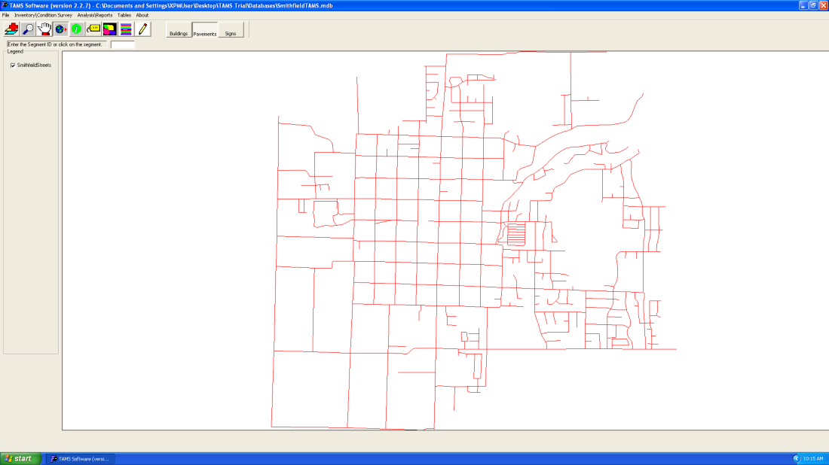
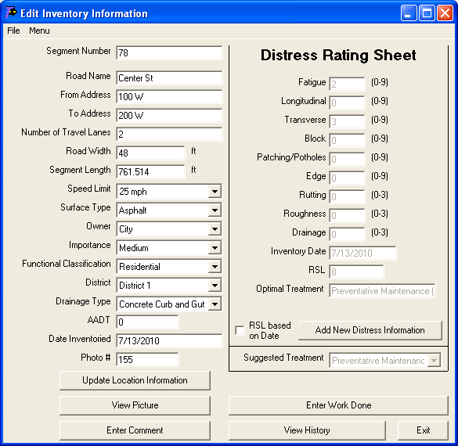
2 TAMS
Developed by the Utah LTAP and USU
A Pavement Management System (PMS) used to collect current pavement condition data, forecast deterioration and provide economic analysis and M&R recommendation
Smithfield City 2010

Slide 5
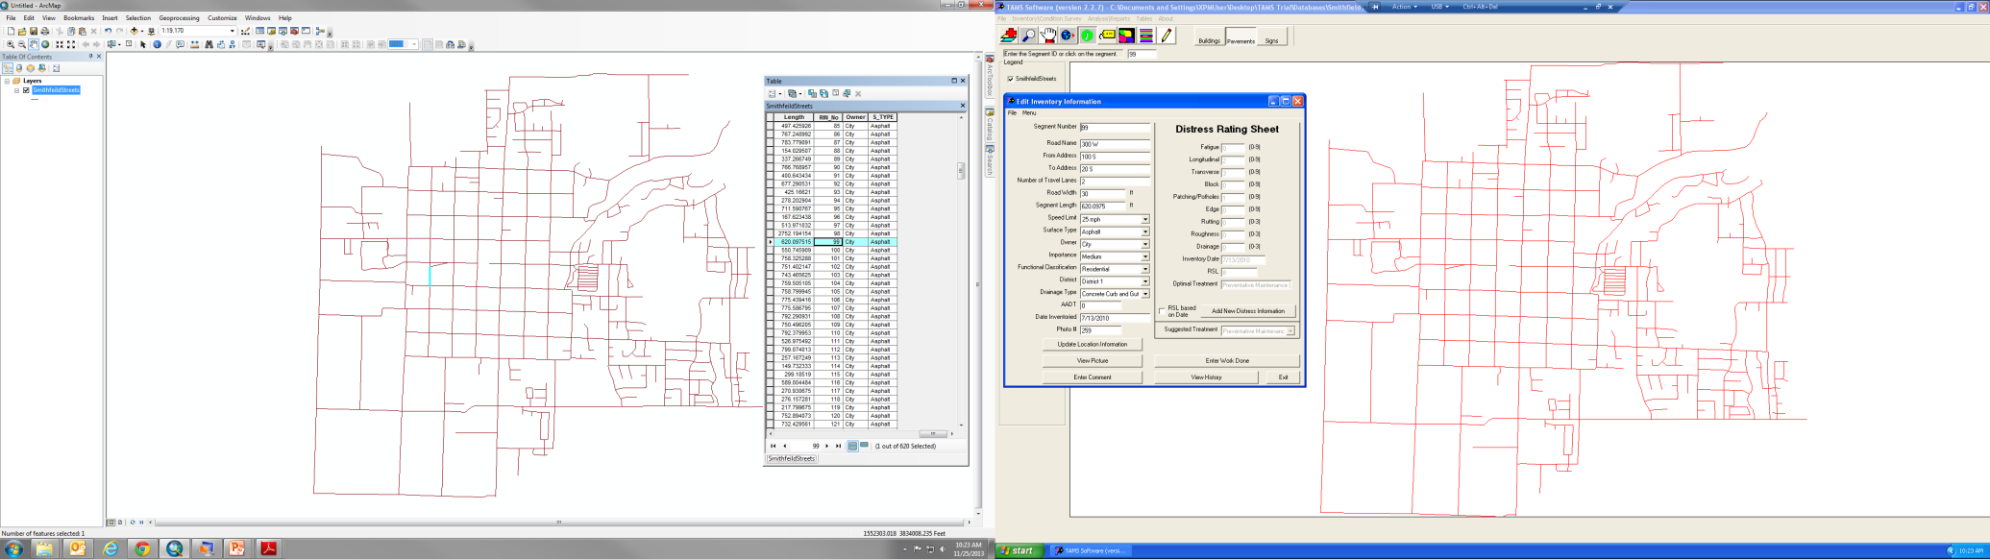
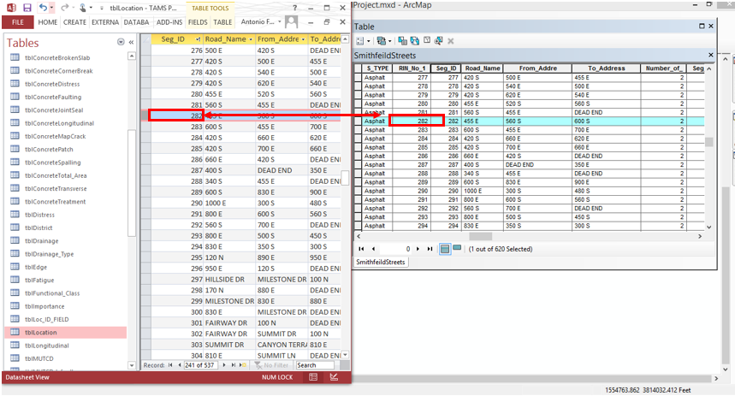
3 TAMS
Data collected through the use of a polyline shapefile
Data stored in Access database
Enables easy transition from database to ArcGIS through the use of “Road Identification Number”

Slide 6
3 TAMS in GIS
Remaining Service Life (RSL)
Suggested Treatment

Slide 7
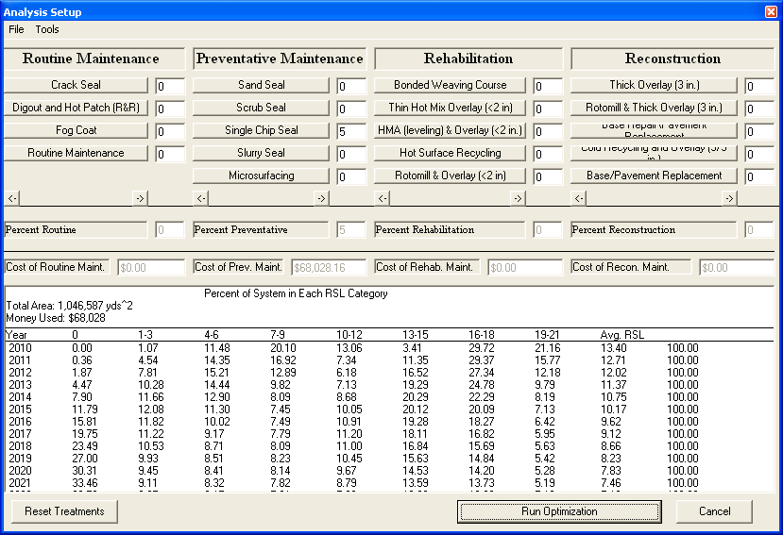
4 Economic Analysis in TAMS
Approaches pavement network macroscopically
Deals with quantitative values of % area for pavement network

Slide 8
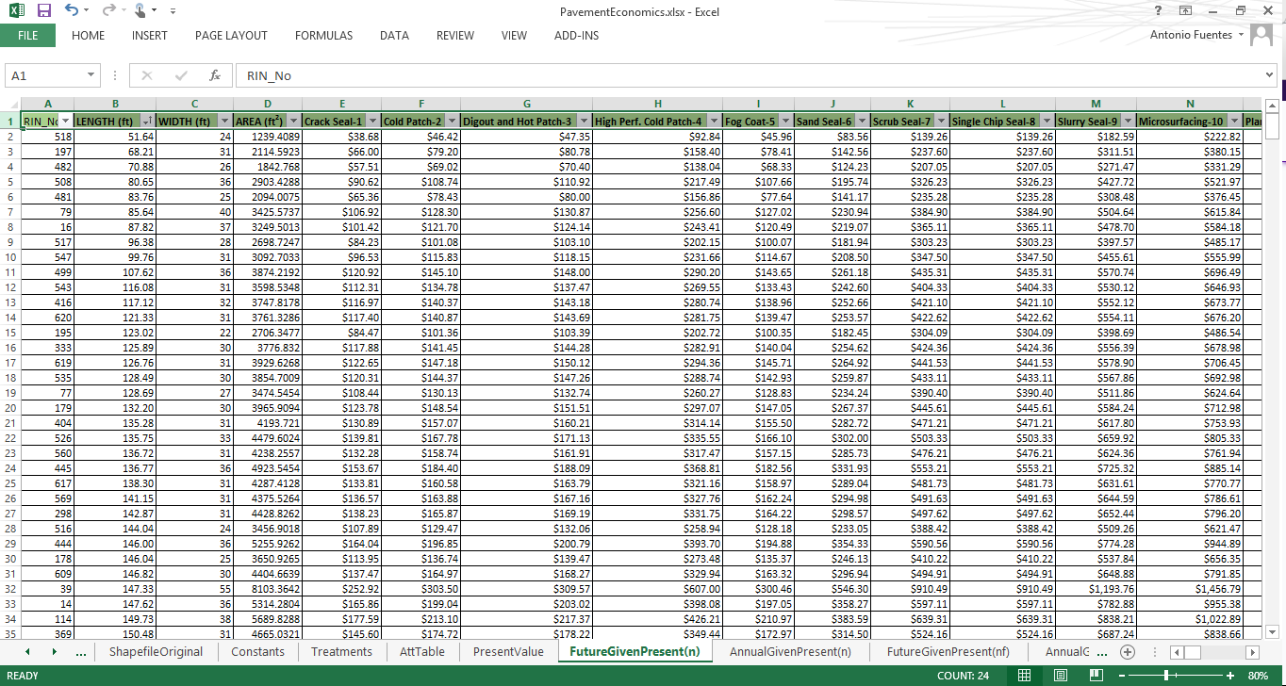
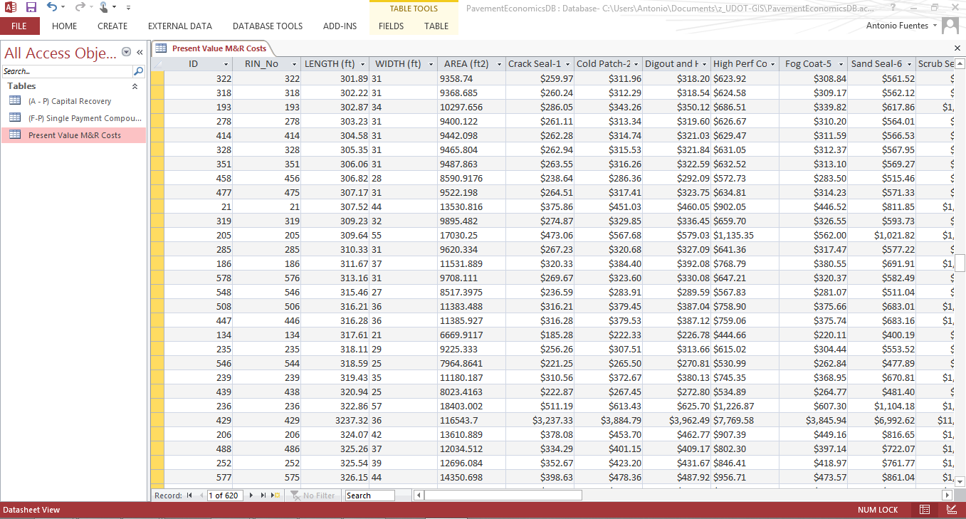
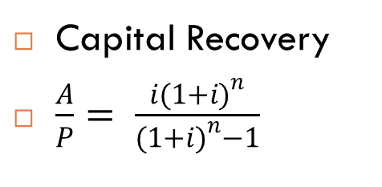
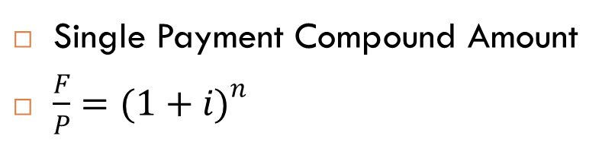
5 Engineering Economics
Single Payment Compound Amount
$\frac{F}{P}={(1+i)}^{n}$
Capital Recovery
$\frac{A}{P}= \frac{{i(1+i)}^{n}}{{(1+i)}^{n}−1}$

Slide 9
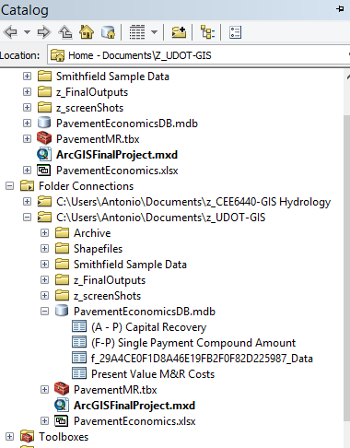
5 Recognized as Geodatabase

Slide 10
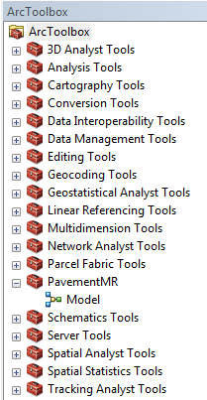
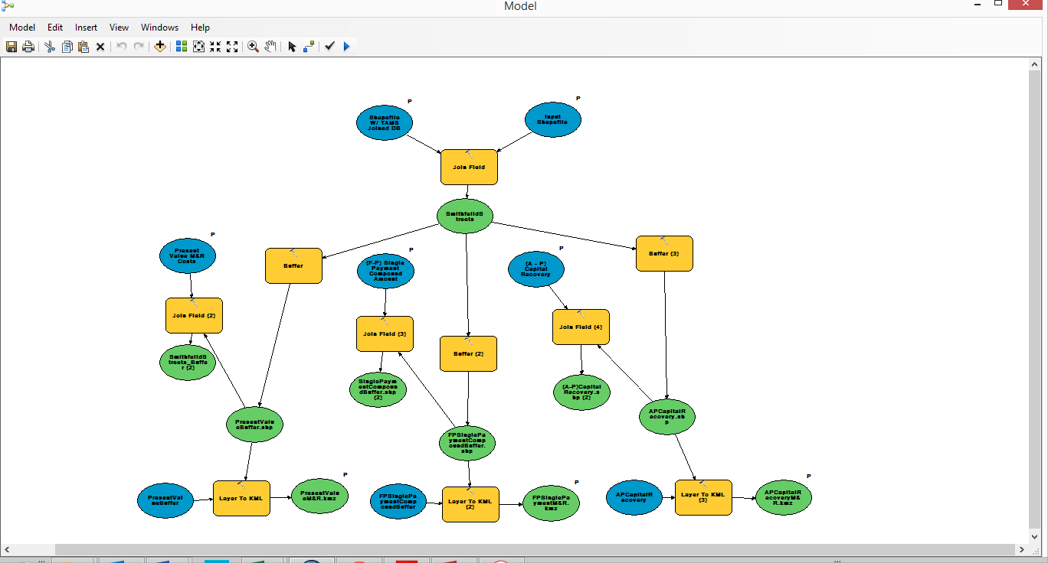
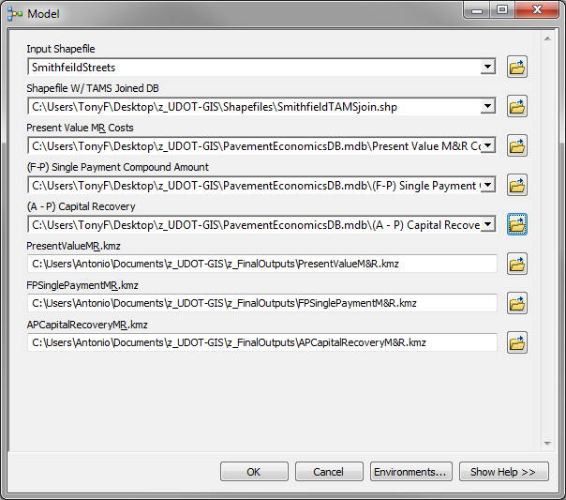
5 ArgGIS Toolbox

Slide 11
5 Discussion of Steps in GIS Tool for M&R Comparison
Treatment costs determined from area of segment
Currently, calculations are conducted in Excel
Tables are then exported into an Access
Polyline converted to polygon for visualization purposes
Results are then exported into kmz format for accessibility in Google Earth

Slide 12
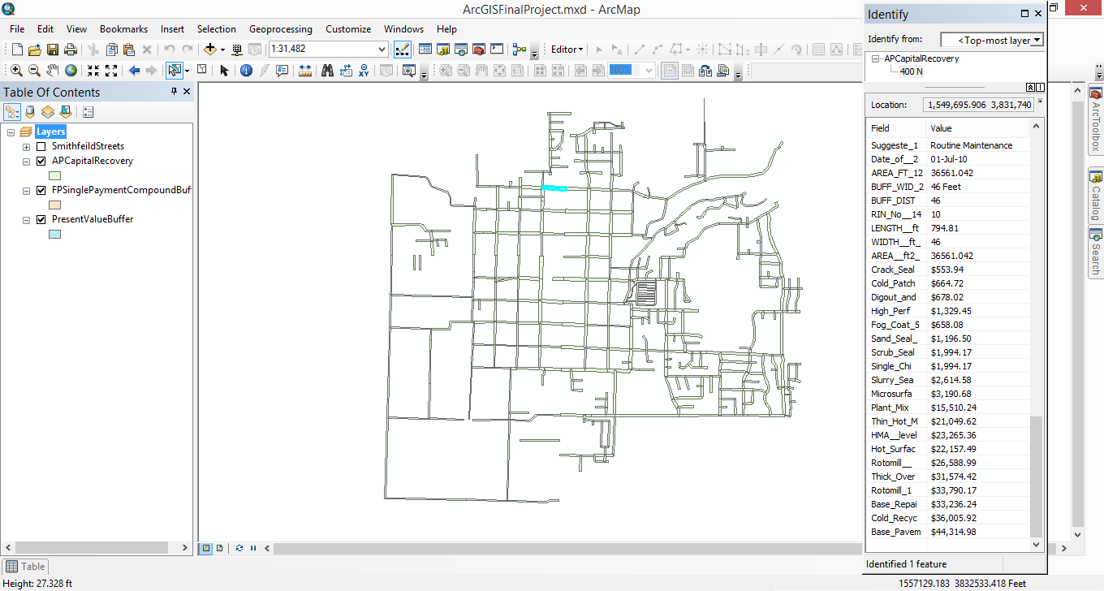
6 Results

Slide 13
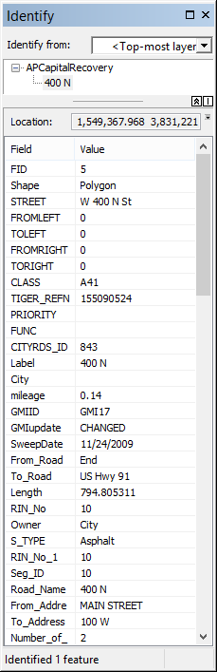
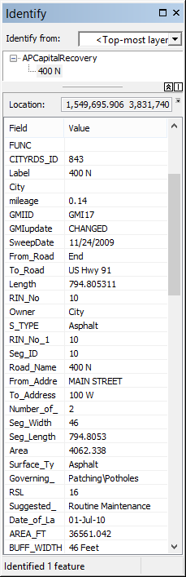
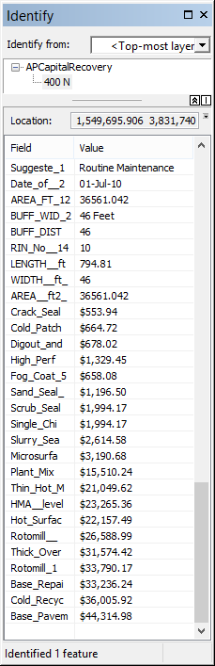
6 Results
Original
Shapefile Data
A/P Estimates
from Access
TAMS
Database

Slide 14
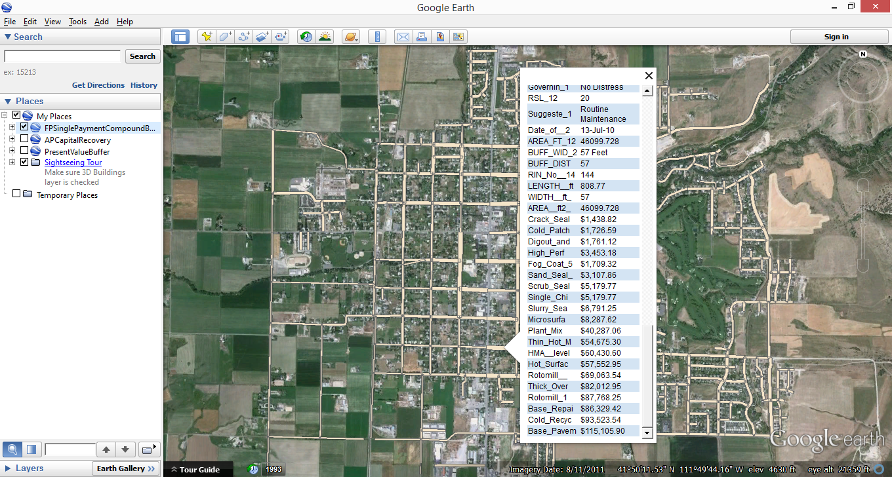
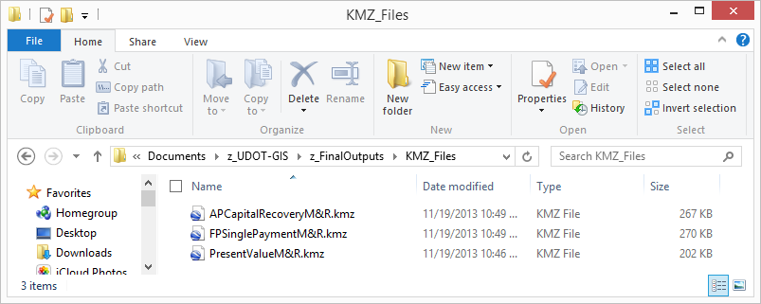
6 Results

Slide 15
7 References
Utah LTAP (2011). “Utah LTAP TAMS, Transportation Asset Management” Utah LTAP, http://utahltap.org/software/tams.php (Nov. 1, 2013)
Utah AGRC. “Road Centerlines” Roads and Highway system< http://gis.utah.gov/data/sgid-transportation/roads-system/ > (Oct. 2, 2013)
Jones, N., (2010) Analysis and Recommendations for Street Network, Smithfield City
Shahin, M. Y., Welborn, W., Hammond, L., Kim, S., Meisel R., Cerda, L. (2012) PAVERTM 6.5 Users Manual. US Army Corps of Engineers Chapter 13 M&R Plan (95-102)

Slide 16
8 Questions
The End
Thank you

