Slide 1
Automation of Input data preparation of TOPNET model using Python
Presented by Nazmus Sazib
CEE6440
GIS in Water Resources
11/27/2012

Slide 2
Introduction
GIS enables user to manipulate, analyze, visualize, and share the spatial datasets in easy and efficient way.
Automation of this analysis makes work easier, faster and more accurate.
There are different ways for automation of GIS work:
Model Building
Writing script
Using Arc object.

Slide 3
Objective
Objective of this project is to automation of input data preparation of TOPNET by writing script.
There are different language for writing scripts, including Python, Jscript, and Perl.
Python is used in this project for writing script.

Slide 4
TOPNET model
TOPNET model is distributed hydrologic model.
Developed for modeling of stream flow on existing and climate change condition.
Model elements are topographically delineated.
GIS based procedure to estimate model parameters.

Slide 5
Input data preparation
Preparation of input data for TOPNET is complex and involved the following steps:
Delineate streams, model elements and establish model element and stream connectivity.
Establish rainfall weights for precipitation and model parameter for each drainage
Establish wetness index, distance distribution.

Slide 6
Watershed delineation
TauDEM(Tarboton, D. G.)function is used for watershed delineation.
Multiple TauDEM command line functions are used in the script.
DEM and outlet shape file are the necessary inputs for running the program.
Watershed with stream network is the output of the program.

Slide 7
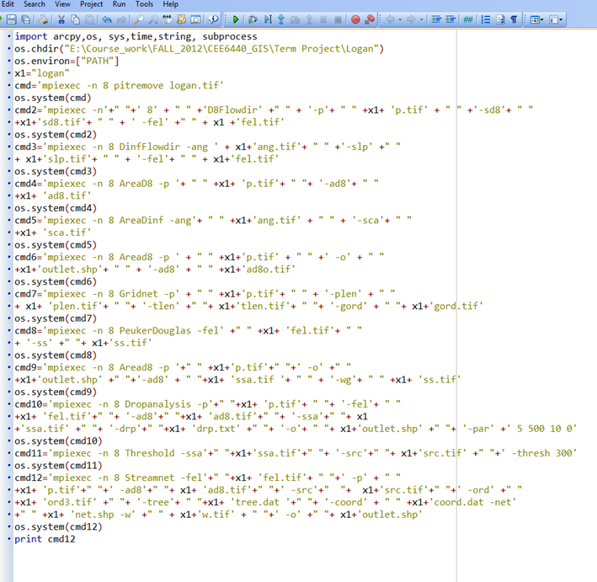
Code

Slide 8
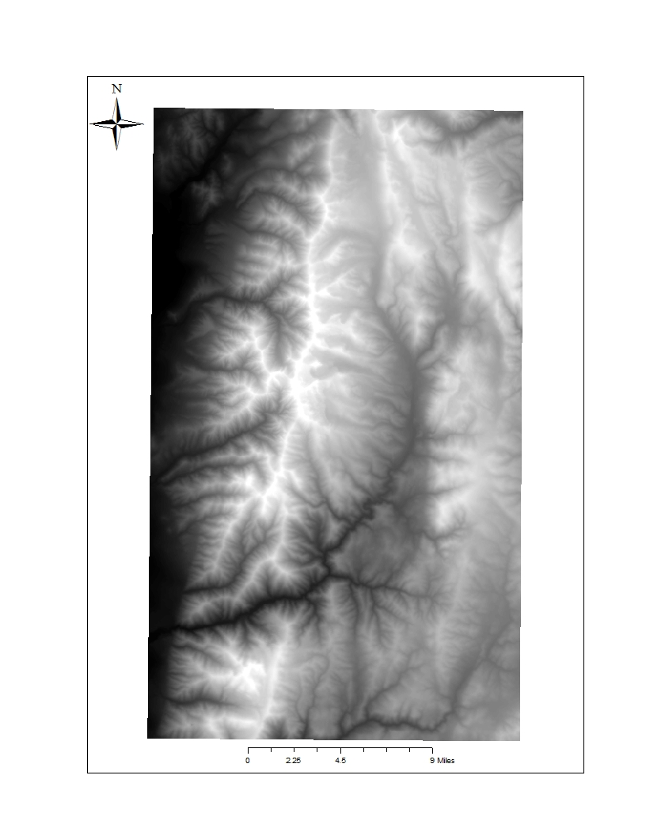
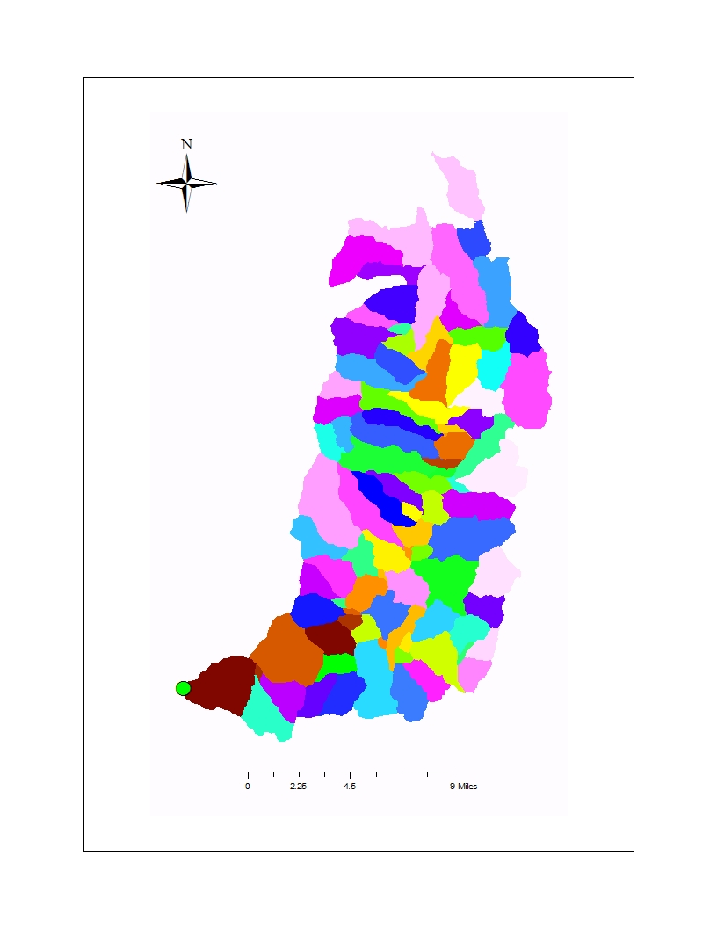
Output
Input(DEM)
Output(Watershed)

Slide 9
Wetness index distribution
Group the values of index into bins for each drainage.
The proportion of area within each bin no more than 5% of the area.
The data giving the proportion of area in each wetness index class for each drainage is written to a text file.

Slide 10
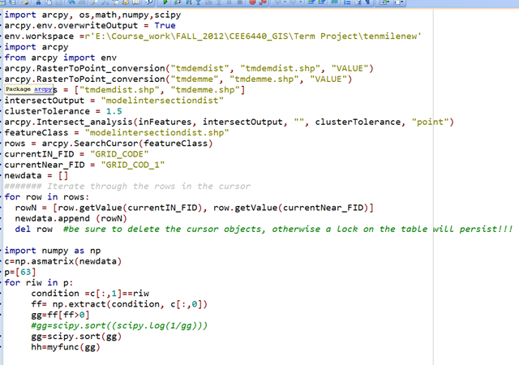
Code

Slide 11
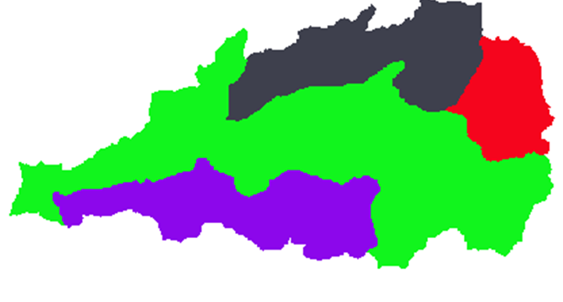
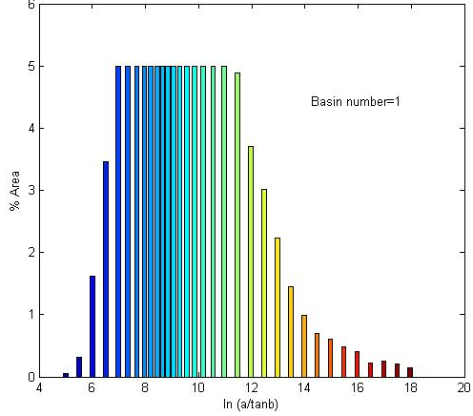
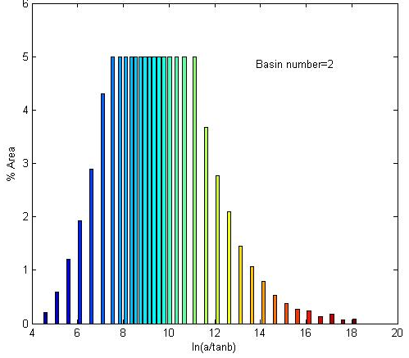
Output
1
2

Slide 12
Distance distribution
TauDEM function is used to compute the overland flow distance from each grid cell to the streams
Group the values of index into bins for each drainage.
The proportion of area within each bin no more than 20% of the area.
The data giving the proportion of area in each wetness index class for each drainage is written to a text file.

Slide 13
Output
Still working on that.

Slide 14
Conclusion and Future work
Automation makes work easier faster and more accurate
Establish model element and stream connectivity.
Establish rainfall weights for precipitation inputs and model parameter for each drainage.

Slide 15
Reference
Bandaragoda, C., D. G. Tarboton and R. Woods, (2004), "Application of Topnet in the Distributed Model Intercomparison Project," Journal of Hydrology, 298: 178-201, doi:10.1016/j.jhydrol.2004.03.038. http://www.neng.usu.edu/cee/faculty/dtarb/Bandaragoda_Tarboton_Woods_Dmip_joh.pdf
Tarboton, D. G., (2007), "Surface Water Quantity Model Development and Calibration, WRIA 1 Watershed Management Project Phase III, Task 4.1 report," Utah Water Research Laboratory, Utah State University, http://wria1project.whatcomcounty.org/uploads/USU/2008/Task4.1-SWQNcalibration.pdf .

Slide 16
Thanks!
Question?

