Slide 1
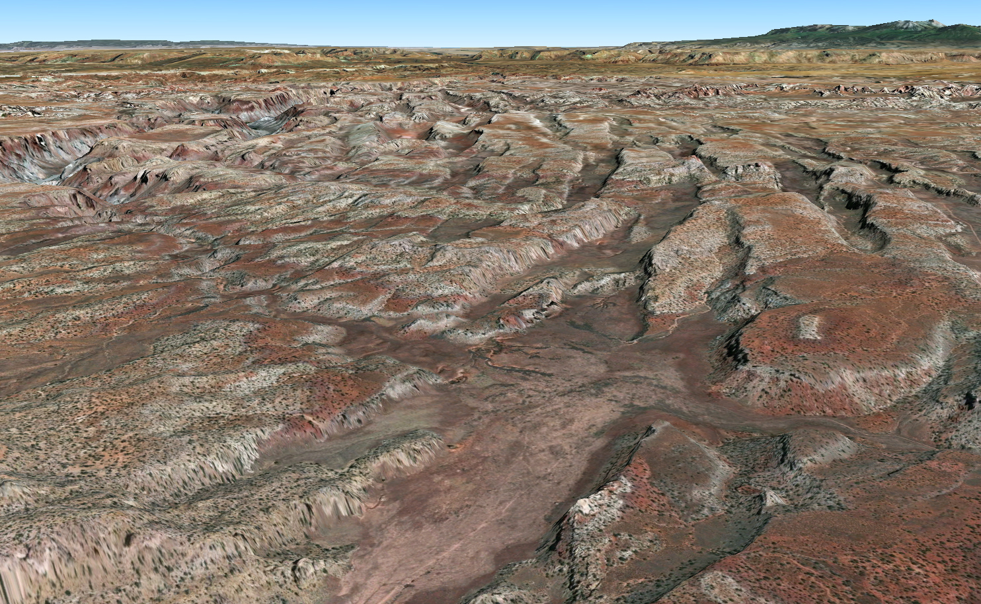
Using GIS to appraise lithologic and structural control of streams in the Grabens of southeast Utah
GISWR Term Project Presentation
Faye Geiger
Masters student in Geology
Utah State University

Slide 2
Overview
Objectives
Meet the Grabens
Using streams to understand landscape evolution
Methods
Results
Conclusions

Slide 3
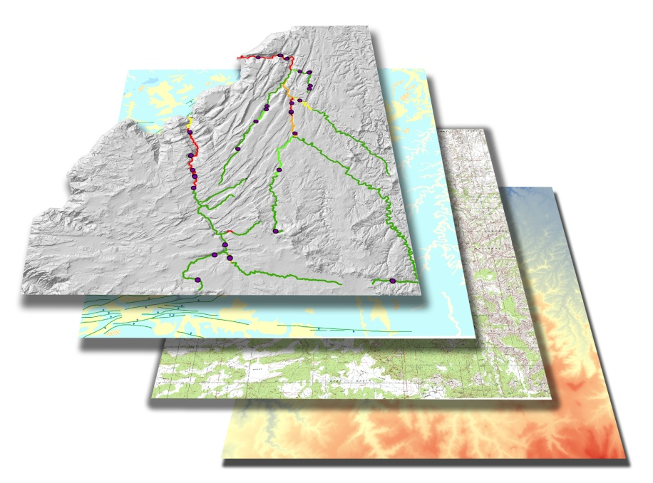
Objectives
Use GIS to identify anomalies (knickpoints) in stream longitudinal profiles.
Overlay results on a geologic map to determine how knickpoints formed.

Slide 4
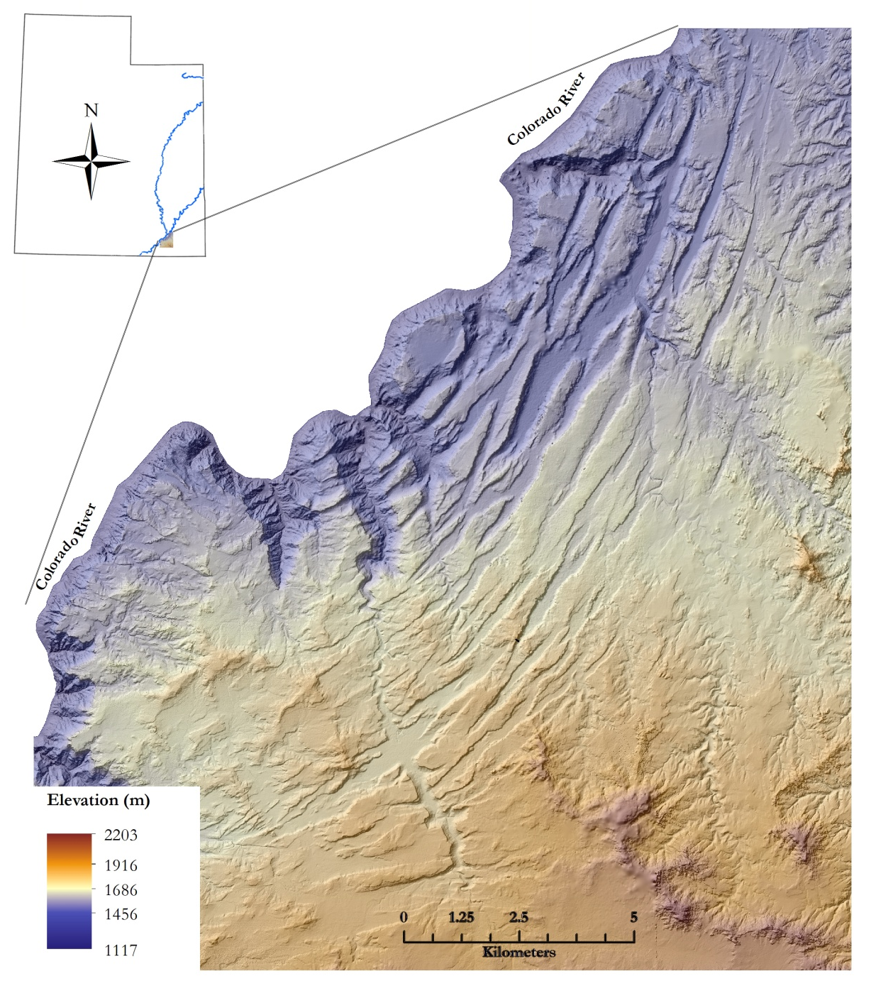
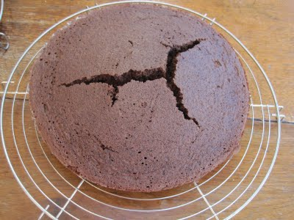
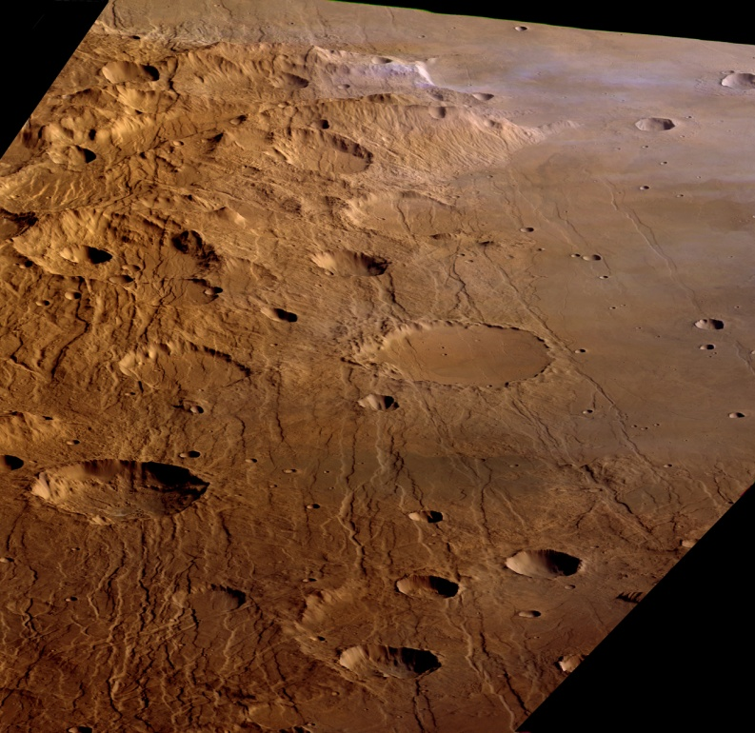
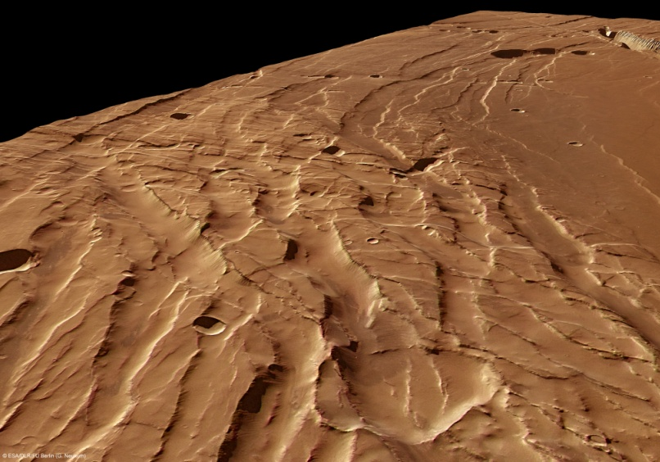
Mmmm, graben!
www.tipsybaker.com
European Space Agency
Notes:
Anyone who has baked has seen this—brittle deformation of a cake due to rapid expansion
Aerial view of the Grabens: extension normal to structures strike. Streams, paleostreams
Use of stream id (from aerial photos) to reconstruct approximate timing of deformation

Slide 5
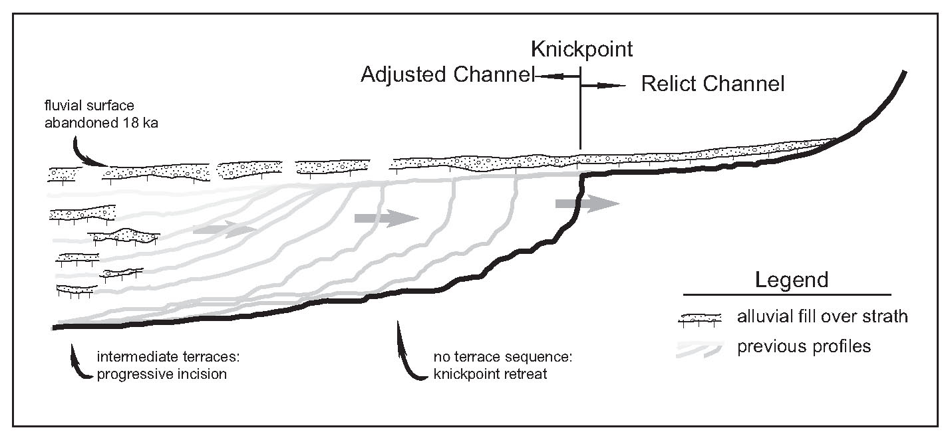
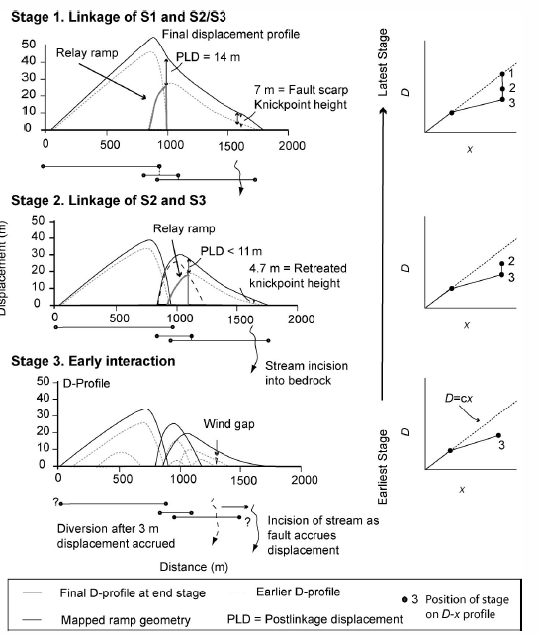
Stream metrics
from Knickpoint initiation and distribution within fluvial networks: 236 waterfalls in the Waipaoa River, North Island, New Zealand. Crosby and Whipple, 2006. Geomorphology 82, 16-38.
Notes:
“Typical” streams have a concave-up profile. Under ideal conditions, this reflects that the stream’s ability to do work (move or store sediment) is basically constant along its length.
Streams respond to climate, base level, sediment supply, geology
Anomalies in this concave-up profile indicate some kind of disturbance or change; knickpoints are either pinned (lithologically controlled) or transient (base level fall, stream integration, uplift)
Within the last 50 years, geomorphologists have integrated more quantitative analyses; within the last 10 years availability of DEMs and Lidar make it possible to do GIS analysis. A possible application would be to ID knickpoints on a DEM to select places in the field to explore.
S = k_{sn} x A^{-θ}
k_{sn} takes uplift rates and erosivity (function of rock strength and precip) into account.
Θ = concavity. 0 = straight slope (elevation/distance from divide), .5 is normal concavity, 1 is very deep concavity. Profiles w/convexities have lower θ values.

Slide 6
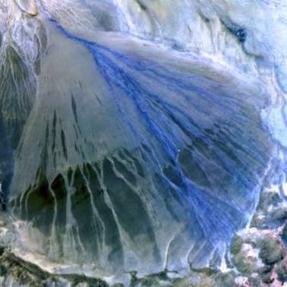
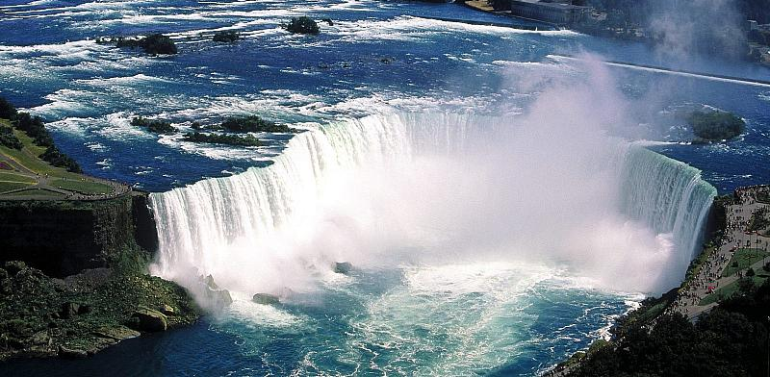
Stream metrics
Bruce Trudgill
Are knickpoints formed by:
base level fall due to movement on faults?
Bedrock change
niagrafallslive.com
Notes:
If we can ID knickpoints, can we then combine this analysis with geologic understanding to determine whether they’re bedrock controlled?

Slide 7
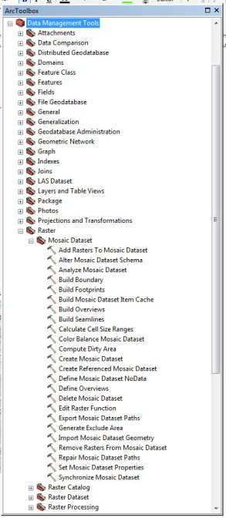
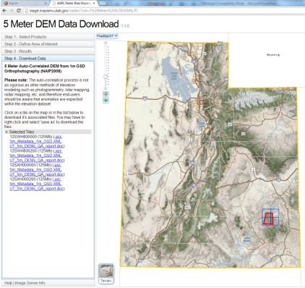
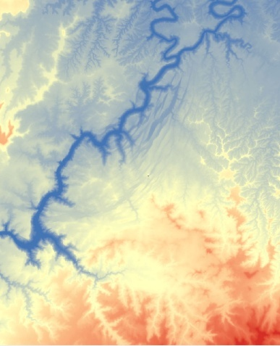
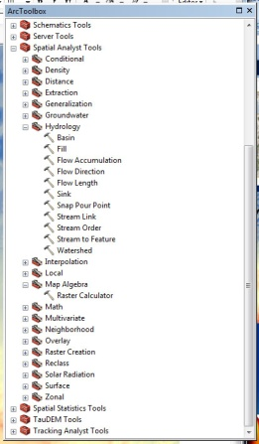
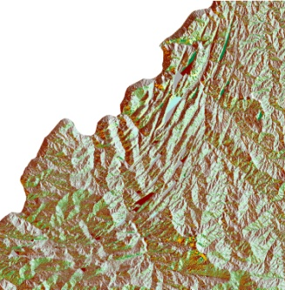
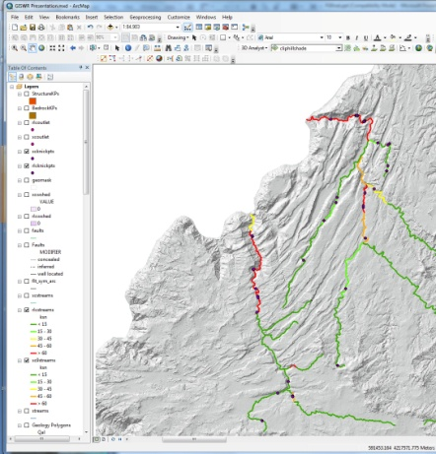
Methods
DEM, geologic maps, topographic maps acquisition
DEM preparation in ArcMap 9.3
Flow direction/accumulation tools
Choose streams
Matlab longitudinal profile tool
Work with .shp files in ArcMap 10.1
Classify knickpoints
Notes:
Methods

Slide 8
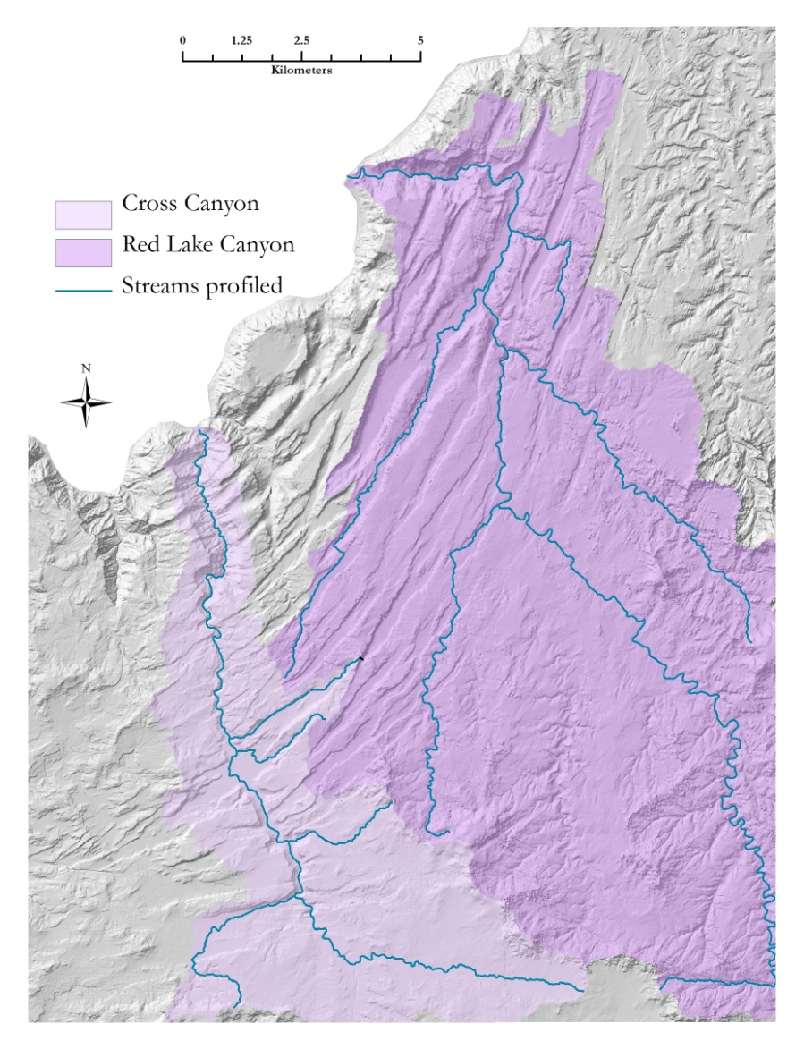
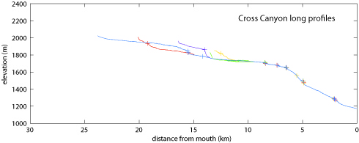
Results

Slide 9
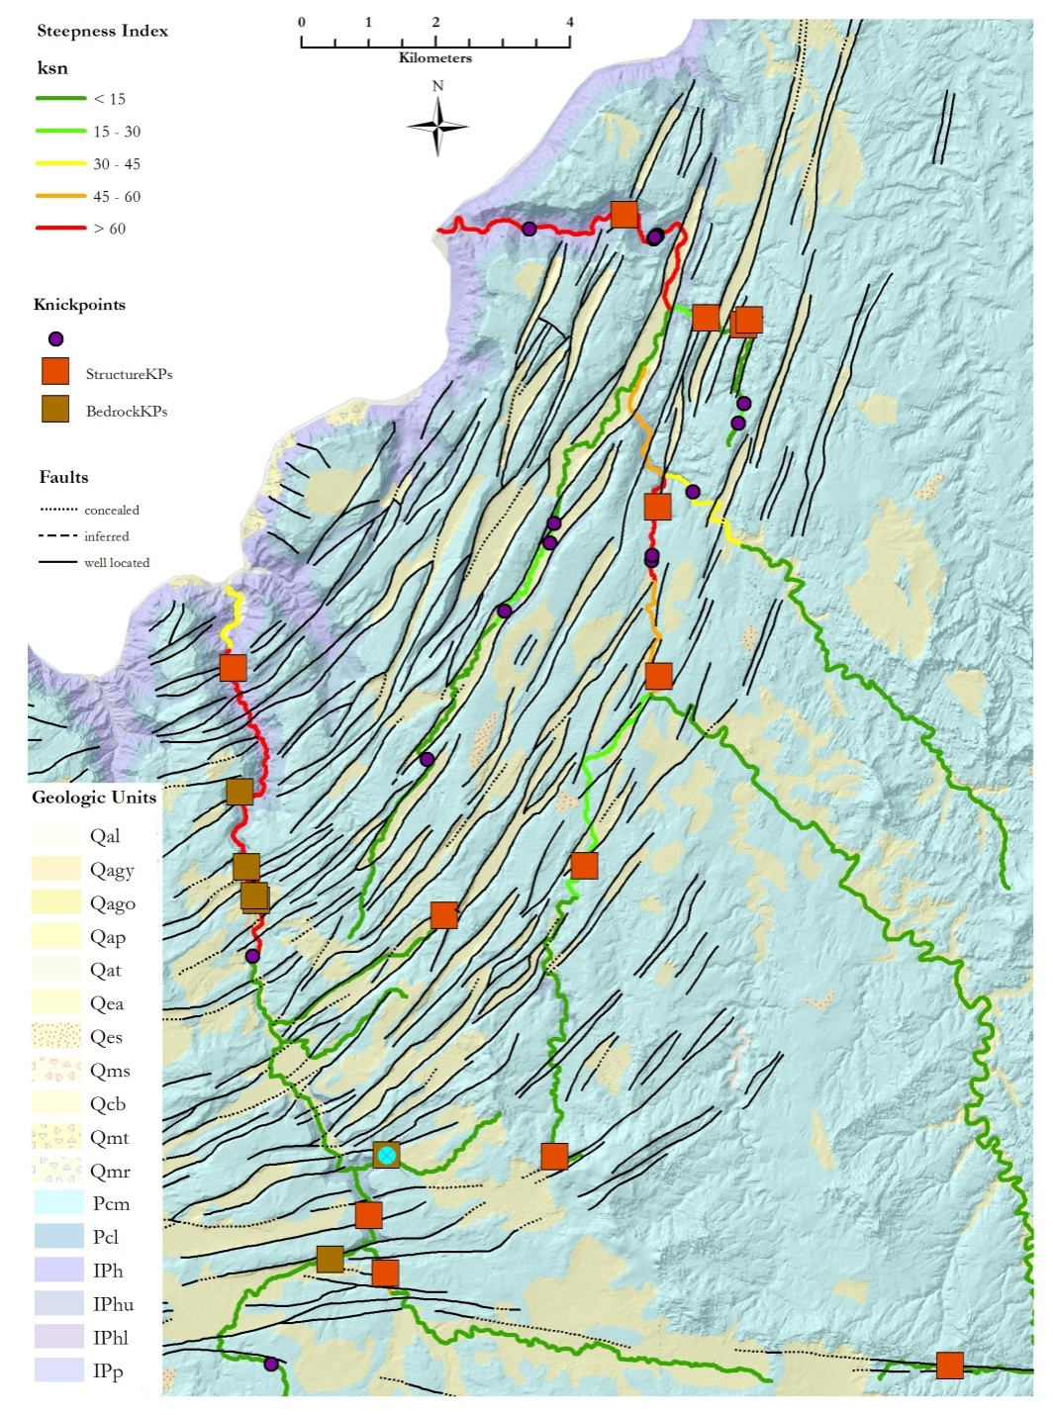
Results
30 knickpoints identified
13 structurally controlled
5 bedrock controlled
11 undetermined
1 on a paleodrainage

Slide 10
Conclusions
With the right parameters, knickpoint location worked!
Identification was possible for ~60% of knickpoints
Results support the use of knickpoints for inferring past displacement…
But bedrock variability does control at least 12% of knickpoints and should always be considered

Slide 11
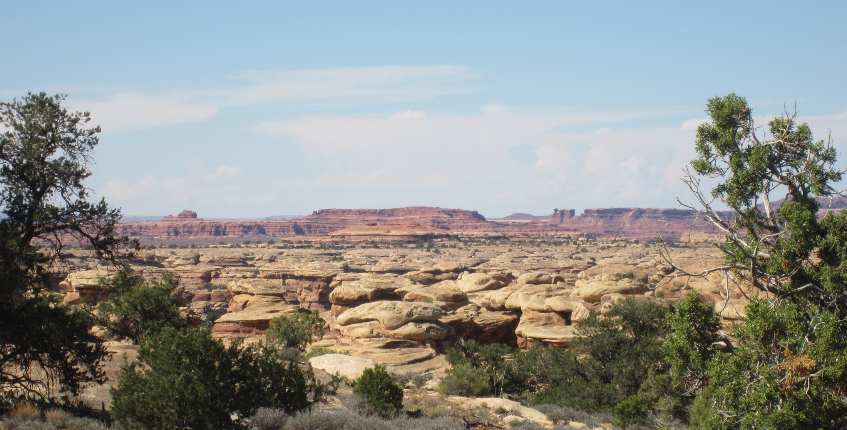
Thank You
Dr. David Tarboton
Dr. Joel Pederson
Dr. Patrick Belmont
John Geiger
Andy Jochems
Justin Stout
Areekamol Tor Chaisuwan

Slide 12
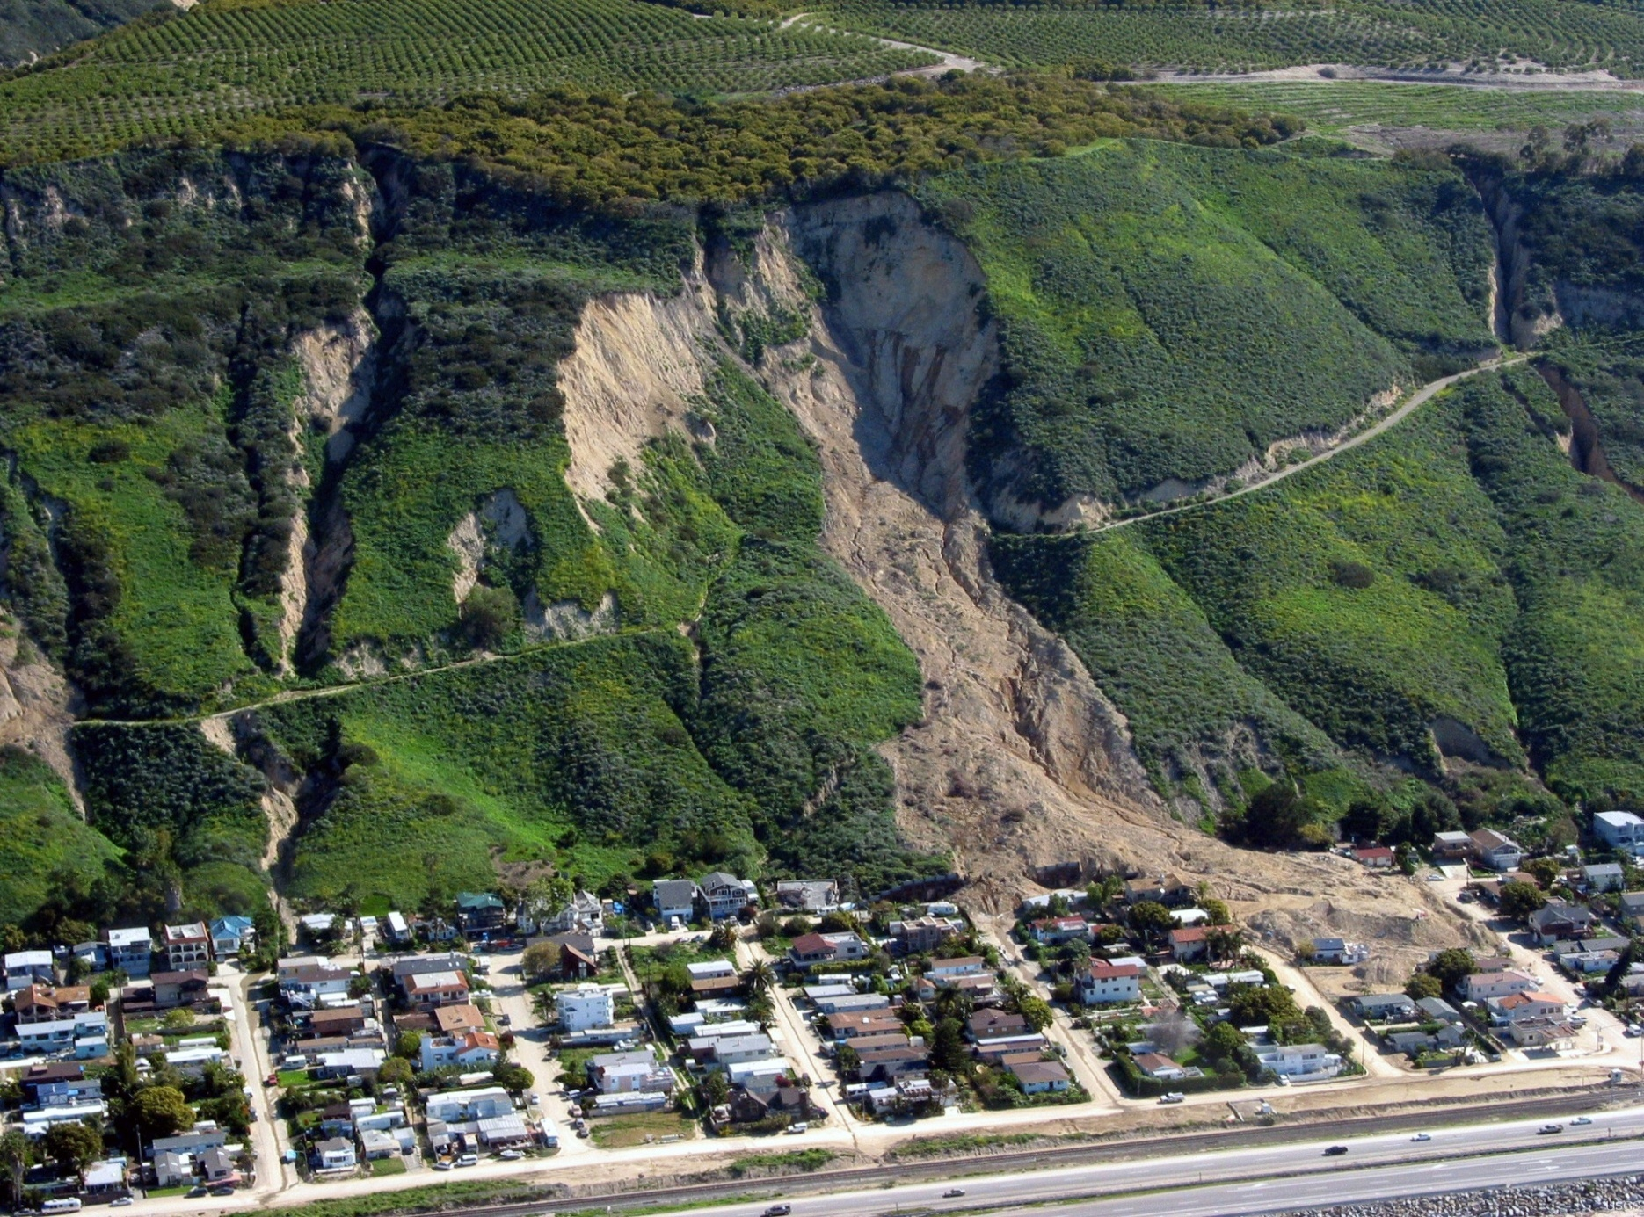
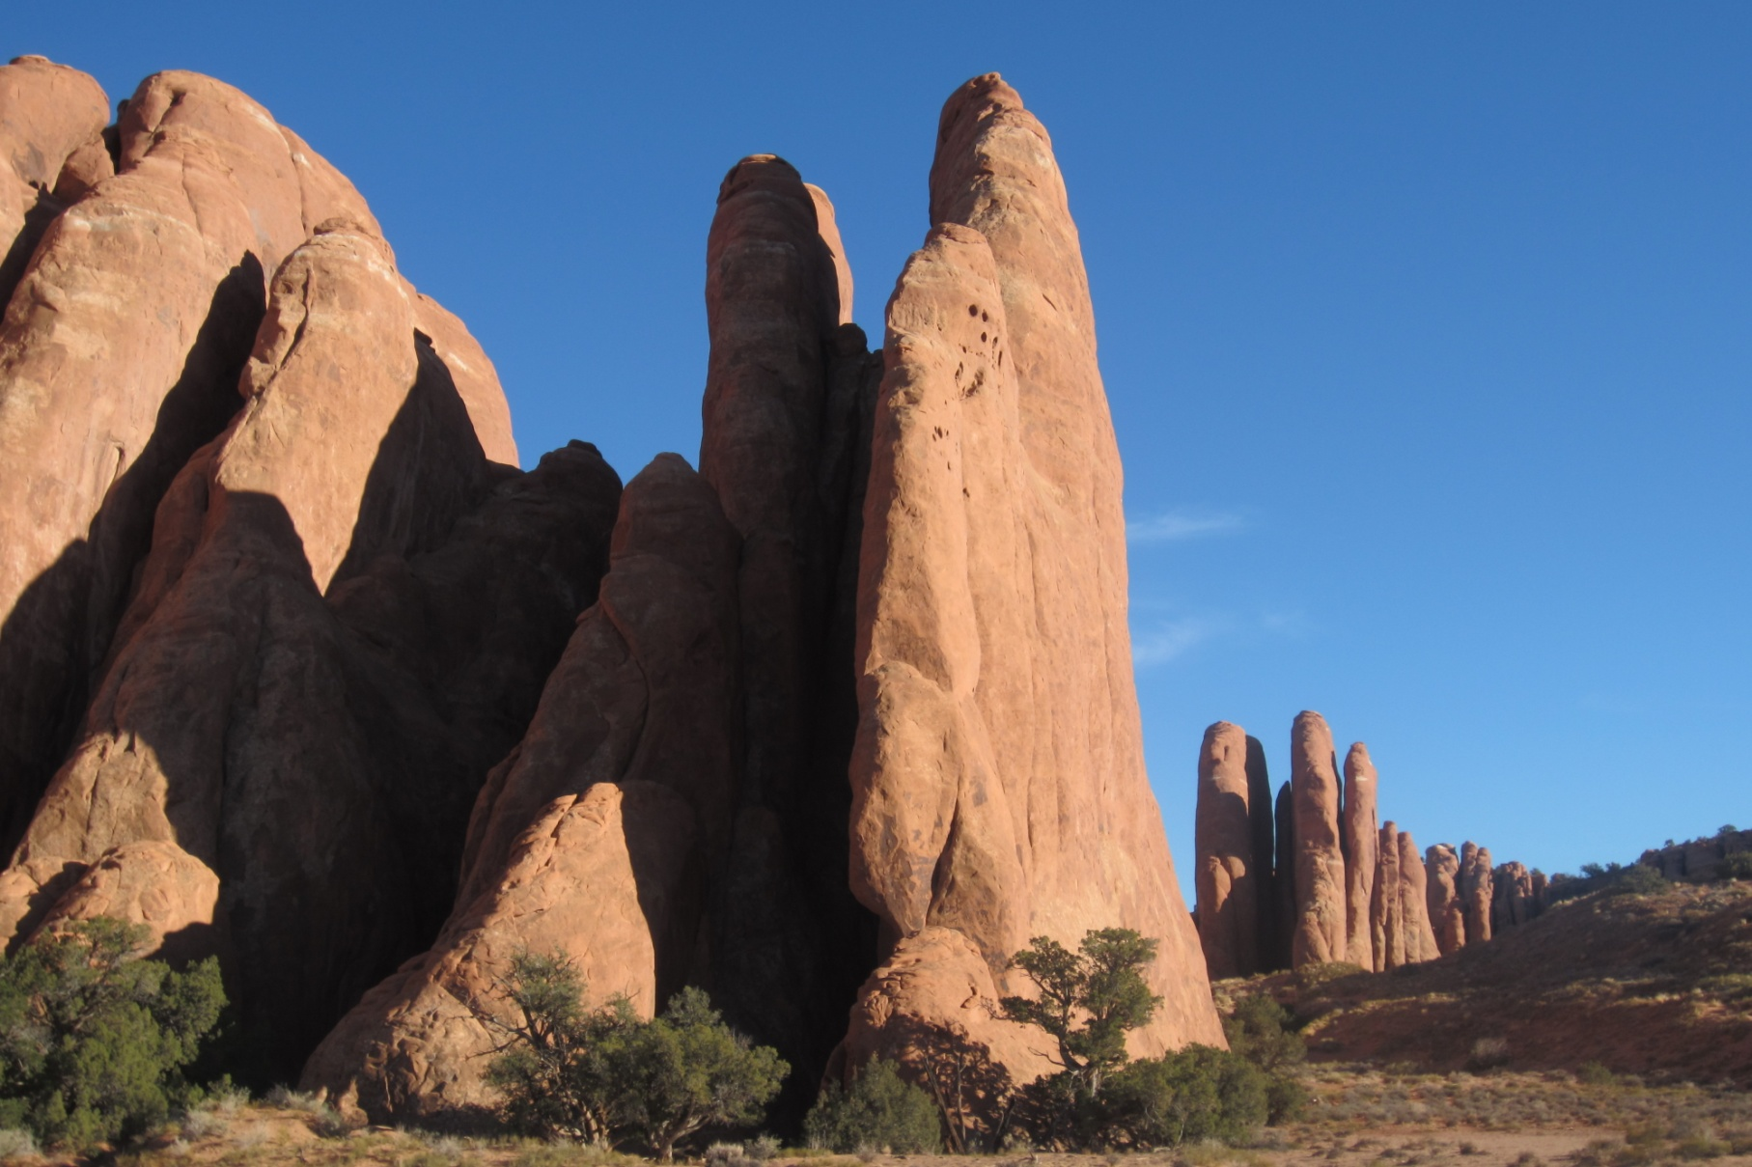
Geomorphology
Notes:
Understanding of geomorphic processes allows us to build and plan development (in theory!)
Understanding why a landscape looks the way it does gives us insight into Earth’s fascinating history…and that of other planets!
Being able to look at a landscape and discern how it came to be enriches our experience as human beings.

