Slide 1

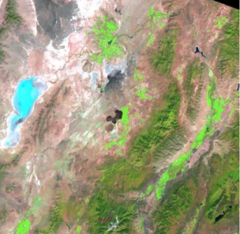

Better Estimation of ET for Efficient Irrigation in Delta, UT using GIS
CEE 6440: GIS in Water Resources
Prepared by: Roula Bachour
(Fall, 2011)

Slide 2
Motivation
Delta is a major agriculture area in the Sevier River Basin, Central Utah
Water in diverted based on requests from the farmers depending on their water shares
Accurate ET estimation are important for water management
Better Estimation of ET for Efficient Irrigation in Delta, UT Using GIS

Slide 3
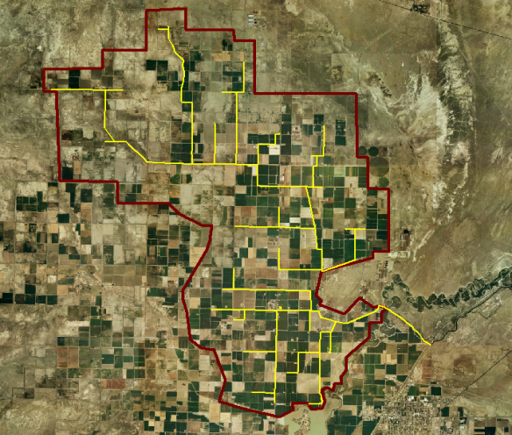
Study Area – Delta, Central UT
Irrigation from: Sevier River
Canal B
Main Crops: Alfalfa, Corn, Barley
Better Estimation of ET for Efficient Irrigation in Delta, UT Using GIS

Slide 4
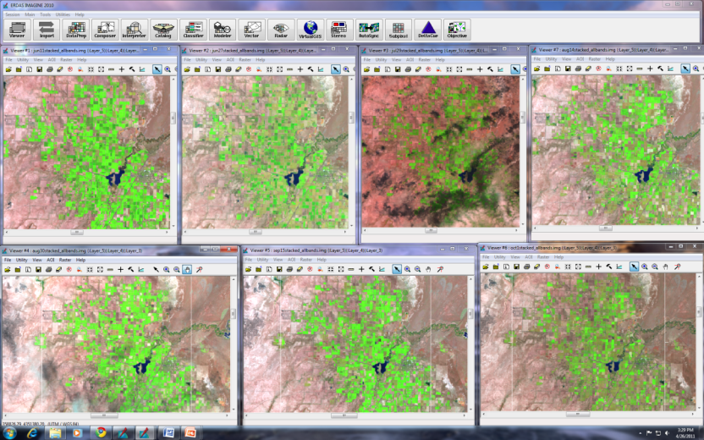
Satellite images (Landsat 5 – TM)
Jun 11
Jun 27
Jul 29
Aug 14
Aug 30
Sep 15
Oct 1
Better Estimation of ET for Efficient Irrigation in Delta, UT Using GIS

Slide 5
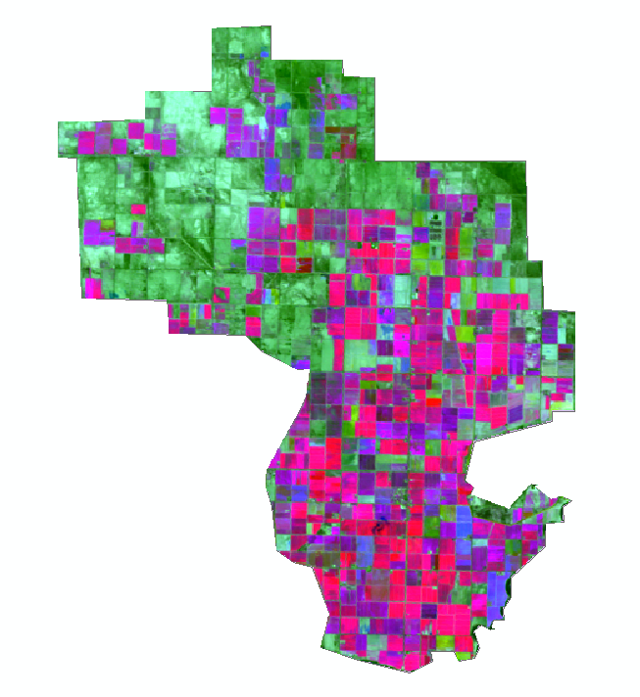

6-bands LANDSAT Image
Using ERDAS Imagine: Stacking bands 4 (NIR) and 3 (RED) for:
- June 11
- June 27
- August 30
Better Estimation of ET for Efficient Irrigation in Delta, UT Using GIS

Slide 6
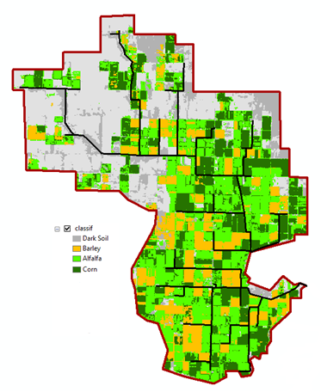
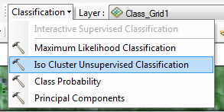
Unsupervised image classification
using ArcGIS
VALUE | CLASS NAME | Area (ha)
1 | Barley | 1,543
2 | Corn | 1,972
3 | Alfalfa | 3,346
4 | Fallow | 3,924
Better Estimation of ET for Efficient Irrigation in Delta, UT Using GIS

Slide 7

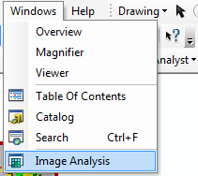
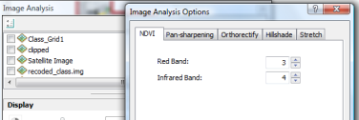
Crop Water Requirements (CWR)
ET_{c} = ET_{o} * K_{c}
Date | ETo (mm/day)
May 1-15 | 4.85
May 16-31 | 5.78
Jun1-15 | 6.15
Jun 16-30 | 8.36
Jul 1-15 | 8.01
Jul 16-31 | 7.94
Aug 1-15 | 7.13
Aug 16-31 | 6.52
Sept 1-15 | 4.73
Sept 16-30 | 4.68
Oct 1-15 | 2.77
Oct 16-31 | 2.61
K_{c} (corn) = 1.37*NDVI – 0.017
K_{c} (alfalfa) = 1.36*NDVI – 0.031
K_{c} (Barley) = 1.25*NDVI – 1.37
(Rocha et al., 2010)
Better Estimation of ET for Efficient Irrigation in Delta, UT Using GIS

Slide 8
Crop Coefficient
Better Estimation of ET for Efficient Irrigation in Delta, UT Using GIS
Notes:
For each date NDVI was extracted using GIS image processing
Kc from linear relationship with NDVI for each crop

Slide 9
Actual ET_{c} for each crop
ET_{c}=ET_{o} x K_{c}
Better Estimation of ET for Efficient Irrigation in Delta, UT Using GIS

Slide 10
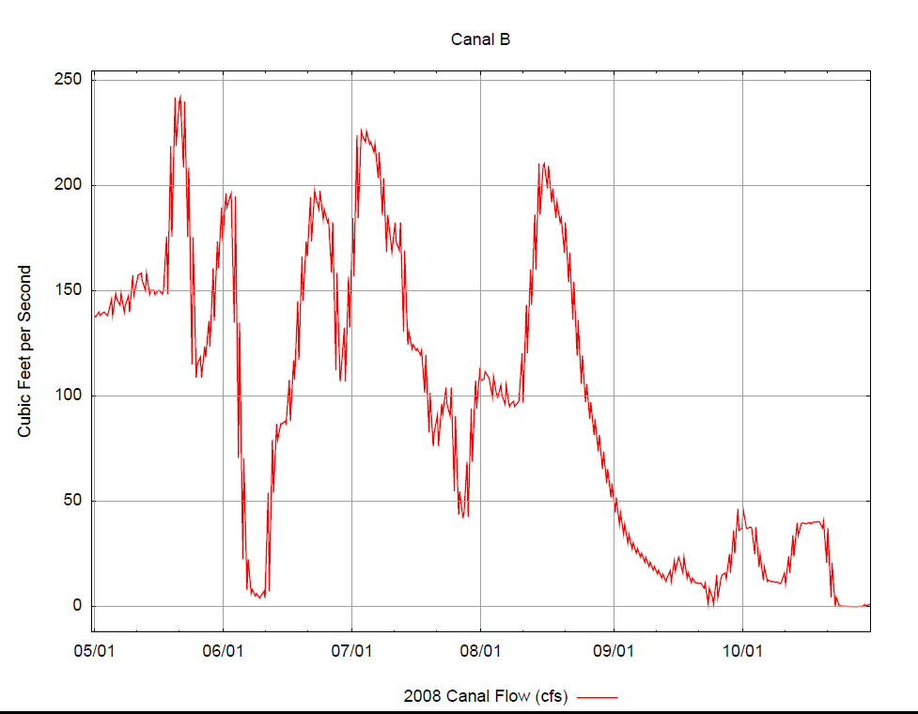

Flow of Canal B
Better Estimation of ET for Efficient Irrigation in Delta, UT Using GIS

Slide 11
Results
Total flow (Q) from canal B for the irrigation season ≈ 49 MCM
Total Crop Water Requirement (CWR) for the irrigated area = 31 MCM
System Efficiency = CWR/Q = 63%
Better Estimation of ET for Efficient Irrigation in Delta, UT Using GIS

Slide 12
Recommendations
Use of remotely sensed data to better estimate ET
Evaluate the portion of the irrigation efficiency (i.e. conveyance, application efficiency…)
Use methods to forecast ET in advance so it helps farmers to estimate their crop water needs.
Better Estimation of ET for Efficient Irrigation in Delta, UT Using GIS

Slide 13
References
http://climate.usurf.usu.edu/products/data.php
http://glovis.usgs.gov/
http://sevierriver.org/rivers/delta/b-canal/
Rocha. J., A., Perdigao, R. Melo, and C. Henriques (2010). Managing Water in Agriculture through Remote Sensing Applications. Remote Sensing for Science, Education and Natural and Cultural Heritage, 223-230
Thank You!
Better Estimation of ET for Efficient Irrigation in Delta, UT Using GIS

