Slide 1
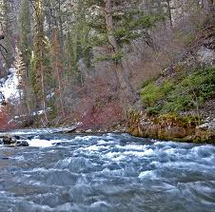
Analysis of the Snow Water Equivalent (SWE) in the Logan River Watershed
Paul Ackerson
CEE 6440

Slide 2
Objective
Provide evidence that SWE is related to elevation.
Estimate spring runoff based on SWE buildup.

Slide 3
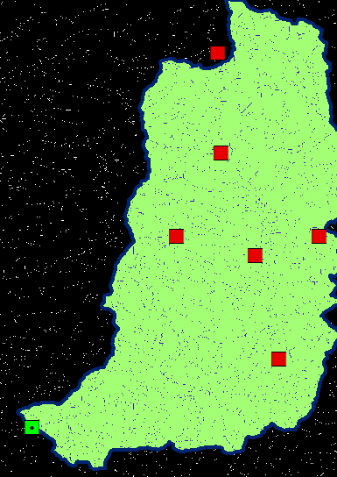
Building the Logan River Catchment
Seamless data from USGS to obtain DEM
Obtaining stream flowline from NHDPlus
Fill
Flow direction
Flow Accumulation
Outlet
Watershed
Raster to Polygon
Tabulated Area (211 Mi.²)

Slide 4
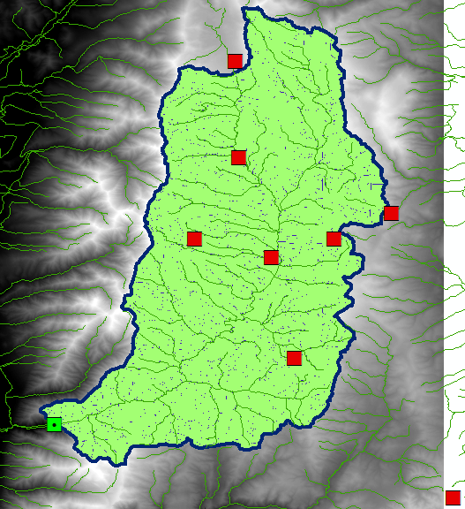
Logan River Basin

Slide 5
Snow Water Equivalent
Data obtained (SWE) from NRCS
8 Station data
Found average SWE for each day
Took average for Feb. 1, Feb 15, Mar.1 Mar, 15…
Plotted each series with corresponding date
Found that SWE was related to elevation
SWE = a + bz

Slide 7
Theory of Elevation

Slide 8
Relating SWE to flow

Slide 9
Work to be done
Interpolate the SWE over the watershed using kriging function
Show relationship of SWE = a + bz in different maps at different time of the year
Estimate total SWE storage for entire Logan River Catchment

Slide 10
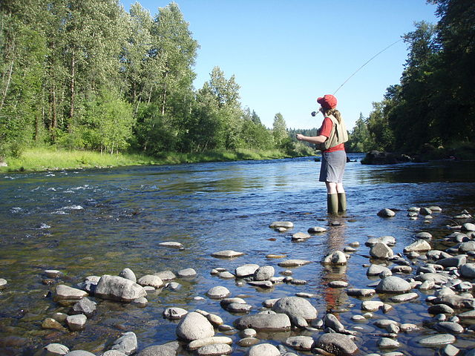
Thanks!
Questions?

