Slide 1
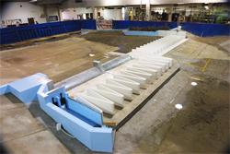
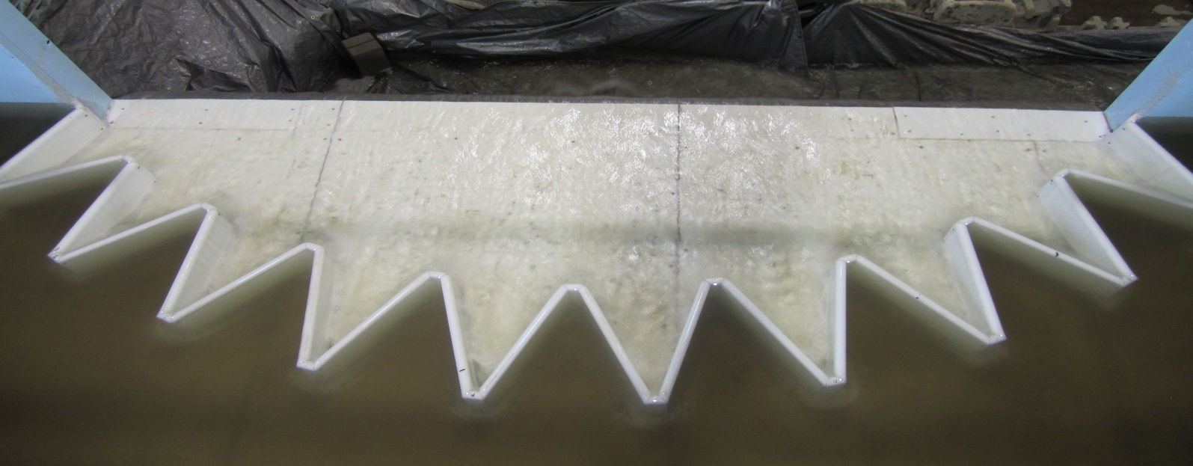
Labyrinth Weir Flow Analysis & Maps
By Nate Christensen

Slide 2
Introduction -
Lake Brazos Dam & 19th Street Spillway
Five Labyrinth Weirs in Texas region
Unique applications (measure flow rate, control floods, alter flow regime)
Understand flow conditions

Slide 3
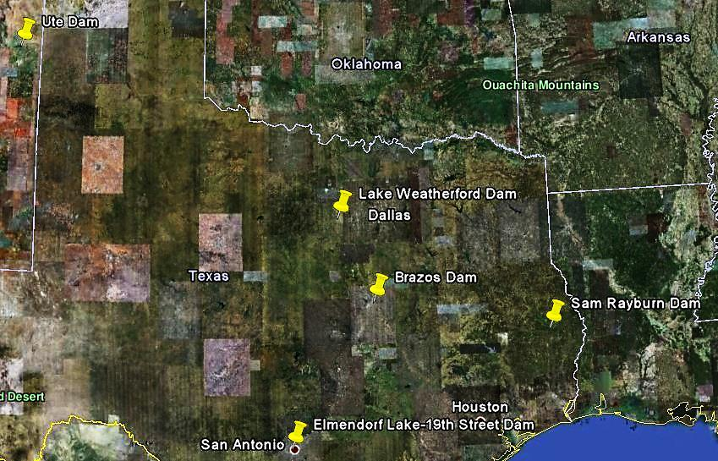
Objectives -
Delineate Watersheds at each weir
Determine flow accumulation & compare to stream flow data
Hydrographs, Cross-sections, & maps
Feasibility of ArcGIS as a design tool for labyrinth weirs

Slide 4
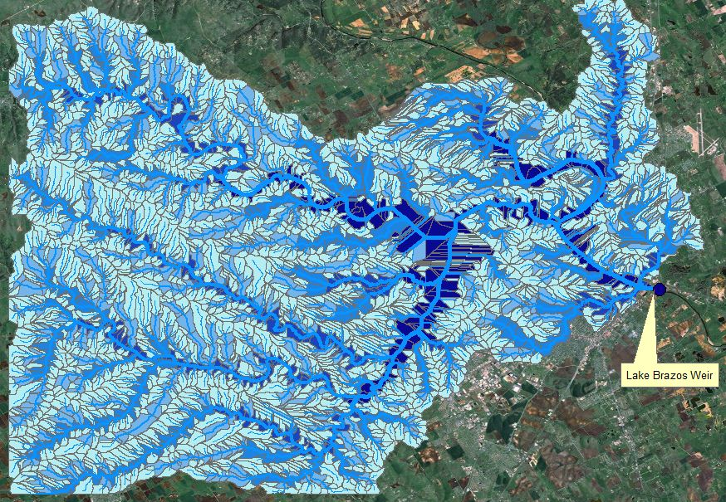
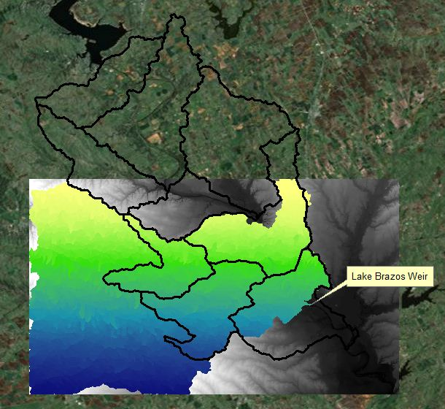
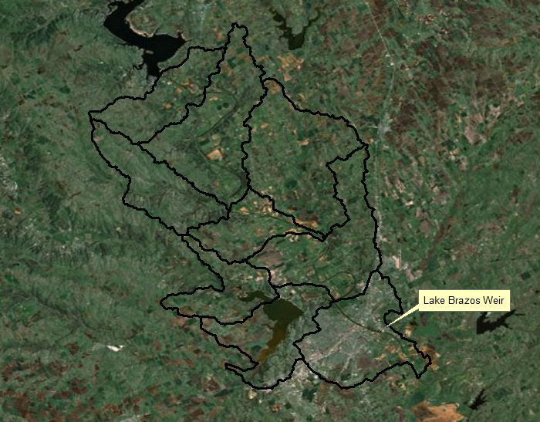
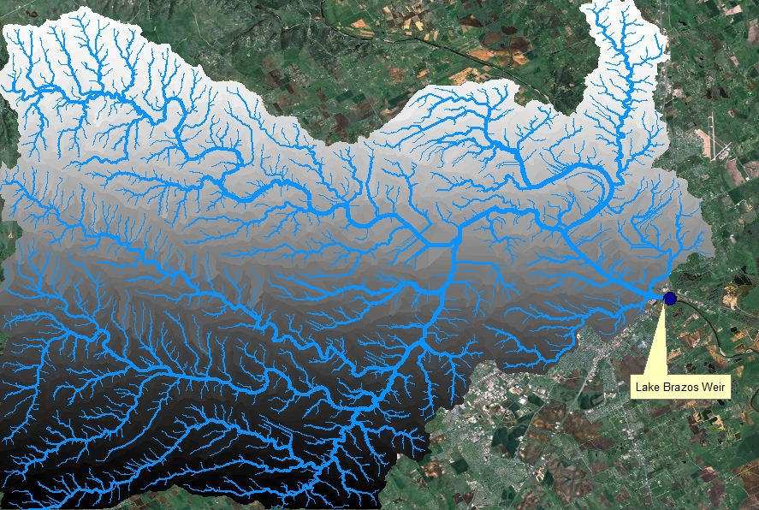
Watersheds – Texas State Plane Coordinates
Lake Brazos Dam – large scale project w/Grid Network
Mean Annual Flow = 1500 cfs

Slide 5
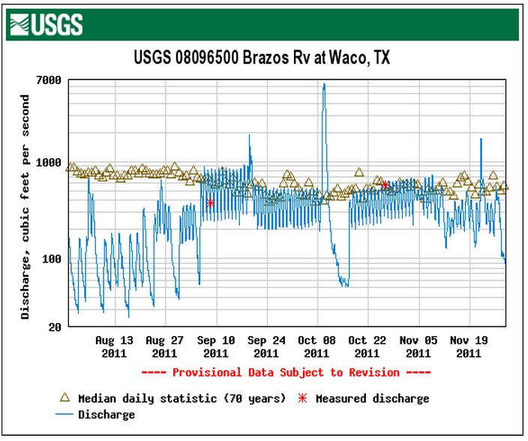
Flow Comparison -

Slide 6
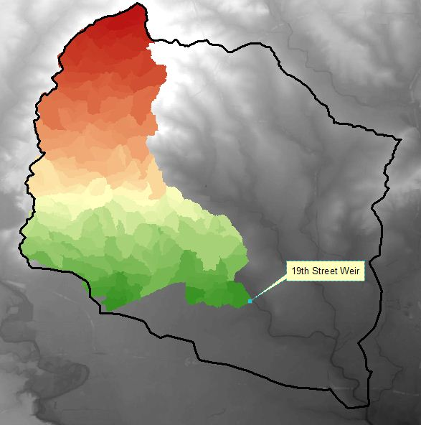
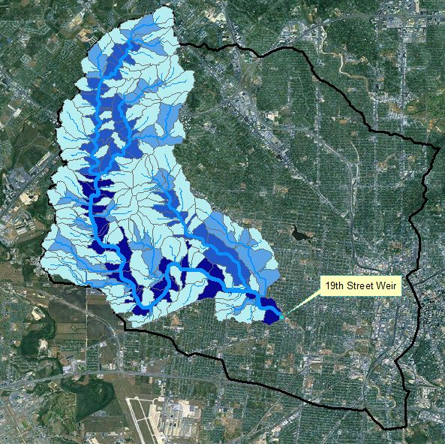
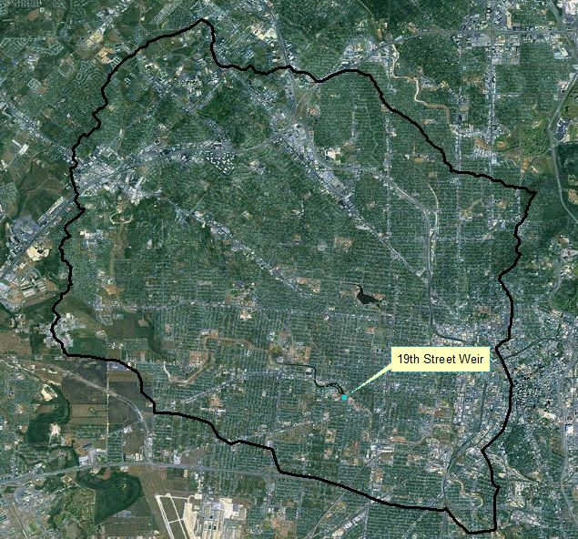
Watersheds – Texas State Plane Coordinates
19th Street Spillway – small scale project w/Grid Network
Mean Annual Flow = 15 cfs

Slide 7
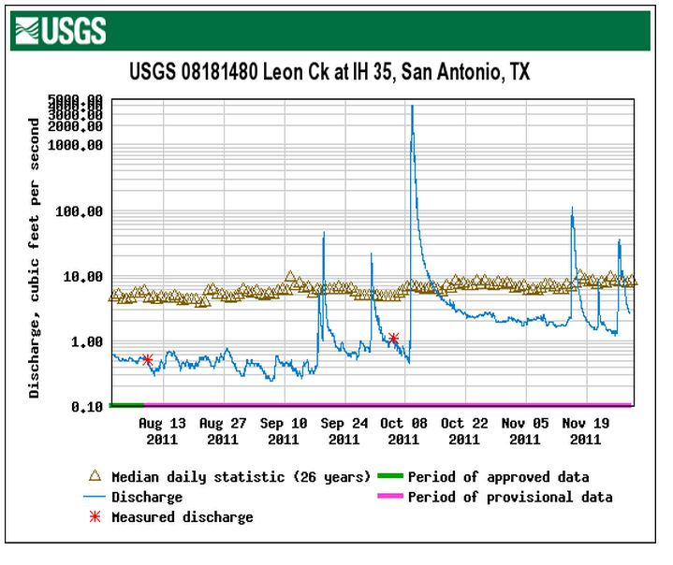
Flow Comparison -

Slide 8
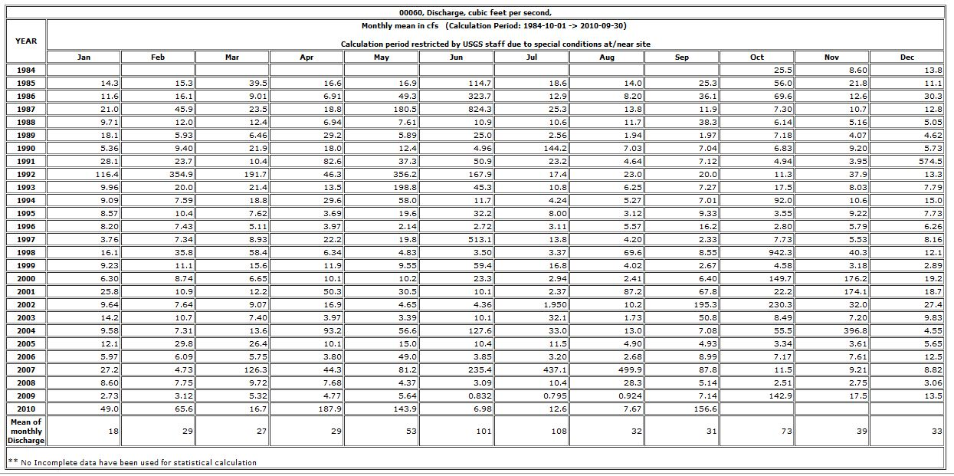
Flow Hydrograph - http://waterdata.usgs.gov/nwis/

Slide 9
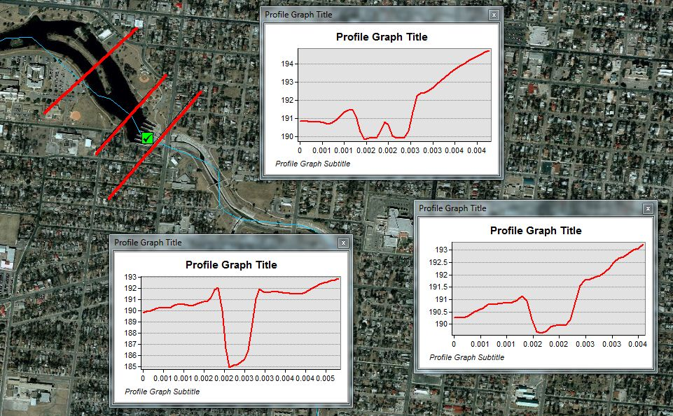
CrossSections – Elmendorf Lake

Slide 10
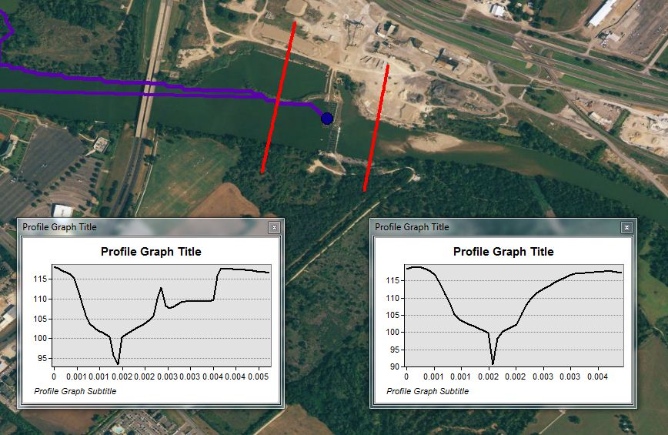
CrossSections – Lake Brazos

Slide 11
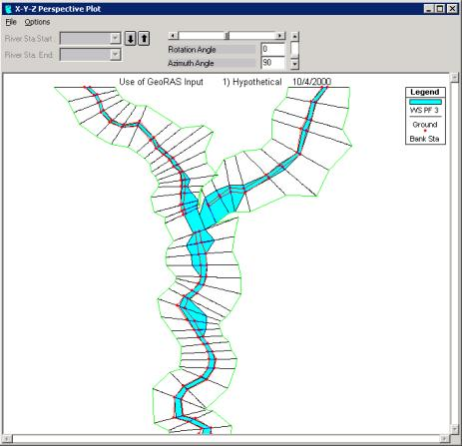
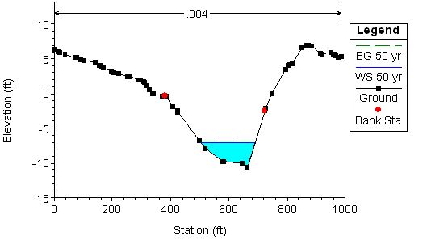
Design Possibilites -

Slide 12
Work To Be Done -
Tabulate the error in flow calculations
Look at Aquifer/spring water in watersheds
Look at land-use maps to establish danger zones
Maybe run a HEC-RAS model
(time pending)
GIS can be a handy design tool

