Slide 1
Optimizing Crop yield Using ET Maps and in GIS in Delta,UT
Leila Esfahani
GIS in Water Resources
CEE 6440
11/29/2011

Slide 2
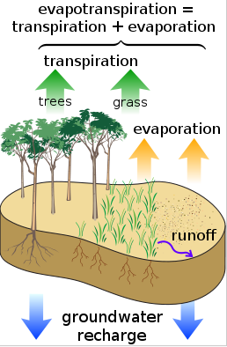
Introduction evapotranspiration?
Apart from precipitation, the most significant component of the hydrologic budget is evapotranspiration.
Evapotranspiration varies regionally and seasonally; during a drought it varies according to weather and wind conditions.

Slide 3
Project objective
To maximize benefits from selling the crops
By considering
Water share (canal B)
Crop type
Crop water demand (ET maps)
Crop market

Slide 4
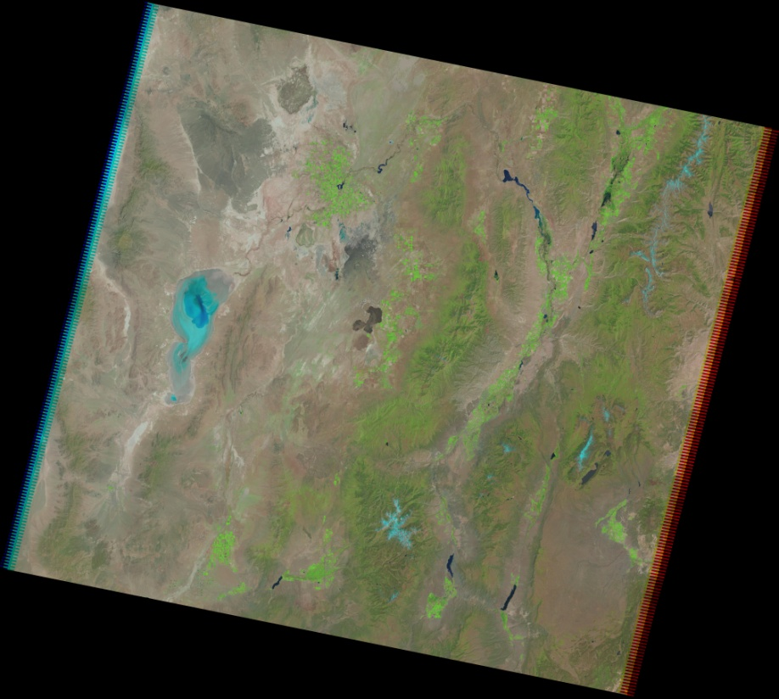
Data and Methodology
Landsat data (4-5 TM) were downloaded from: http://glovis.usgs.gov/ Date: 2010/6/17

Slide 5
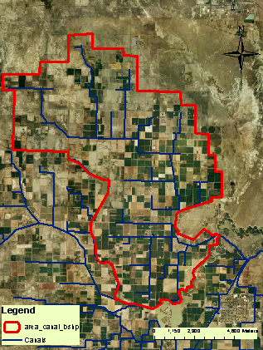
Delta
Delta is a city in Millard County, Utah, United States which is a major agriculture area in the Sevier River Basin.

Slide 6
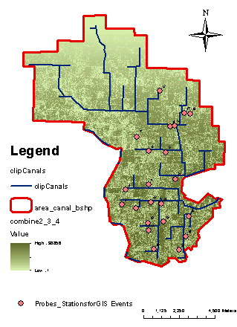
3-bands LANDSAT Image
Crop installed 2010
Field A | Field B
B | B
B | B
C | C
B | B
A | A
A | A
A | C
A | A
A | A
A | A
B | B
Crop installed 2010
Field A | Field B
B | B
B | B
C | C
B | B
A | A
A | A
A | C
A | A
A | A
A | A
B | B

Slide 7
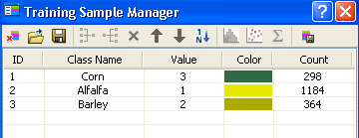
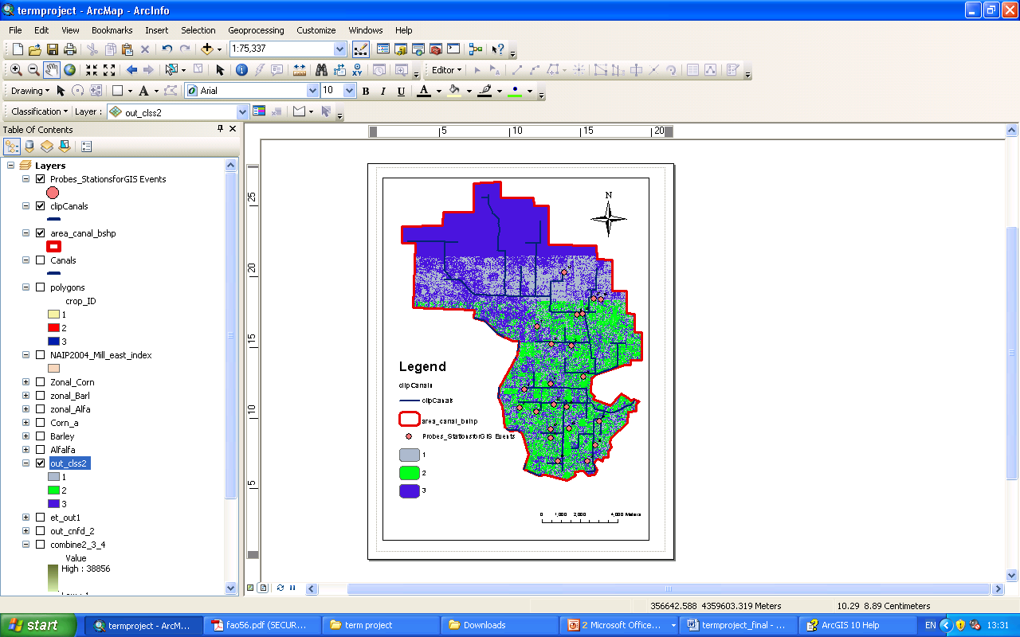
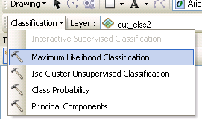
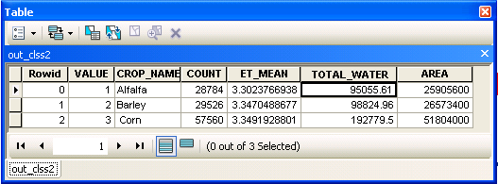
Unsupervised image classification
1→Alfalfa
2→Barley
3→Corn

Slide 8
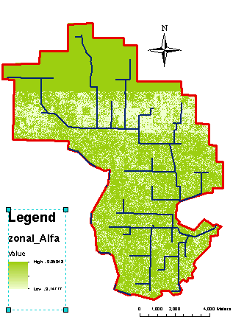
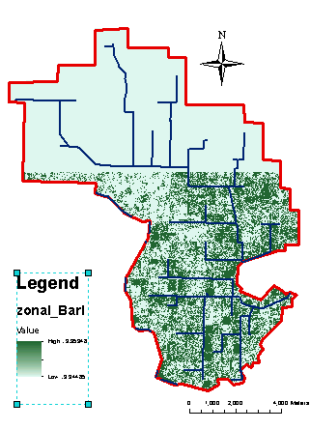
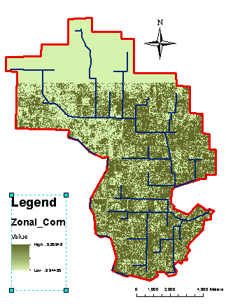
Zonal Statistics
Crop | Maximum Yield | Maximum ET | Actual ET | Yield Response Factor | Cost | Area
 | Ton/acres | mm/day | Mm/day | - | $/ton | acres
Alfalfa | 20 | 3.353 | 3.3024 | 0.9 | 99.97 | 6401.41
Barley | 5 | 3.353 | 2.3470 | 1.07 | 158.38 | 6566.43
Corn | 8.5 | 3.353 | 3.3492 | 1.25 | 186 | 12801.05

Slide 9
Optimization:
When water supply does not meet crop water requirements, actual evapotranspiration (ETa) will fall below maximum evapotranspiration (ETm) or ETa < ETm. Under this condition, water stress will develop in the plant which will adversely affect crop growth and ultimately crop yield.
finding a way to minimize decrease in yield will conclude to maximize benefits from selling the crops. In this study LINGO optimization software is used to maximize benefits by using yield function basis as an objective function.

Slide 10
Yield Function
describes the relationship between irrigation water and crop yield under the assumption of optimal irrigation scheduling

Slide 11
Results
Crop | Maximum Yield | Maximum ET | Actual ET | Yield Response Factor | Cost | Area
 | Ton/acres | mm/day | Mm/day | - | $/ton | acres
Alfalfa | 20 | 3.353 | 3.3024 | 0.9 | 99.97 | 6401.41
Barley | 5 | 3.353 | 2.3470 | 1.07 | 158.38 | 6566.43
Corn | 8.5 | 3.353 | 3.3492 | 1.25 | 186 | 12801.05
Decision Variable | Optimal Value (ton/acres) | Optima Solution ($)
Y_a | 1.21 | 2971397
Y_b | 1.65
Y_c | 2.01

Slide 12
References
http://glovis.usgs.gov/
http://en.wikipedia.org/wiki/Evapotranspiration
http://www.fao.org/landandwater/aglw/cropwater/parta.stm
http://help.arcgis.com/en/arcgisdesktop/10.0/help/index.html#//00qp0000000v000000.htm
Thank you

