Slide 1
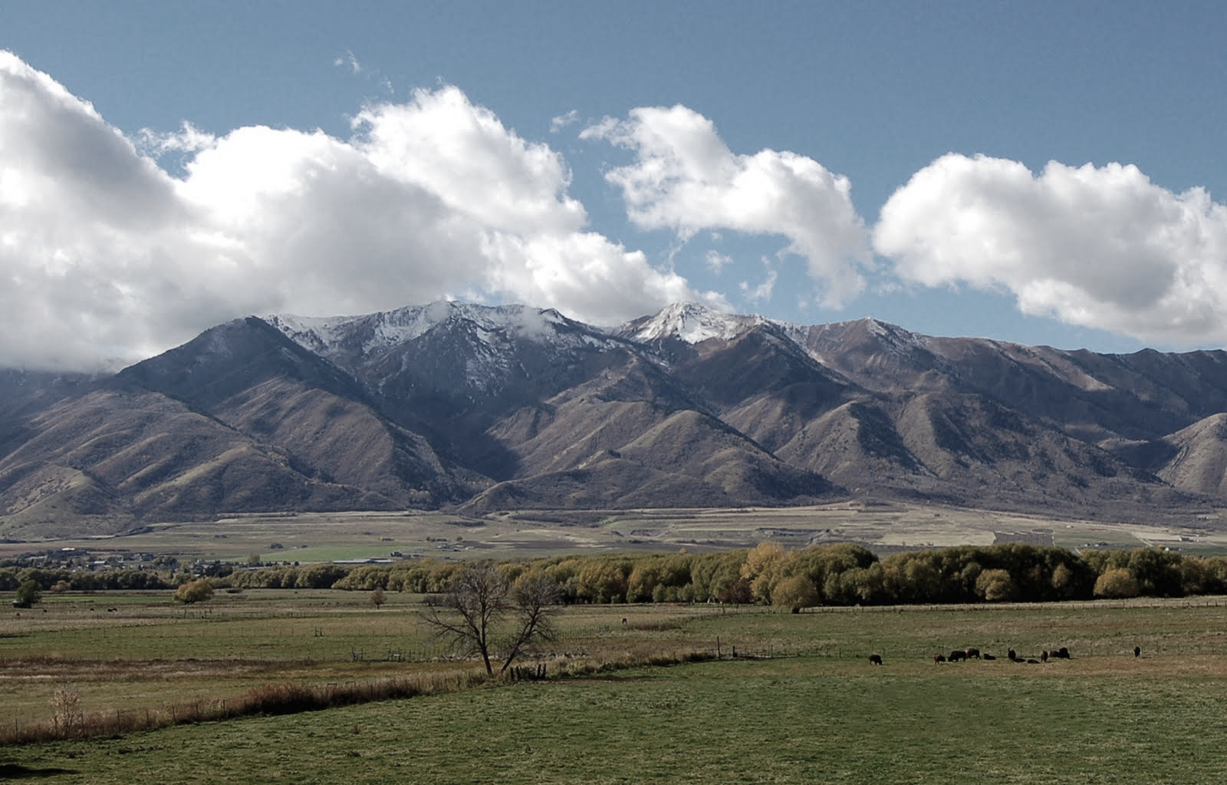
Correlation Between Stream Flows and Land Use in Cache County, UT
Erin Whyte
Utah State University
November 21, 2011
http://www.ridingandwritingutah.com/2010_06_01_archive.html
Notes:
http://www.ridingandwritingutah.com/2010_06_01_archive.html

Slide 2
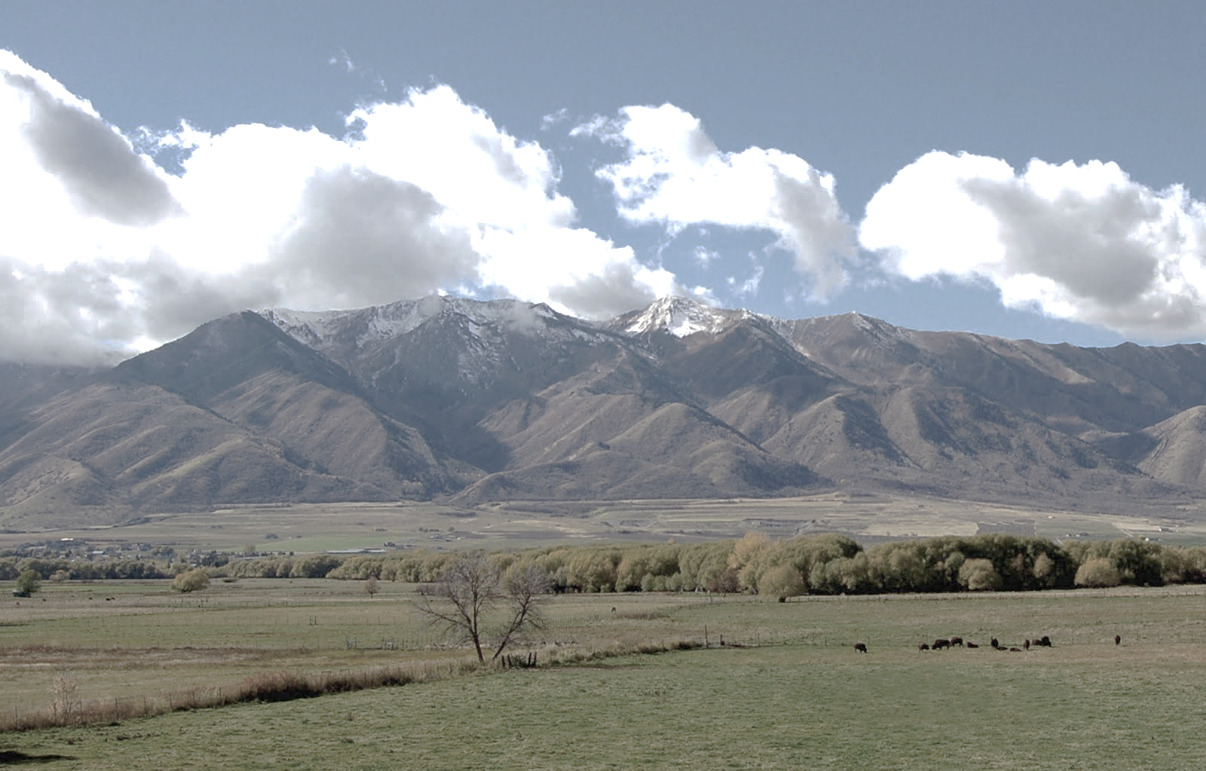
Project Goals and Overview
Goal: Determine if there is any correlation between stream flows and land use in Cache County
Data collection and analysis
Stream flows
Land use and changes
Notes:
http://goldens.wordpress.com/2007/02/21/barley-field/

Slide 3
Data Collection
U.S. Census
  Population
  Housing Units
Public Utilities
  Logan City
  Smithfield City

Slide 4

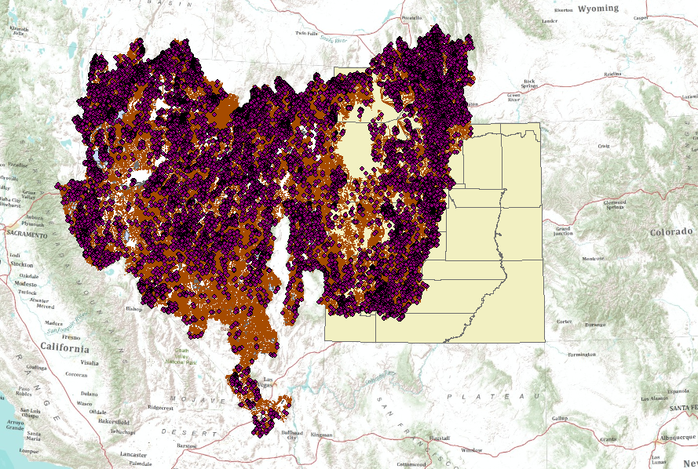
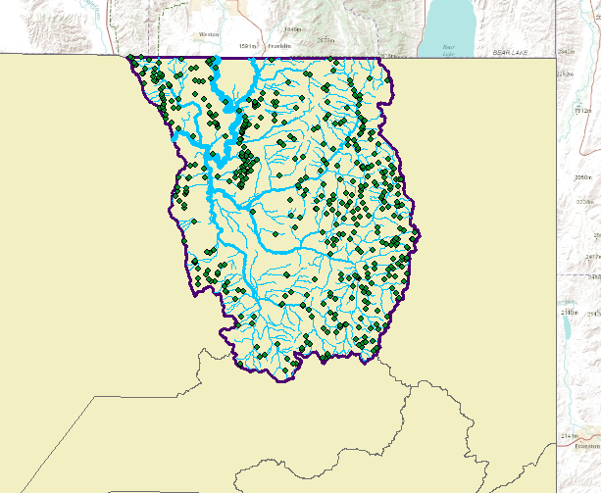
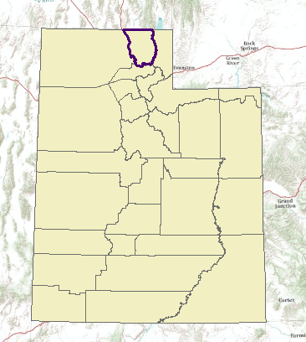
Stream Flows

Slide 5
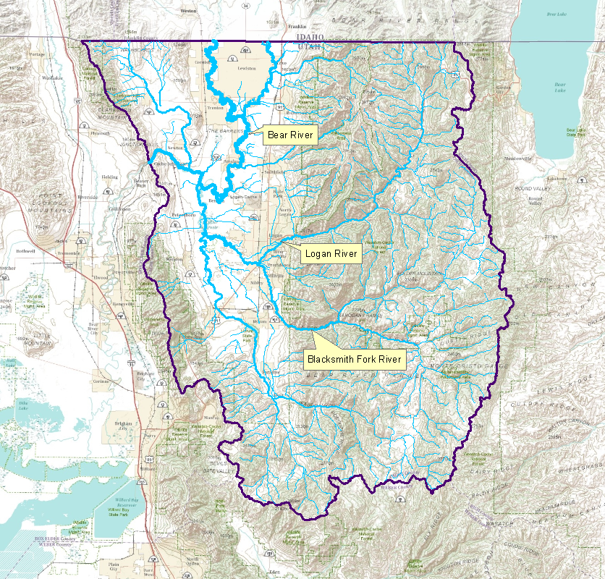
Mean Annual Stream Flow

Slide 6
Mean Annual Stream Flow

Slide 7
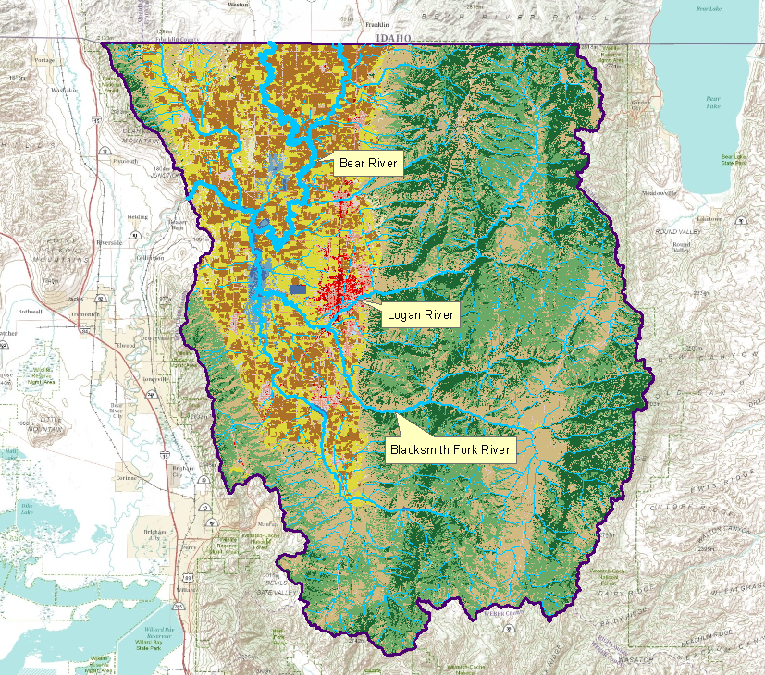
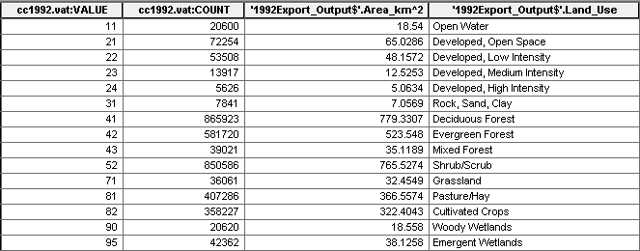
1992 Land Cover

Slide 8
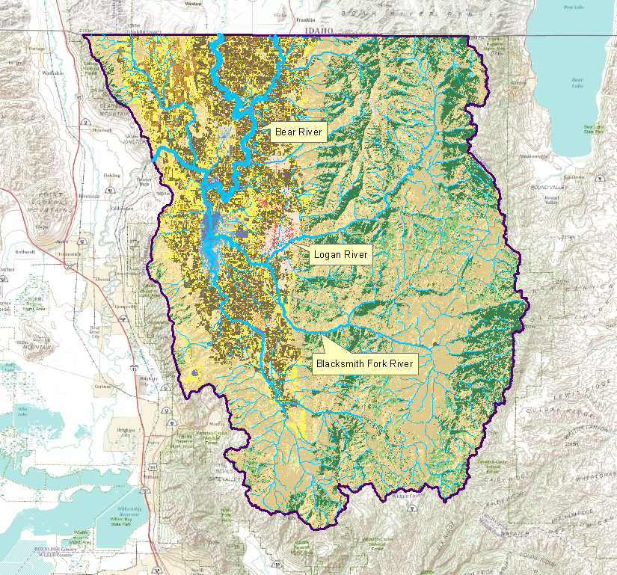
2001 Land Cover

Slide 9
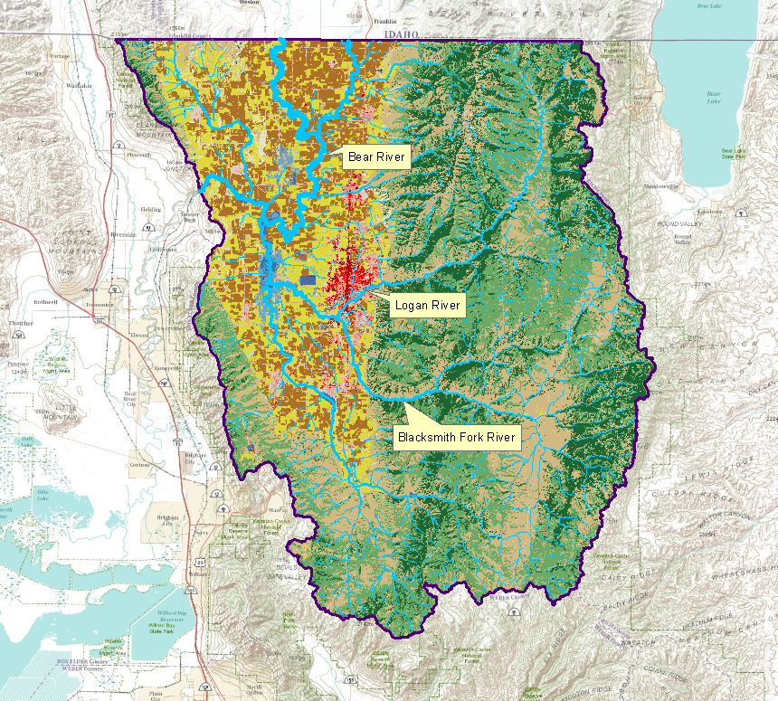
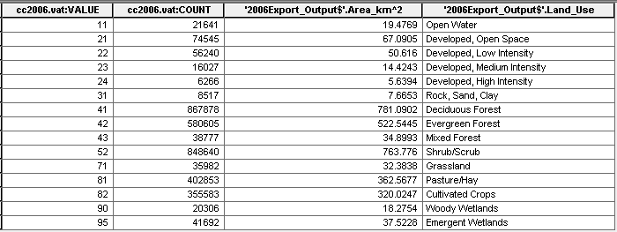
2006 Land Cover

Slide 10
Land Cover Comparison

Slide 11
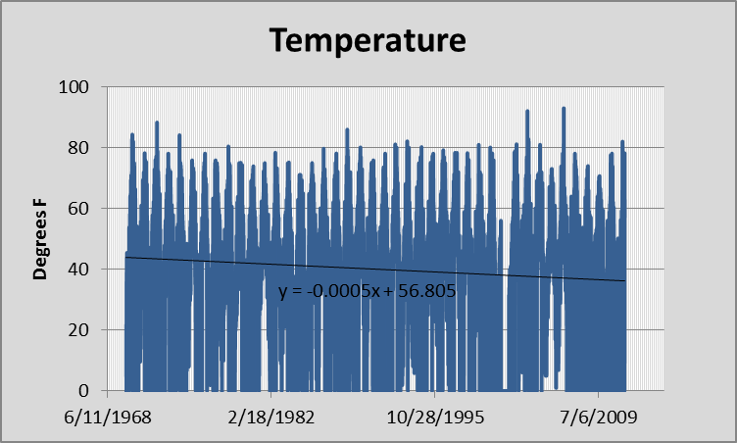
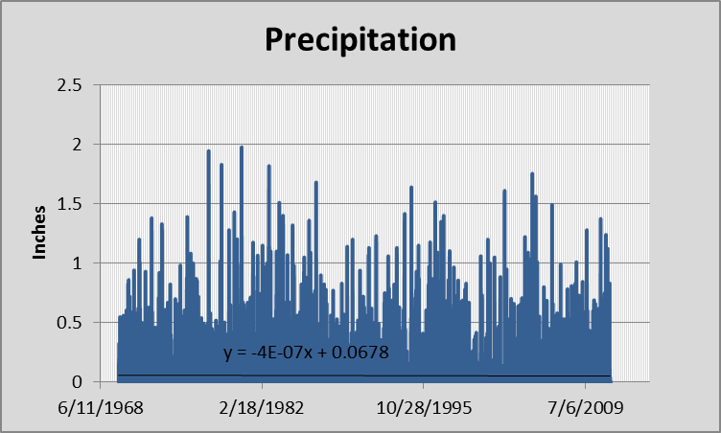
Temperature &
Precipitation Data

Slide 12
Summary
Population of Cache County is increasing
Land use is changing:
  Urban areas increasing
  Open areas decreasing
Stream flows are decreasing

