Slide 1
A GIS model for locating climatically sensitive trees in northern Utah
Eric Allen
Fall 2011
GIS 6440

Slide 2
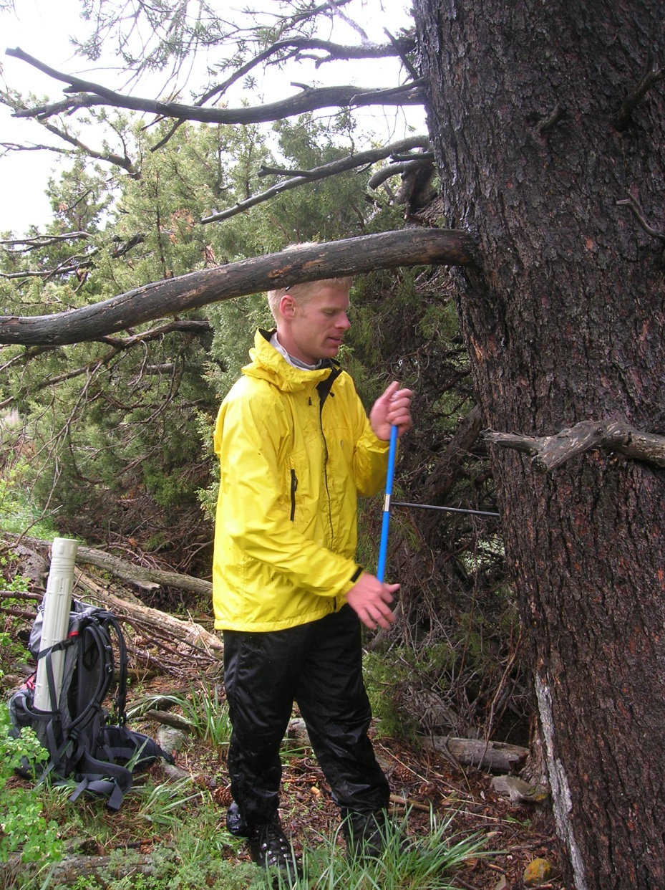
Outline
Dendroclimatology
Methods
Calibration
Making the model
Verification
Conclusion

Slide 3
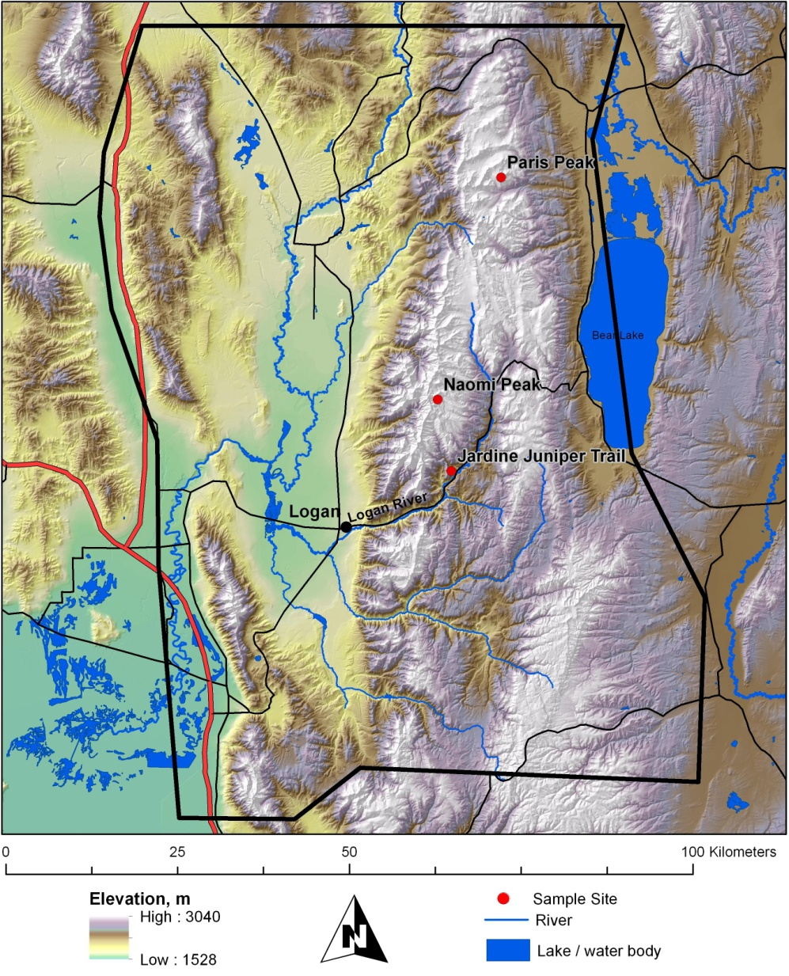
Dendroclimatology
Dendroclimatology
Locating sensitive trees
South facing
Steep slope
Elevation
Sample Sites
JJT
NAO
PAR

Slide 4
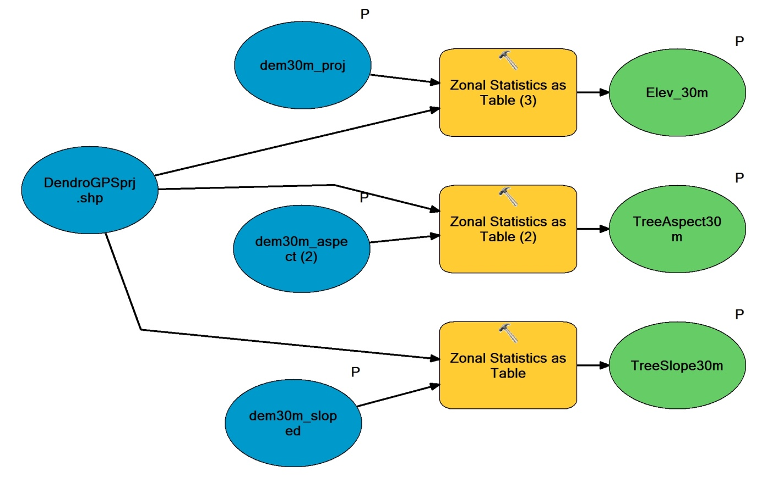
Methods: Data
Tree GPS data
DEM:
Elevation
Slope
Aspect

Slide 5
Methods: Calibration

Slide 6
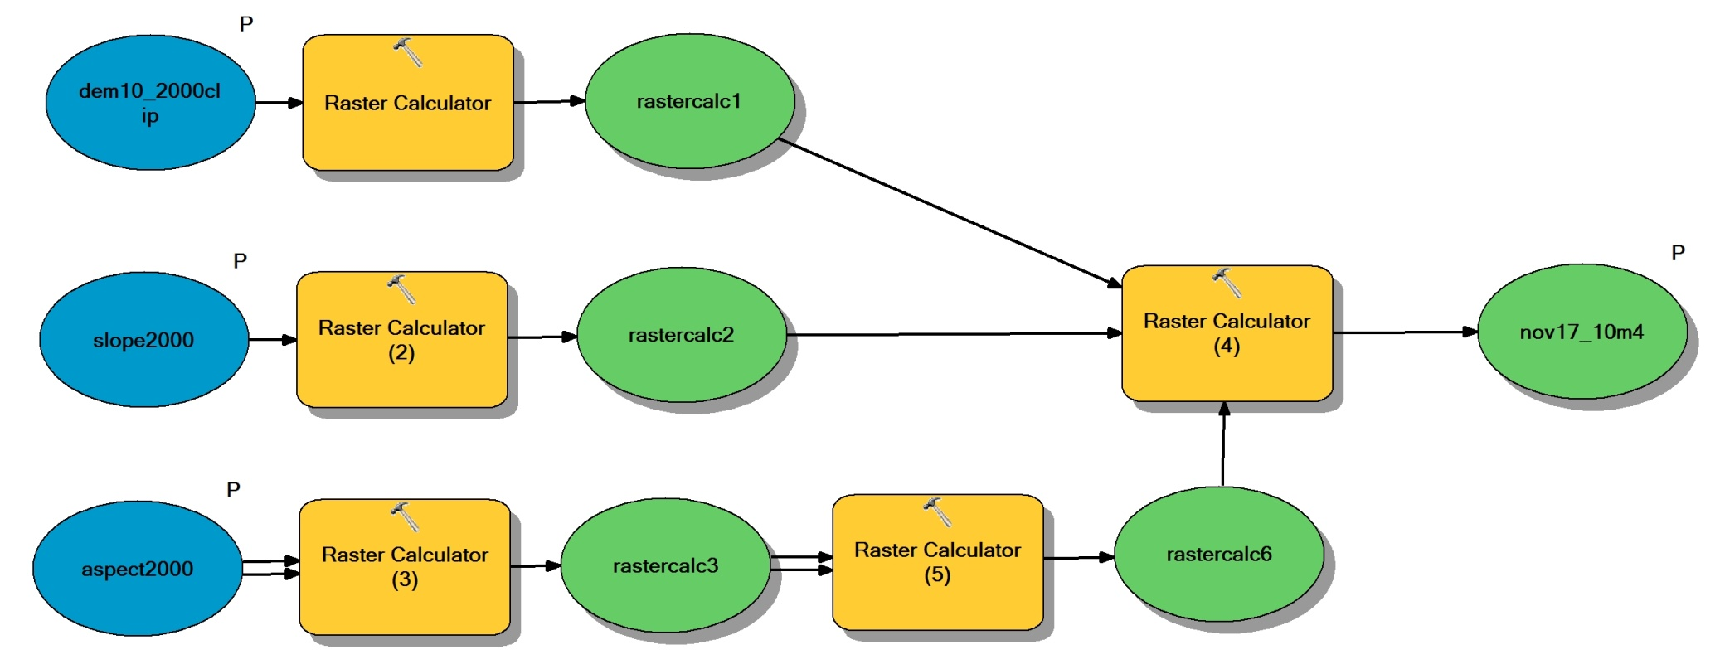
Methods: Making the Model

Slide 7
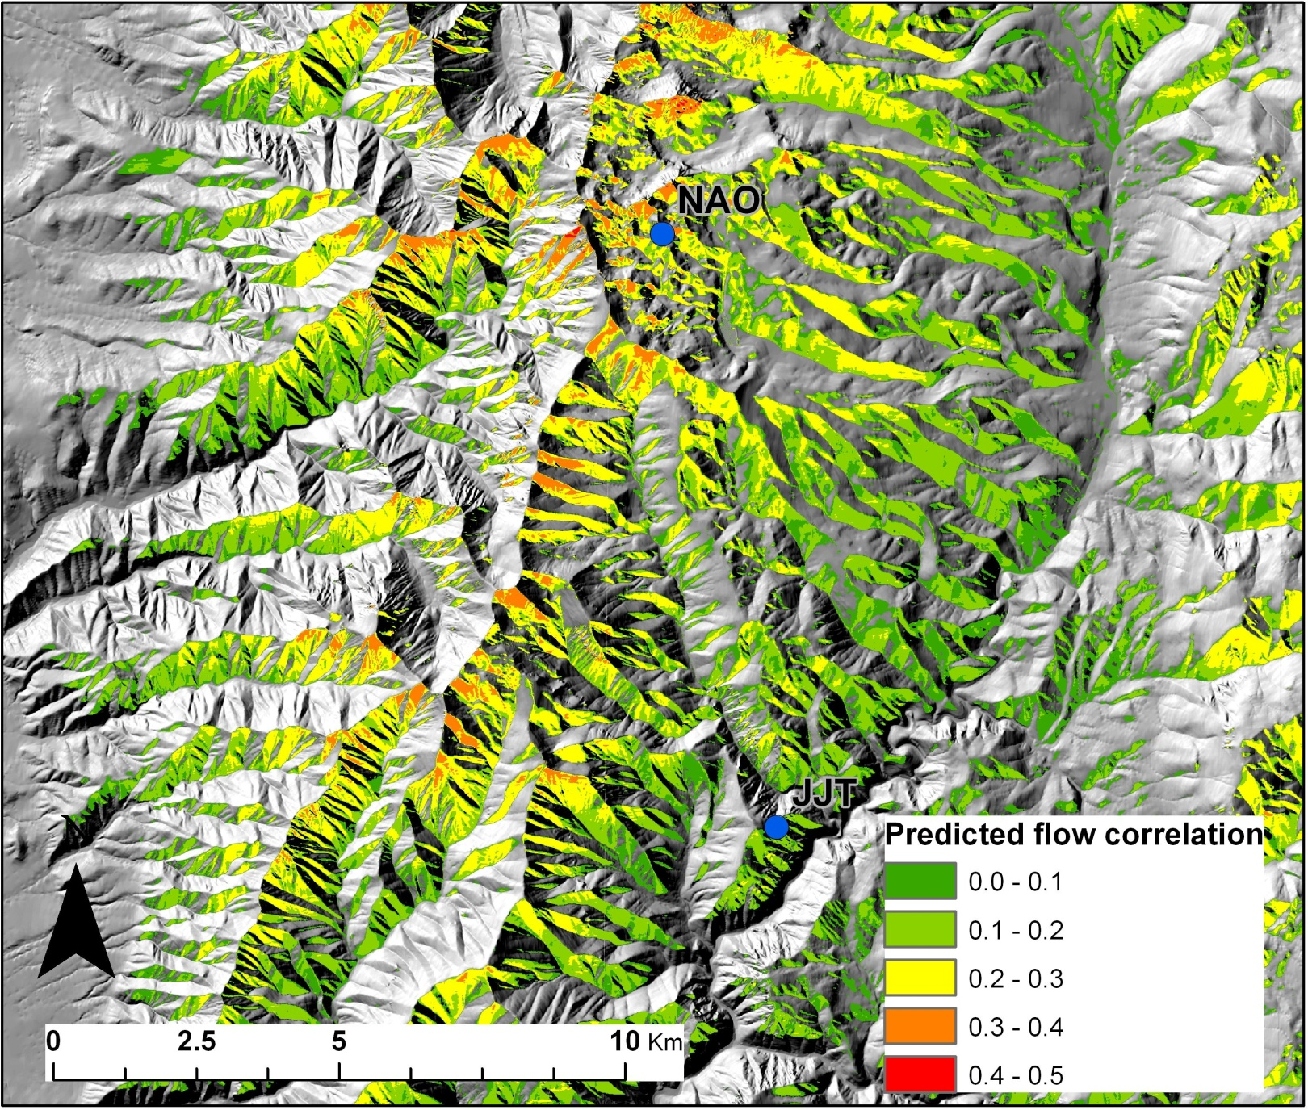
Results: The Model

Slide 8
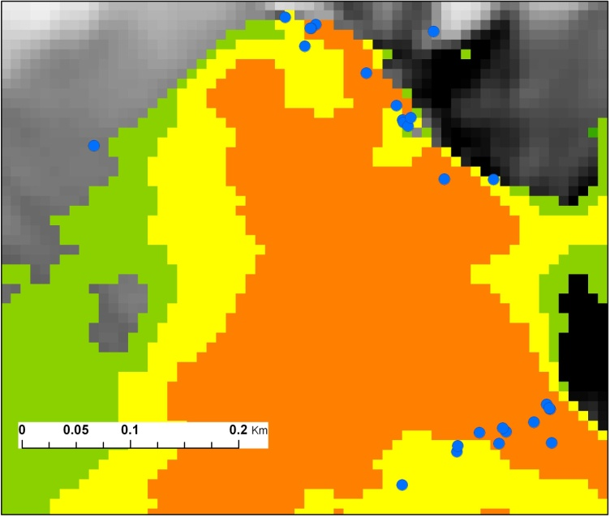
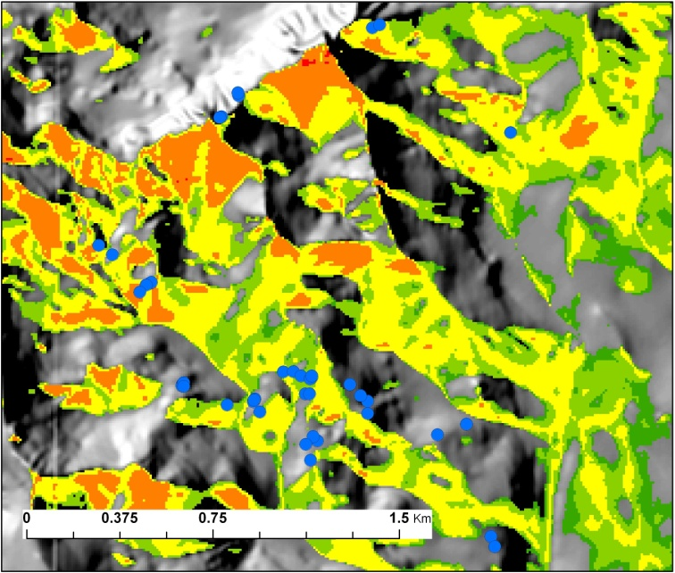
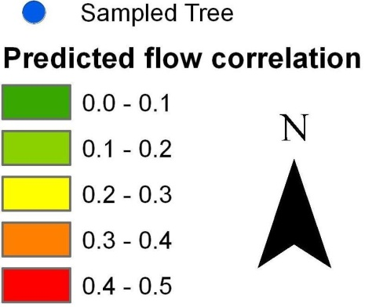
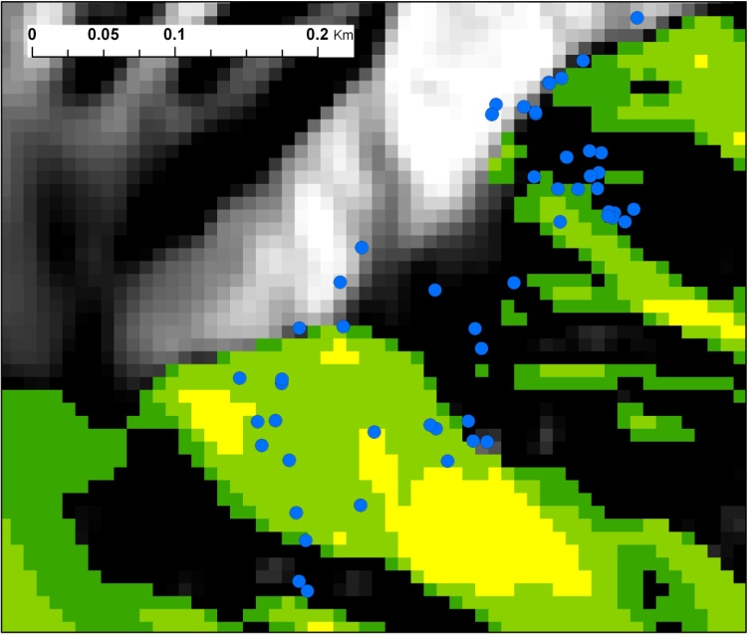
Verification
PAR
NAO
JJT

Slide 9
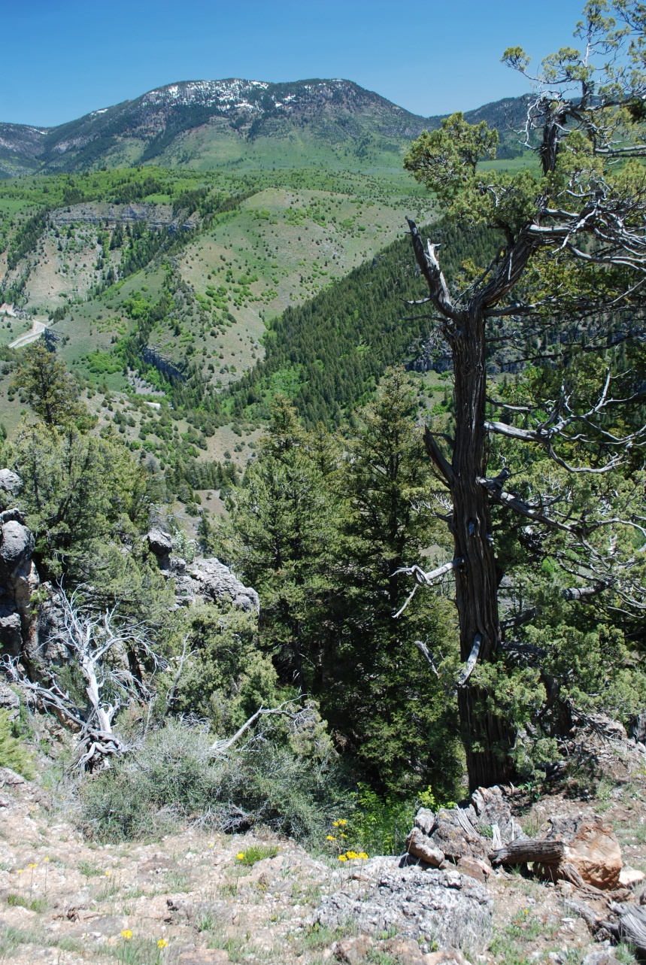
Conclusion
Predicted sampled sites
Relies on field data
Use to inform site search

Slide 10
Sources
USGS National Map
USGS gage 10109001 (Logan River)
Fritts, H.C., 1976, Tree Rings and Climate, Academic Press, London, 557pp.

