Slide 1
Water Quality Analysis for Selected Streams in Utah and Idaho
Ruba Mohamed
GIS in Water Resources
CEE 6440
11/23/2010

Slide 2
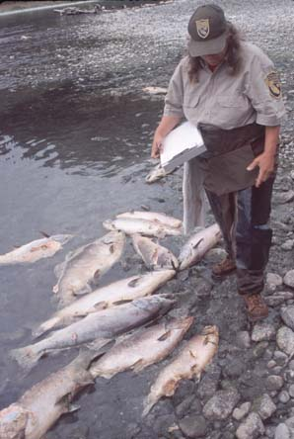
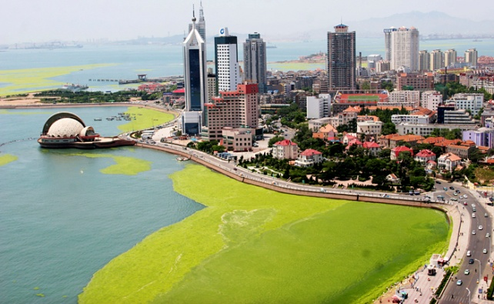
Why we care ?
Water quality affects:
Fish and aquatic organisms
Aesthetics

Slide 3
Study Purpose
Is to use ArcGIS to estimate the phosphorous load on the streams using the landuse data and loading rates from literature
The streams are:
Bear River, UT, ID and WY
Logan River, UT and ID
Spring Creek, UT
Little Bear River, UT

Slide 4
How I used ArcGIS!

Slide 5
Selection of Streams, Watersheds, and flow monitoring points. Data are obtained from USGS (2010)
Displaying Land use data obtained from USGS (2010)
Create subwatershed for Little Bear River and Logan River using the TauDEM command line script from the USU TauDEM webpage and the Command prompt, DEM data obtained from USGS (2010)

Slide 6
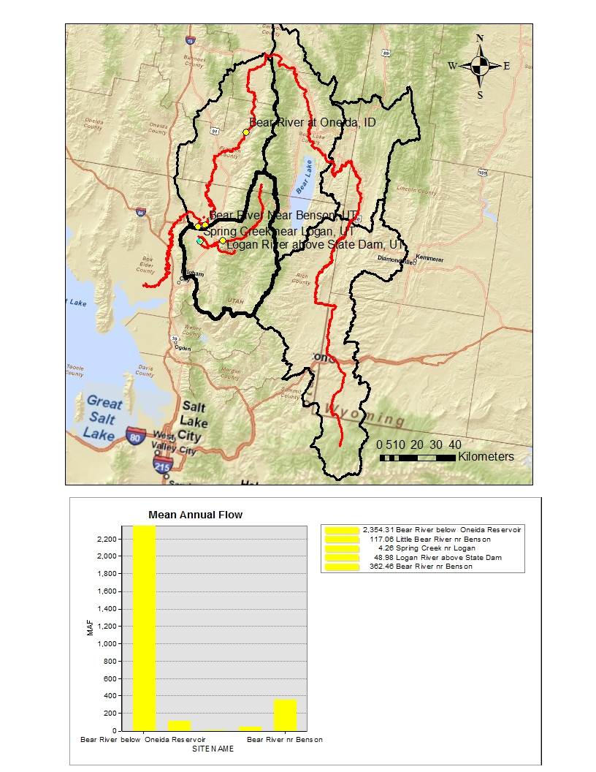
Streams, Watersheds and Flow Monitoring Stations
Monitoring stations feature class is created by exporting MS Excel file and displaying xy data
- Flow Data Source: NHDPlus 2010, region 16
Stream | Mean Annual Flow (cfs)
Logan River above state dam, UT | 84.386
Spring Creek at 600 S nr Logan, UT | 27.108
Little Bear River at Benson marina, UT | 117.06
Bear River below Oneida reservoir, ID | 219.688

Slide 7
Landuse Data
Data Management tools Raster Raster Dataset Mosaic
Spatial analyst tools Extraction Extract by Mask

Slide 8
- Pit removal (fel) - Flow direction using the D8 method (P) - D8 slope (sd8) - Contributing area (ad8o) - Longest flow path (plen), flow paths length (tlen) and network order (gord) - Stream network skeleton (ss) - Stream delineation (ssa) - Stream network (w)
TauDEM Application
(P)
(ad80)
(ssa)
(fel)
(sd8)
(tlen)
(w)

Slide 9
Results

Slide 10
Subwatersheds Delineation

Slide 11
Logan River
Landuse Percentage
Bear River
Little Bear River

Slide 12
Summary of the landuse percentage
Landuse | Logan River | Bear River | Little Bear
Cropland and pasture | < 3% | 20% | 22%
Shrub-brushed rangeland | ≈ 33% | ≈ 50% | ≈ 40%
Forest land | ≈ 60% | 20% | ≈ 20%
Urban, residential, industrial, and commercial | < 1% | < 1% | < 3%
Literature phosphorous loading rate
Land Use | Total Phosphorous Loading Rate (lb/ac/yr)
Industrial | 4.77
Transportation, communications and services | 2.5
Commercial and Services | 2.05
Residential | 1.97
Cropland and pasture | 0.94
Herbaceous Rangeland | 0.22
Shrub-brushland rangeland | 0.22
Forest land | 0.08
Lakes and reservoirs | 0

Slide 13
Conclusions
Little Bear River is subjected to the highest load of phosphorous because it has the highest percent of cropland and pastures.
Logan River is healthy because 60% of its landuse is forest and less than 2% cropland and pasture.
Bear River is expected to receive a relatively high load of phosphorous downstream.

Slide 14
Future Work
Delineate the Spring Creek subwatershed and apply the same approach to estimate the load of phosphorous.
Calculating the area of each landuse and use it to find the phosphorous concentration.
Appling the same study with other nutrients i.e. nitrogen and organic carbon

Slide 15
Questions?

