Slide 1
Streamflow Forecasting for
Environmental Purpose at
Bear River Watershed
Omar Alminagorta
Utah State University
GIS in Water Resources
Nov 2010

Slide 2
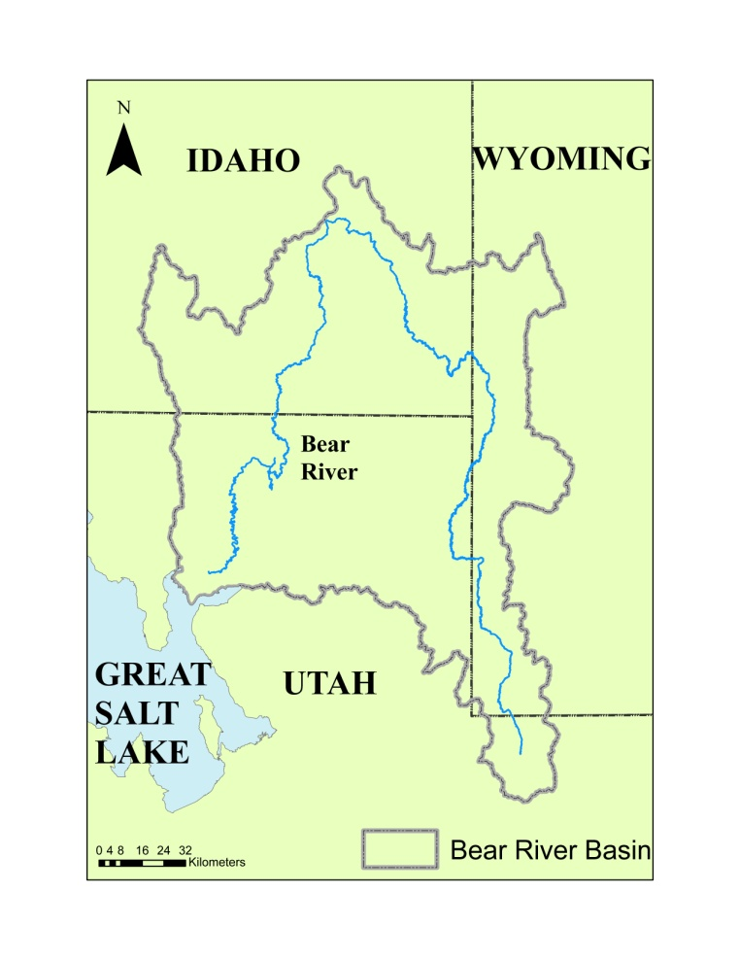
Background - Bear River Watershed
Covers 7,500 square miles
Bear River crosses state boundaries
5 times and it is the largest tributary
to the Great Salt Lake.
3 important wetlands:
Cokeville,
Mudflat and
Bear River Migratory
Bird Refuge

Slide 3
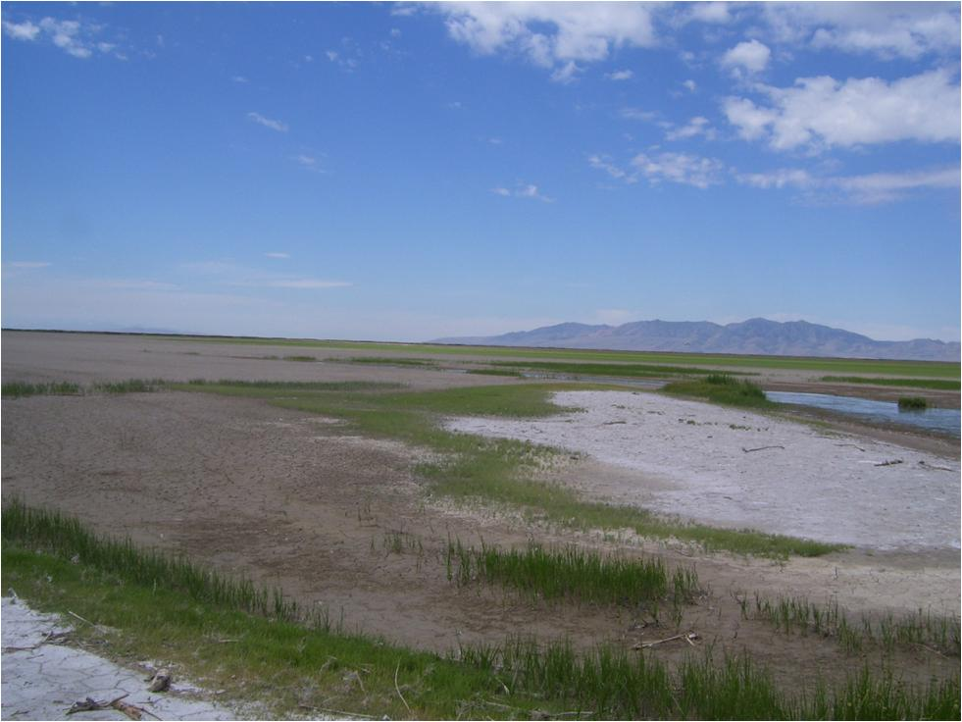
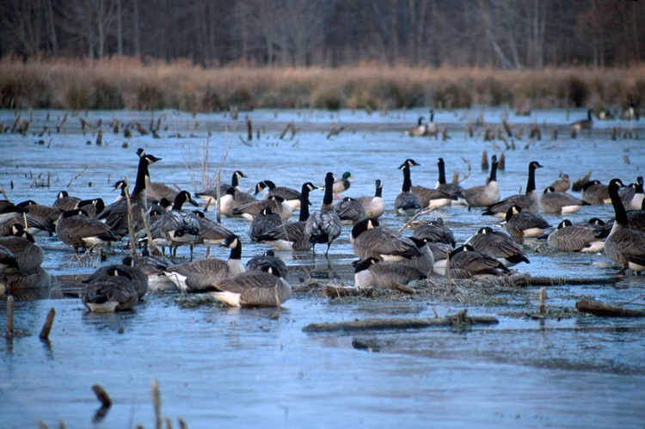
Forecasting water availability to improve wetland management
Necessity to forecast water supply

Slide 4
Objective
Forecast the quantity of surface flow at specific points at the Bear River Watershed using spatial analysis

Slide 5
Methodology
Data Collection
GIS Analysis
- Spatial Interpolation
Forecasting Analysis
Weather Information
Precipitation
Soil Moisture
Relationship
between weather
parameters
and Flow from
Stream Gages
Stream Gauges Stations
- Flow

Slide 6
Data Collection
15 SNOTEL sites
Precipitation
Soil Moisture
07 Stream gauges stations.

Slide 7
Input Data to GIS
2007 to 2009
Average of three years
Monthly Analysis

Slide 8
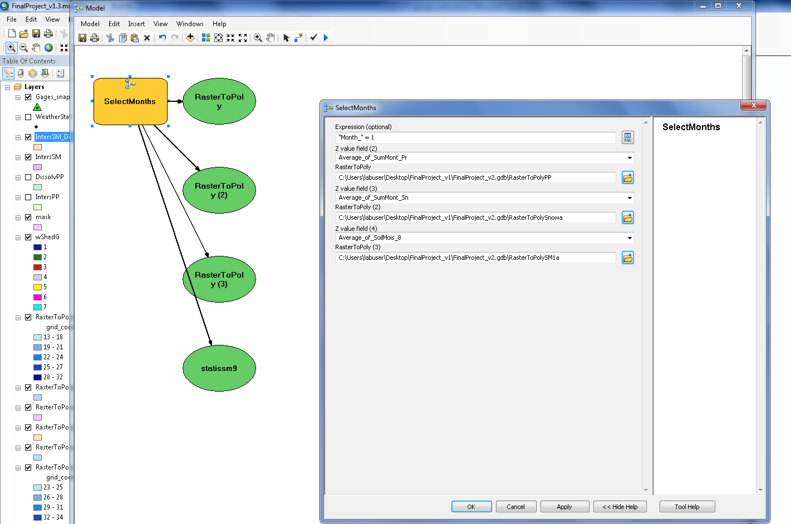
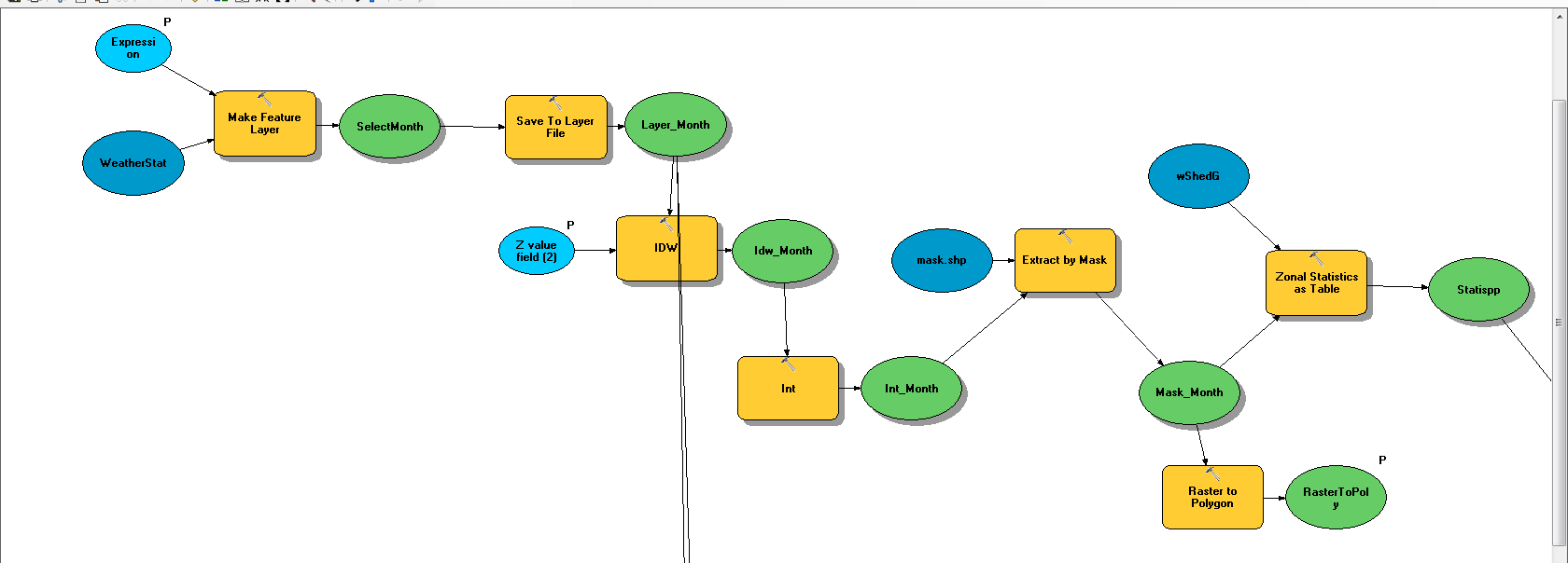
Application of GIS model

Slide 9
Precipitation January
Soil Moisture June

Slide 10
Forecasting Analysis
Q_{t}= f( PP_{t-1}, SM_{t-1}, Q_{t-1})
PP= Spatial Interpolation of Precipitation
SM= Spatial Interpolation of Soil Moisture
Q = Stream Flow

Slide 11
Flow Prediction

Slide 12
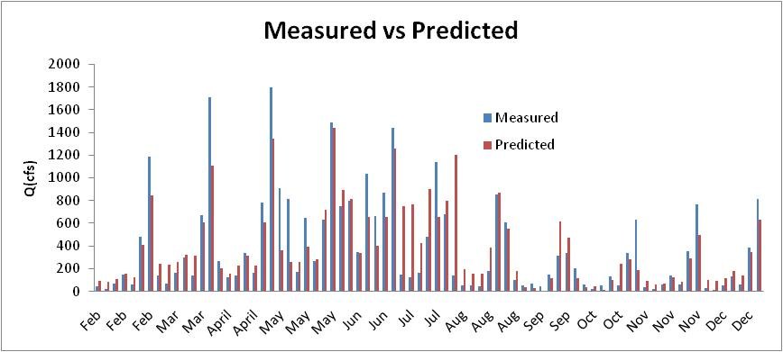

Slide 13
Questions

