Slide 1
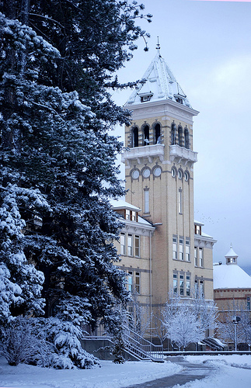
Relationship between Logan Canyon Snowfall and the spring runoff in Logan River
CEE 6640:GIS for Water Resources
11/23/2010
Naho Orita

Slide 2
Purpose of the study
Prediction of the volume of runoff from previous water years snow water equivalent
Runoff causes erosion, resulting in reduced crop productivity
Important for the farmers in Cache Valley

Slide 3
INTRODUCTION
Logan Canyon
Located on North East corner of UT
Logan River
Irrigational use since 1890s, Recreational use
Surface water & Ground water
Avg.flow≈100 to 150 cfs
Spring Runoff up to 1500 cfs

Slide 4
SNOTEL Sites & USGS gage

Slide 5
5 SNOTEL stations in Logan River watershed
Tony Grove Lake (1978 to present)
Temple Fork (2001 to present)
USU Doc Daniel (2007 to present)
Tony Grove Road Side (2009 to present)
Klondike Narrows (2009 to present)

Slide 6
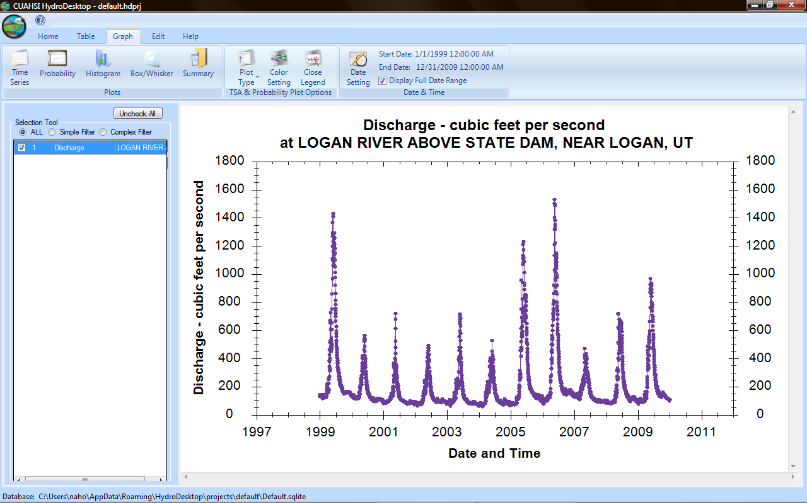

Slide 7
Statistics
Linear Relationship
April 1st data
Average snow fall of the season
Maximum snowfall of the water year

Slide 9
Conclusion & Future Work
The max. precipitation seems to correlate with the volume of the spring runoff
e.g. Tony Grove Lake st.
Runoff (cfs)=33.65*maximum snow water equivalent of previous water year (in)-448.3
Better prediction using all 5 stations
Now we know how much
…could we predict when?

Slide 10
QUESTIONS?

