Slide 1
Using GIS to show the temporal –spatial variation of Phosphorus in Wellsville City Sewage Lagoons as simulated by a water quality model By Maureen Kesaano (GIS in Water resources: CEE 6440)

Slide 2
OUTLINE
BACKGROUND AND JUSTIFICATION
OBJECTIVES
METHODOLOGY
RESULTS AND DISCUSION
CHALLENGES FACED
RECOMMENDATIONS

Slide 3
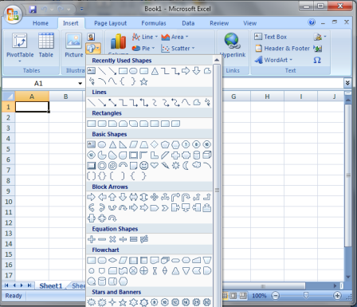
KEY POINTS OF TERM PROJECT
Process model
GIS display
Excel

Slide 4
BACKGROUND OF STUDY
PROBLEM: Deteriorating WQ of LBR due to increased nutrient loading (TP) from Wellsville City Sewage lagoons (LBR TMDL).
STEPS TAKEN SO FAR: City contracted J.U.B engineers to assess the situation and come up with alternatives (2007)
2010: No action alternative thus the discharge limits’ violations is still on going

Slide 5
JUSTIFICATION OF STUDY
2007: State issued a UPDES permit to Wellsville City Lagoons limiting the total P discharges to 72 kg of TP /season (warm season, June – September) and 360 kg of TP/season (cool season, October – May)
Discharge is determined by the facility operators, therefore it is important for them to know which cell has the least P and when this occurs so that they can maximum discharge without violating the limits

Slide 6
STUDY OBJECTIVE
To determine and visually display the amount and distribution of phosphorus within the Lagoons according to season

Slide 7
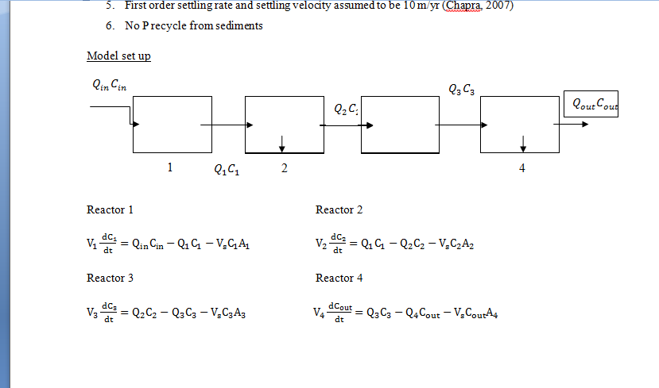
METHODOLOGY
Process model
ASSUMPTIONS
Each cell was CSTR with constant volume
No non point P sources and recycle
P removal by discharge, ppt & attachment to sediment
1st order settling rate & settling velocity of 10 m/yr (Chapra, 2007)

Slide 8
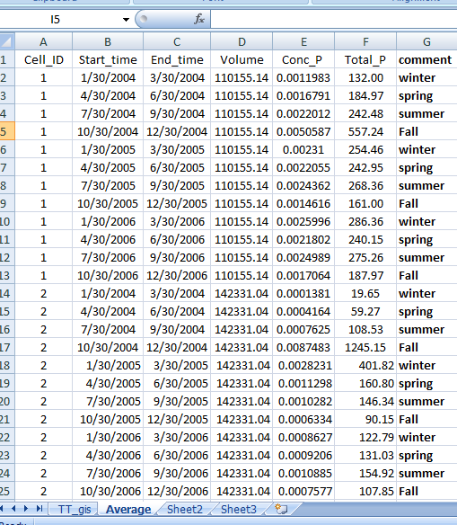
METHODOLOGY
Model output in excel
Numerical method:
Created a cell_ID field as an identifier and date field for the temporal aspect of the data
TP Units: kg P/season

Slide 9
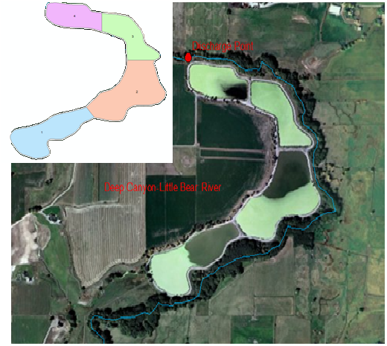
DATA USED in arcGis
Bear River watershed
NHDPlus data
Created a layer from already existing shape file
Edited cell shapes using editor tool
Analysis tool to extract & clip the LBR flow line

Slide 10
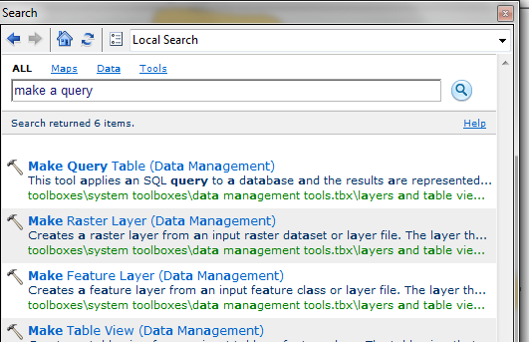
DATA USED in ArcGIS
Shape file table
Xls. Imported table
PROCEDURE
Tables joined using a query
Connected the tables using identifier Cell_ID
NOTE: Join/relates command wouldn’t work because of the one-many relationship

Slide 11
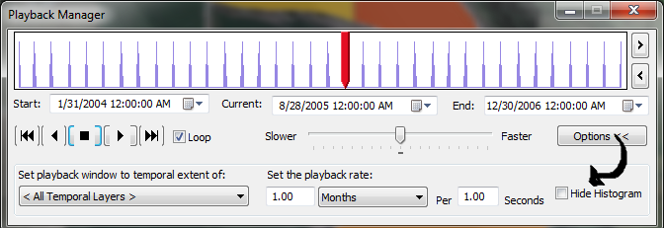
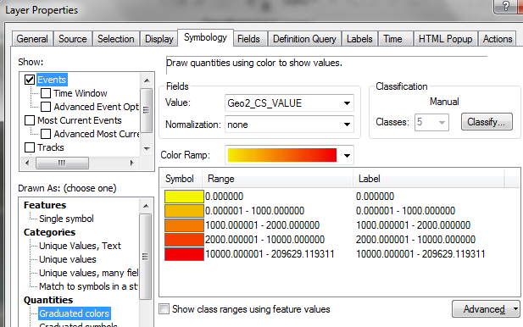
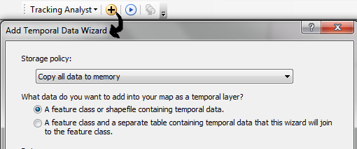
VISUALIZATION USING TRACKING ANALYST TOOL
Enable tool using customize extensions
Make sure all data is in the same GDB
Query table was exported as a layer in GDB
Add temporal data

Slide 12
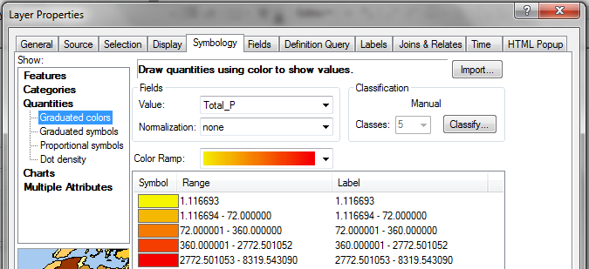
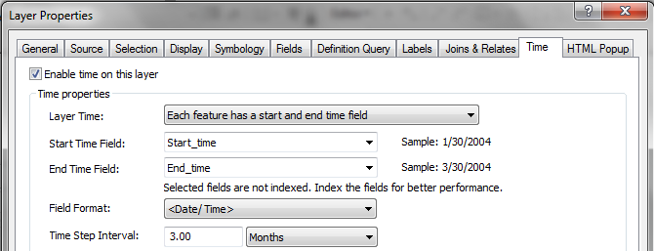
VISUALIZATION USING TIMESLIDER
Export query table into GDB as table
Enable time from the properties layer
Specify the time extent, change symbology and start timer

Slide 13
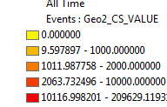
RESULTS AND DISCUSSION
DEMO in CLASS (tracking analyst)

Slide 14
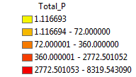
RESULTS AND DISCUSSION
DEMO in CLASS (time slider)

Slide 15
Challenges FACED
Sparse data for P
Learning the tracking analyst tool
One – many relationship table join

Slide 16
conclusions and recommendations
GIS tools can be used to enhance visualization of data from process models
Tracking analyst tools recommended for temporal data from scientific research or real time data

Slide 17
ACKNOWLEGDEMENTS
Instructors :Dr. Davis Tarboton, Dr. David Maidment, Dr. Ayse Irmark
Peer reviewers: Andrew Barney and Andrew Ritchey

Slide 18
Thanks

