Slide 1
Aberdeen, ID Groundwater Analysis
Jerimiah Fenton

Slide 2
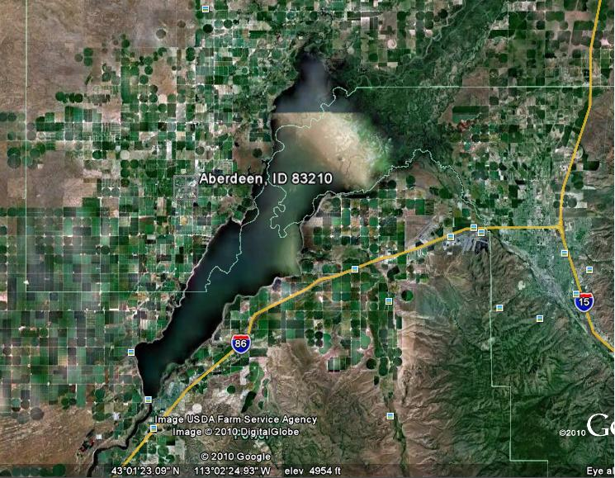
Aberdeen Wetlands
During the 1970s irrigation water was delivered through canals
Resulted in ponds and high water tables
Pressurized irrigation replaced canals
Ponds Dried Up

Slide 3
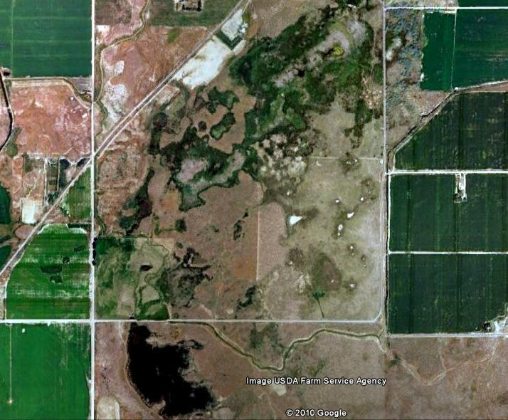
Pond Rehabilitation
Fish and Game wanted to bring back ponds
Use wells to pump water constantly into dammed areas

Slide 4
Problems
Resulted in flooding of surrounding fields
Increase in mosquito population decreased livestock birth rate
Farmers have requested a water level analysis to see if the Fish and Game ponds are the cause

Slide 5
Solution Approach
Time series water tables
This should give an idea of how the ponds have affected the area water tables

Slide 6
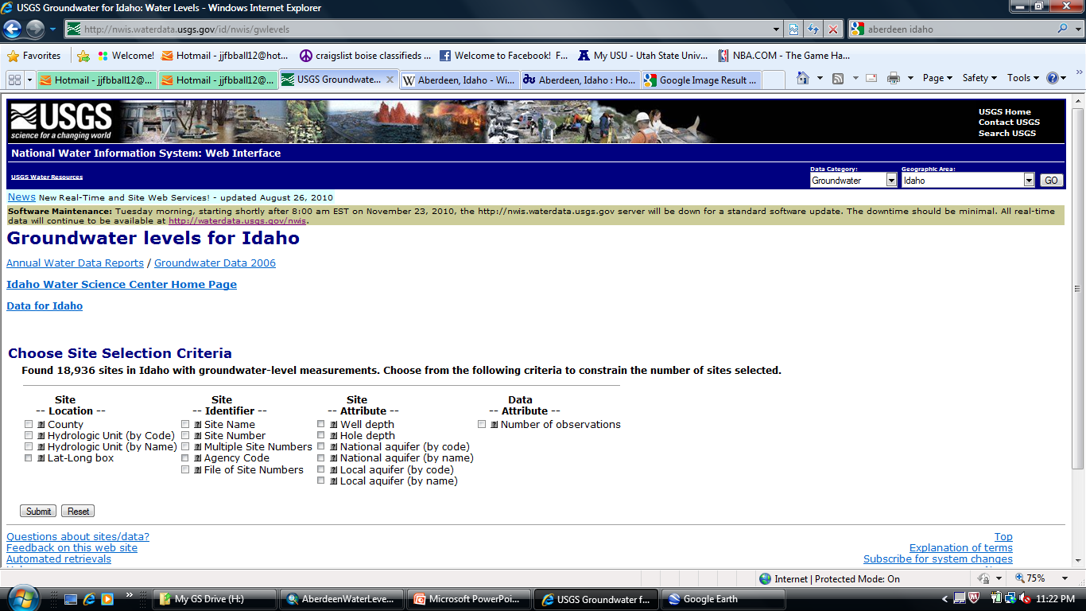
Data Collection
USGS well water levels

Slide 7
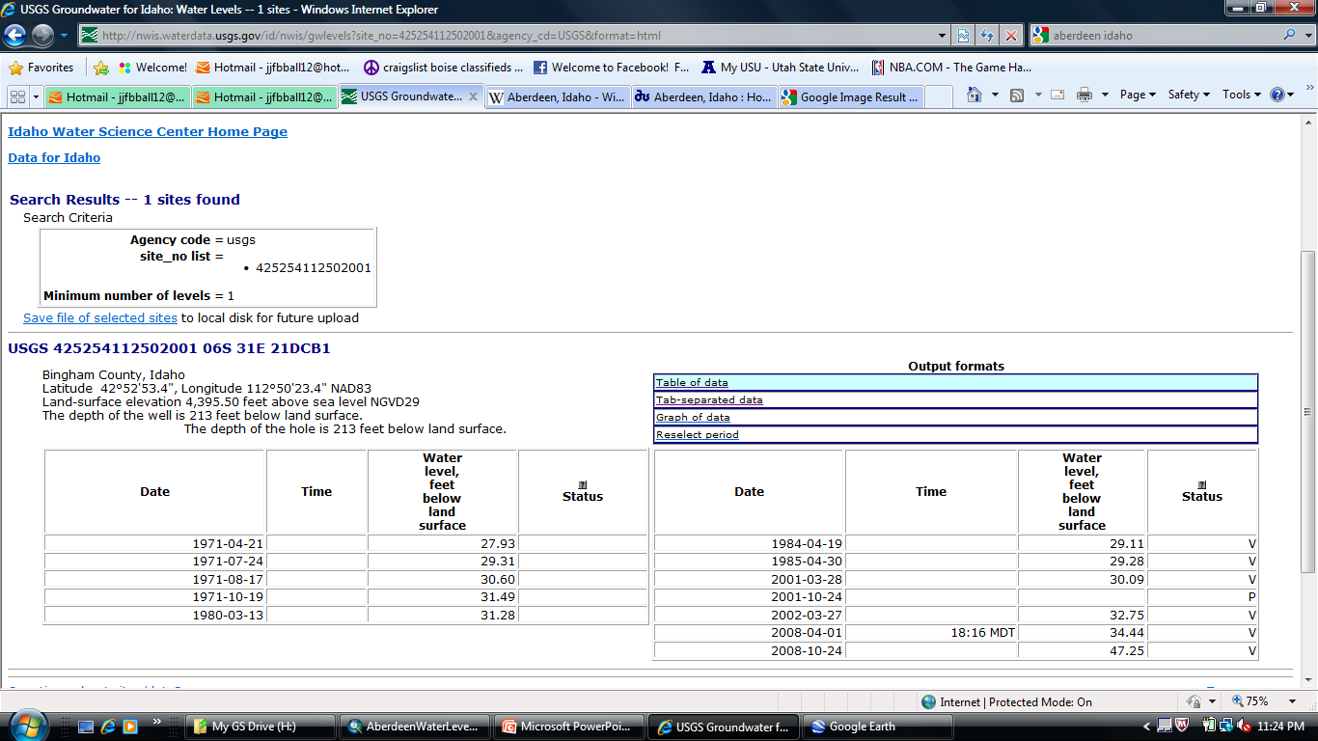
Water Table Data

Slide 8
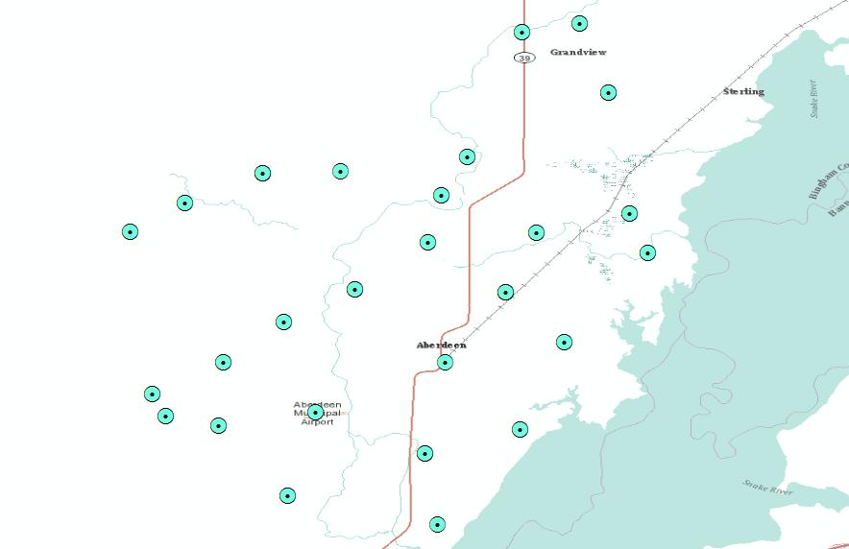
Spatial Representation of Data
Display X,Y coordinates (similar to Ex 2)
A lot of data for 2001, 2002, 2008

Slide 9
IDW Spatial Analyst Tool
Interpolates a raster surface from points
IDW was used to generate interpolated water depth maps

Slide 10
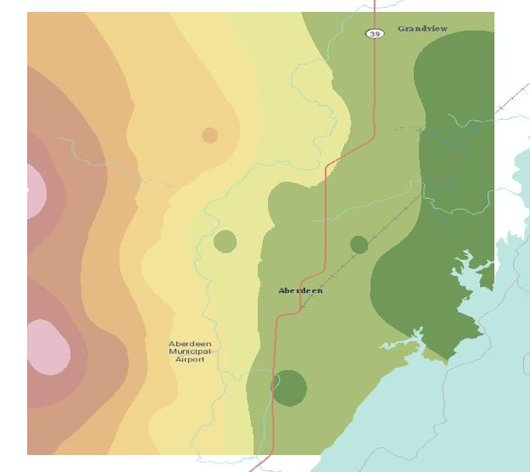
2001 Water Level Map

Slide 11
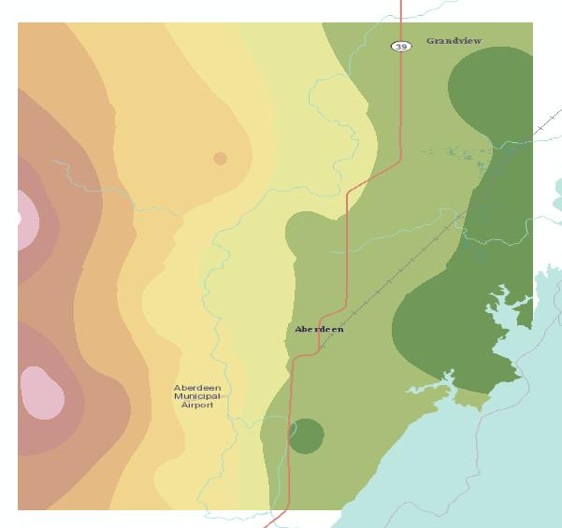
2002 Water Level Map

Slide 12
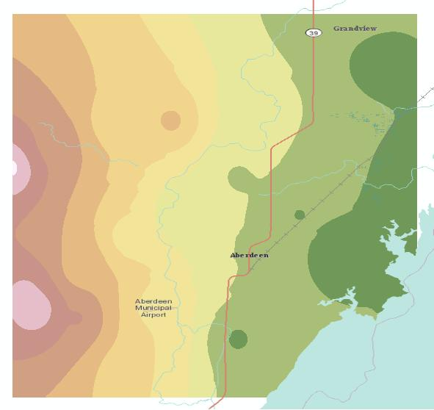
2008 Water Level Map

Slide 13
Conclusions
Water table is actually decreasing in most of the area
There is no proof that ponds are the cause of increased water table
One well has significantly increased
More data is required
Ponds may just be leaking into surrounding area

Slide 14
Further Work
Search for more current data
Look at the direction of ground water flow (AHGW)
Spatial Perspective of ponds (images)

Slide 15
References
ARCGIS.com. Physical Base Map. <arcgis.com>. Path: Search for Data: Base maps: Physical. (Oct 30, 2010).
Aqueveo. “ARC Hydro Groundwater Tutorials: Wells and Time Series.” [Electronic Version].
USGS.gov. NWIS: Ground Water Levels For Idaho. < http://nwis.waterdata.usgs.gov/id/nwis/gwlevels >. (Oct 15, 2010).
Water Well Consultants. Verbal Contact.

