Slide 1
Innovation Through GIS
Improving Empirical Hydrology Methods Through New GIS Technology

Slide 2
Outline
Hydrologic Background & Existing Methods to find Runoff
Solutions Through GIS
ArcGIS Manipulation
Methods
Results
Photograph taken from maps.google.com. (2010)

Slide 3
Hydrologic Background
Traditionally, hydrologic modeling has been an empirical process.
Seen in standard methods such as the Rational and SCS methods.
Uses single values over an entire area

Slide 4
The Problem with Existing Methods
Old methods still in use
Areas and distances are often rough estimates
Can’t account for changing topography
Require a single “main” stream

Slide 5
Rational Method
Q = runoff flow (cfs)
c = coefficient of runoff
i = rainfall intensity (in/hr)
A = area (ac)

Slide 6
SCS Method
Takes into account average slope and length!
…but it’s only good for watersheds less than 2000ac

Slide 7
Possible Solutions Through ArcGIS
ArcGIS can provide more accurate estimates for:
Lengths
Slopes
Areas
Changing Topography

Slide 8
Dry Canyon, Logan UT
Dry Canyon was used due to its relatively small size and single land use type
Simple layout where flows all travel to the northwest
Photograph taken from maps.google.com. (2010)

Slide 9
Data Required
5m DEM & Roads from Utah GIS Portal
Soil Classification from National Resources Conservation Service (NRCS)
Land Use Classification from National Land Cover Dataset (NLCD)

Slide 10
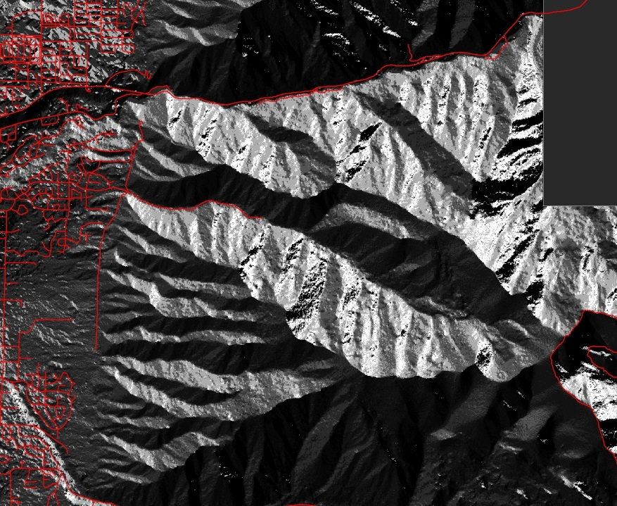
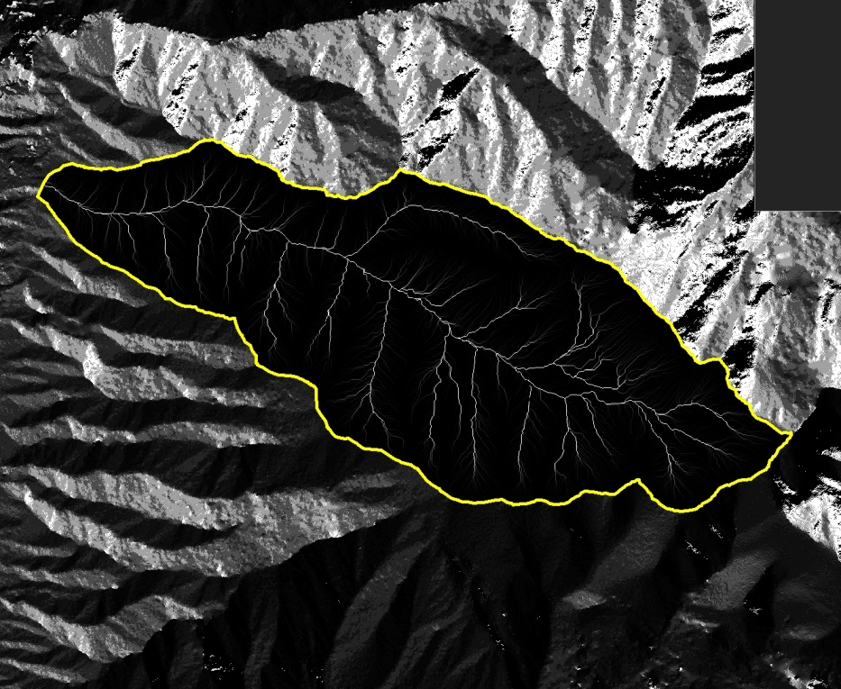
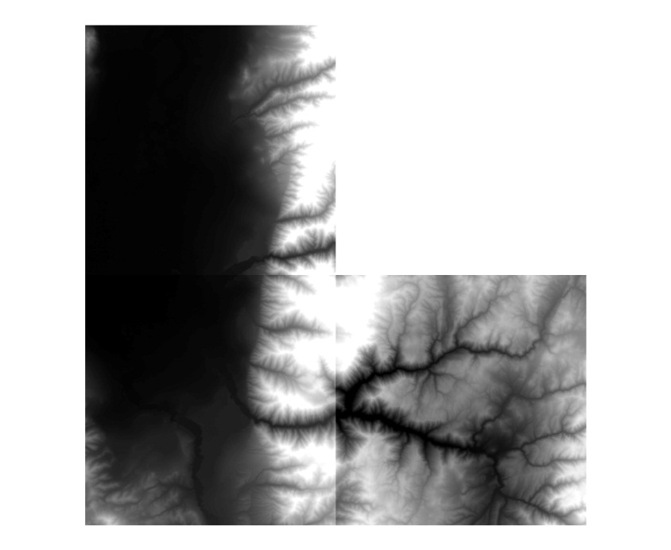
Manipulation
DEM→ Flow Direction →Flow Length

Slide 11
Three Methods
Rational Method:
Rational Method using fixed travel distances
Rational Method using weighted distances by integrating cell slopes

Slide 12
Rational Method Results
Coefficient of 0.2 used for Forest
24-hr 100-yr storm event
Area taken from ArcGIS
Q = 1789.7cfs

Slide 13
Rational Method Using Fixed Length
Cells are counted downstream of each cell
Unit value of 1.0 for each cell
Count cells
Image taken from ArcGIS Help Guide. (2010)

Slide 14
Rational Method Using Weighted Distances
It is anticipated that including slopes will increase velocities, the peak flow will also increase.
More difficult due to cell weighting

Slide 15
Comparisons
Largest number of cells holding the same value should represent the travel distance/time of the peak flow
Integrate time to find velocities

Slide 16
Results & Conclusions
While the differences calculated using ArcGIS are small, they demonstrate the need for updated methods

Slide 17
Future Work
Complete a count for cell values
Integrate time into the results
Create comparison
Complete integration of weighted distances with the rational method?

Slide 18
References
Rational Equation Calculator. LMNO Engineering, Research, and Software, Ltd. October 2010. http://www.lmnoeng.com/Hydrology/rational.htm
Hydrologic calculations for Peak Discharge, Runoff Depth, Runoff Curve Number, Time of Concentration, and Travel Times. LMNO Engineering, Research, and Software, Ltd. October 2010. http://www.lmnoeng.com/Hydrology/hydrology.htm#Curve%20Numbers
Knox County Stormwater Manual. Knox County. October 2010. http://www.knoxcounty.org/stormwater/pdfs/vol2/3-1-5%20SCS%20Hydrologic%20Method.pdf
Utah GIS Portal. State of Utah. October 2010. http://agrc.its.state.ut.us/
Soil Data Mart. NRCS. October 2010. http://soildatamart.nrcs.usda.gov/Download.aspx?Survey=UT603&UseState=UT
Point precipitation frequency estimates from NOAA Atlas 14. NOAA. October 2010. http://hdsc.nws.noaa.gov/cgi-bin/hdsc/buildout.perl?type=pf&units=us&series=pd&statename=UTAH&stateabv=ut&study=sa&season=All&intype=3&plat=&plon=&liststation=0&slat=41.72460&slon=-111.76121&mlat=41.72460&mlon=-111.76121
ArcGIS Help. ESRI. 2010.

Slide 19
Questions?

