Slide 1
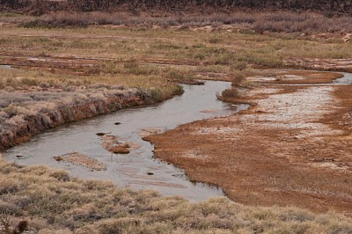
Run-off and Flood Prediction for the Muddy River By Erik Robison

Slide 2
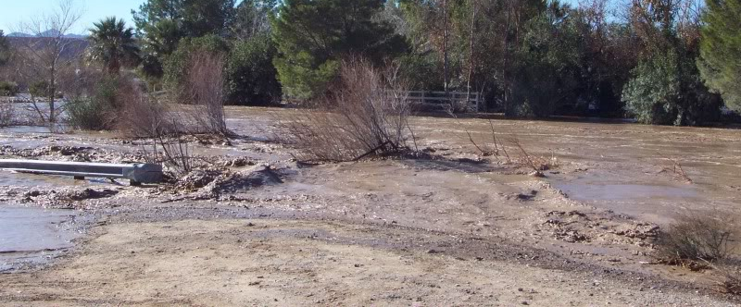
The Problem
Problematic flooding occurs in Moapa Valley approximately once every 10 years.
If these floods are occurring every 10 years what would be the magnitude and flooding extent of a 100 year storm.

Slide 3
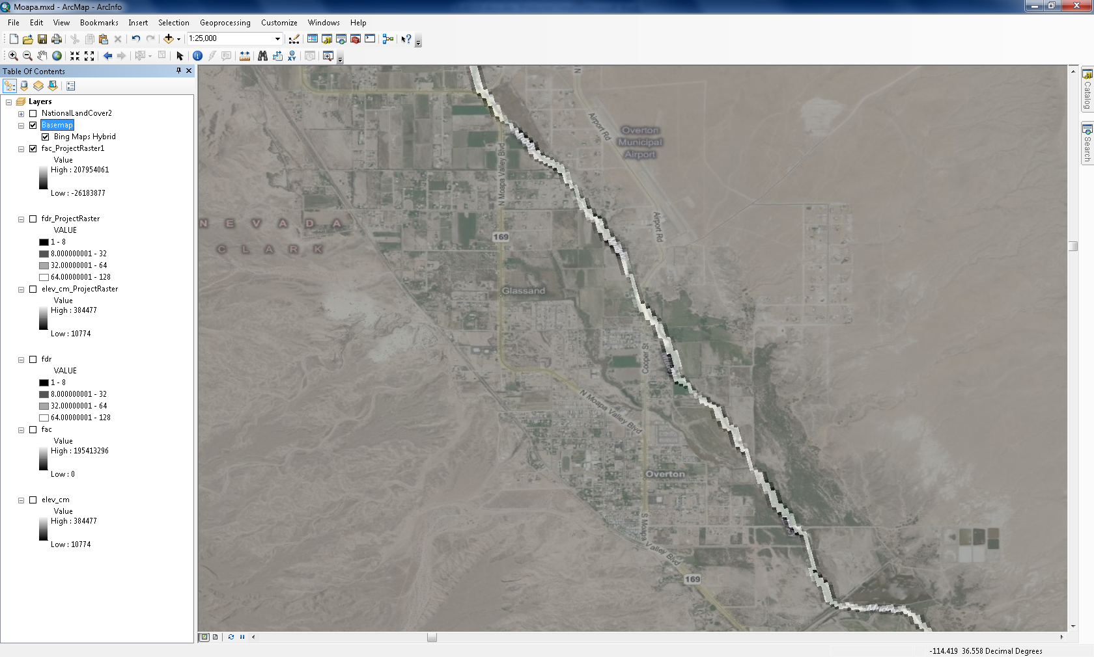
The Objective
Determine the Magnitude of a 100 year storm event on the Muddy River catchment basin.
Route the 100 year storm runoff through Moapa Valley, to determine extents of Flooding.

Slide 4
DATA SOURCES
Data from NHDPlus was used to develop a DEM, Flow Accumulation, Flow lines, and Flow Direction of the area (30 m x 30 m cell size)
Rainfall data was collected from the NOAA website for the area to determine the 100 year storm event Precipitation intensity and duration
Soil data was obtained from the NRCS (National Resources conservation Services)
Land cover was obtained from ArcGIS online (National Land Cover Data set)

Slide 5
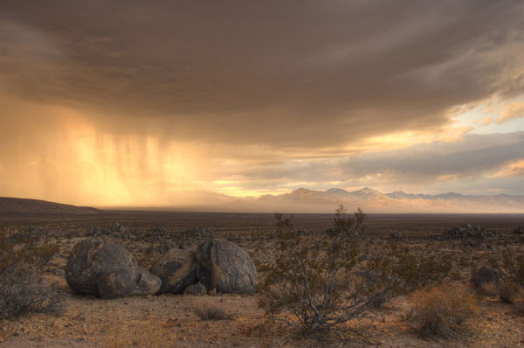
Precipitation events for a 100 year storm were evaluated at a 100 year return period and 24 hour duration on the catchment basin.
Approximately 2.62 inches
Note: The actual precipitation number may be smaller than calculated, because the drainage basin is large, and a storm event may not cover the entire basin.

Slide 6
The Land Cover Data, and soil data were used to determine SCS curve numbers for the Drainage Basin.
Approximately 89% of the land cover in this drainage is Barren soil, with a few Mixed Forests, and less than 1% development.
A | B | C | D
77 | 86 | 91 | 94
36 | 60 | 73 | 79
Barren Soil
Mixed forest
Q$=\frac{(P−Ia)^2}{\left(P−Ia\right)+S}$
S$=\frac{1000}{CN}$ -10
Q = runoff (in)
P = precipitation (in)
Ia = Initial Abstraction (in)
CN = Curve Number

Slide 7
Conclusions
Large accumulations of Runoff are present due to the size of the drainage basin
Flooding will continue to be an issue until changes to the environment occur

Slide 8
Additional Research
Due to the lack of sufficient cross-section information, routing the 100 year storm to determine the extents of flooding isn’t possible.
Future assessments of the basin would be necessary to determine the extents of flooding during a 100 year storm event (HEC-RAS).
Work to modify the river system to accommodate a 100 year storm is currently underway (modification of the current cross-sections).

Slide 9
Questions
?

