Slide 1
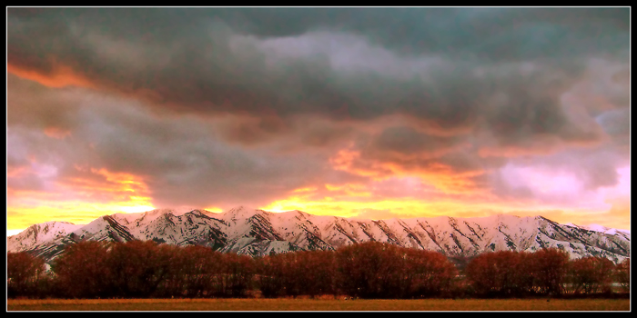
runoff potential in eastern cache valley
Pre-Development and Post-Development Runoff Comparisons

Slide 2


acknowledgments
Eric Major
GIS in Water Resources 2010
Utah State University
23 November 2010
Thanks to Dr. David Tarboton, Dr. David Maidment,
and Dr. Ayse Irmak for their instruction and expertise.
Thanks to the Logan City Engineering and GIS Divisions
for their ongoing support and encouragement for this project.

Slide 3
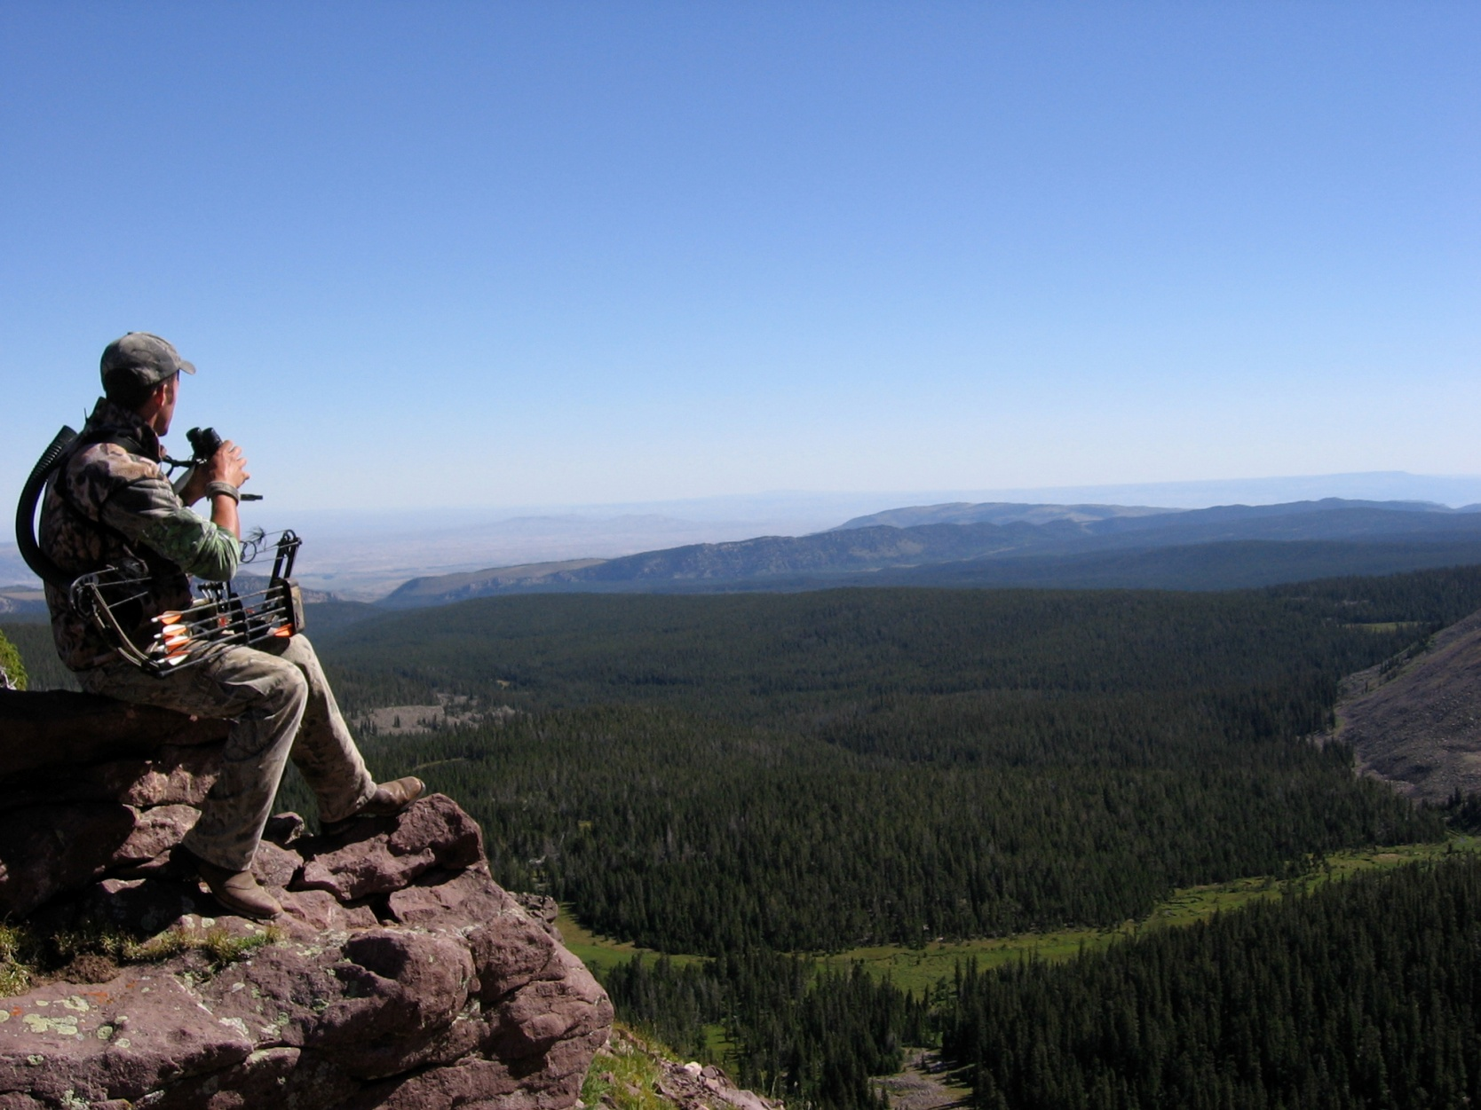
overview
Project Introduction
Project Justification
Data Inputs
GIS Methods
SCS Runoff Calculations
Results
Future Work
References & Questions

Slide 4
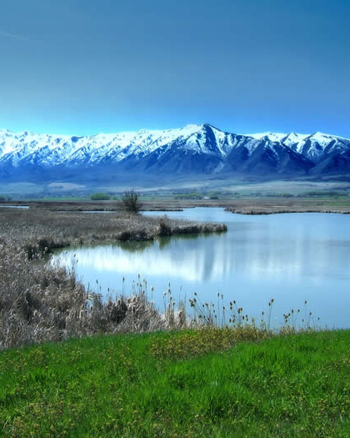
Project introduction
Why the hype about stormwater runoff?
Federal & State Environmental Standards
Stormwater Management Requirements & BMPs
Quantify storm runoff from developed & rural areas in Cache Valley
SCS Method Runoff Calculation factors:
  Soil Type
  Land Cover
  Catchment Properties & Areas
Bear River & Cutler Marshes

Slide 5
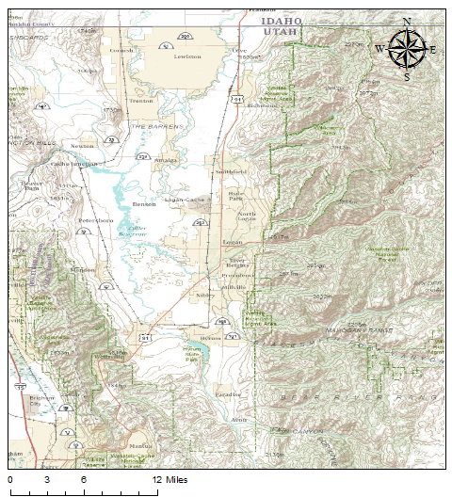
Project Location
Eastern Cache Valley
  Hyrum to Richmond
  Benches, Cities, & Fields
Basemaps
  US Topo Quads - 7.5 min
  Topographic
Logan & USU

Slide 6
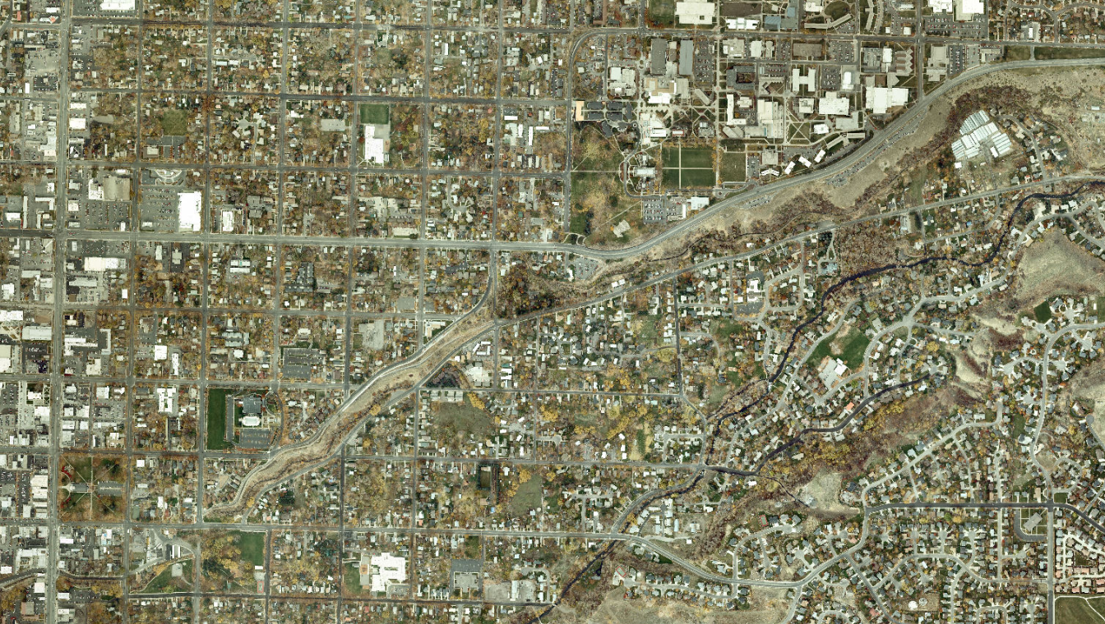
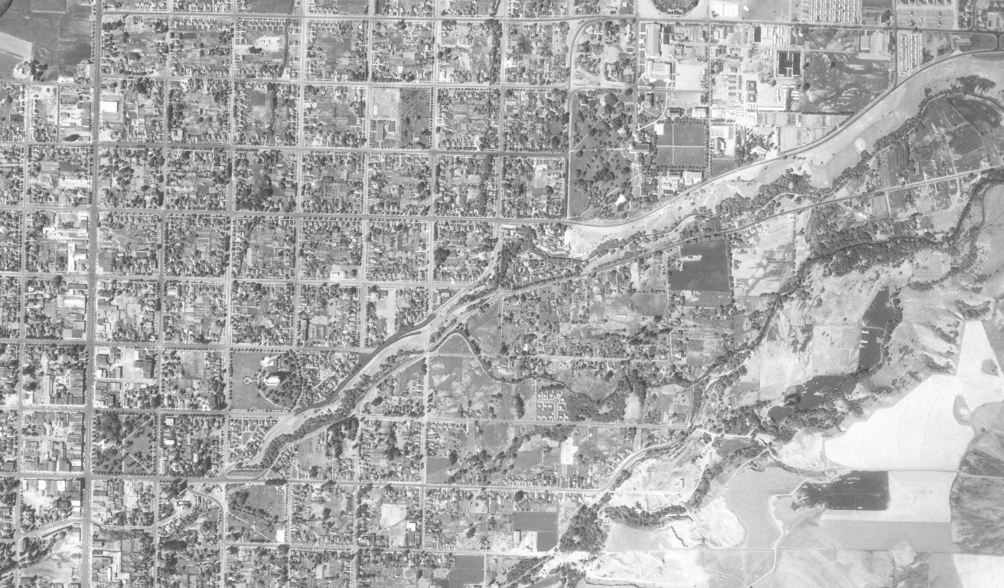
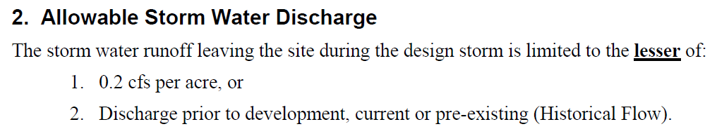
Project Justification
Northern Cache Valley Storm Water Design Standards
  Logan City
  North Logan City
  Smithfield City
  Hyde Park
Pre-Development or Historical Runoff
USU Campus
Logan 2009 Aerial (LCGIS 2010)
Logan 1960 Aerial (LCGIS 2010)

Slide 7
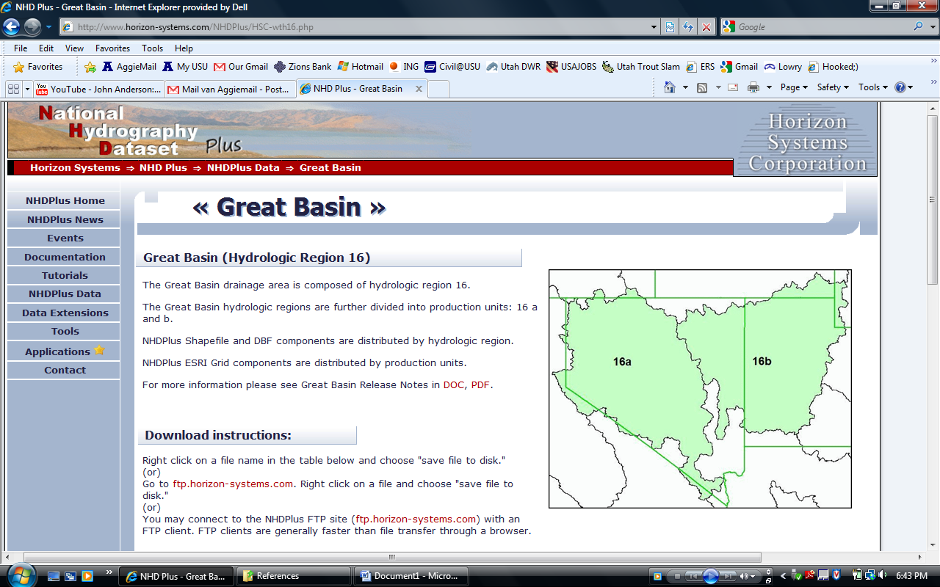
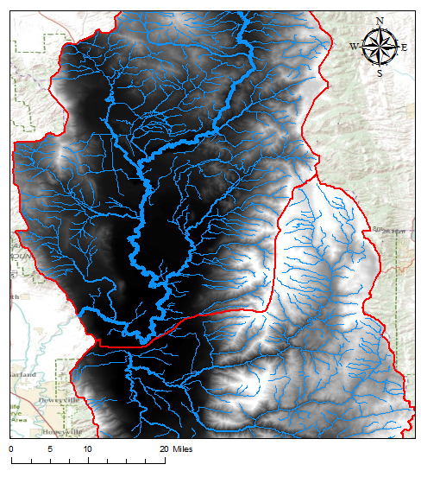
Elevation & Flowline data
NHDPlus Unit16b
  30 Meter DEM
  NHD Flowlines
Reconditioned and Projected for Study Area Watersheds
  Middle Bear (Northern)
  Little Bear (Southern)

Slide 8
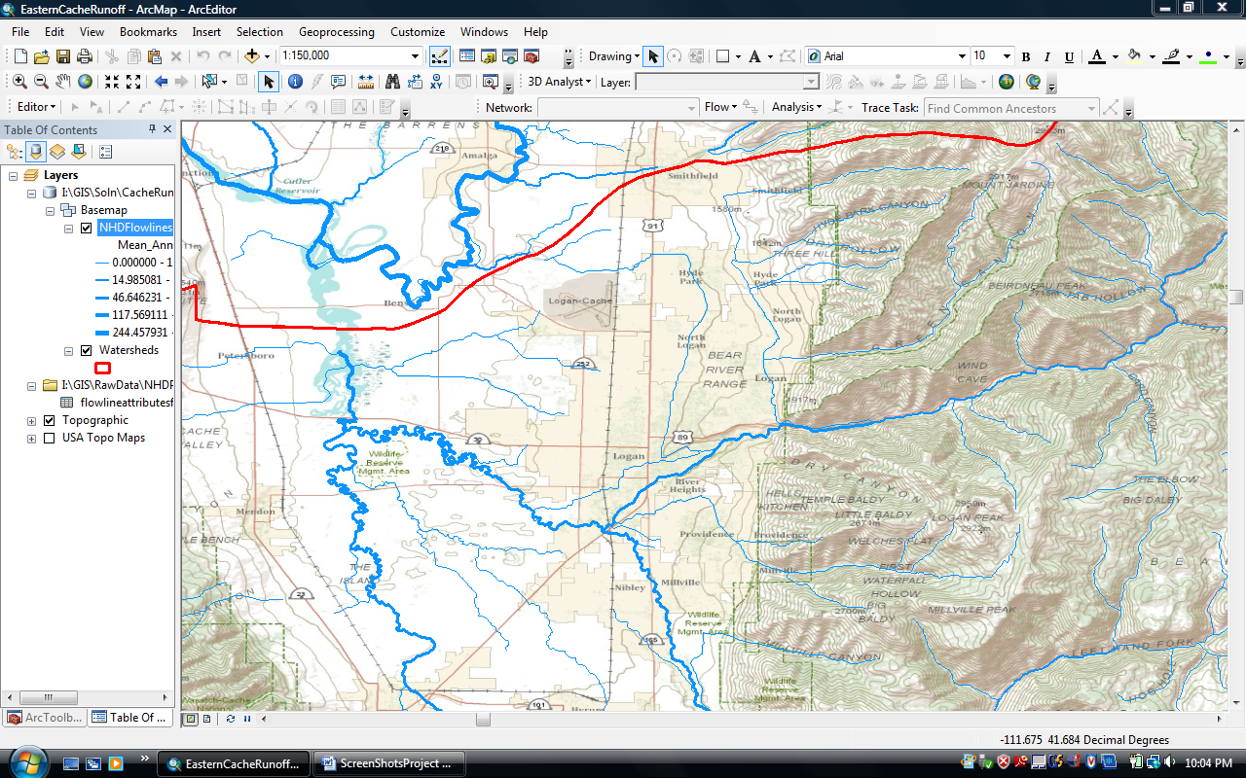
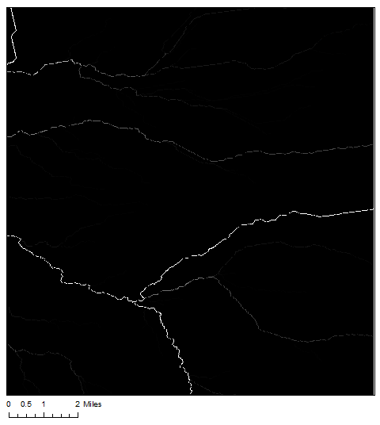
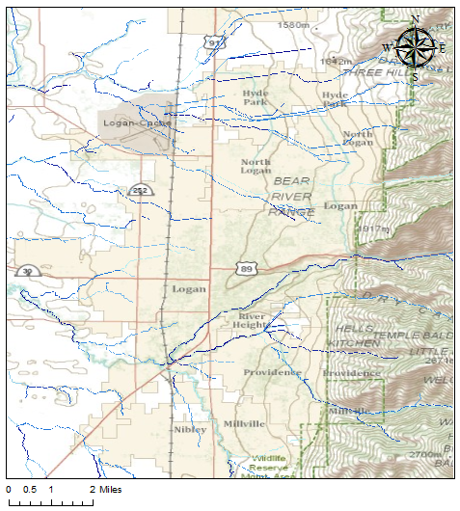
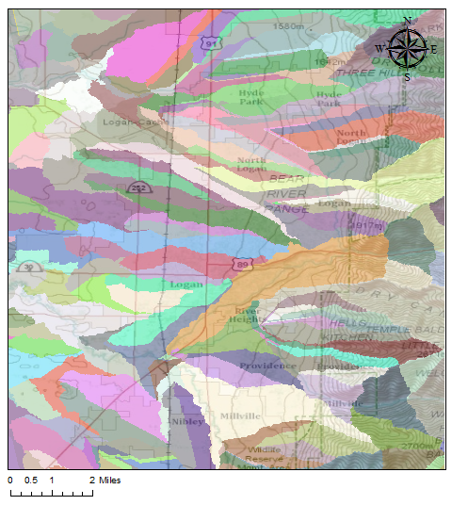
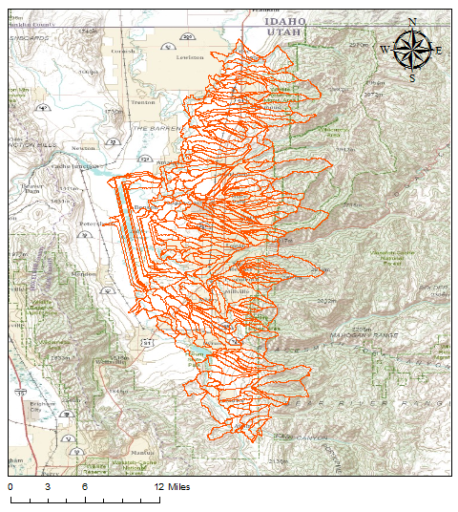
Defining Catchments
Flow Accumulation
Stream Networks & Links
Catchment Raster
Study Area Catchments
NHD Flow Lines used for reference only
Streams defined for 1000 cells, Stream Links Calculated
Catchments defined and study area identified

Slide 9
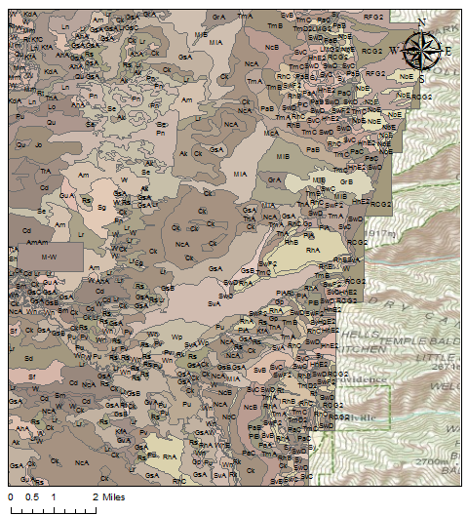
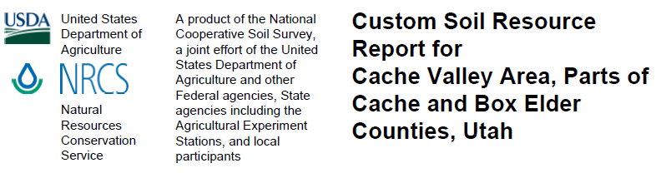
Soil Data
Soil Data Mart from NRCS for GIS Data
Web Soil Survey for Descriptions and Hydrologic Soil Groups (HSG) for SCS Method

Slide 10
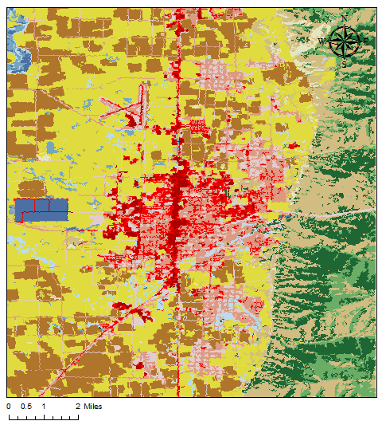
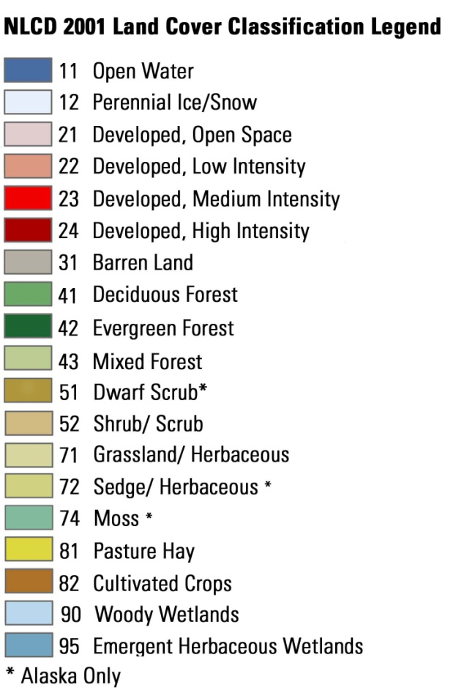
Land Cover Data
USDA – NRCS Geo Spacial Data Gateway
Raster from National Land Cover Dataset
30 m X 30 m Cell Size
Assigned SCS Curve Numbers (CN) to each land cover/use

Slide 11
SCS Curve numbers

Slide 12
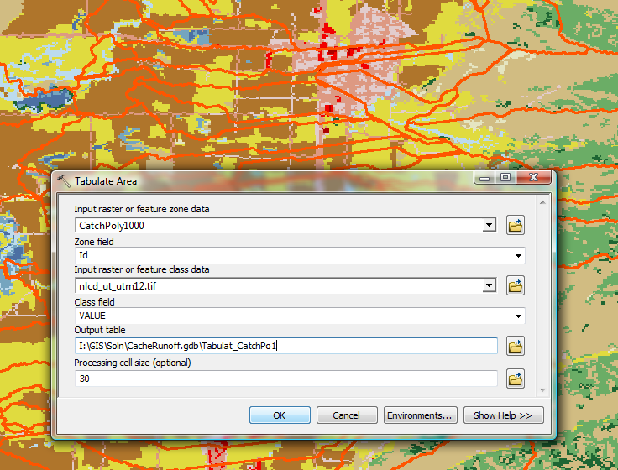
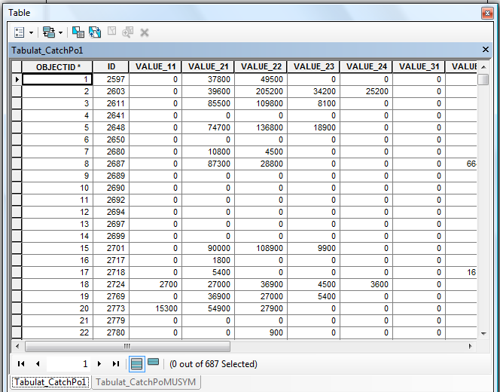
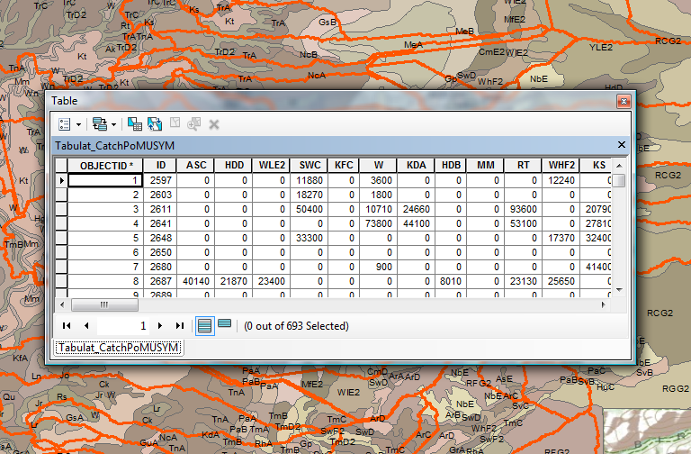
GIS TOOLS: TABULATE area

Slide 13
Excel: Catchment ccn’s
Composite Curve Number Calculations
Soil Areas & HSG
Weighted Averages

Slide 14



Scs runoff calculations
TR-55 (NRCS 1986)
SCS Runoff Equation
Initial Abstraction
Soil & Cover

Slide 15
Precipitation: Design storm
Northern Cache Valley Storm Water Design Standards (LCPW 2009)
Return Periods, Using 24 hour Duration
  10 yr, 25 yr, 50 yr, 100 yr

Slide 16
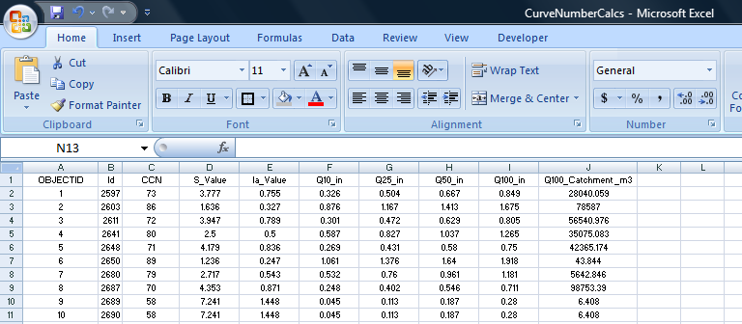
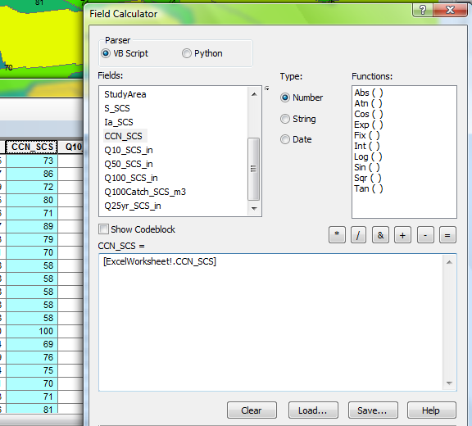
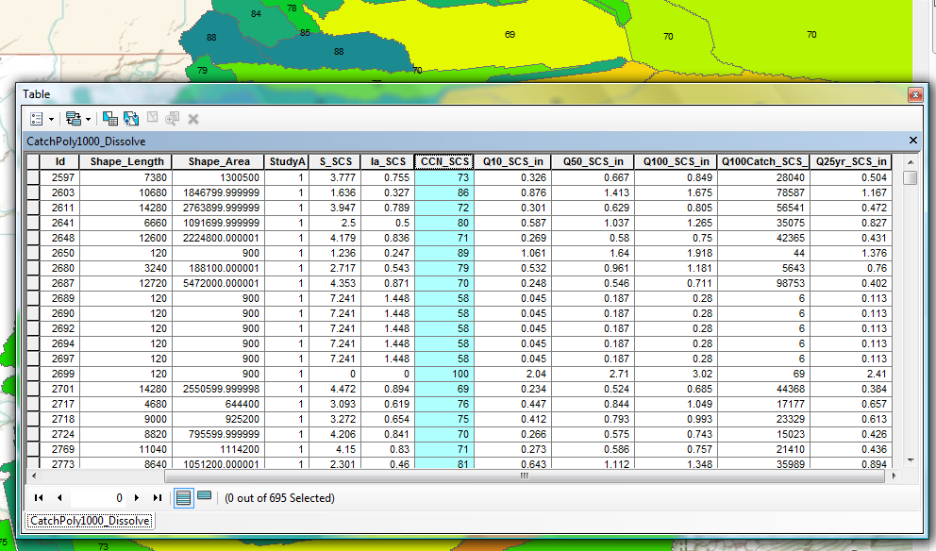
Excel to gis: tabular joins

Slide 17
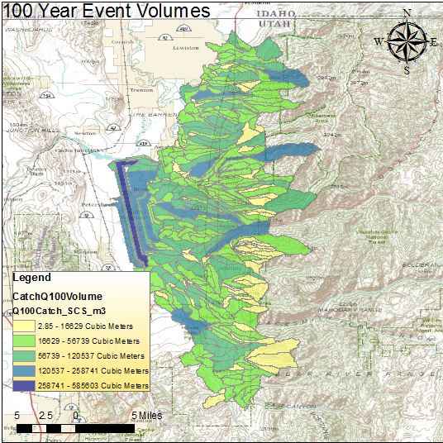
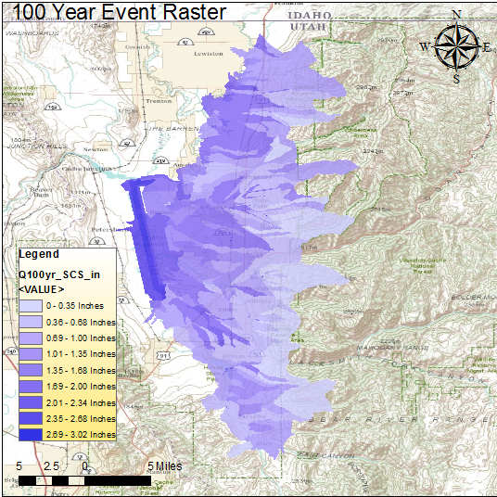
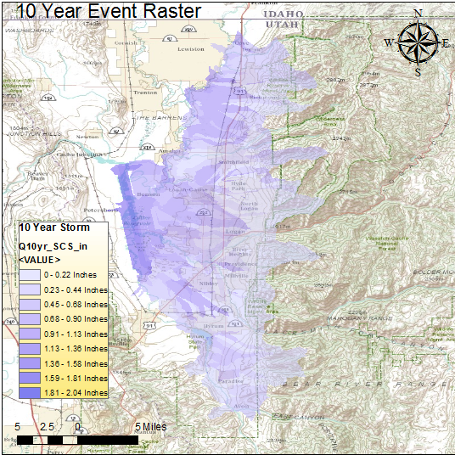
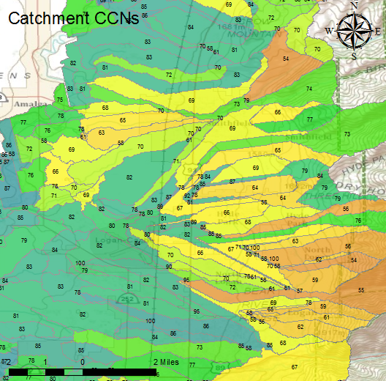
results

Slide 18
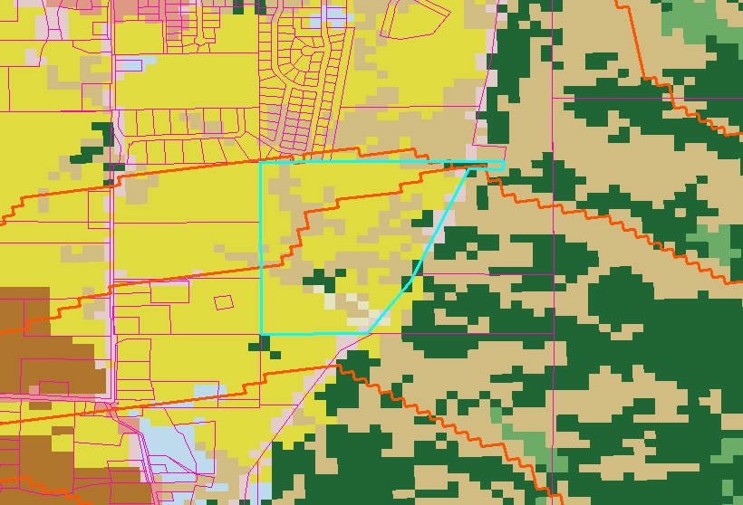
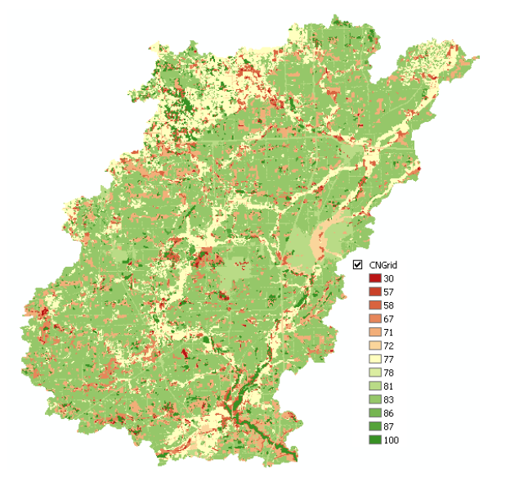
Future work
Parcels vs. Catchments
Canal System
Stormwater Utility Fee Integration
HEC-GeoHMS
HEC-GeoHMS Application (Merwade 2010)

Slide 19
REferences
Homer, C. C. Huang, L. Yang, B. Wylie and M. Coan. 2004. Development of a 2001 National
Landcover Database for the United States. Photogrammetric Engineering and Remote Sensing, Vol. 70, No. 7, July 2004, pp. 829-840.
Logan City Public Works (LCPW). 2009. “Northern Cache Valley Storm Water Design
Standards”. November 18, 2010. http://loganutah.org/public_works/Engineering/stdsspecsdesign.cfm
Merwade, Venkatesh. 2010. Creating SCS Curve Number Grid using HEC-GeoHMS. School of
Civil Engineering, Purdue University. November 18, 2010. http://web.ics.purdue.edu/
~vmerwade/education/cngrid.pdf
National Hydrography Dataset Plus (NHDPlus). 2010. Great Basin (Hydrologic Region 16).
October 2010. http://www.horizon-systems.com/nhdplus/HSC-wth16.php
Natural Resources Conservation Service (NRCS). 2010. Soil Data Mart. Soil Types for UT603:
Cache Valley and Box Elder County. November 18, 2010. http://soildatamart.nrcs.usda.gov/Download.aspx?Survey=UT603&UseState=UT
Natural Resources Conservation Service (NRCS). 2009. Custom Soil Resource Report for Cache
Valley Area, Parts of Cache and Box Elder Counties, Utah. November 18, 2010. http://websoilsurvey.nrcs.usda.gov/app/WebSoilSurvey.aspx
Natural Resources Conservation Service (NRCS). 1986. Urban Hydrology for Small Watersheds.
Technical Release 55. June 1986. pp. 1-164.
Shaw, Chuck. Logan City GIS Division Head. Personal Communication. October 2010

Slide 20
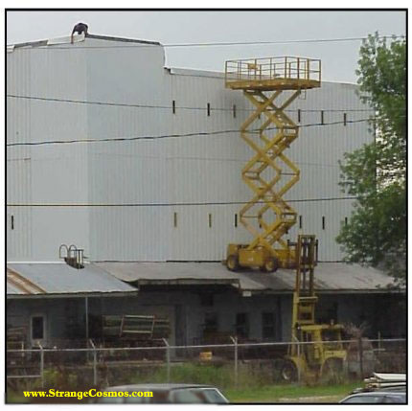
Questions?
Thank You!

