Slide 1
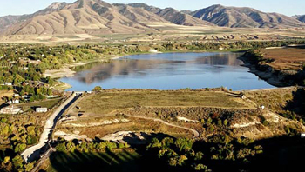
Hydrologic Analysis of the Hyrum Reservoir watershed
By Andrew Ritchey

Slide 2
Introduction:
Objective:
Perform a hydrologic analysis of the Hyrum Reservoir watershed for a 6 hr - 100 yr storm using Arc-GIS.
Produce Inflow Hydrograph.
Route the 6 hr – 100 yr storm through Hyrum Reservoir.

Slide 3
Data Sources:
NHDplus Data: Region 16 b
DEM
flow direction
Flow Accumulation

Slide 4
Data Sources:
USGS:
Land Cover Data

Slide 5
Data Sources:
NOAA Atlas 14
Precipitation Frequency Estimates
6 hr -100 yr Precipitation
2.21 in

Slide 6
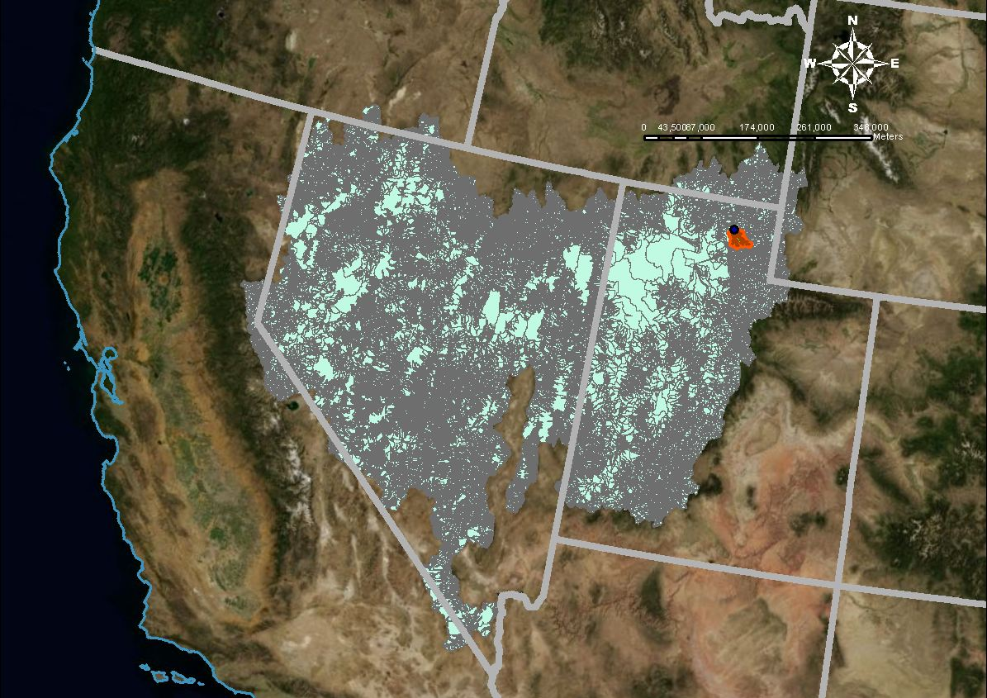
Analysis Using Arc GIS 10:
Watershed Delineation
Stream Delineation
Network Analysis
Land Use Analysis

Slide 7
Watershed Delineation:
Outlet
Inputs:
fdr
Outlet
Spatial Analyst Tool:
Watershed

Slide 8
Stream Delineation:
Inputs:
fac
wshed
Spatial Analyst Tool:
Raster Calculator
(“fac”>500)&(“wshed>0”)

Slide 9
Network Analysis:
Inputs:
Streamlines
Tools:
Feature Vertices to Points
Utility Network Analyst

Slide 10
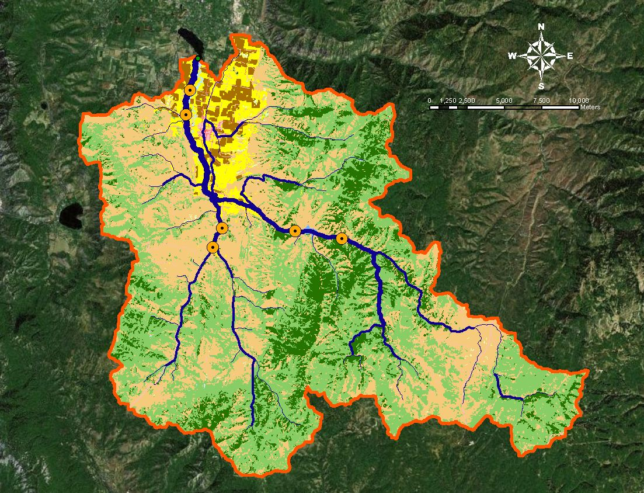
Land Use Analysis:
USGS Land Use Raster Cropped to Watershed
Used to develop CN

Slide 11
Calculations: Curve Number, CN
Land classification counts used to determine the percentage of watershed in each land use.

Slide 12
Calculations: Curve Number, CN
SCS Soil Group Classification needs to be determined before CN can be determined

Slide 13
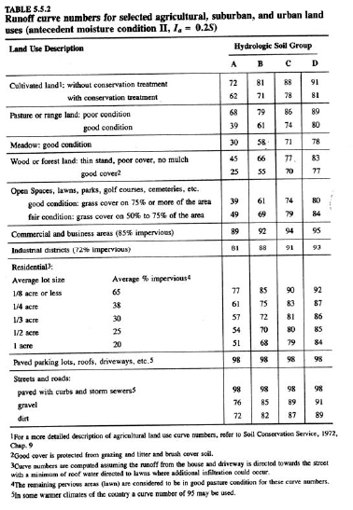
Calculations: Curve Number, CN

Slide 14
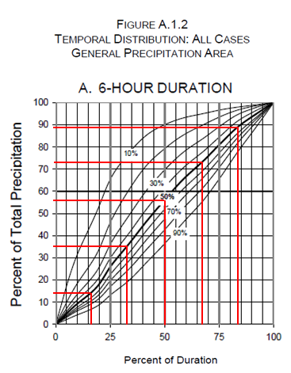
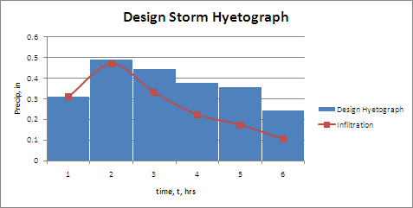
Calculations: Design Storm (SCS)

Slide 15
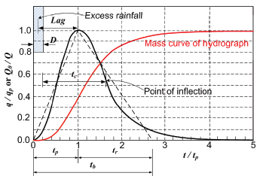
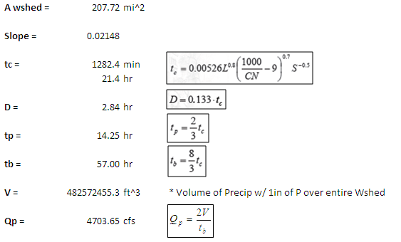
Calculations: SCS Unit Hydrograph

Slide 16
Calculations: Design Storm Hydrograph

Slide 17
Calculations: Reservoir Flood Routing

Slide 18
Calculations: Reservoir Flood Routing

