Slide 1
Management of Flood Waters through Mcphee Reservoir
GIS in Water Resources
December 2009
Josh Mortensen

Slide 2
Introduction
Location: SouthWest Colorado
2nd Largest in Colorado
Completion: 1985
Uses: Irrigation (61,660 acres)
Municipal/Industrial
Hydropower
Flood Control
Capacity: 381,000 acre-ft

Slide 3
Change in Project Focus
Was downstream irrigation structures
Insufficient information
Not a real life problem
Now Upstream Inflows
Information available
Job for ArcGIS
More applicable

Slide 4
Objective: Use ArcGIS to predict the inflow at remote reservoir inlets for a storm event.
Purpose: Conserve water through improved reservoir operation from more accurate inflow data.
Decrease the necessity of stream gages at remote locations.

Slide 5
Colorado Decision Support Systems Map Server
Outlet
(Dam, Emergency
Spillway)
Additional inlets
from storm runoff?
Outlet
(3 main irrigation
canals)
Inlet (Only inflow
gage, Dolores River)

Slide 6
Pool Elevation (ft)
Inflow (cfs)
Volume (acre-ft)
Release (cfs)

Slide 7
100 yr – 2 hr Storm Event
Assumptions
Storm covers lake and watershed
Occurs in spring during peak base flows
All runoff is from this storm (no snow runoff from this watershed)

Slide 8
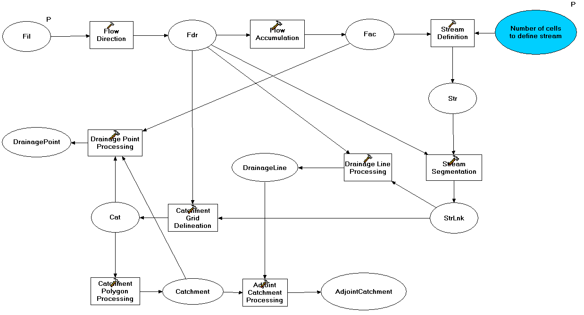
Model Builder (ex.)

Slide 9
Base Map
GCS_North_American_1983

Slide 10
Precipitation vs. Stream Flow
Use precipitation data from a storm in 1993
Compare predicted stream flow from data to measured stream flow at stream gage

Slide 11
Summary
Inflow from runoff in remote canyons not taken into account for reservoir operation
Inflow to be predicted for a storm event (not including snow)
Model of storm event and verification with past data (1993 storm) still need to be completed

