Slide 1
Mapping the run-off related to the land use in Little Bear-Logan Utah
Ling Lv

Slide 2
Content
Introduction
Data resources
Methodologies
Building up the Catchments
Land cover Analysis
Run-off Analysis
Conclusions

Slide 3
Introduction
Objection:
Map the runoff related to the land use in 1992 in Little Bear-Logan UT for a 100-year storm.

Slide 4
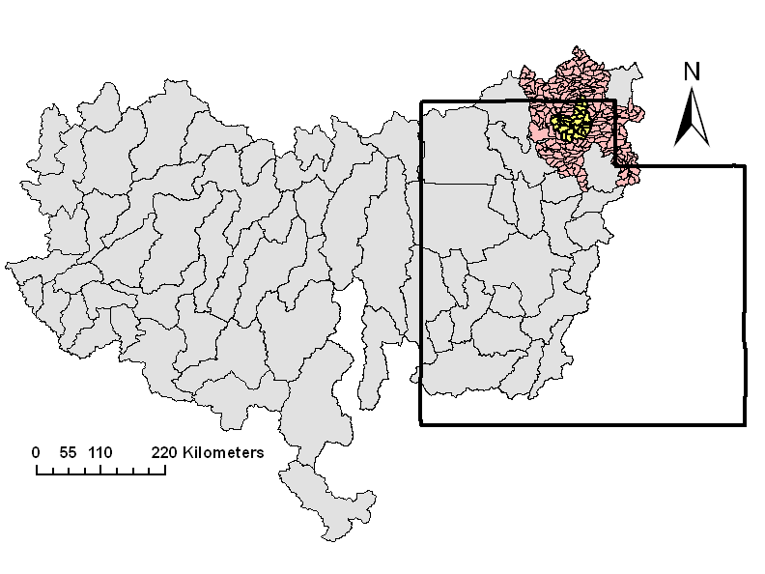
Introduction
Site description:
Fig 1 the Layout of Research Area in Region 16

Slide 5
Data Resources
(1) Region 16 Catchment shape file
(2) Region 16 Catchment Flow line Attributes
(3) Region 16 Elevation Unit b
(4) Region 16 National Hydrography Dataset

Slide 6
Data Resources
Cache HUC 12 Watershed Boundary Dataset
Cache HUC8 watershed Boundary Dataset

Slide 7
Data Resources
1992/2001 Land cover change data
Multi-Resolution Land Characteristics (MRLC) Consortium

Slide 8
Data Resources
Tab 1 Runoff Coefficient
Class No. | Land Use Type | Runoff Coefficient
1 | Open water | 0
2 | Urban | 0.7
3 | Barren | 0.8
4 | Forest | 0.15
5 | Grassland/Shrub | 0.25
6 | Agricultural Land | 0.4
7 | Wetland | 0.05
http://igs.indiana.edu/survey/projects/hydrotools/html_files/element2.cfm

Slide 9
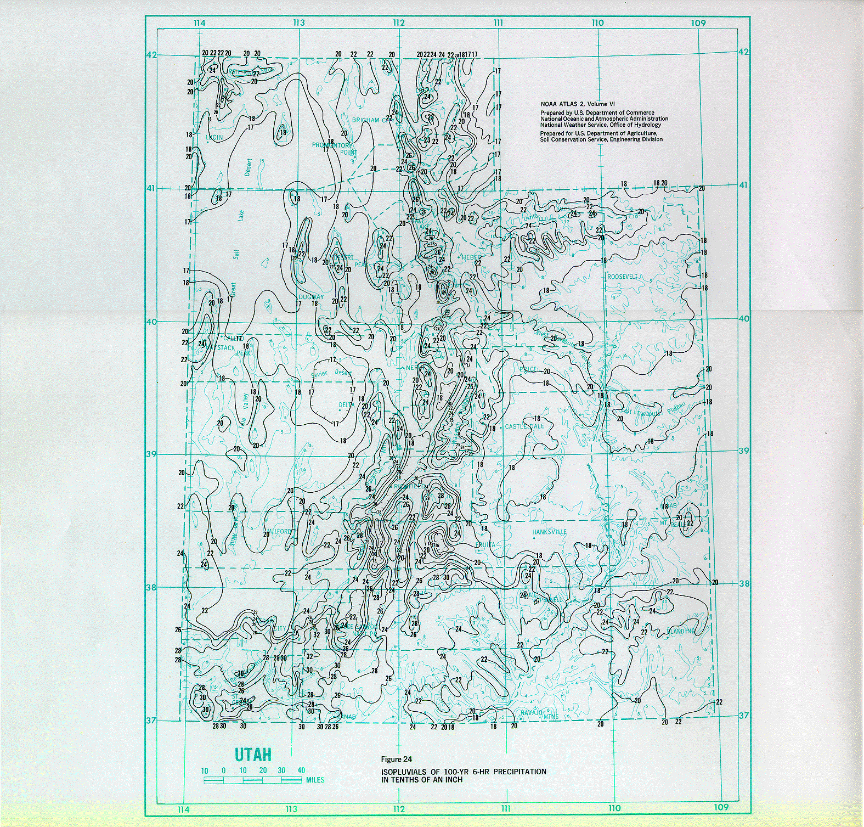
Data Resources
Utah100 yr precipitation frequency
From: http://igs.indiana.edu/survey/projects/hydrotools/html_files/element2.cfm

Slide 10
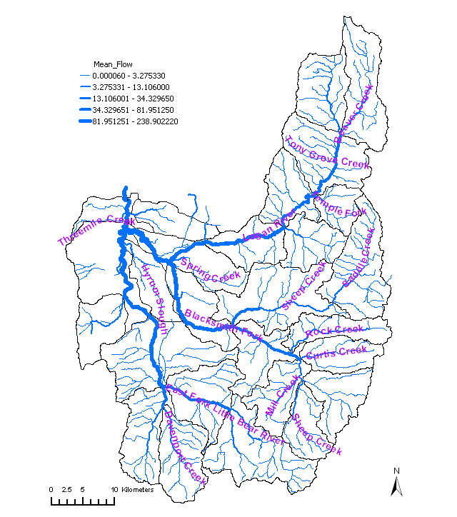
Methodologies
Building up the Catchments
Fig 2 the Layout of Research Area

Slide 11
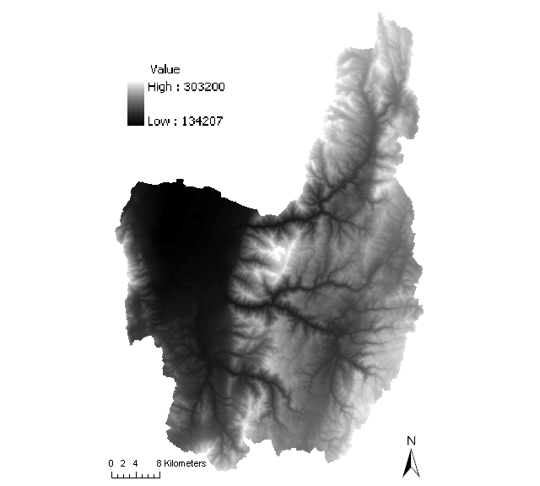
Methodologies
Building up the Catchments
Fig 3 the Layout of DEM

Slide 12
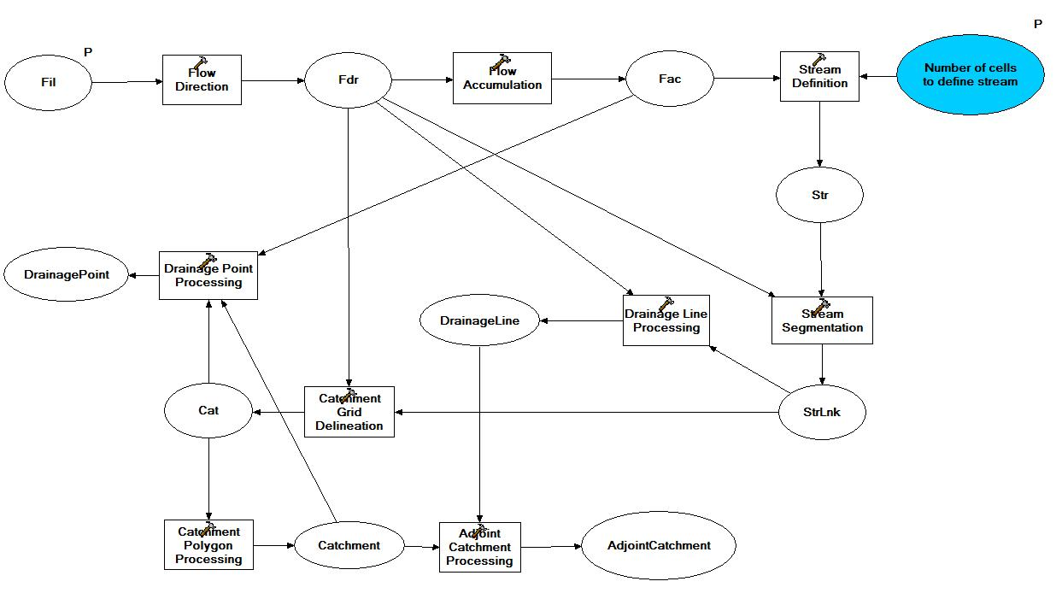
Methodologies
Building up the Catchments
Building the Catchment with HydroID
Fig 4 the Terrain Processing Workflow

Slide 13
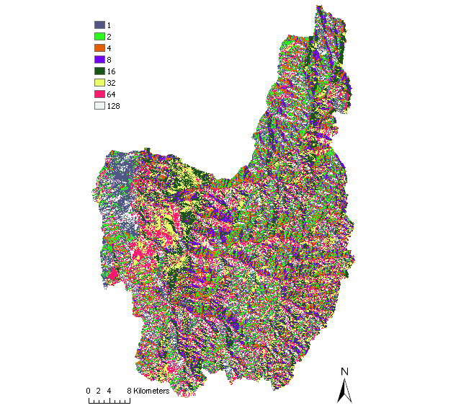
Methodologies
Building up the Catchments
Fig 5 the Flow Direction

Slide 14
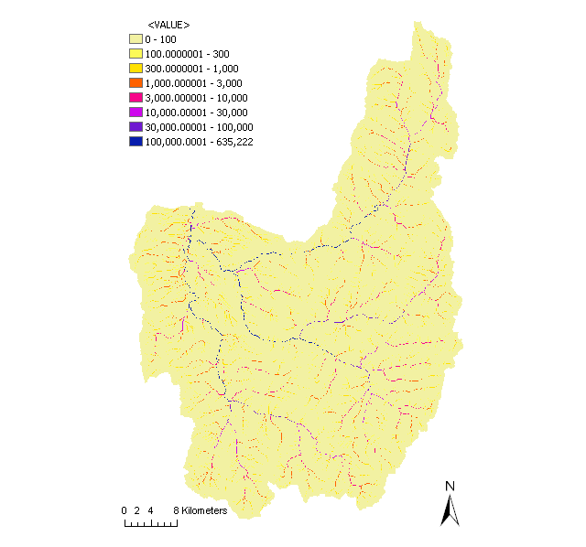
Methodologies
Building up the Catchments
Fig 6 the Flow Accumulation

Slide 15
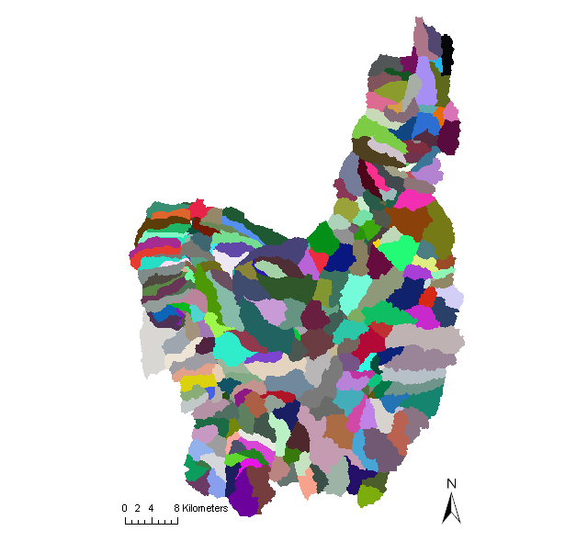
Methodologies
Building up the Catchments
Fig 7 the Cat raster

Slide 16
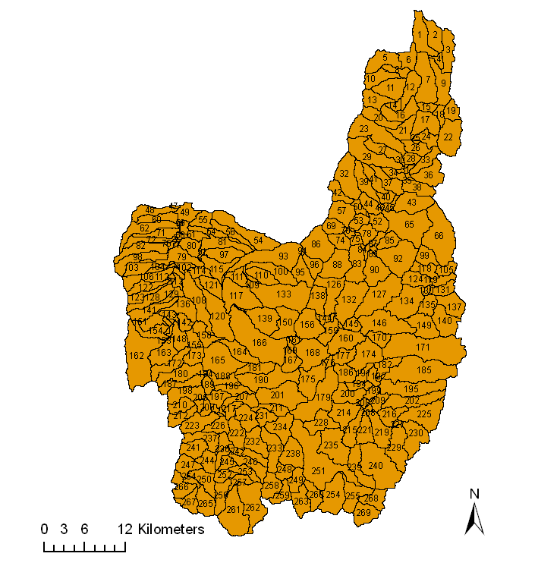
Methodologies
Building up the Catchments
Fig 8 the Catchment Polygon

Slide 17
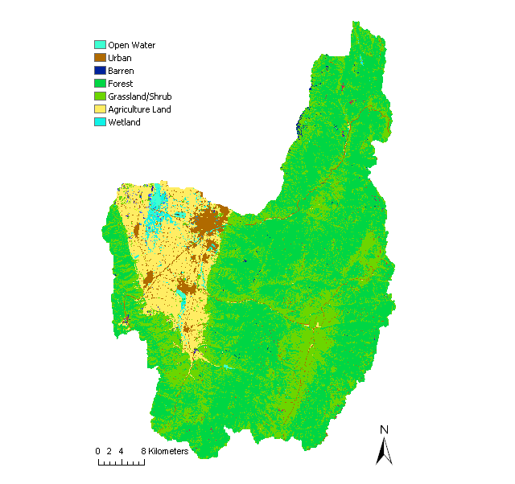
Methodologies
Land Cover Analysis
Fig 9 the Land Use in Research Area

Slide 18
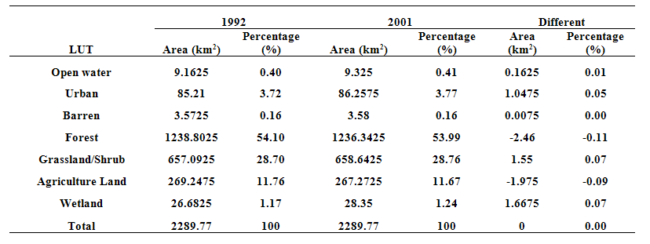
Methodologies
Land Cover Analysis
Table 2 the land use of research area in 1992 and 2001

Slide 19
Methodologies
Land Cover Analysis
Table 3 Hierarchical cluster analysis of land use by catchments in1992
Type | Description | HydroID
Open Water | The area of open water>75% | 58, 59, 63
Wetland | The area of wetland>75% | 73, 74, 77
Urban | The area of urban>90% | 147
Agriculture land | The area of agriculture>75% | 48-49, 54-56, 60-61, 64, 71, 76, 79-80, 91, 101-102, 104, 107-108, 112-115, 117, 120-121, 129, 136, 142, 148, 153, 155, 158, 165, 173, 183-184, 188, 197, 218
Urban+Agriculture land | The area of urban and agriculture>75%, they are almost the same areas | 97, 109, 111, 116, 143, 152
Forest+Grass+Agrculure land | The area of forest, grass and agriculture>75%, they are almost the same areas | 47, 62, 72, 82, 93, 98, 103, 106, 110, 122, 123, 128, 141, 163, 164, 166, 172, 189, 196, 213, 217, 220
Forest | The area of forest>75% | others

Slide 20
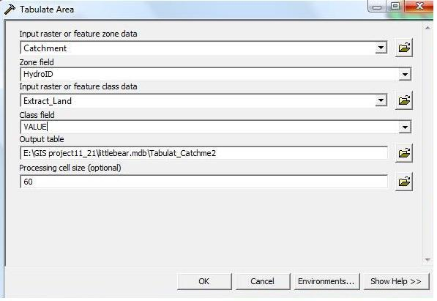
Methodologies
Runoff Analysis
Fig 10 the Tabulate Area Function

Slide 21
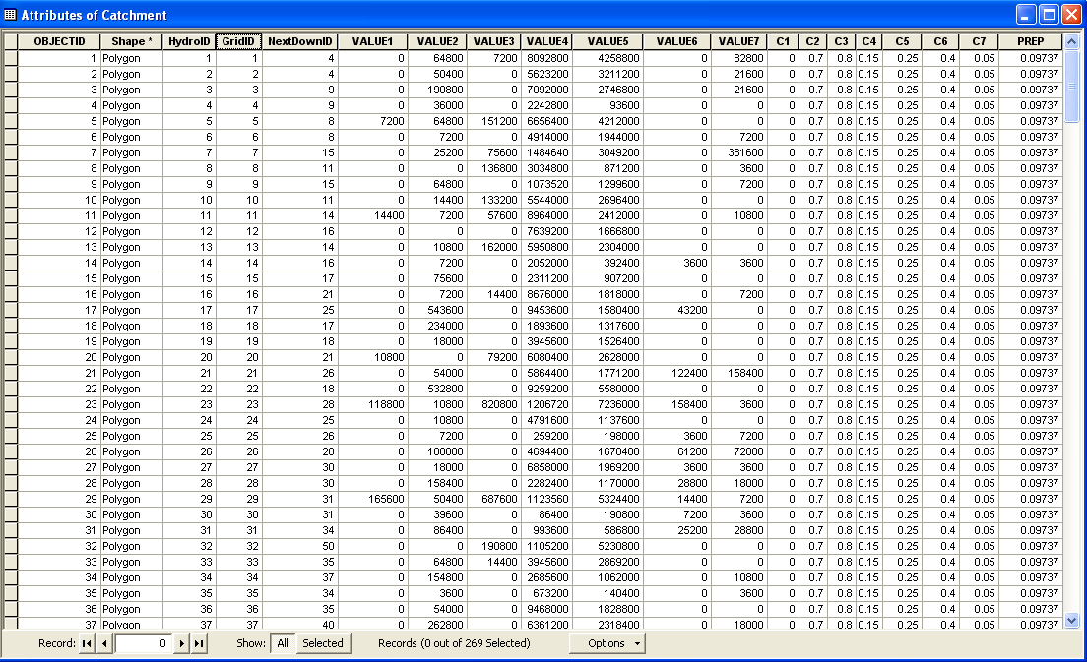
Methodologies
Runoff Analysis
Fig 11 the Tabulate Area Function

Slide 22
Methodologies
Runoff Analysis
---- the runoff of catchment, mm;
---- the runoff coefficient of different land use types;
---- the precipitation intensity, m/h, it is constant here;
---- the continuous time of rainfall, h
---- the area of land use in a catchment, m²;
-----the land use types.

Slide 23
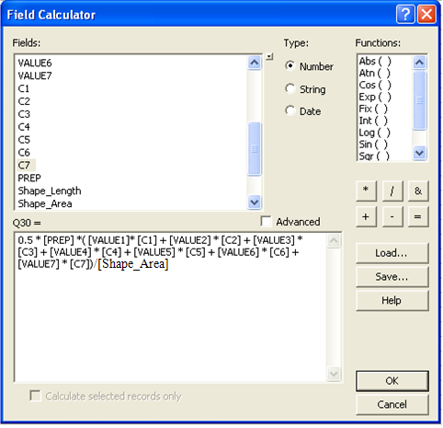
Methodologies
Runoff Analysis
Fig 12 the Runoff Calculation

Slide 24
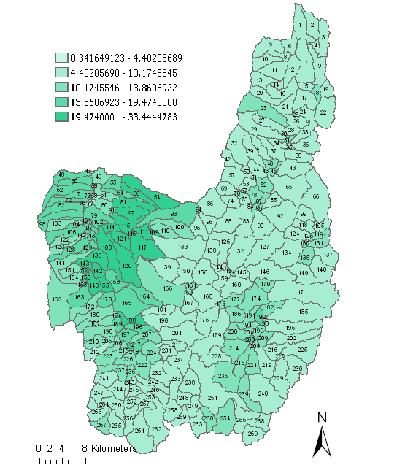
Methodologies
Runoff Analysis
Fig 13 the Runoff within 0.5h

Slide 25
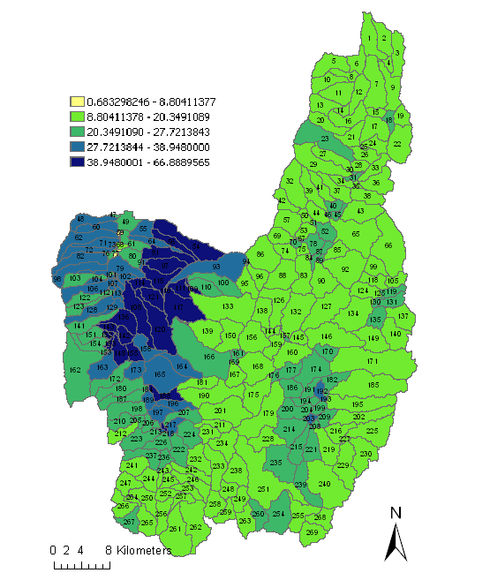
Methodologies
Runoff Analysis
Fig 14 the Runoff within 1h

Slide 26
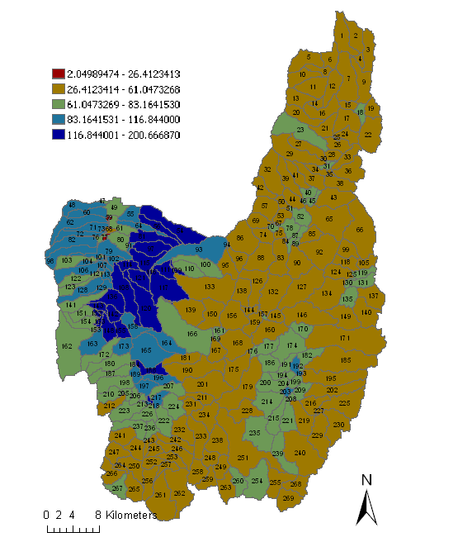
Methodologies
Runoff Analysis
Fig 15 the Runoff within 3h

Slide 27
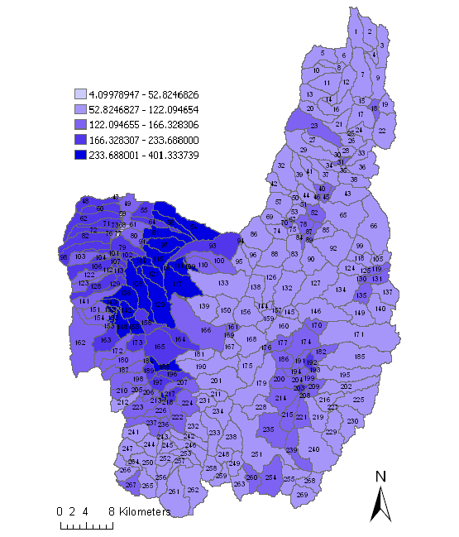
Methodologies
Runoff Analysis
Fig 16 the Runoff within 6h

Slide 28
Methodologies
Runoff Analysis
Table 4 Hierarchical cluster analysis of 0.5h runoff in catchments in1992
Type | Description | HydroID
Open water+Wetland | Average runoff was 2.05mm, and runoff was between 0~4.5mm | 58, 59, 63, 73, 77
Forest+Grassland | Average runoff was 9.8mm, and runoff was between 9~13.5mm | Others
Agriculture land | Average runoff was 17.93mm, and runoff was between 14~24mm | 48, 54-56, 60, 62, 64, 71-72, 79, 81-82, 91, 93, 98, 101-102, 104, 106-108, 111-115, 117, 120-121, 128-129, 136, 142, 148, 153, 155, 158, 163-165, 173, 183-184, 188-189, 192, 196-197, 203--204, 213, 217, 218, 220
Urban+Agriculture land | Average runoff was 26.11mm, and runoff was between 25~27mm | 97, 109, 116, 143, 152
Urban | Runoff was 33.45mm | 147

Slide 29
Conclusions
(1) The land covers in the Little Bear Logan-UT, had no significant changes between 1992 and 2001.
(2) The catchments in the Little Bear Logan-UT, could be divided into 7 types according to the hierarchical cluster analysis: Open Water, Wetland, Urban, Agriculture land, Urban+Agriculture land, and Forest domain catchments.

Slide 30
Conclusions
(3) The runoff in the catchments in the Little Bear Logan-UT were divided into 5 levels. The runoff generated in each catchment was correlation with the land use features in the catchment. Open water domain catchment had the lowest runoff and Urban domain catchment had the highest runoff, followed by Urban+Agriculure land, Agriculture land and Forest+Grassland

Slide 31
QUESTIONS ?

