Slide 1
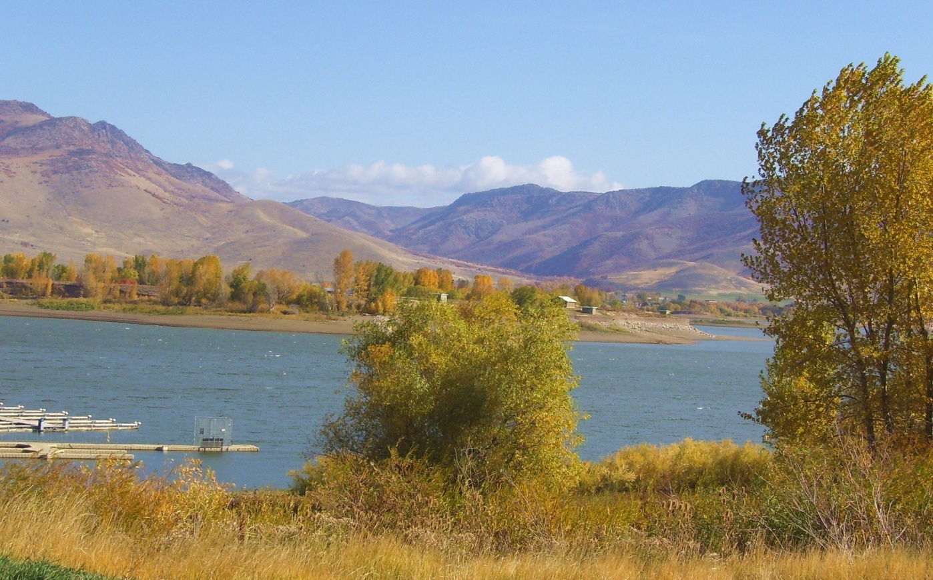
Non-Point Source Pollution in Pineview Watershed Lindsey DeBoer CEE 6440

Slide 2
Pineview Reservoir
Notes:
Northern Utah, about 8 miles east of Ogden
Characteristic duck shape

Slide 3
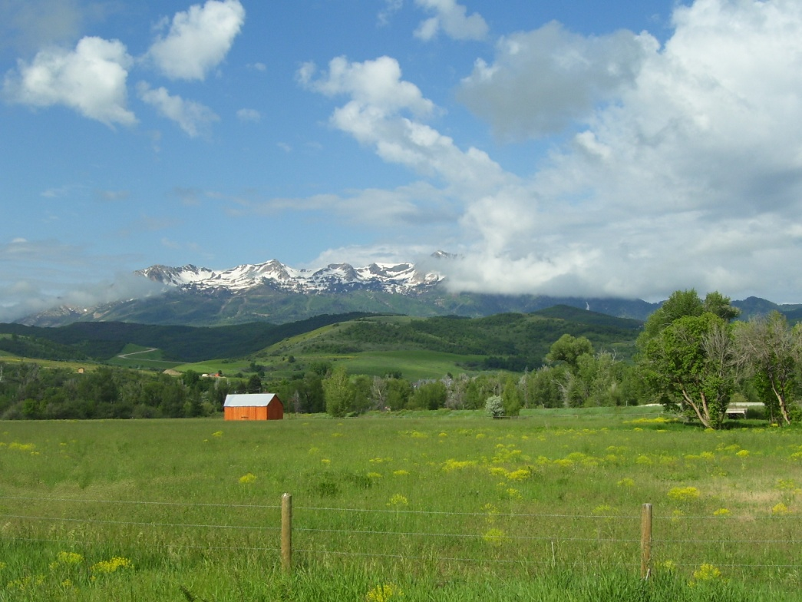
The Problem
Beneficial use of reservoir not met
Production of algal and cyanobacterial blooms
Decomposition processes increase hypolimnetic oxygen demand
TMDL reports N
and P co-limiting
No point sources
Development

Slide 4
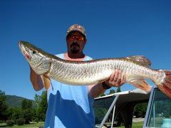
Why should we care?
http://photos1.blogger.com/x/blogger2/3657/3325/240/z/151362/gse_multipart57949.jpg
Drinking water source
Recreation & aesthetics
Ecological impacts
Notes:
Ogden City population >80,000
Snow Basin & Powder Mountain Ski Resorts
Premiere site for Tiger Muskie which do not tolerate warm water very well

Slide 5
Export Coefficients
Depend on land use, geography, climate, etc.

Slide 6
Drainage Area Based on Land Use

Slide 7
Drainage Area by Land Use

Slide 8
Comparison of Two Reaches
North Branch
South Branch

Slide 9
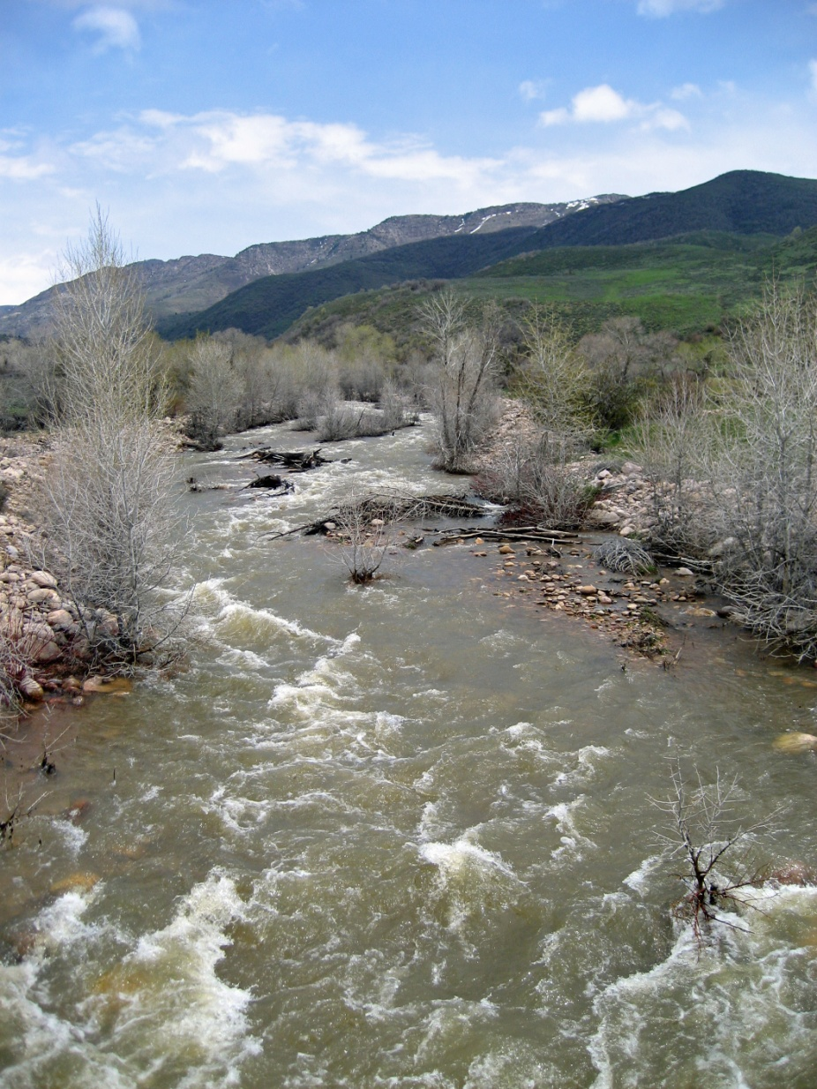
Limitations
Unidentified land use considered ‘Rangeland’
Water flow is natural
Nutrients unaffected by in-stream processes

Slide 10
Questions?

