Slide 1
Floodplain Management using ArcGIS and HEC-RAS
CEE6440 GIS in Water Resources
December 1, 2009
Jongho Keum

Slide 2
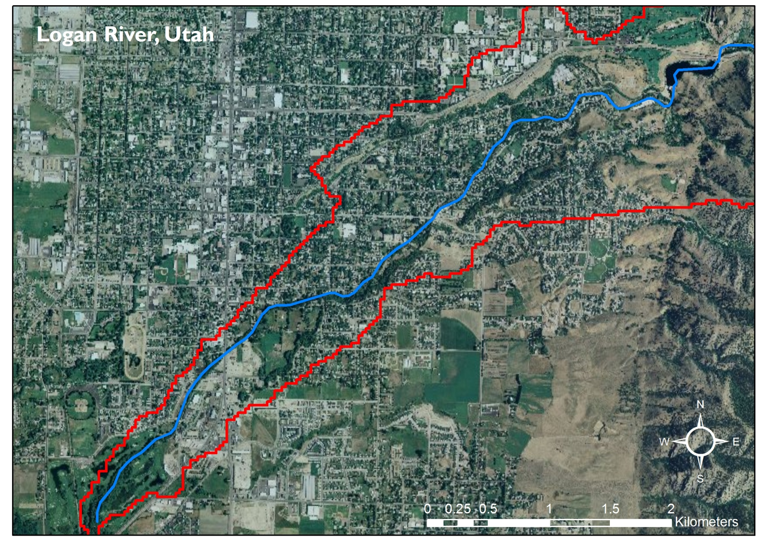
Study Area

Slide 3
Software
ArcGIS
  Geometry
  Mapping
HEC-RAS
  Water Surface Profile
HEC-GeoRAS
ArcGIS Extension

Slide 4
Data Requirements
Digital Elevation Model (DEM)
  Cell size : 1/3 arc-second
  http://seamless.usgs.gov
  Converted to TIN for RAS geometry export
Streamflow
  Daily streamflow of Logan River
  Site : Logan River above State Dam (10109000)
  Profile
    Historical maximum flow
    75%, 50%, 25% quartile flow

Slide 5
Floodplain mapping procedure
Pre-RAS
  Export channel geometry for HEC-RAS
HEC-RAS
  Calculate water surface elevation
Post-RAS
  Map water surface elevation to terrain

Slide 6
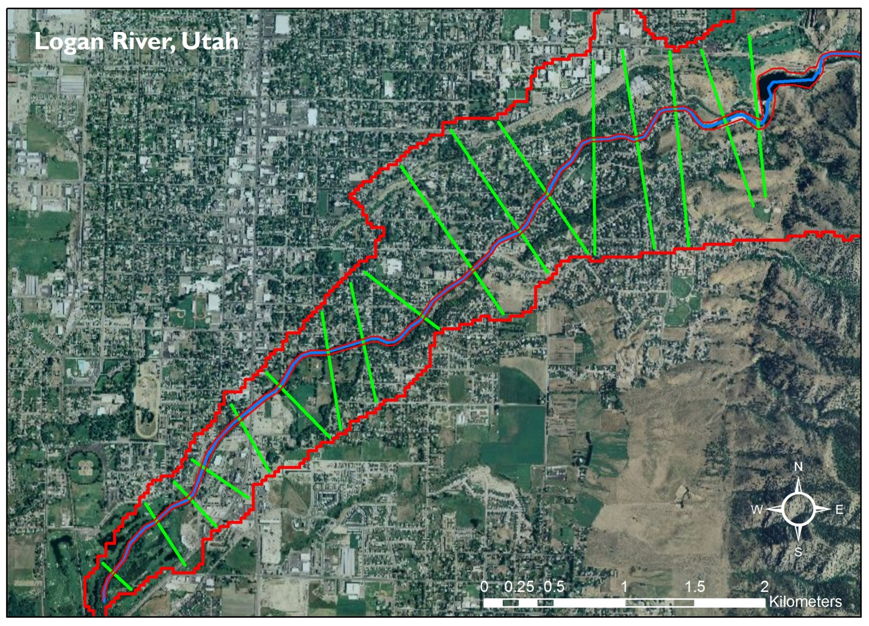
Pre-RAS

Slide 7
Pre-RAS

Slide 8


HEC-RAS
Standard Step Method
Energy equation between two cross sections

Slide 9
HEC-RAS
Streamflow
  historical max.
  25% probability
  50% probability
  75% probability

Slide 10

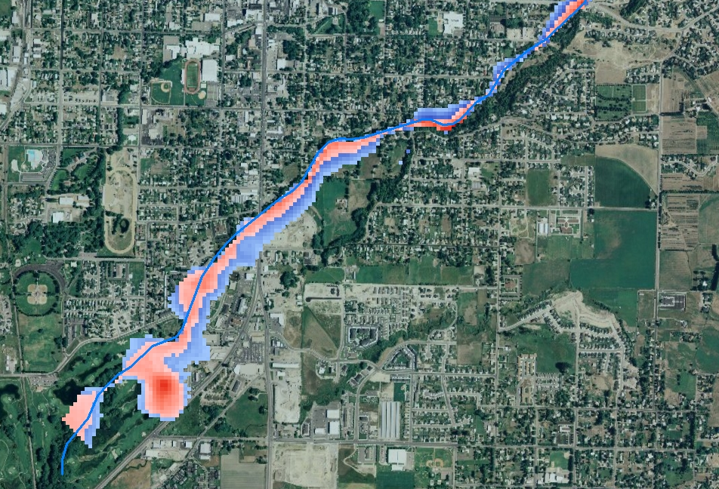

Post-RAS
historical max.
25% probability

Slide 11


Post-RAS
50% probability
75% probability

Slide 12
Floodplain management
Modifying flooding
  structural control measures
Modifying susceptibility to flooding
  non-structural mitigation measures
Modifying the impacts of flooding
  do not reduce, spread the cost
Preserving the natural and beneficial functions of floodplains
  ecological perspective
Simonovic (2002)

Slide 13
Application
Residential area
  hard to apply non-structural methods
Non-residential area
  non-structural mitigation measures
Natural river area
  preserve current floodplain

Slide 14
Conclusion
Delineate floodplain of Logan River
Suggest a guideline for managing flood
  where anti-flooding facilities are needed
  where new building cannot be constructed
  submerging depth

Slide 15
Limits
needs high-resolution DEM
  or surveying channel cross section
  1, 1/3, 1/9 arc-second grid?
    scale of river
    1 and 1/3 are ready to use in US
    1/9 is at the beginning
      Unfortunately, HEC-GeoRAS does not work in ArcGIS educational version

Slide 16

Thank You
Questions or comments?

