Slide 1
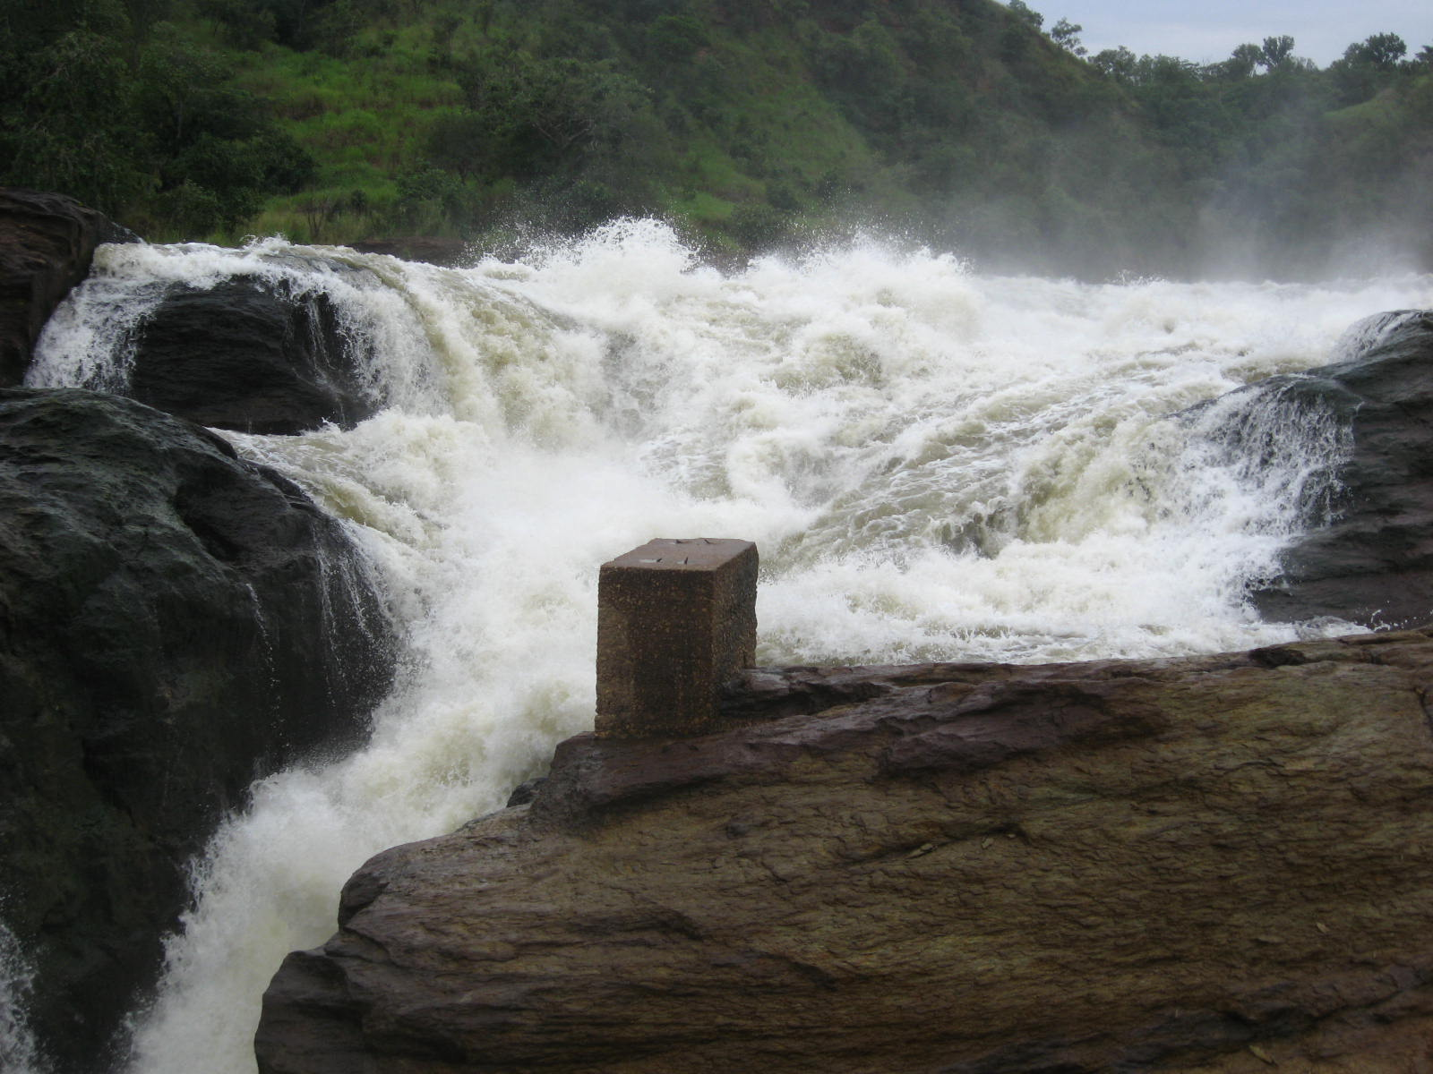
Little Bear River 100-Year Storm Flood
Joe Hawkes
December 1, 2009

Slide 2
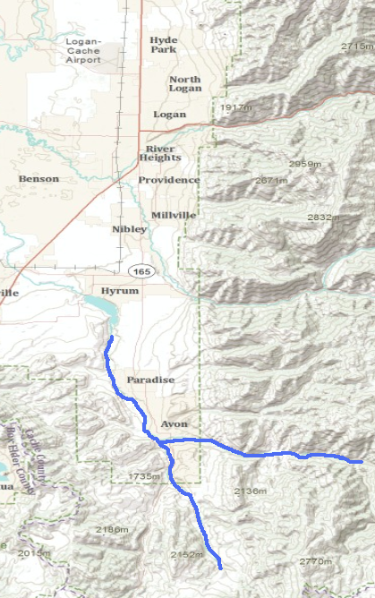
The Problem
Advancing residential developments in Cache Valley don’t analyze hydrologic aspects of development sites
Dry Canyon
Example
Dry Canyon debris dam cost approximately $5 million
Little Bear River
This report focuses on residential development in the Little Bear River Floodplain.

Slide 3
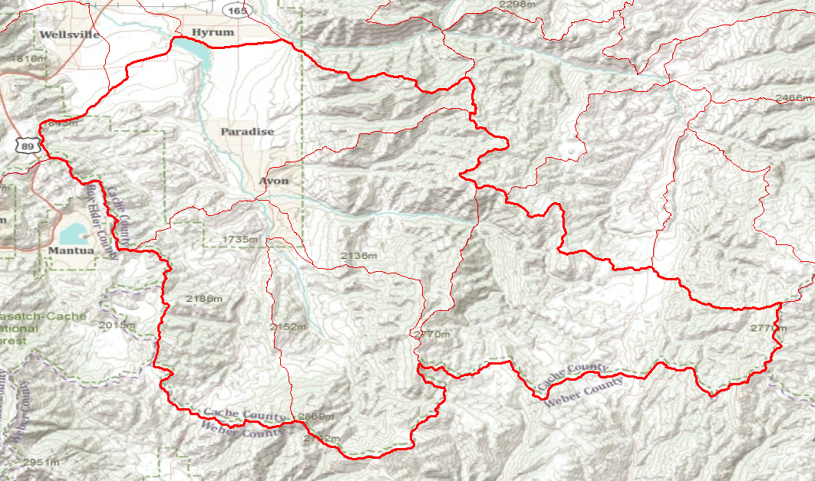
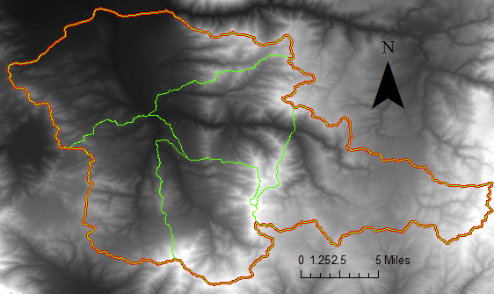
The Location
The South end of Cache Valley holds the Little Bear River. The river is formed from the South Fork and East Fork branches of the Little Bear.
The analysis location is between Hyrum Reservoir (downstream) and Porcupine Reservoir (upstream).
Less than 10 miles

Slide 4
Data Collection
USGS
Digital Elevation Model
National Hydrography Dataset
Stream Gage Data for Paradise
1992-2009
ArcGIS Online
World Topographic Map
Google Earth
Images of analysis area
NOAA
100-year point precipitation estimates

Slide 5
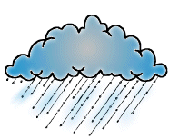
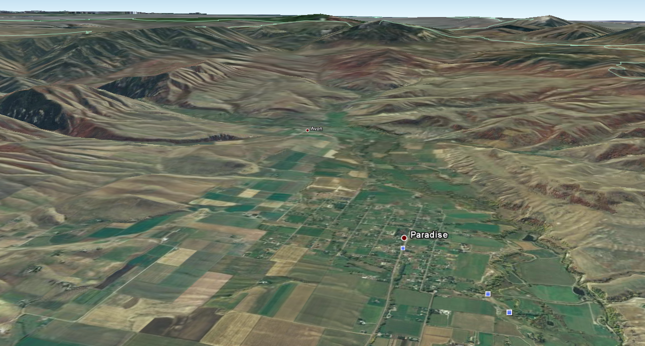
General Method
Model storm over drainage
Use DEM to calculate flow direction and accumulation
Apply runoff ratio
Create hydrograph

Slide 6
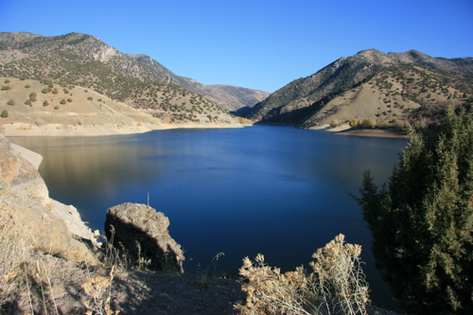
Unique Difficulties
Porcupine Reservoir
Reservoir operations determine streamflow
Privately Owned Reservoir
Operation records more difficult to find
With correct operation, max flow equals flow through both penstocks
Streamflow and runoff upstream of reservoir can be ignored

Slide 7
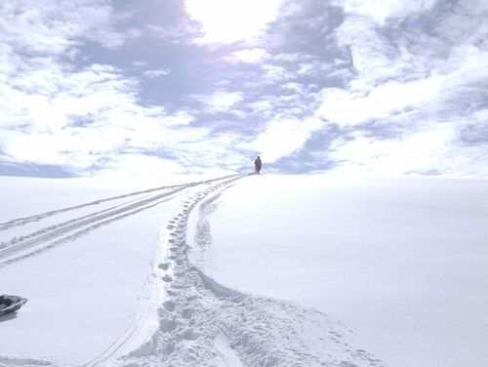
Unique Difficulties cont.
Spring Runoff
Rain on Snow
Temperature index
Snow Depths
Average May Temperature
Snow everywhere/sufficient depth
Baseflow
Difficult to determine

Slide 8
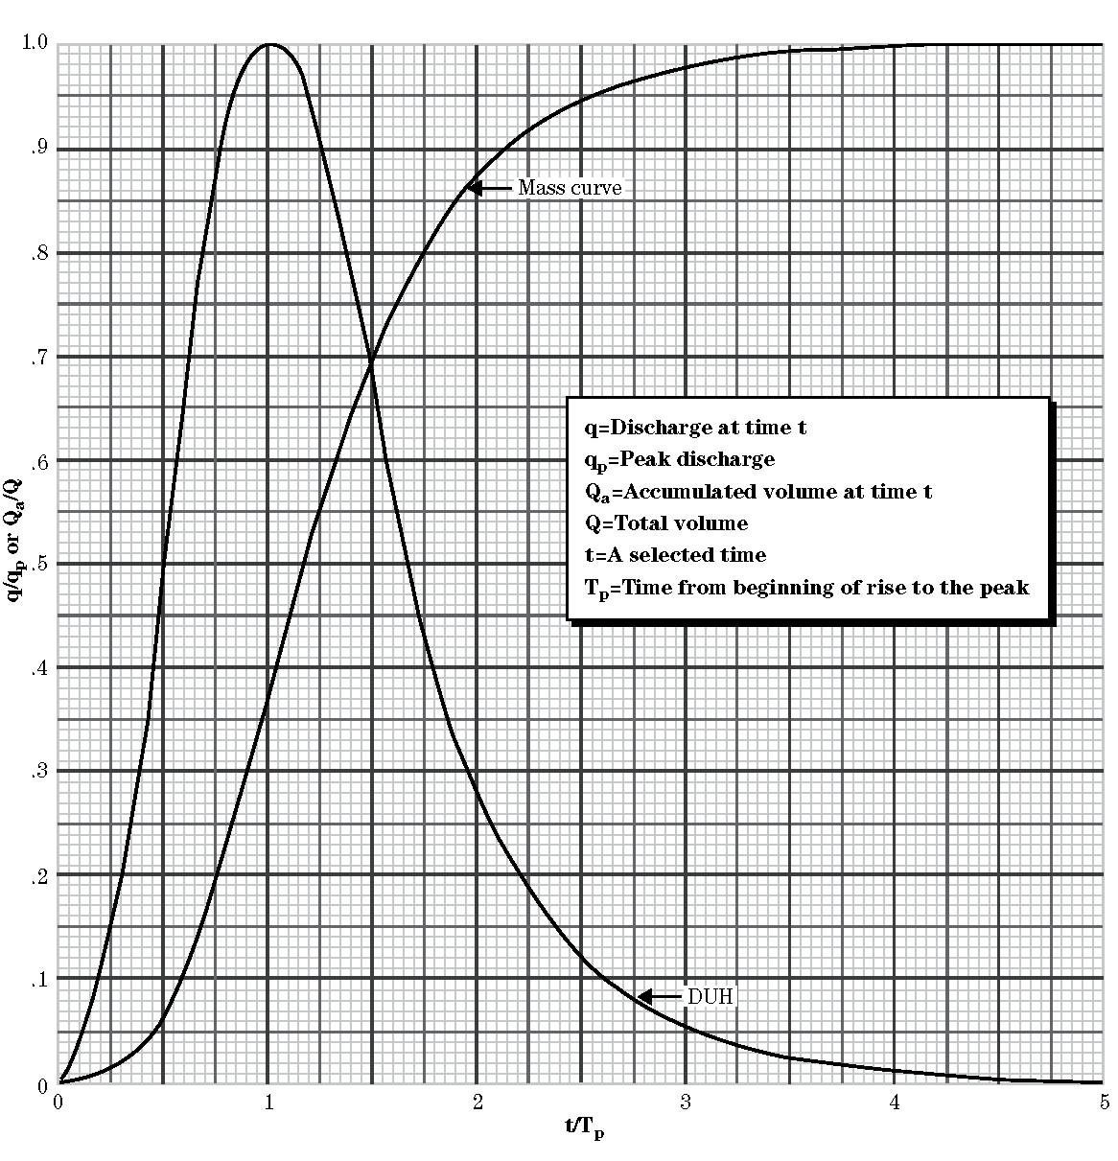
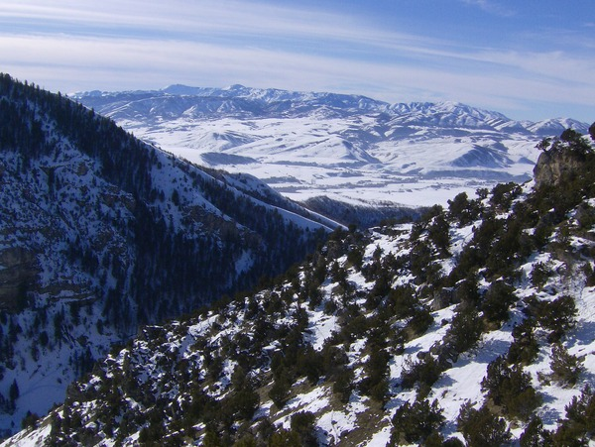
To do…
Create Hydrograph using unitless Hydrograph
Calculate melting index and runoff
Compare to last 16 years of streamflow

Slide 9
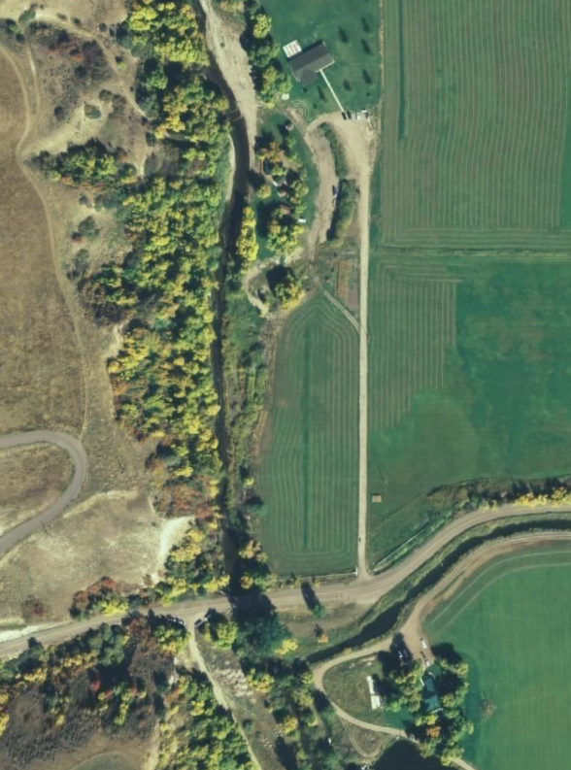
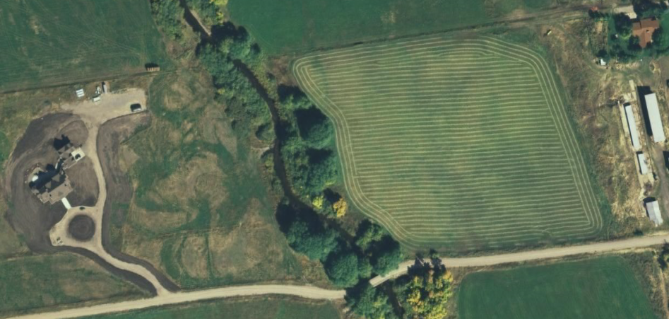
Conclusion
Building
The flood hydrograph can be further analyzed using open channel hydraulics and the riverbed characteristics to find when the river banks will be topped and the damage, if any, caused.
ArcGIS can be used on a local scale by municipalities to solve problems and avoid future costs.
Bridge
Hawkes House
Building
Building
Bridge

Slide 10
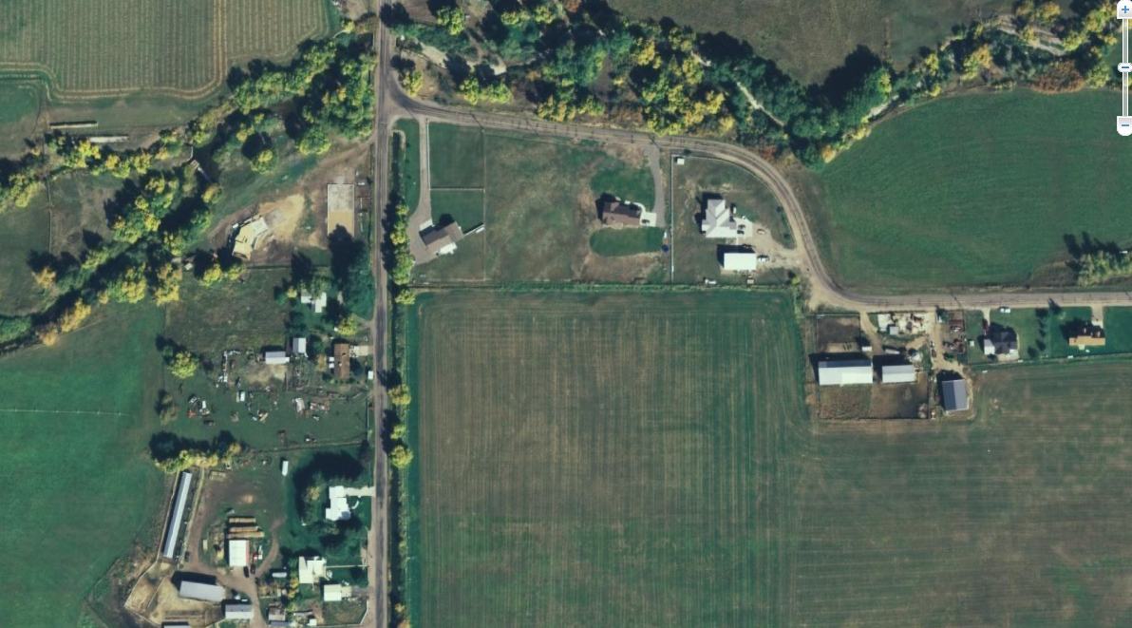
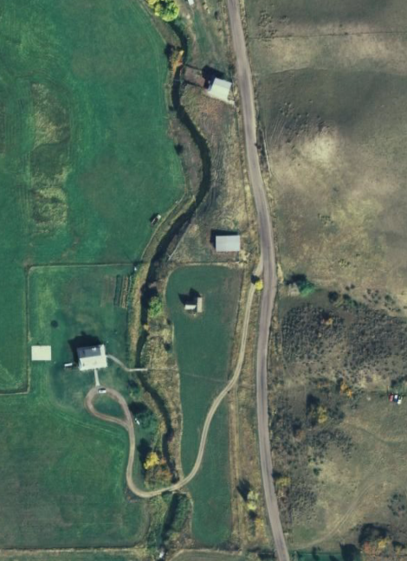
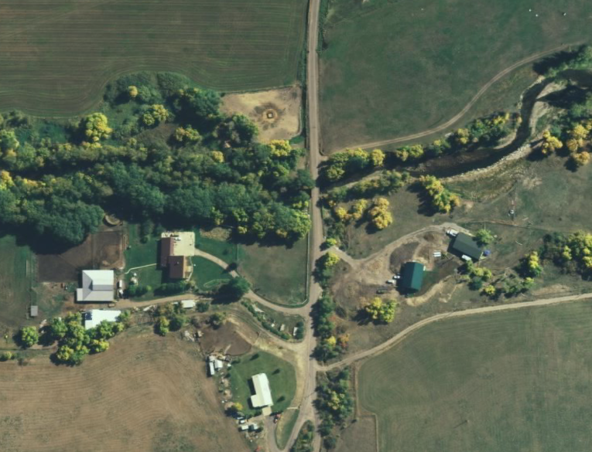
Questions… comments… praise?

