Slide 1
Lower Malad Sub Watershed Analysis and its Effect On The Bear River Migratory Bird Refuge by Francisco Suero UTAH STATE UNIVERSITY

Slide 2
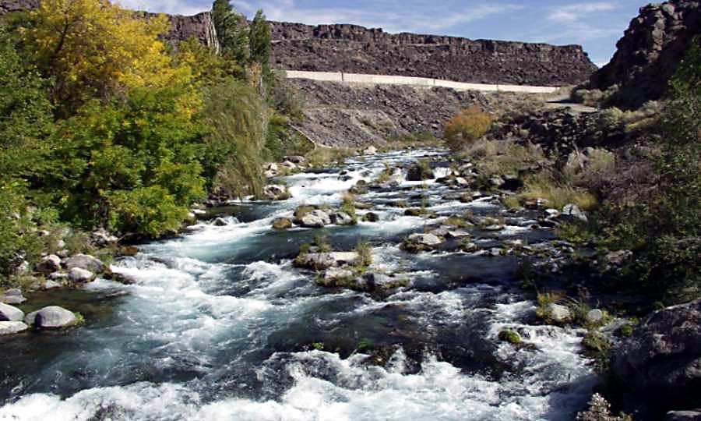
Outline
Location
Topography
Climate
Hydrography
Bird Data
Analysis

Slide 3
Location
It’s located between:
Longitudes: 111⁰W and 113⁰ W
Latitudes: 41⁰N and 43⁰N.
Area: 3257.55 km²
It’s split almost in half by the border between the state of Utah and the state of Idaho.

Slide 4
Topography
Maximum elevation: 2,855.65 m
Minimum elevation: 1,280.50 m (Great Salt Lake)

Slide 5
Climate - Precipitation
Spring: 4.40 in.
Summer: 1.46 in
Fall: 3.36 in
Winter: 3.80 in

Slide 6
Climate – Evaporation
Spring: 5.78 in.
Summer: 15.38 in
Fall: 6.41 in
Winter: 1.56 in

Slide 7
Hydrography
 | Flowrate (cfs)
Spring | 2518.60
Summer | 288.75
Fall | 715.65
Winter | 1389.69
* Bear River near Corrine

Slide 8
Bird Data and Variables
 | Spring | Summer | Fall | Winter
Precipitation | 4.40 | 1.46 | 3.36 | 3.80
Evaporation | 5.78 | 15.38 | 6.41 | 1.56
Flowrate | 2518.60 | 288.75 | 715.65 | 1389.69
Birds | 6,166,368 | 7,062,530 | 10,385,765 | 1,561,384

Slide 9
Bird Data by Year

Slide 10
Analysis
2006
 | Flowrate (cfs) | Precipitation (in) | Evaporation (in) |  | Number of Birds
Spring | 3774 | 5.36 | 3.27 |  | 5,937,343
Summer | 491 | 1.87 | 19.22 |  | 4,113,848
Fall | 1016 | 4.30 | 7.83 |  | 11,141,526
Winter | 1603 | 4.34 | 1.15 |  | 2,362,063
2007
 | Flowrate (cfs) | Precipitation (in) | Evaporation (in) |  | Number of Birds
Spring | 1264 | 3.43 | 8.28 |  | 6,395,393
Summer | 87 | 1.05 | 11.53 |  | 10,011,211
Fall | 415 | 2.41 | 4.99 |  | 9,630,004
Winter | 1176 | 3.26 | 1.96 |  | 760,705
Average
 | Flowrate (cfs) | Precipitation (in) | Evaporation (in) |  | Number of Birds
Spring | 2518.60 | 4.40 | 5.78 |  | 6,166,367.50
Summer | 288.75 | 1.46 | 15.38 |  | 7,062,530
Fall | 715.65 | 3.36 | 6.41 |  | 10,385,765
Winter | 1389.69 | 3.80 | 1.56 |  | 1,561,384

Slide 11
Questions?

