Slide 1
The 1997 New Year’s Flood of Record in the Walker River Basin
Nathaniel Bergman
CEE 6440
1 December, 2009

Slide 2
Presentation Outline
Introduction
Study Area
The 1997 Flood of Record
Methods
Data from various sources
Further work planned
Questions

Slide 3
Introduction
The geomorphic theory has 2 classic opposing theories regarding the effect of large floods and their significance on shaping the landscape:
1. Large (high magnitude) low recurrence interval (RI) floods have a long lasting effect on channel morphology compared to small and moderate flood events (Baker, 1977; Wolman and Gerson, 1978).
VS.
2. Small and medium flood events that are frequent (low magnitude high recurrence interval) are the ones that determine channel morphology (Wolman and Miller, 1960).

Slide 4
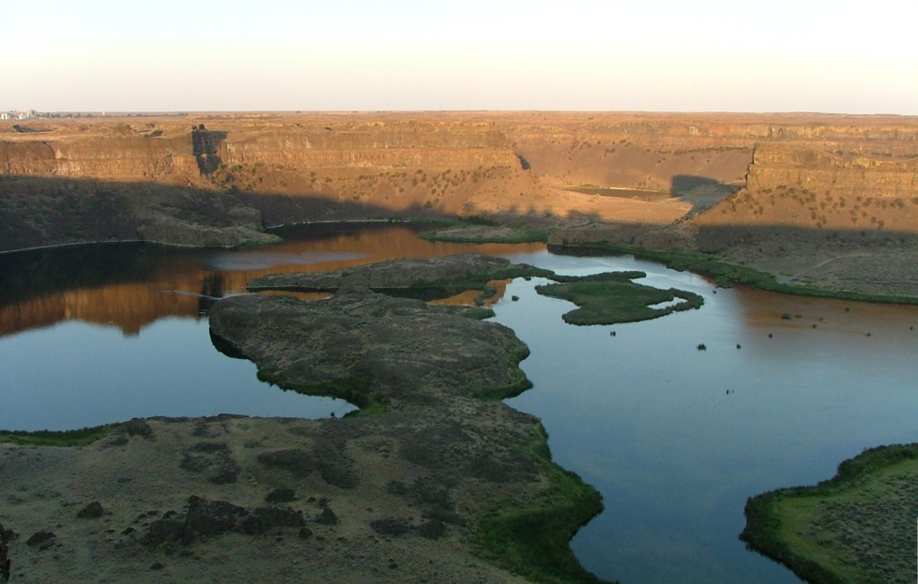
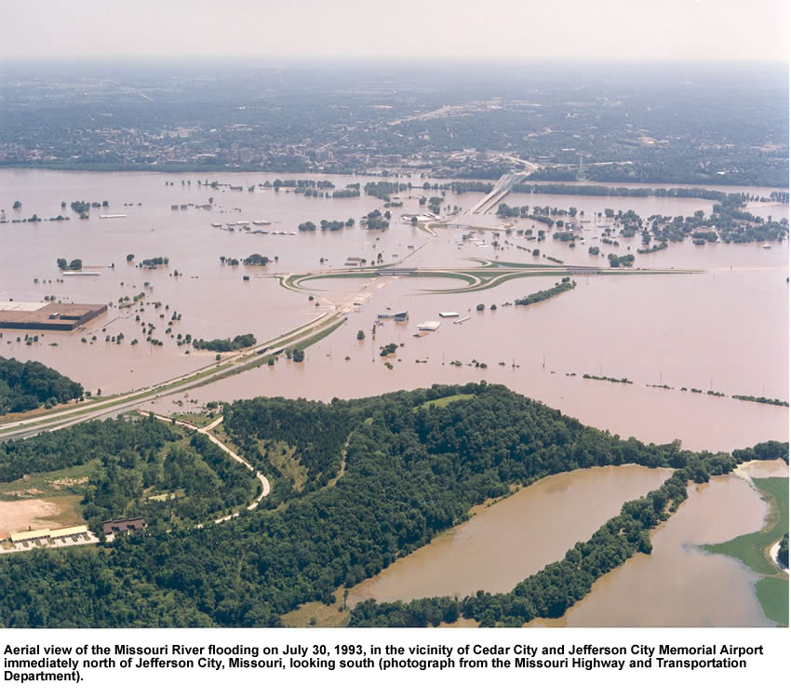
Examples
Dry Falls Washington created during the glacial Lake Missoula Floods. Channel erosion and depositional features preserved since the last age.
The Great Flood of 1993 in the Missouri and Mississippi Rivers that left no geomorphic signature but flooded 9 states and caused damage of $20 billion and 47 deaths.

Slide 5
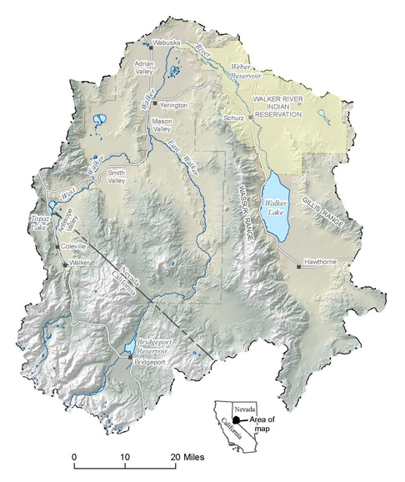
Study area – Walker River Basin
Location: Eastern California (Sierra Nevada Mountains) and western Nevada (part of the Great Basin).
Basin Area: 6480 km² (4050 mi²)
Relief: 3760 m to 1200 m (Sierra headwaters to Walker Lake, respectively).
Geology: Quaternary alluvium, Triasic-Quaternary volcanics, Tertiary sandstone, Jurassic and Cretaceous granites, Ordovician-Triassic metamorphics
Climate: Arid high desert with cold winters and warm summers. Average annual precipitation in Yerington is 5.31 inches
Soils: Aridosols and Mollisols
Vegetation: Aspen-fir and Sonoran sagebrush on high elevations, juniper, sagebrush grasslands
N

Slide 6
The 1997 Flood of Record
“The major weather-related event in the region’s history…” (O’hara et al., 2007)
Flooding of the Susan, Truckee, Carson and Walker Rivers in western Nevada.
Damages of $1 billion in Nevada only.
Floods were reduced due to operation of reservoirs as detention and storage units despite out of irrigation season use.

Slide 7
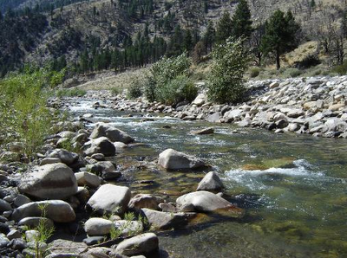
The 1997 Flood of Record (cont.)
Complete change in the sedimentary regime of the Walker River valleys.
Dredging is needed to maintain trapezoidal x-sections.
Loss of fisheries that local upstream economies rely on for their livelihood.

Slide 8
Methods
Precipitation data from NOAA website
USGS hydrological data + analysis
LiDAR from the Bureau of Reclamation
Data from Nevada Bureau of Mines and Geology

Slide 9
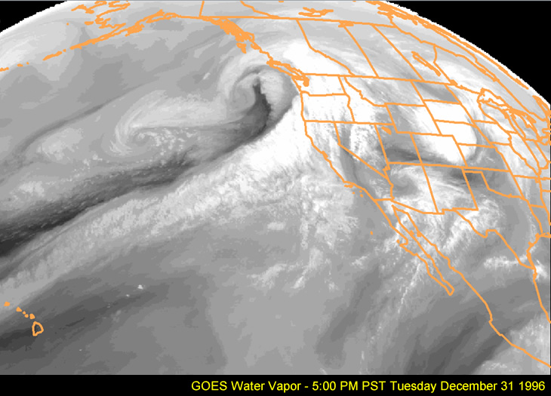
On December 26, 1996 the weather pattern changed (NOAA website).
Warm, moist air from the eastern pacific brought heavy rains.

Slide 10
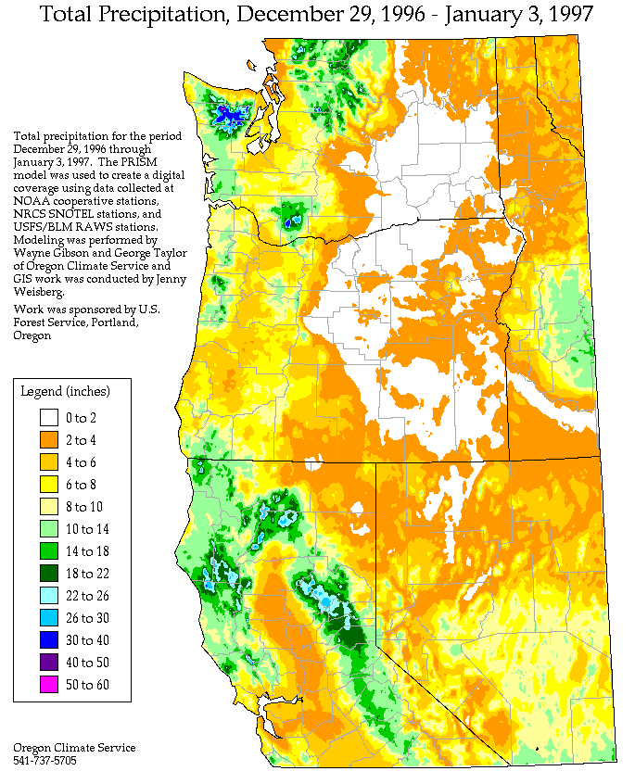
2-18 inches of rain over a few feet of unusually high snow pack.
(NOAA website).

Slide 11
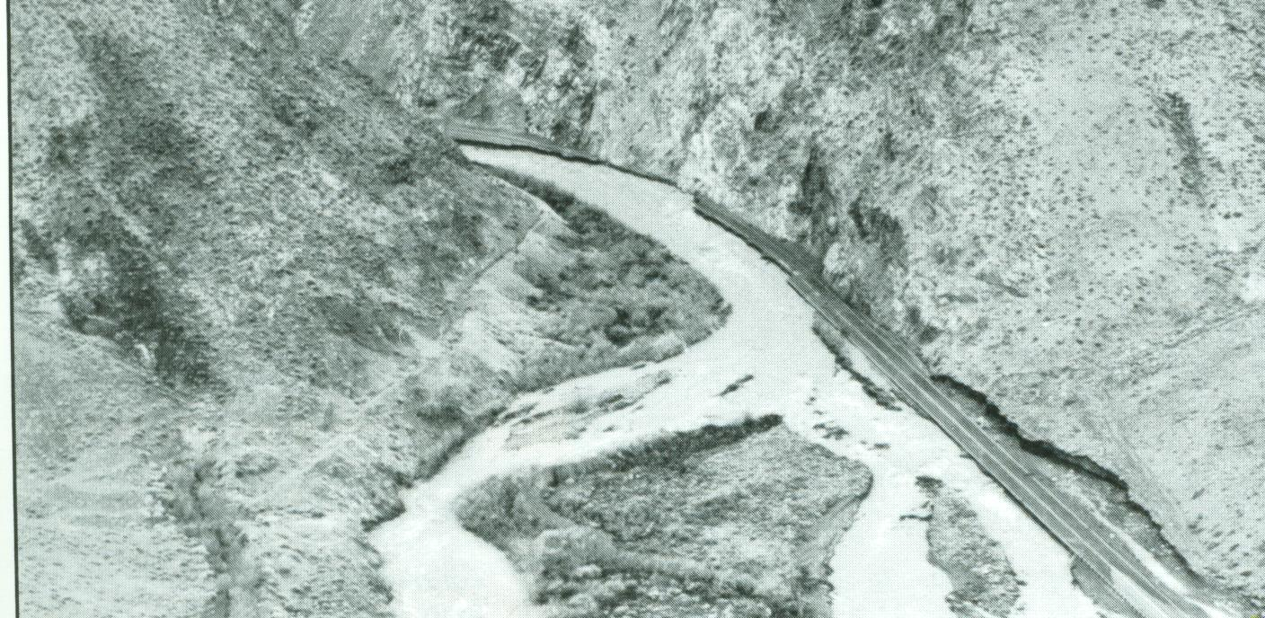
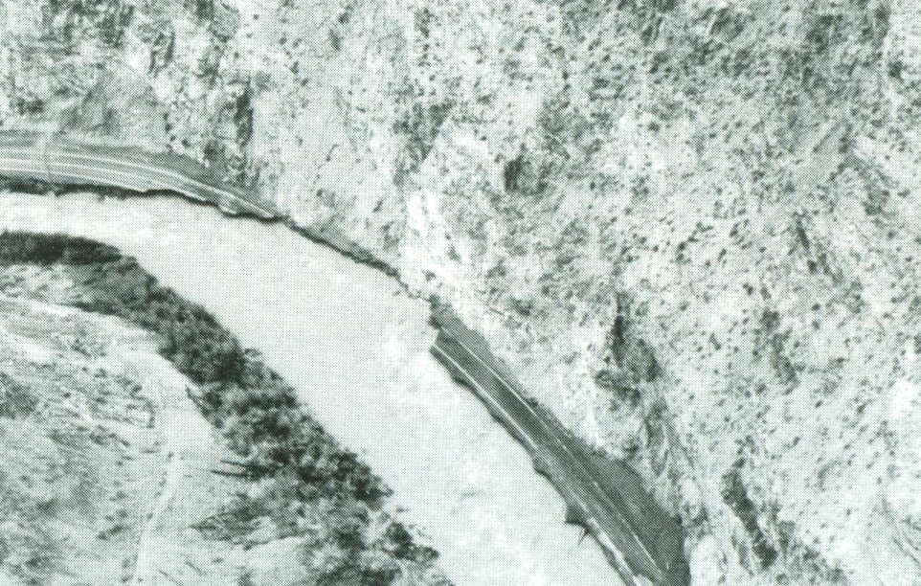
Consequences…
Wilson Canyon
Destruction of State Road 208 and transportation cut between Smith and Mason Valleys

Slide 12
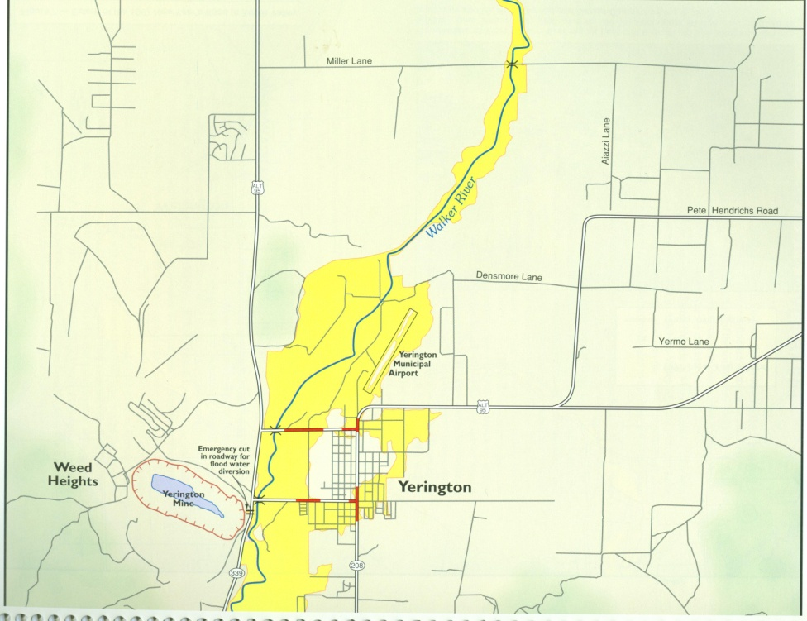
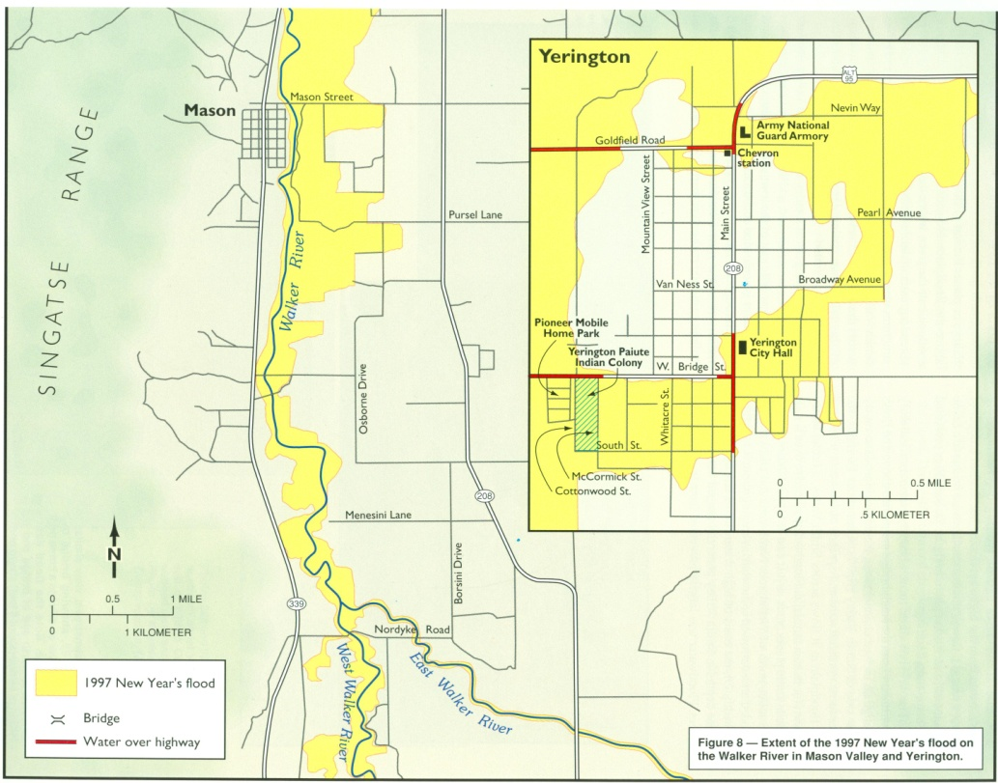
Extensive flooding in Yerington and Mason Valley
Source: Nevada Bureau of Mines & Geology

Slide 13
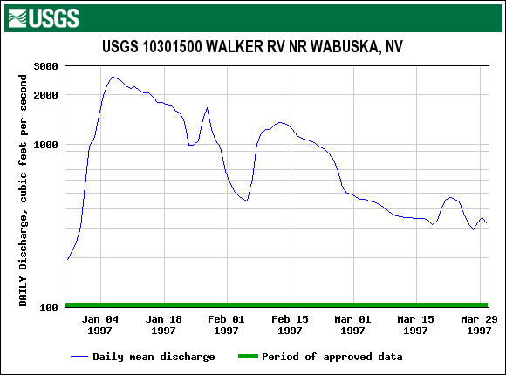
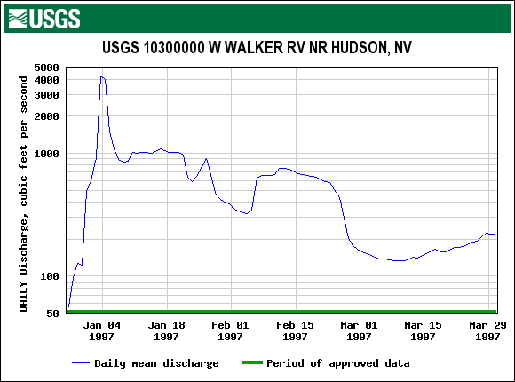
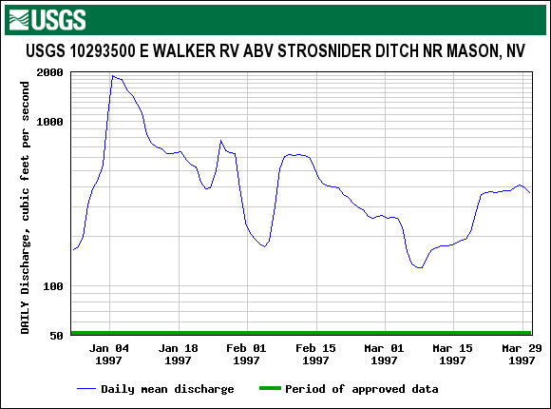
Hydrographs from 3 USGS website
The two Walker main tributaries should have produced a daily mean discharge about 6000 cfs at the main stem – where did all the water go in 20 miles of Mason Valley?...

Slide 14
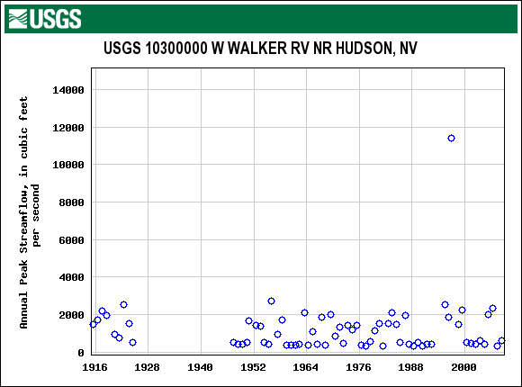
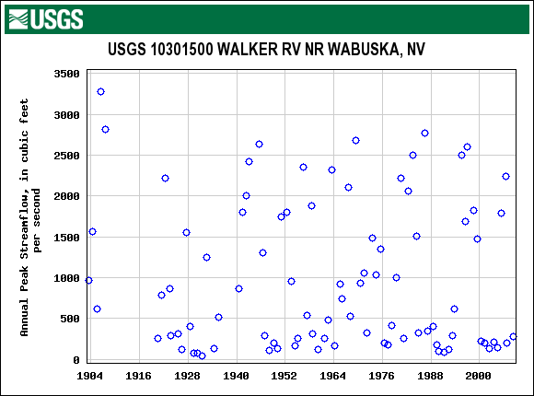
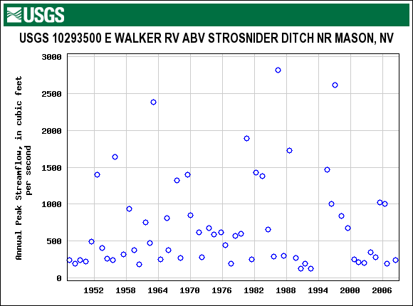
1997 Peak discharges at Mason Valley
Input
2610 cfs from the East Walker
11400 cfs from the West Walker
Output
2600 cfs at Wabuska
The entire West Walker discharge disappeared!

Slide 15
The off-line USGS “secret” server of instantaneous data
These 3 hydrographs need alignment of their time axis to portray the flood wave propagation downstream correctly
BUT they allow calculation of flood volumes…

Slide 16
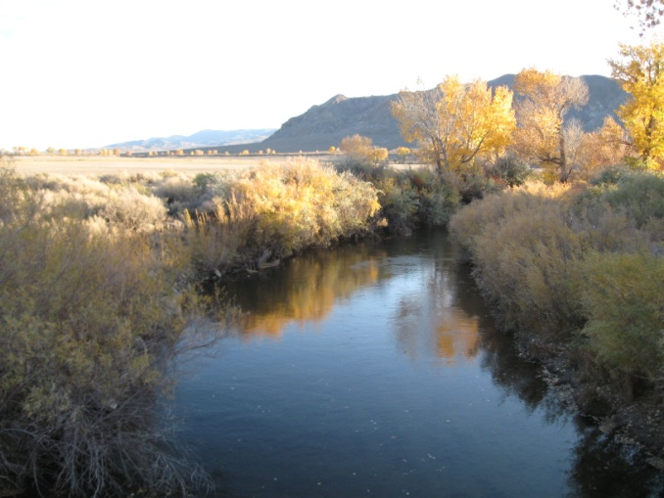
Flood volumes of Mason Valley during 9 days of rain
Input
East Walker River – 5098 acre/foot
West Walker River – 22,612 acre/foot
Output
Walker River – 5157 acre/foot

Slide 17
Flood peak discharge and flood velocity
Very small attenuation due to Topaz Lake Reservoir
2 constricted canyon reaches and Smith & Mason Valleys
Gravel-bed reaches
Sand-bed reaches

Slide 18
Flood frequency analysis of the two tributaries and Walker main stem for Mason Valley
This needs a different statistical analysis maybe using a paleoflood approach rather than the modern record which is less than a century old.

Slide 19
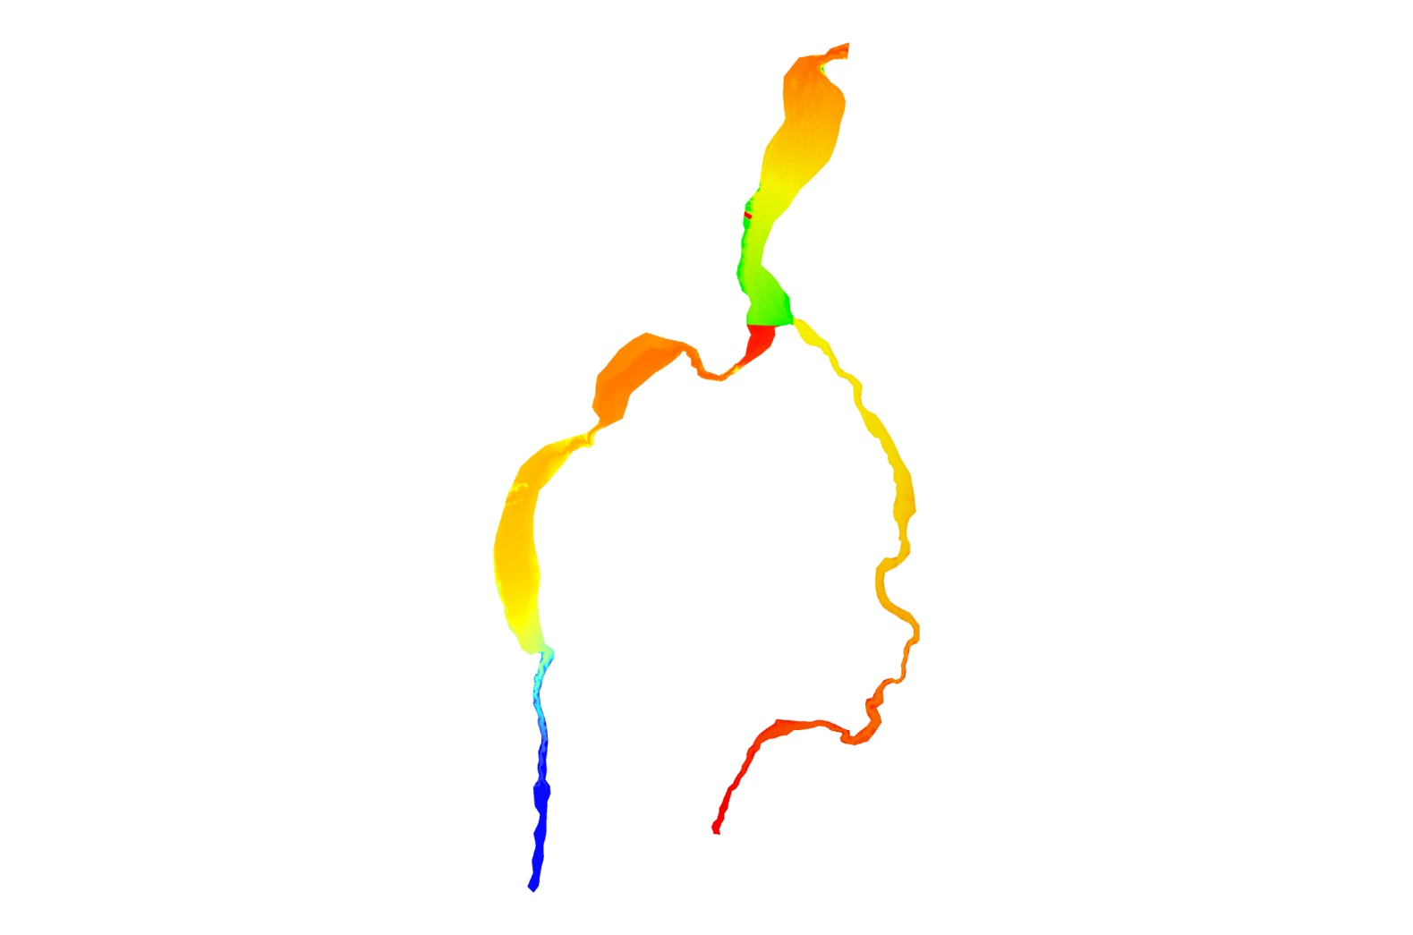
LiDAR from the Bureau of Reclamation
But the data is highly problematic without filtering due to the fact LiDAR has limitations when penetrating water

Slide 20
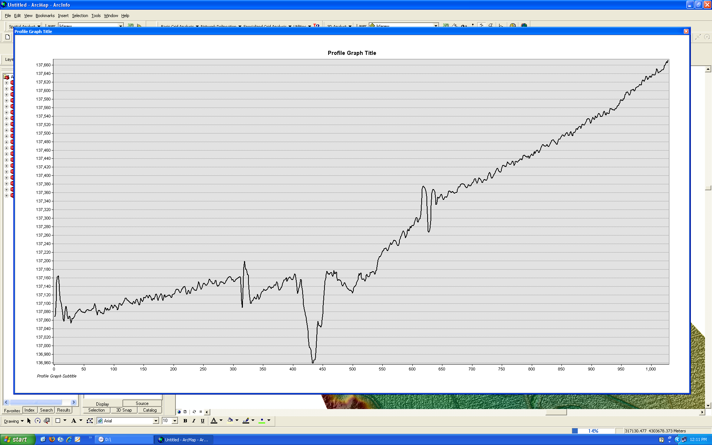
Example of a LiDAR x-section without filtering using the 3-D Analyst.

Slide 21
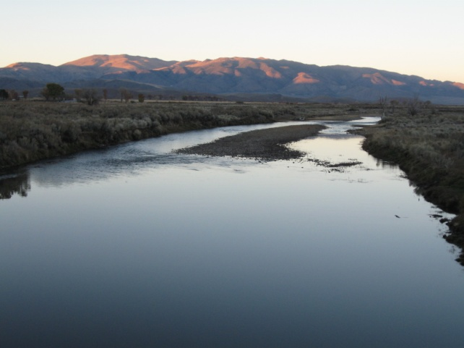
Further work planned:
1. LiDAR filtering and calibration with GPS x-sectional survey.
2. Run HEC-RAS first with regular flood routing and then add sediment transport to the flow.
3. Detect dormant and active sediment storage zones using aerial photography and field survey (grain size distribution) and calculate what discharge will activate them.
4. Get the snow data from NCDC to calculate rain-runoff ratio in a precise way over the basin (will also give extent of losses) and concurrent groundwater measurements.

Slide 22
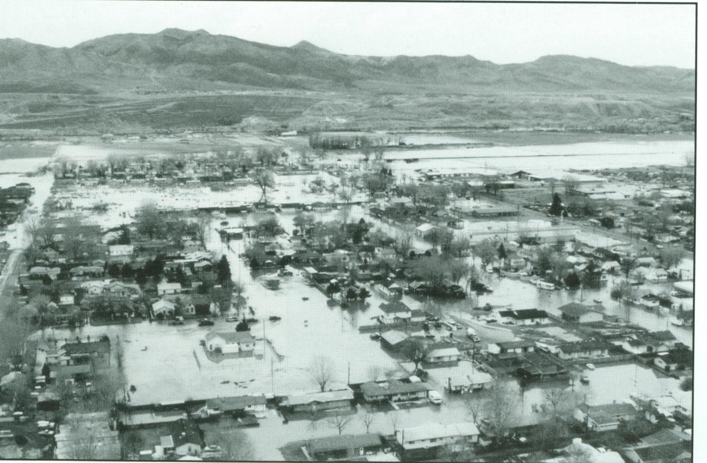
Questions?
Thanks for listening!

