Slide 1
Analysis of the Santa Clara River flood: Jan 9-12, 2005
Alan Moller – CEE 6440

Slide 2
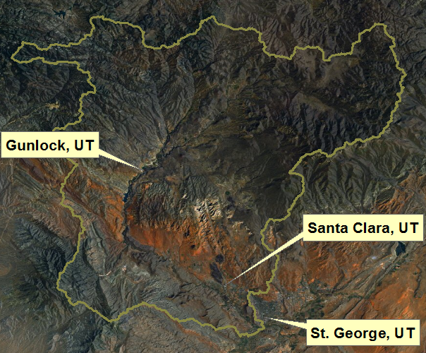
Where is the Santa Clara Basin?

Slide 3
Initial duties:
Develop a base map of the Santa Clara Basin
NHDPlus Flowlines
Watershed Boundary DataSet
Locate weather/stream monitoring stations
USGS Stream gages (4)
COOP weather stations (7)
SNOTEL weather stations (4)

Slide 4
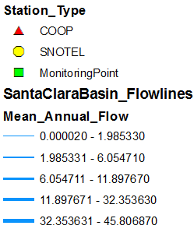
Base map with monitoring stations
(USGS)

Slide 5
When did the precipitation occur?

Slide 6
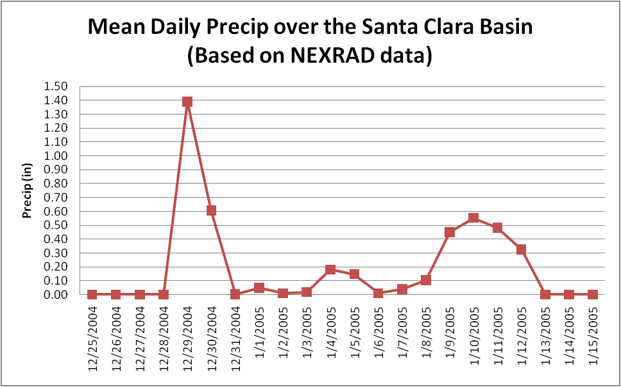
When did the precipitation occur?

Slide 7
Some Radar Imagery
The radar used here is located roughly 55 miles to the NE of the Santa Clara Basin and stands at an elevation of nearly 10000 feet.
Jan 9
Jan 10
Jan 11
Jan 12

Slide 8
Limitations of Radar Data
Complex Terrain leads to blockage
Larger distance from radar reduces quality
Radar beam too high
Radar beam width too wide
Ideal

Slide 9
How much precipitation fell?
Based on COOP and SNOTEL data
Total Event Precipitation (Dec 25-Jan 15)
Dec 25-31 Total
Jan 1-15 Total

Slide 10
So what’s normal?
Avg. Dec + Jan Precip. (in)
Avg. Dec. Precip. (in)
Avg. Jan. Precip. (in)

Slide 11
Precipitation Anomalies for the event
(Dec 25-Jan 15 Totals) – (Dec+Jan Average)
(Dec 25-31)-(Dec Avg)
(Jan 1-15)-(Jan Avg)

Slide 12
Percent of Normal
Dec 25-Jan 15 Totals compared to the Dec+Jan Average

Slide 13
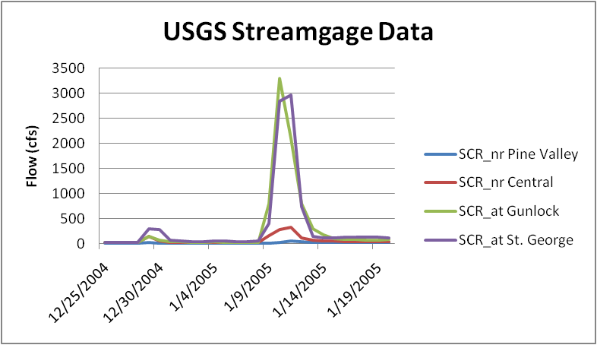
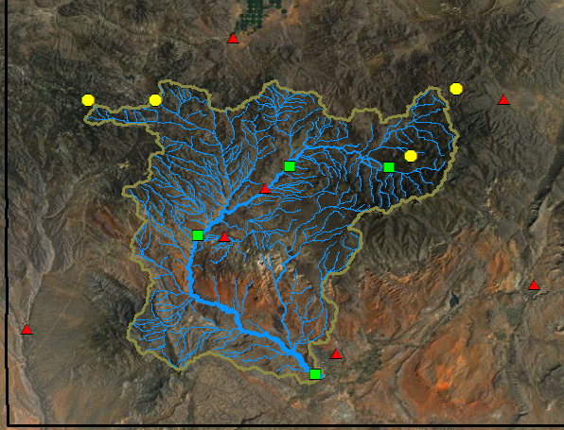
Stream Response

Slide 14
Land use near the river
Santa Clara, UT
St. George, UT
Orange: Residential
Green: Riparian
Other Colors: Various Crops

Slide 15
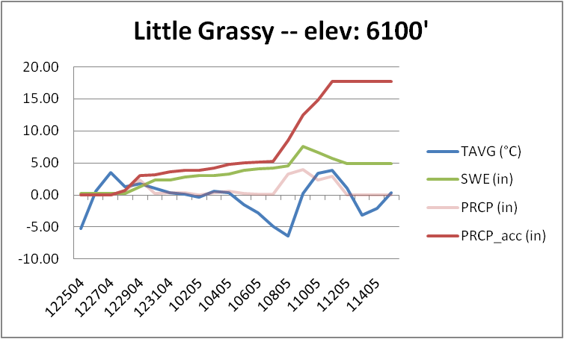
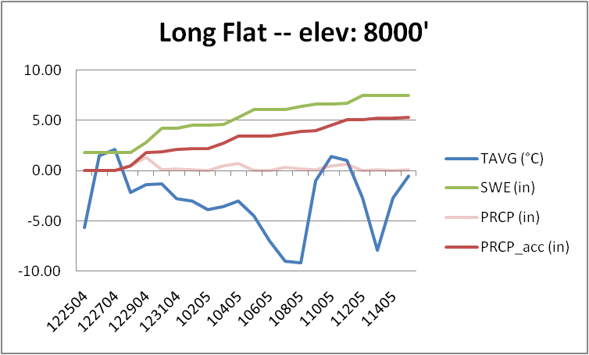
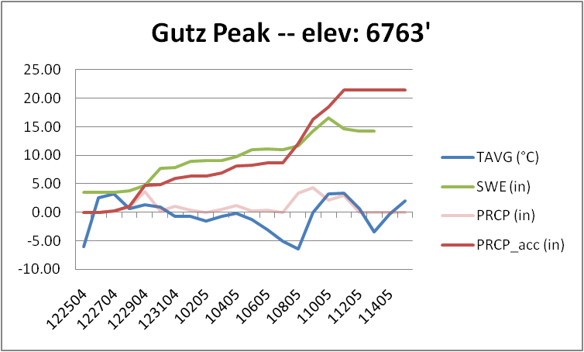
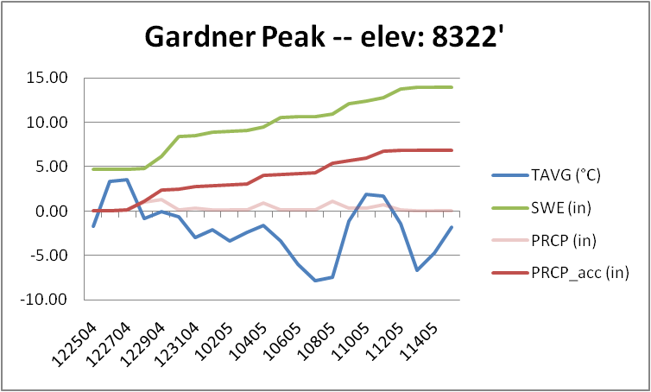
SNOTEL data shows other factors at play:
- Snowfall changing to rain leading to increased runoff due to extra snowmelt

Slide 16
Further Work
Calculate Runoff Ratio
More problematic due to combination of Rain and additional snowmelt
Compare results with data from the Precipitation Frequency Data Server
To get a more thorough understanding of the statistical significance of this event

Slide 17
Thank You

