Slide 1
GIS in Water Resource Term Project
River Mapping Using Low Cost Small Unmanned Aerial Vehicle with Remote Sensing Platform
Yiding Han
Dept. of Electrical and Computer Engineering
Utah State University
E: yiding.h@aggiemail.usu.edu
12/02/2008

Slide 2
Introduction
Background
Project Objects
Data Acquisition
Results
Conclusions

Slide 3
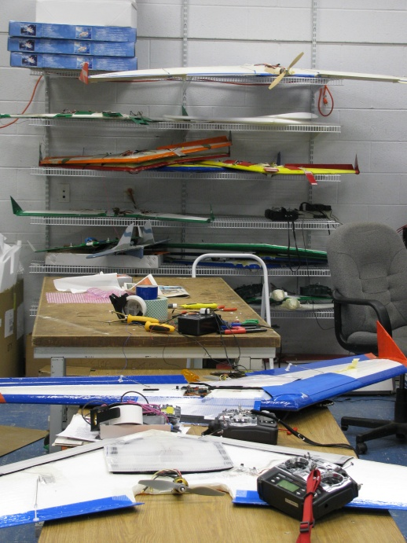
What is UAV?
unpiloted aircraft
  remote controlled
  fly autonomously
    pre-programmed flight plans
    complex dynamic auto-navigation
  military role
  growing number of civil applications

Slide 4
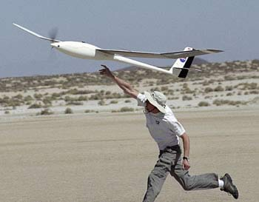
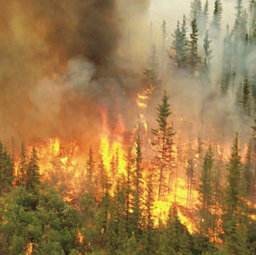
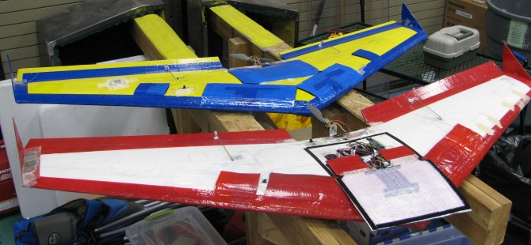
Why UAV?
  Easy
  Safe
  Low cost

Slide 5
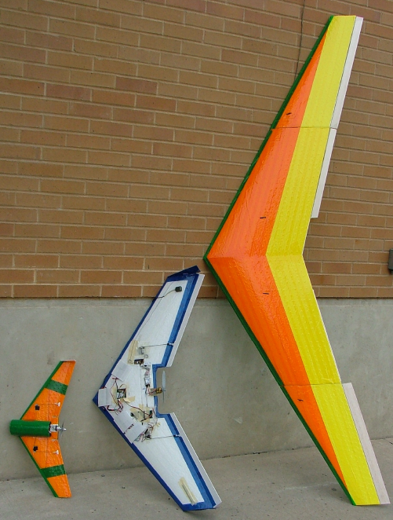
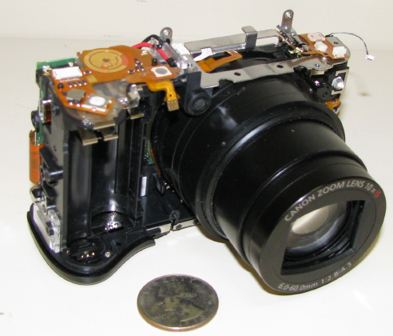
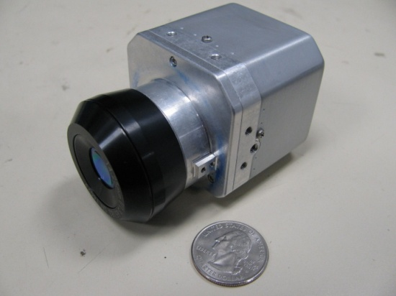
Our UAVs
Different sizes (air frames)
  from 25 inches to 72 inches
Different payloads
  GhostEye cameras: RGB/NIR cameras
  Video cameras
  Thermal Infrared Camera
Different missions
  River Mapping
  …

Slide 6
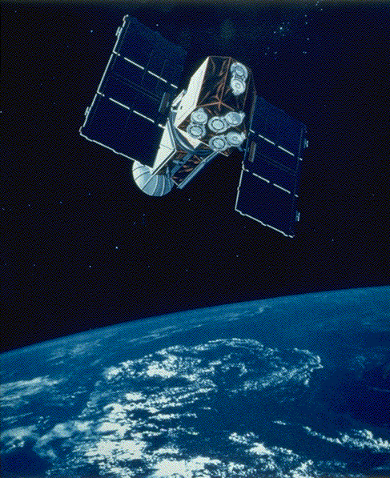
River Mapping Mission
River path might change seasonally
Current remote sensing systems
  Hard to use
  Not accessible to anyone
  High cost
A better tool is needed

Slide 7
UAVs River Mapping Schedule
Design flight plan
Drive to launch site
Launch the plane
Wait
Land the plane
Take the images back for further processing

Slide 8
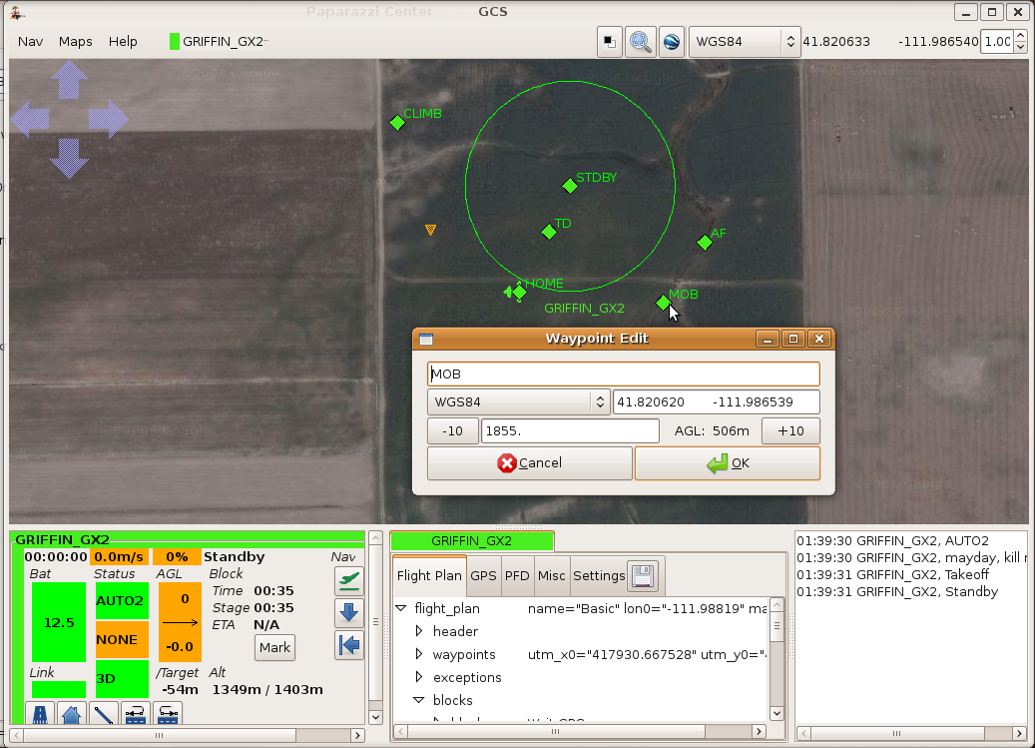
Design the flight plan

Slide 9
Contd...
Problems
  Data may have error
  Tedious
  Elevation change is hard to input
  Time consuming
  ……
Use GIS to help us generate the waypoints

Slide 10


Data source
DEM Data
  USGS
  http://seamless.usgs.gov
Riverflow of Bear River
  NHDPlus
  http://www.horizon-systems.com/NHDPlus/

Slide 11
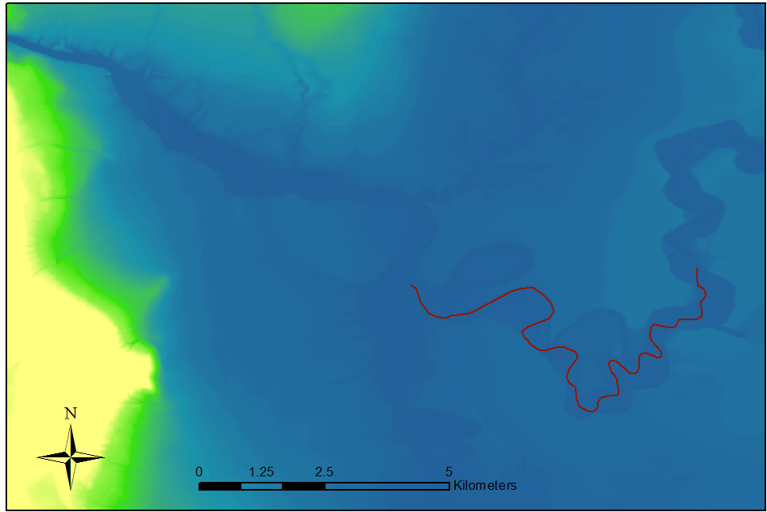
Flight path given by ArcGIS

Slide 12
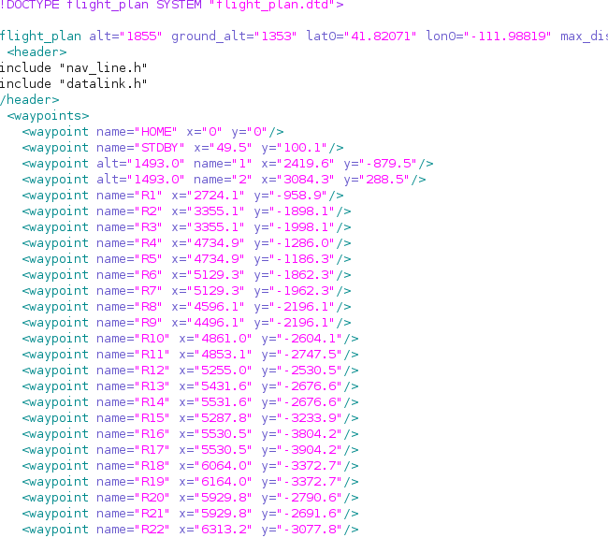
Generate the waypoints
Waypoints are saved in an xml file

Slide 13
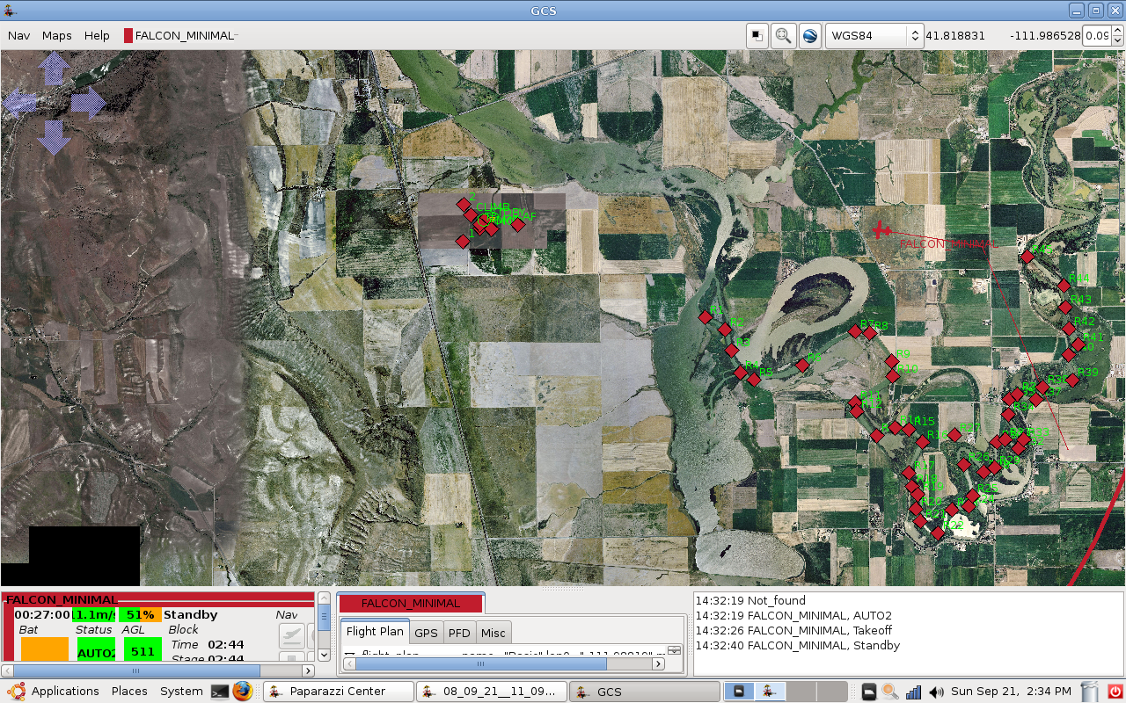
Outcome in GCS

Slide 14
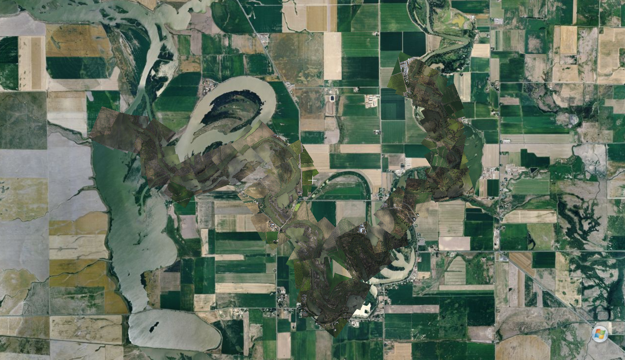
Mosaic of pictures

Slide 15
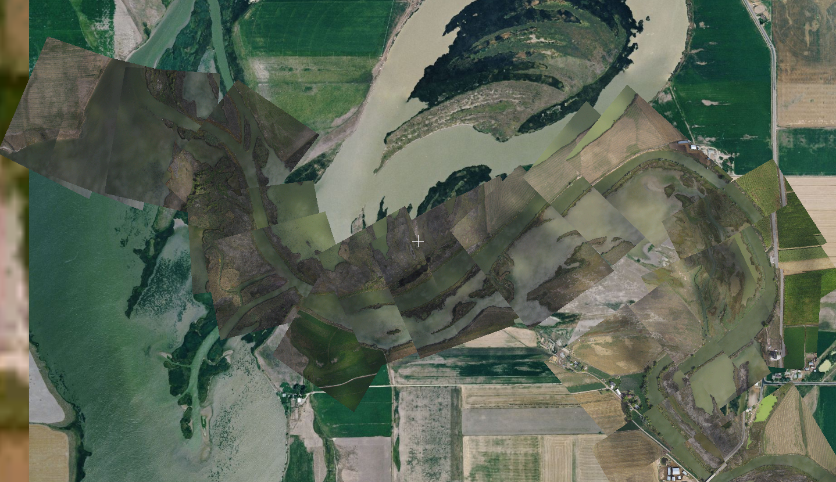
Good Mosaic

Slide 16
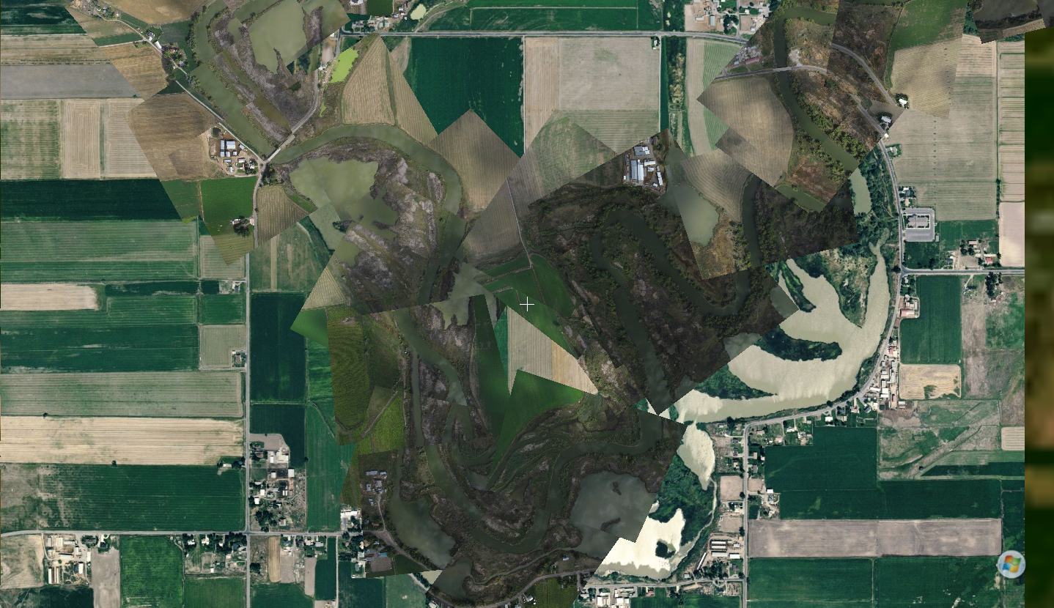
Bad Mosaic

Slide 17
Conclusions
With the help of GIS, it is a lot easier and faster to make complicated flight plan.
The generated waypoints are more accurate.
With 3D coordinate waypoints, UAVs can fly above more complicated terrain.

Slide 18
Thanks

