Slide 1
Using GIS and Aerial Photography to Monitor Riparian Changes in the Virgin River, UT
Shannon Clemens
GIS for Water Resources
December 2, 2008

Slide 2
Outline
Background
Objectives/Goals
Methodology
Data collection
Results
Conclusions and Recommendations

Slide 3
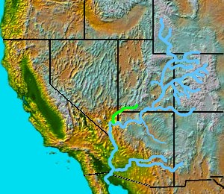
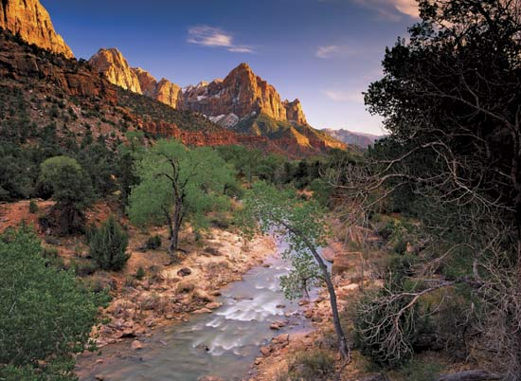
Virgin River Overview
Nearly 160 mile long tributary of the Colorado River
Headwaters above Zion National Park
Desert stream characterized by huge flow fluctuations ranging from a trickle to flash floods

Slide 4
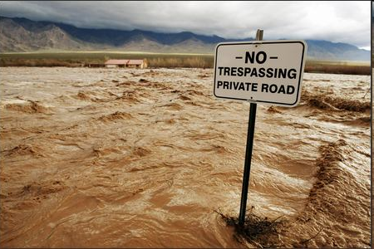
Great Flood of January 9-11, 2005

Slide 5
USGS Flow Data

Slide 6
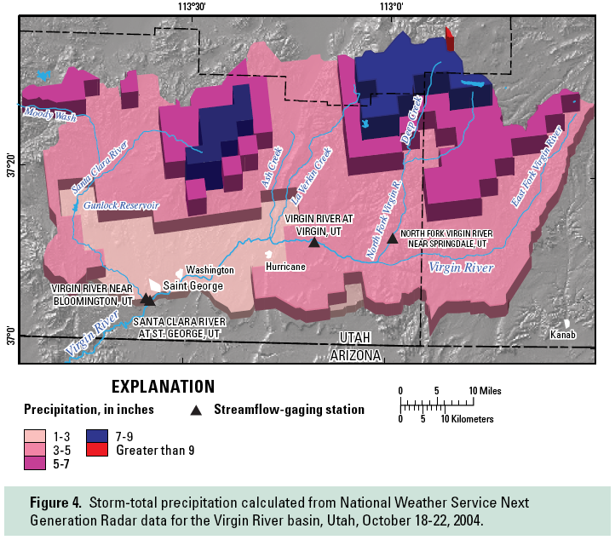
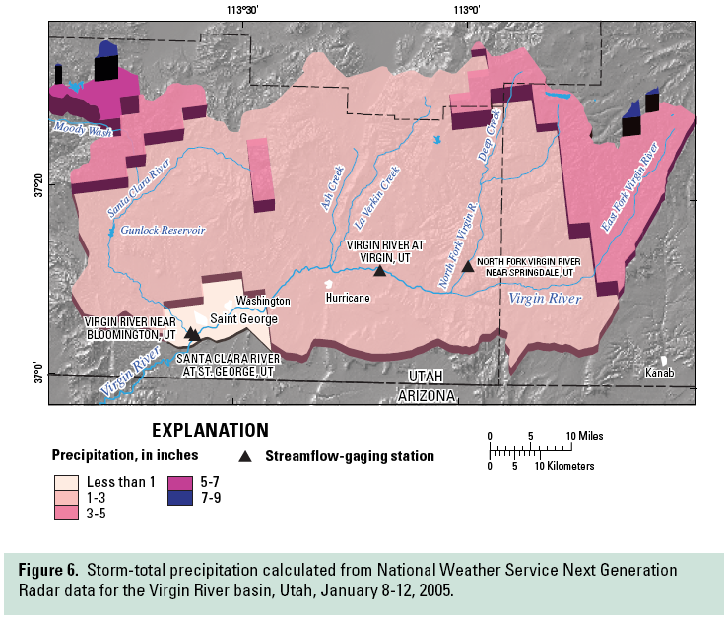
NEXRAD Rainfall Data
Data Source: Wilkowske, C. D.; Kenney, T. A.; McKinney, T. S., Flooding and streamflow in Utah during water year 2005, Utah Water Science Center, 2006

Slide 7

Virgin River Program
“Created to recover, enhance and protect the Virgin River and its inhabitants for all who depend on this precious resource.”
www.virginriverprogram.org

Slide 8
Objectives/Goals
To determine if high resolution aerial photography and GIS can be used to quantitatively assess changes is riparian habitat
To learn the effectiveness of this approach
To suggest a plan for future riparian mapping, data collection and aerial photo acquisition

Slide 9
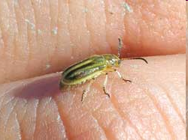
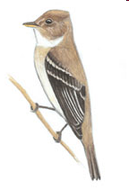
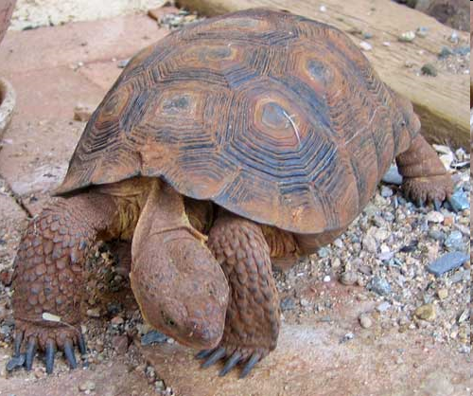
Why is change detection information useful?
For monitoring the effectiveness of the introduced beetle on tamarisk
For managing habitat for the Southwestern Willow Flycatcher (endangered species) and for Desert Tortoise (threatened species)
For other resource planning, management and research projects

Slide 10
Methodology
Prepare “pre-flood” baseline delineation data
Acquire “post-flood” imagery for field mapping
Complete ground based riparian delineation in the field at intensive sites
Perform calculations on digitized/attributed polygons
Examine aerial imagery

Slide 11
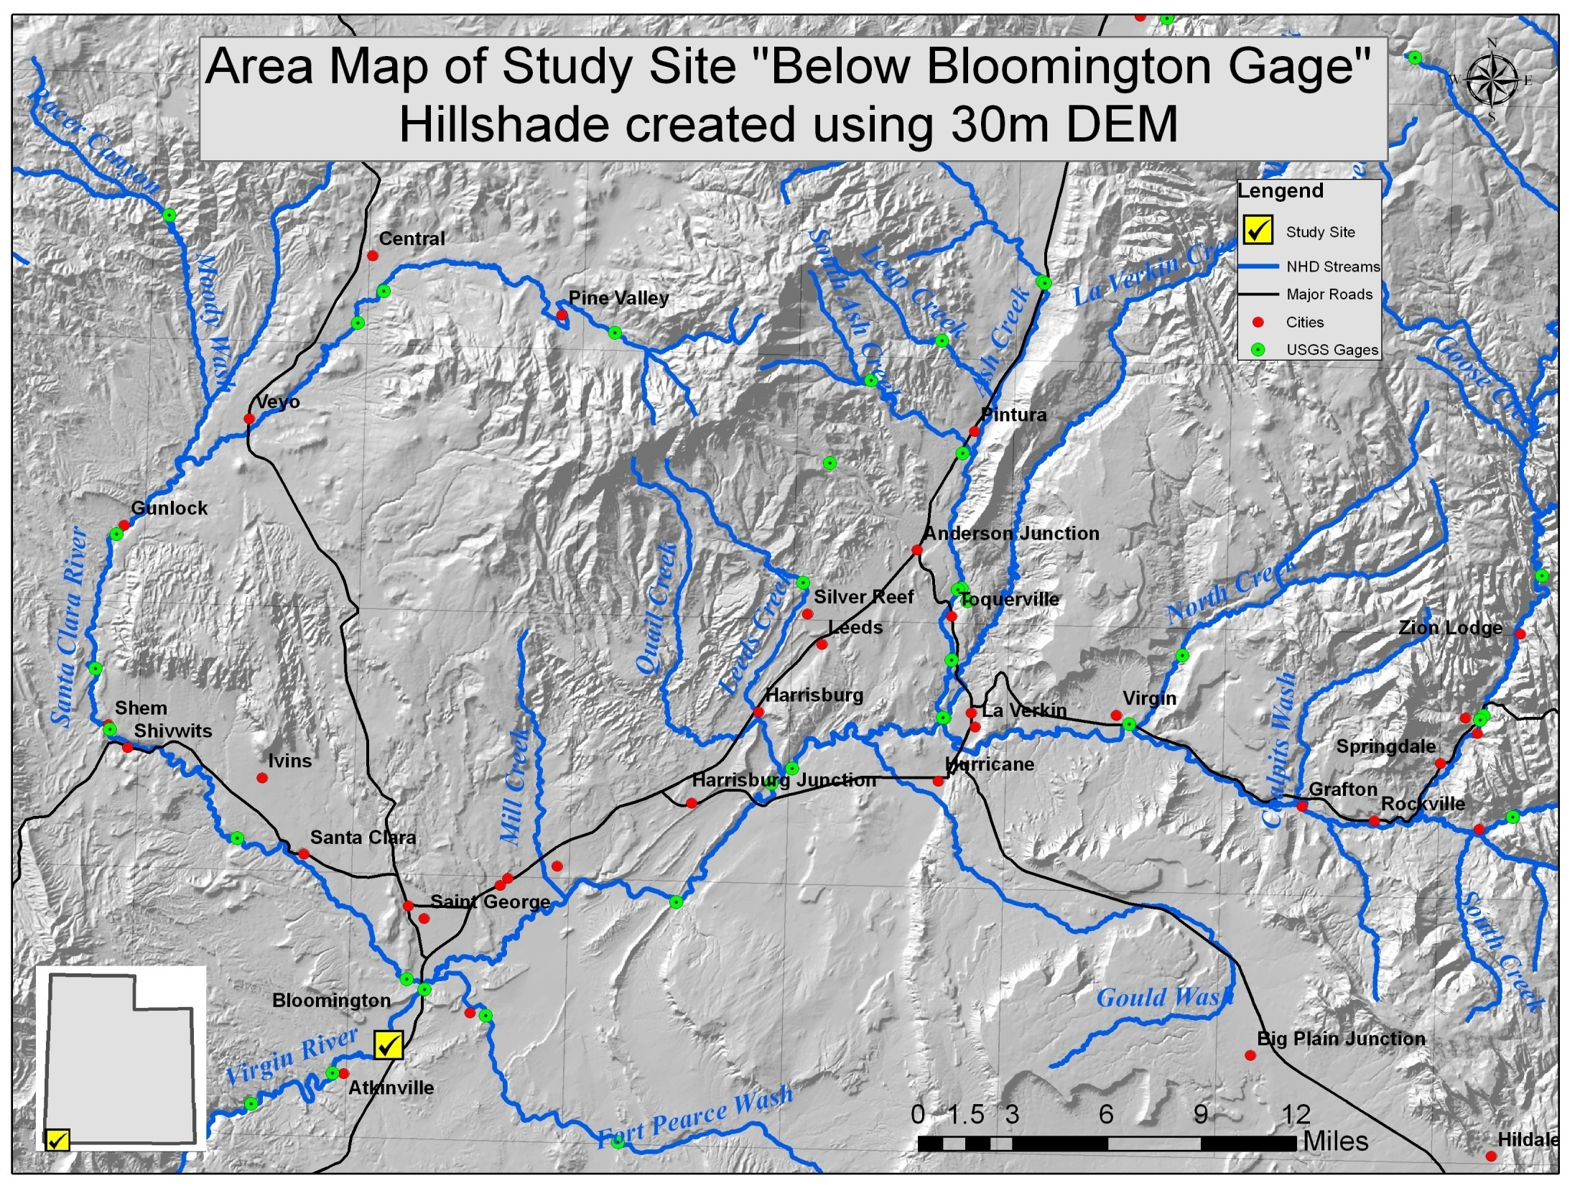

Slide 12
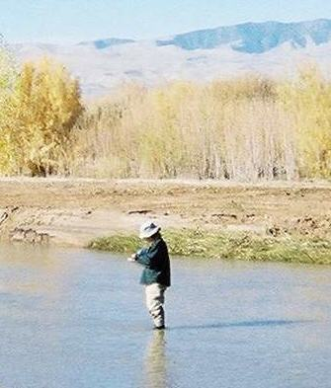
Data Collection “Pre-flood”
In 2002, a basin wide assessment of aquatic and riparian habitats were delineated
Accomplished through ground based delineations and aerial photography

Slide 13
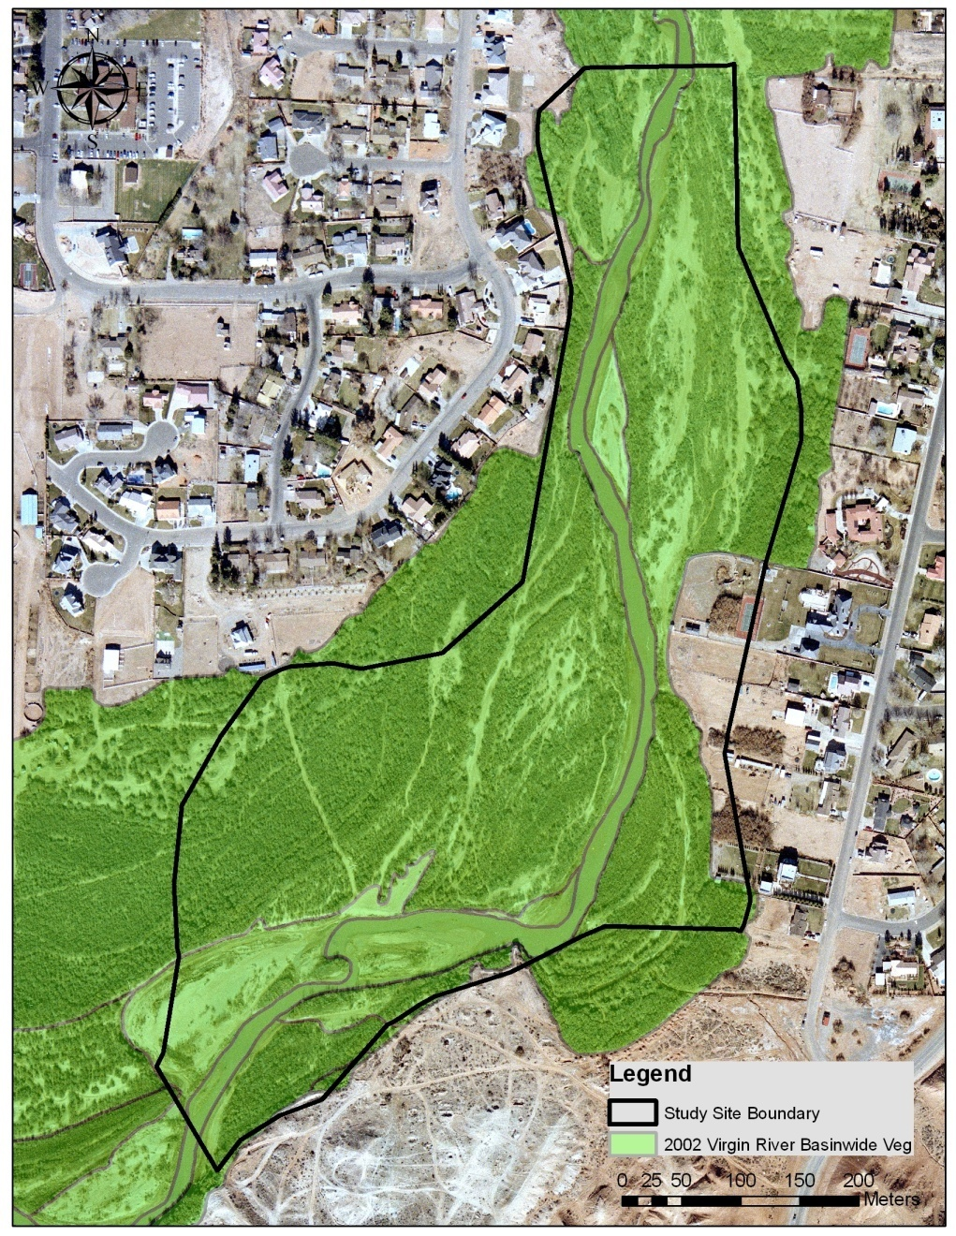
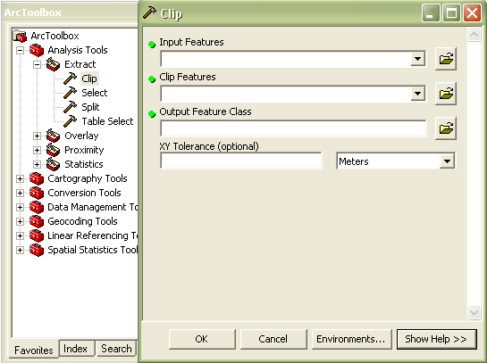
Preparing 2002 Data for Comparison

Slide 14
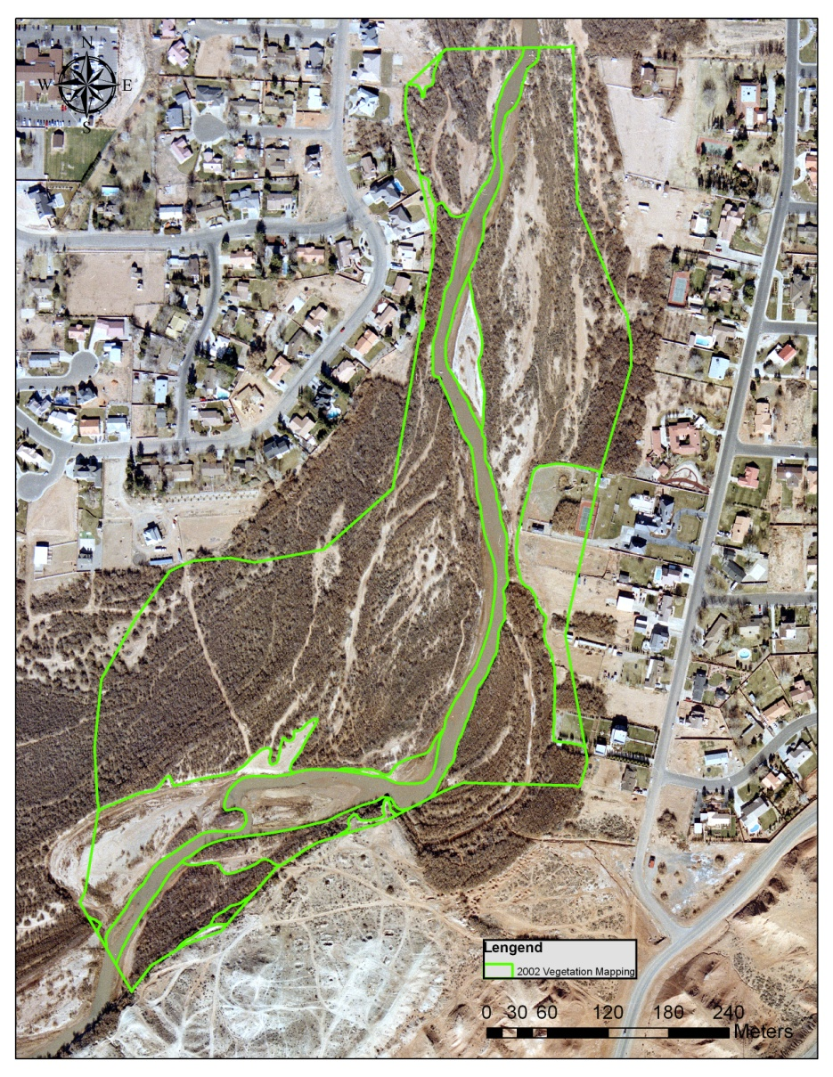
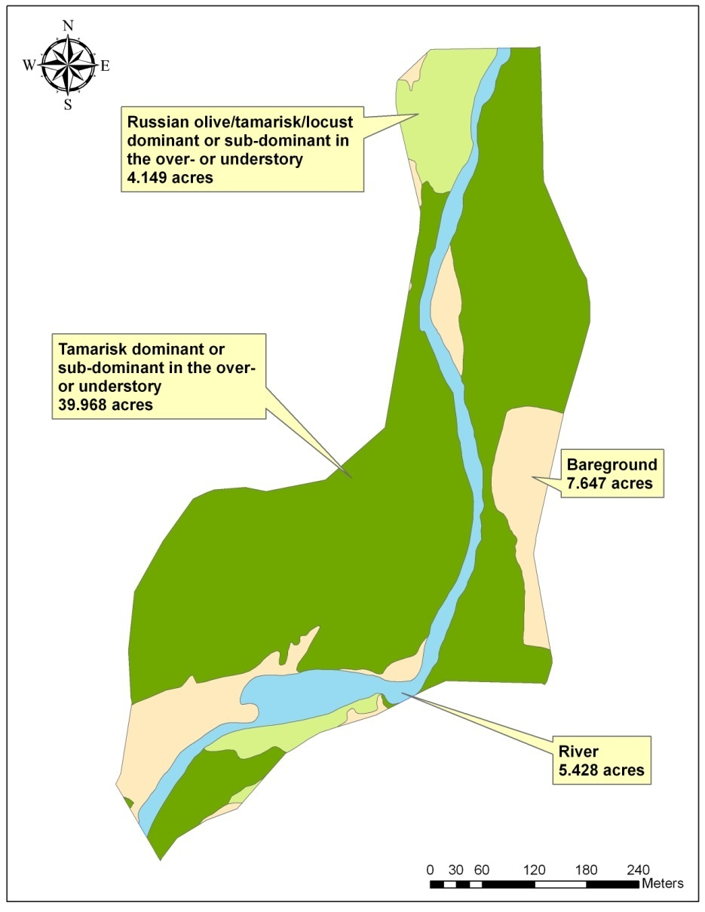
2002 “Pre Flood”
Mapping and Statistics

Slide 15
Data Collection “Post-flood”
2007 “post-flood” aquatic and riparian delineations were completed on selected sites (10 initial intensive sites)
Use ground based delineation and aerial photography
Selected sites were to be used as ground truthing for entire basin

Slide 16
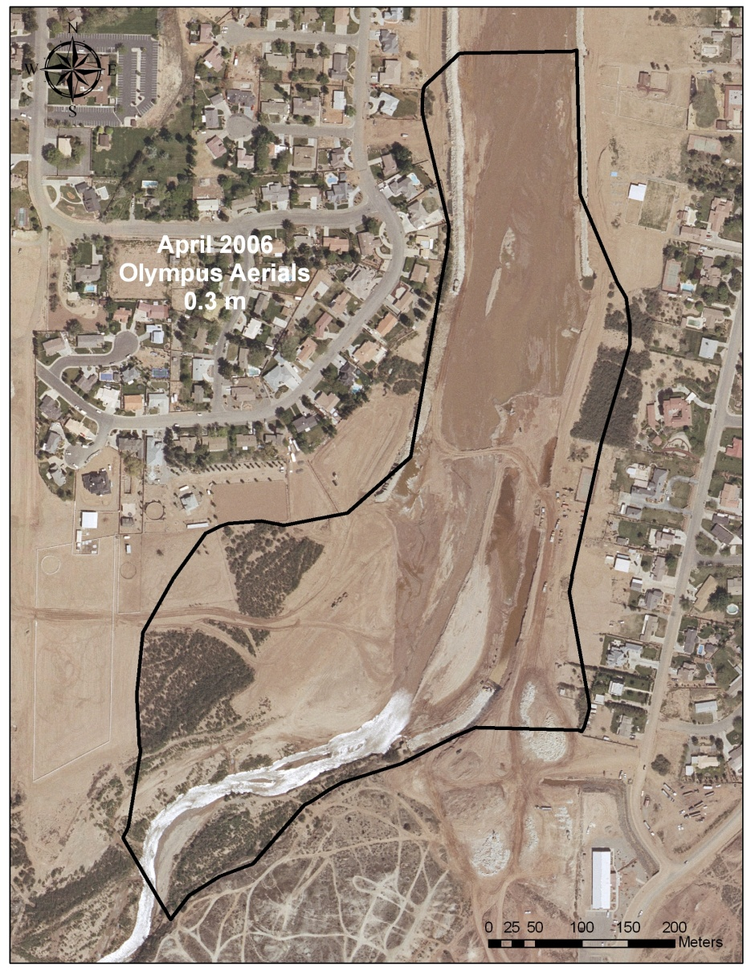
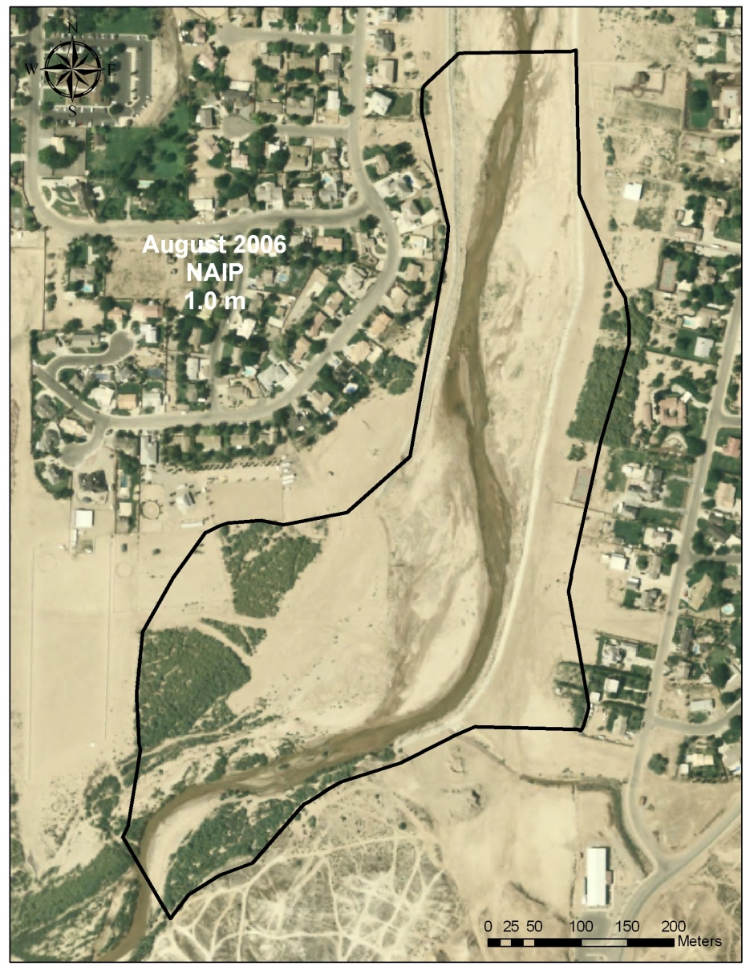
Outdated Aerial Imagery

Slide 17
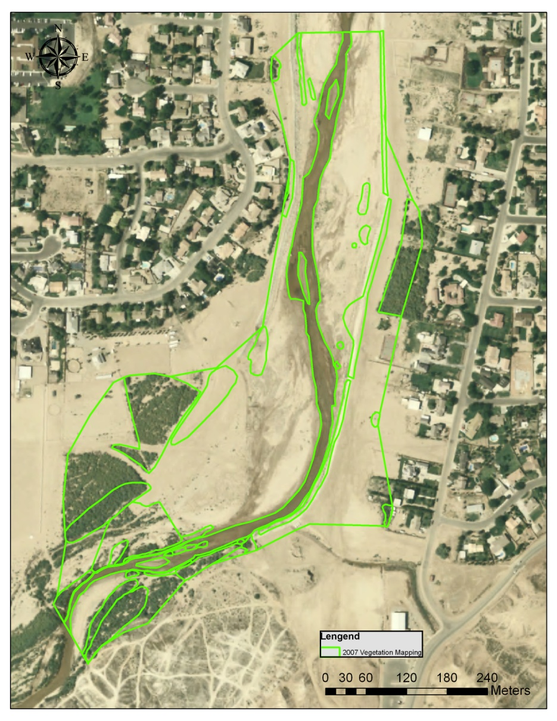
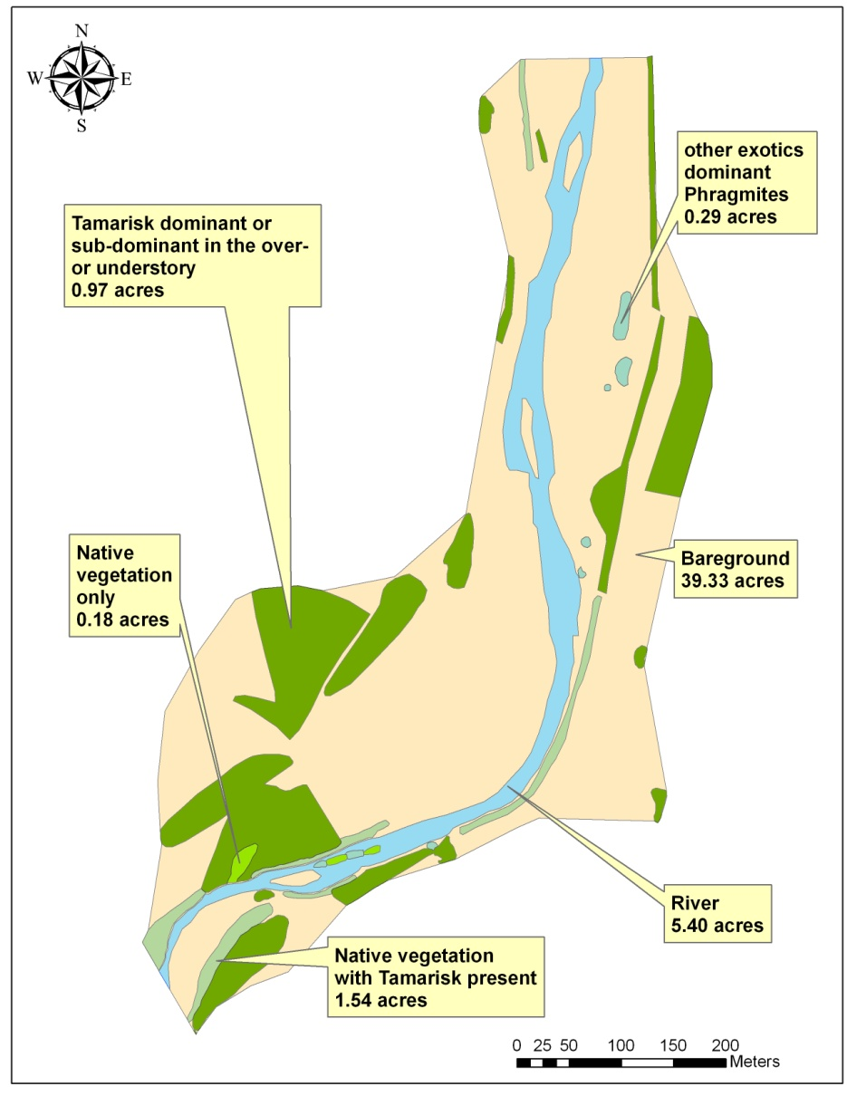
2007 “Post Flood”
Mapping and Statistics

Slide 18
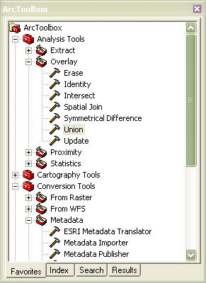
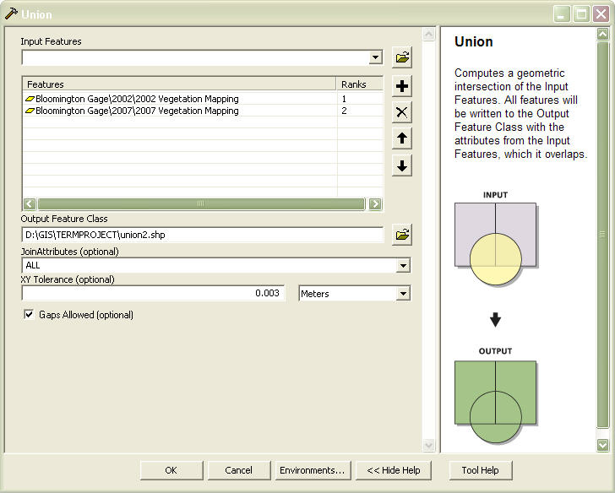
“Union” tool to compare data

Slide 19
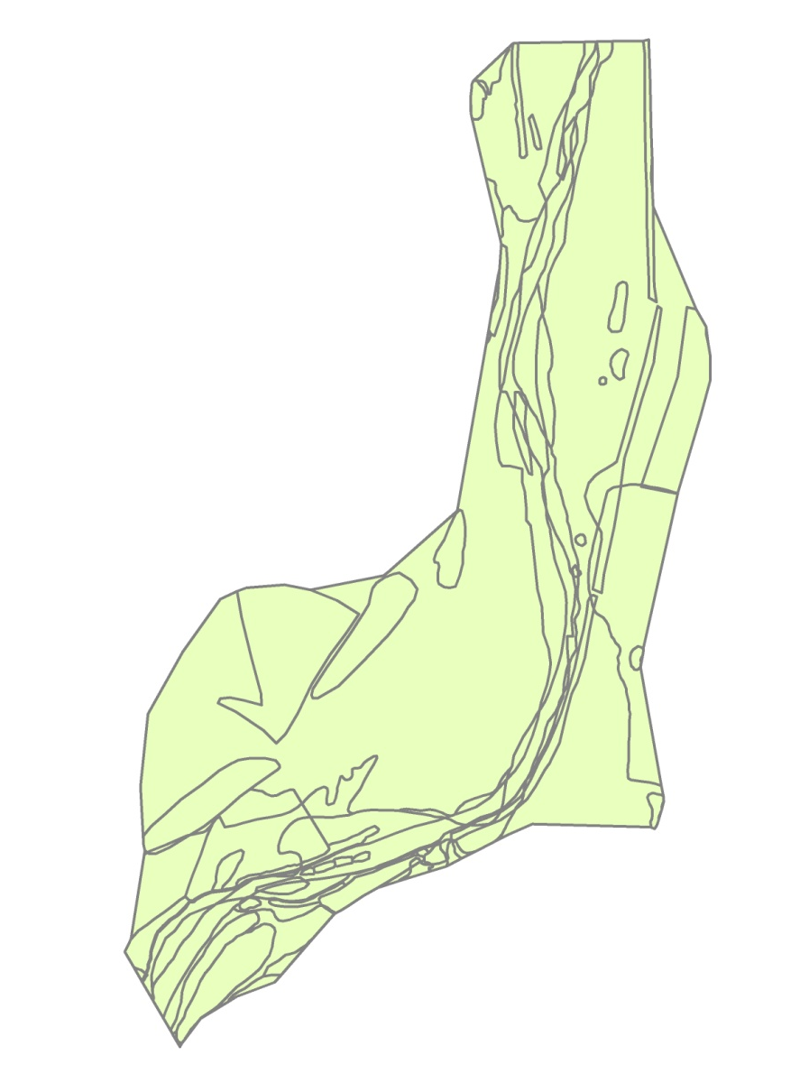
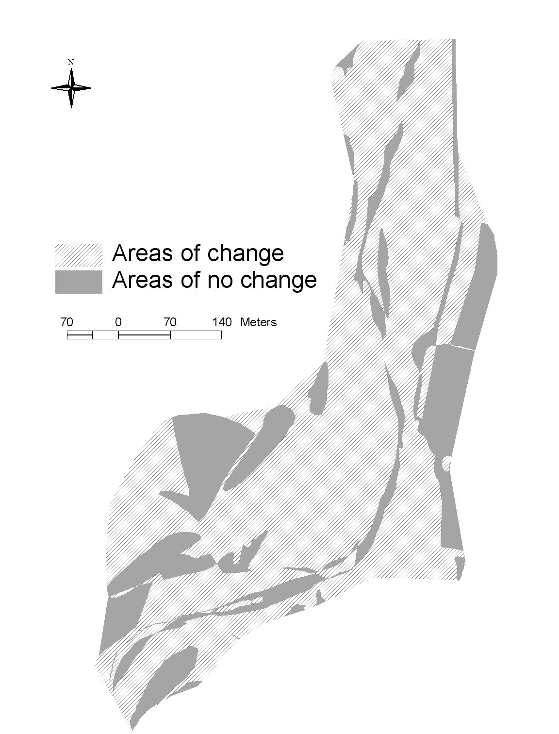

Where did change occur?

Slide 20
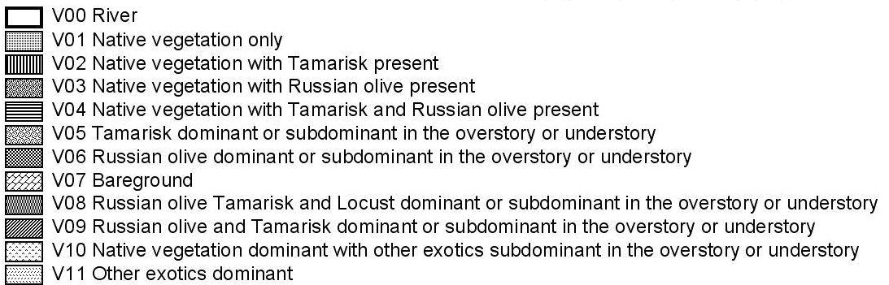
Results

Slide 21
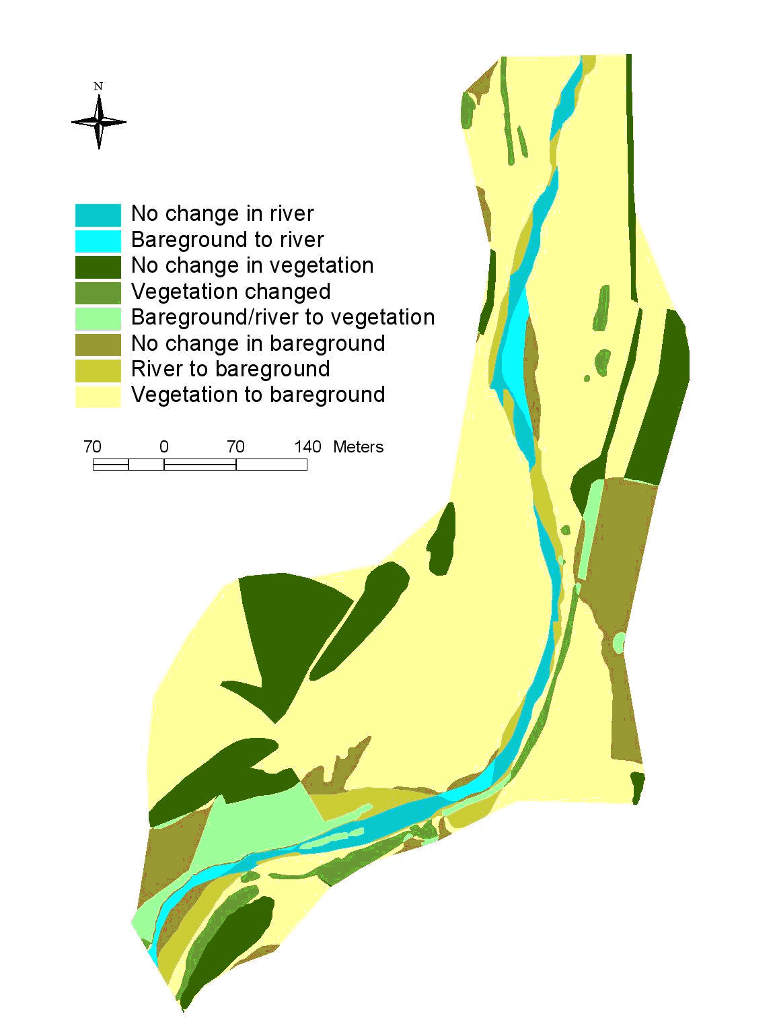
Results

Slide 22
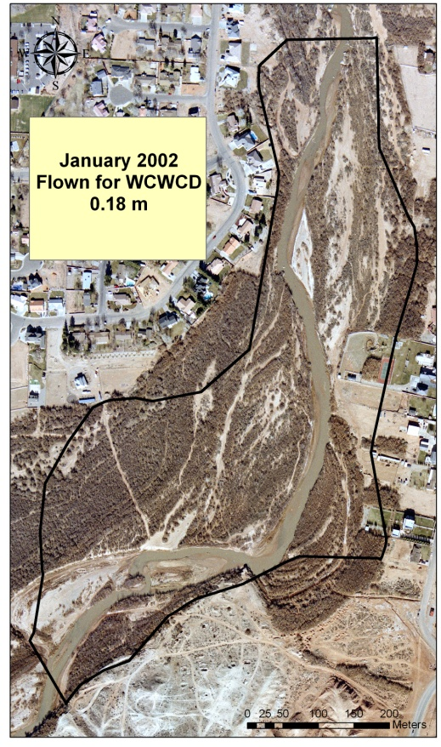
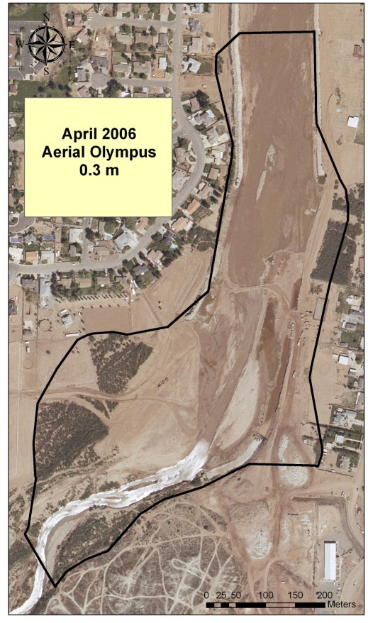
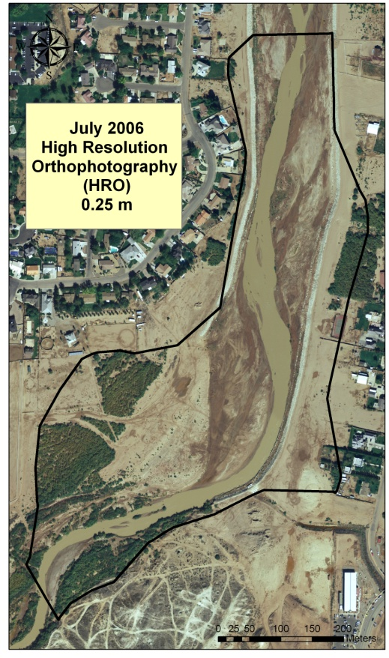
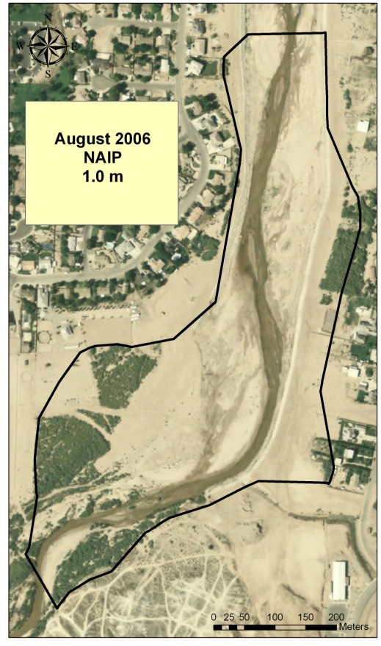
Aerial Imagery Quality

Slide 23
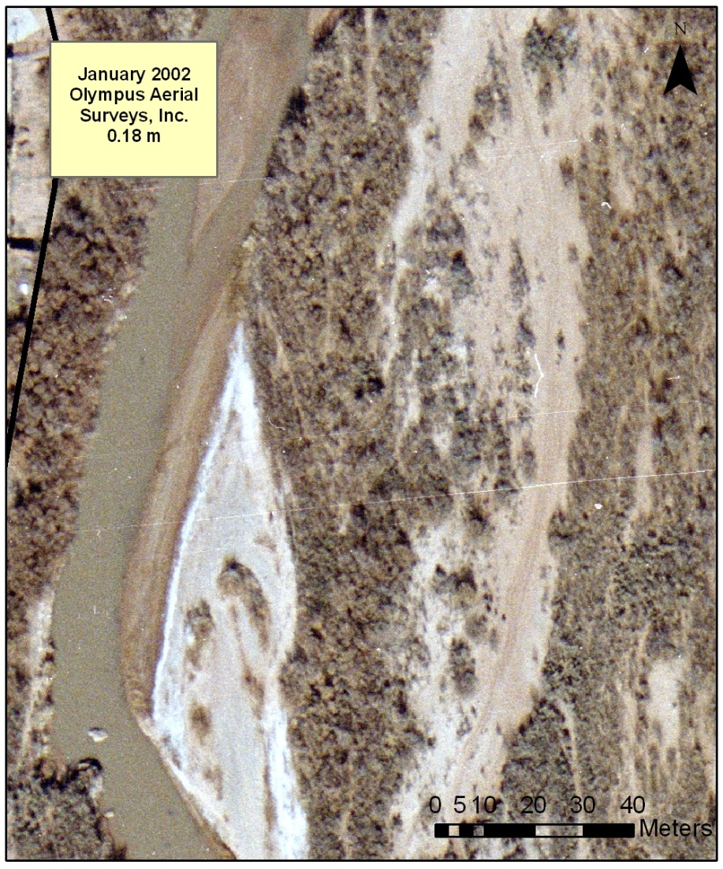
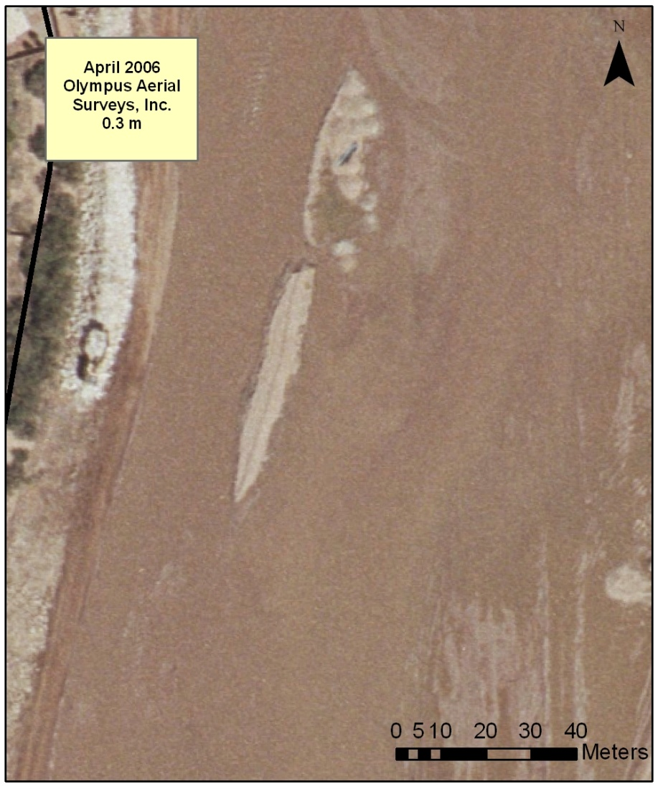
At which resolution is change detected?

Slide 24
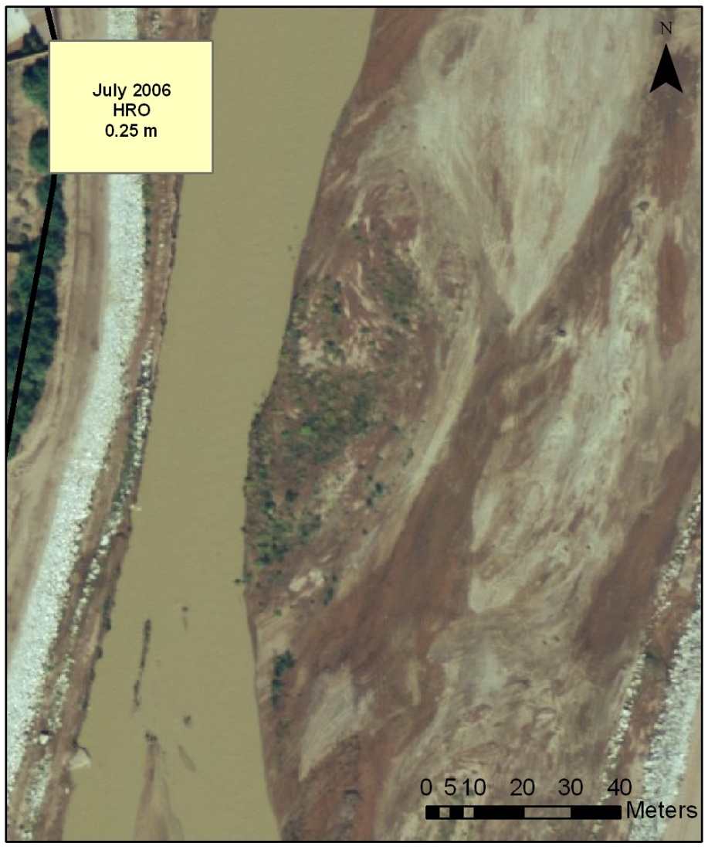
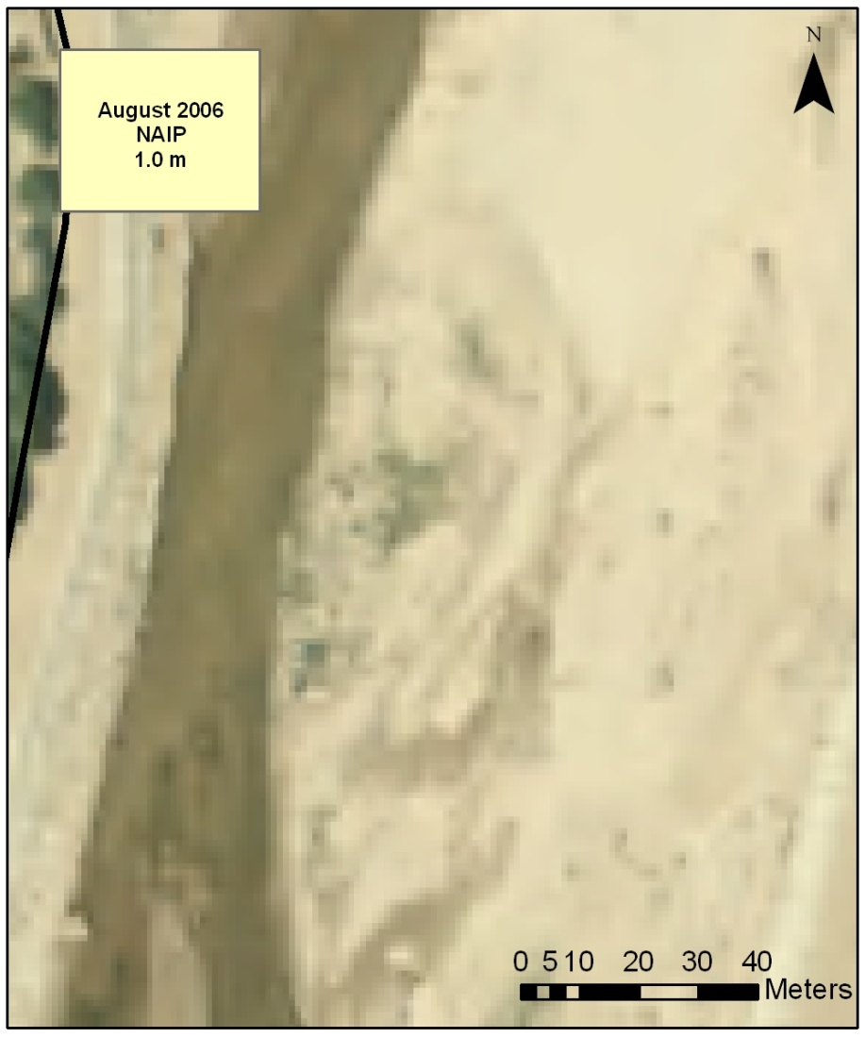
At which resolution is change detected?

Slide 25
Issues with this Study
Mapping Styles – 2002 vs 2007
Inadequate universal vegetation mapping code system
Outdated and coarse aerial imagery
Study site boundaries – area of flood change vs. 2002 area mapped
Addressing river coverage

Slide 26
Recommendations for Long Term Vegetation Monitoring
Establish a vegetation classification system/key (including minimum mapping unit)
Fly UAVs once a year (preferably summer) for yearly monitoring – high resolution, updated imagery
Perform aerial photo interpretation and digitize homogeneous vegetation stands
Use existing ground truthing to QA/QC digitizing

Slide 27
Conclusion
GIS and aerial photography interpretation can be used to monitor changes in riparian vegetation when high resolution, current imagery is used
Imagery should be no less than 0.3 meters in pixel resolution – the finer the better

Slide 28
Questions?

