Slide 1
Soil Loss For Moody Creek, Idaho
CEE 6440 GIS in Water Resources
By: Ren Bagley

Slide 2
Outline
Background
Procedure
Results
Discussion
Conclusion

Slide 3
Where is the Moody Creek watershed?

Slide 4
What is the significance of Soil loss in the Moody Creek watershed?
Moody Creek listed on the 303(d) list for Idaho.
Nutrient and Total Phosphorus is the reason for listing.
The source of these contaminates is unknown.
Generally thought to be from soil erosion

Slide 6
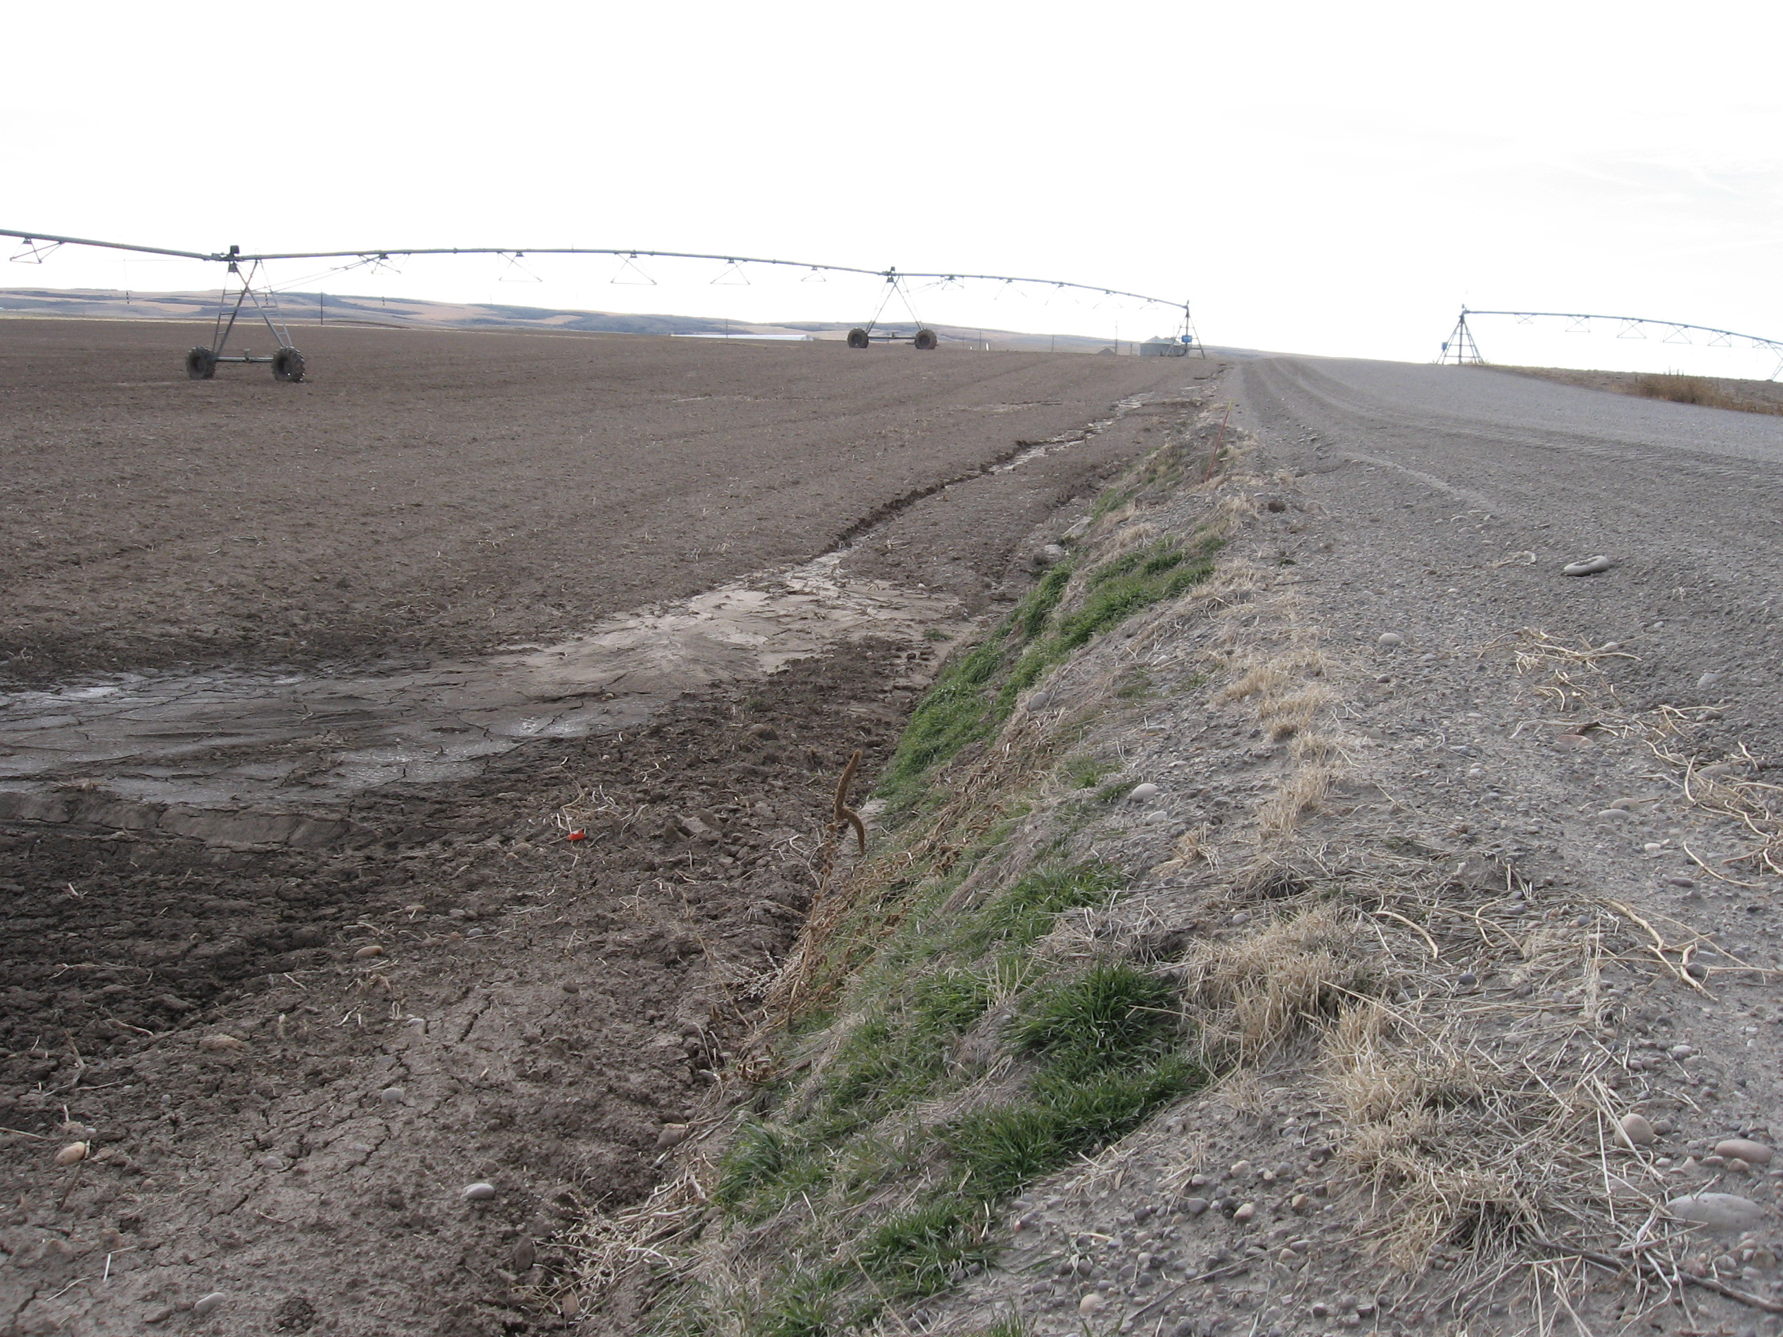

Slide 8
Procedures
Spatial data from Various Sites
NHD Plus for Stream Network
Land cover Data from Madison County GIS Department
DEM for the University of Idaho website
Soil Data from NRCS SSURGO

Slide 9
Procedures
Watershed Delineation
Drainage Density Comparison
Revised Universal Soil Loss equation Data
Madison County NRCS

Slide 10
Drainage Density
Length of stream to area of Catchment
Measure of how well or poorly watershed is drained by Stream Channel

Slide 11
Drainage Density Comparison
Length=301.7 km
Area=297.7 km²
Dd=1.01 km⁻¹
Length=71.083 km
Area=266.45 km²
Dd=0.26 km⁻¹

Slide 12
Revised Universal Soil Loss Equation
A=R*K*L*S*C*P
A - annual soil loss (mass per area year)
R – erosivity factor (erosivity unit per area year)
K – Soil Erodiblity Factor (mass per erosivity unit)
L- Slope Length Factor (unitless)
S- Slope Steepness Factor (unitless)
C- Cover Management Factor (unitless)
P- Support Practice Factor (unitless)

Slide 13
RUSLE Factors

Slide 15
Results
Soil Erosion

Slide 16
Problems
Missing Revised Universal Soil Loss Erosion Factors
Still finding a way to validate results

Slide 17
Sources
Idaho Department of Environmental Quality http://www.deq.state.id.us/water/data_reports/surface_water/monitoring/integrated_report_2002_final_sec5.pdf
Madison County NRCS
USDA
http://www.ars.usda.gov/sp2UserFiles/Place/64080510/RUSLE/RUSLE2_Science_Doc.pdf

