Slide 1
INCORPORATION OF THERMAL IMAGERY IN PARAMETER ESTIMATION AND MODEL CALIBRATION
Quinten G. Bingham
Term Project Presentation
GIS in Water Resources
2008

Slide 2
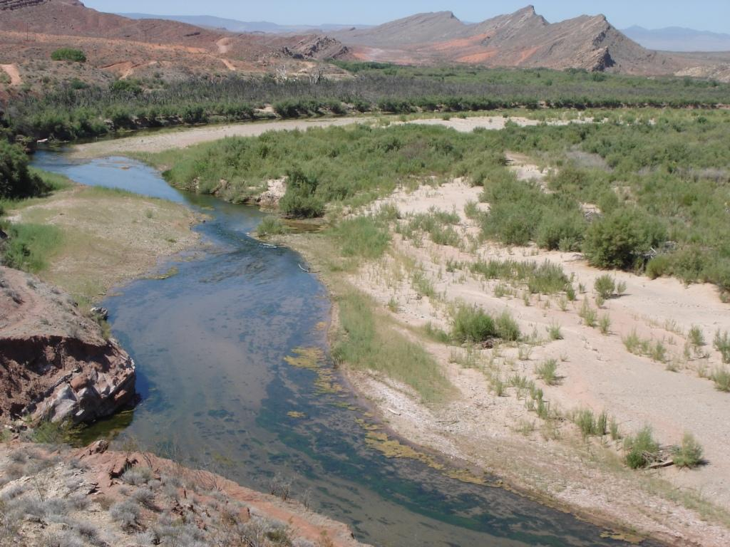
Introduction
Background
Project Objectives
Data Acquisition
Analysis and Results
Conclusions

Slide 3
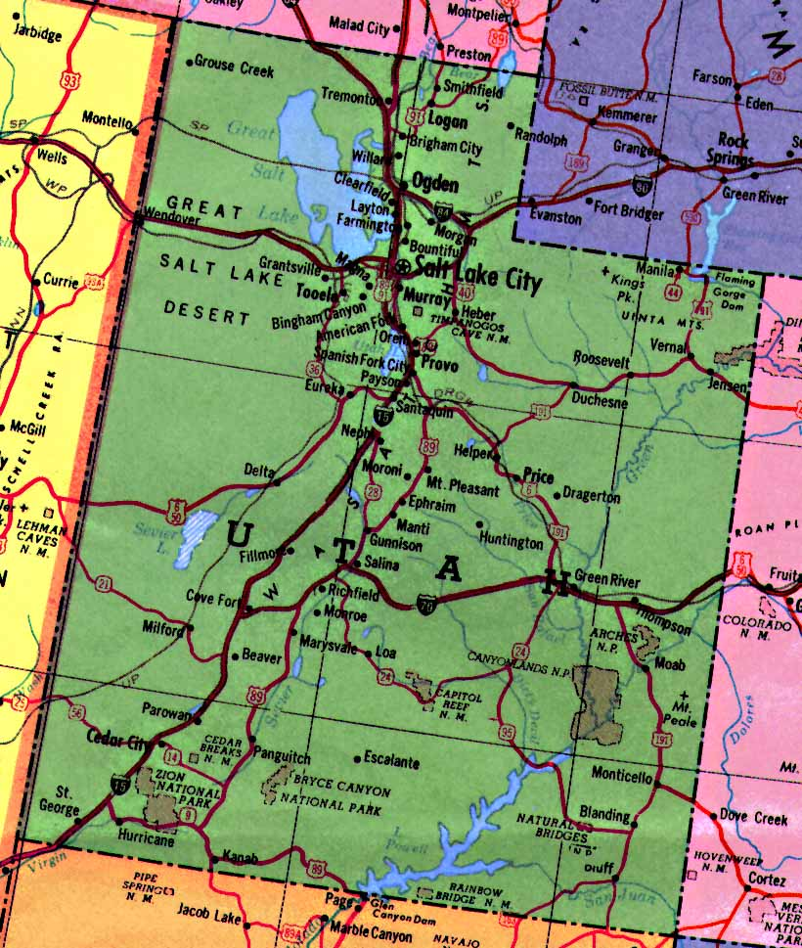
Background
Virgin River, Utah
Heightened Water demands
Drought
Clean Water Act
Endangered Species
TZTS Model

Slide 4
Project Objectives
Incorporation of thermal imagery in parameter estimation and model calibration
Improve the estimation of two model parameters
1. Average Channel Widths
2. Average Dead Zone Areas
W
W
DZ
Notes:
Dead Zone explanation
Why new channel widths and dead zone areas

Slide 5
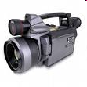
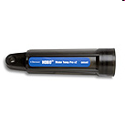
Data Acquisition
Thermal Infrared (TIR) Imagery
FLIR Camera
3-Band Imagery
Instream Temperatures
HOBO® Pro v2 Water Temperature Data Logger
Notes:
Simultaneous instream temperatures aided in image calibration

Slide 6
Image Processing
Mosaic of Images (TIR and 3-band imagery)
Image Calibration
Instream Temperatures
MODTRAN (MODerate resolution atmospheric TRANsmission)
Notes:
MODTRAN is a computer program designed to model atmospheric propagation of electromagnetic radiation from 100-50000 cm-1 with a spectral resolution of 1 cm-1.
Next slides are 3-band and TIR examples

Slide 7
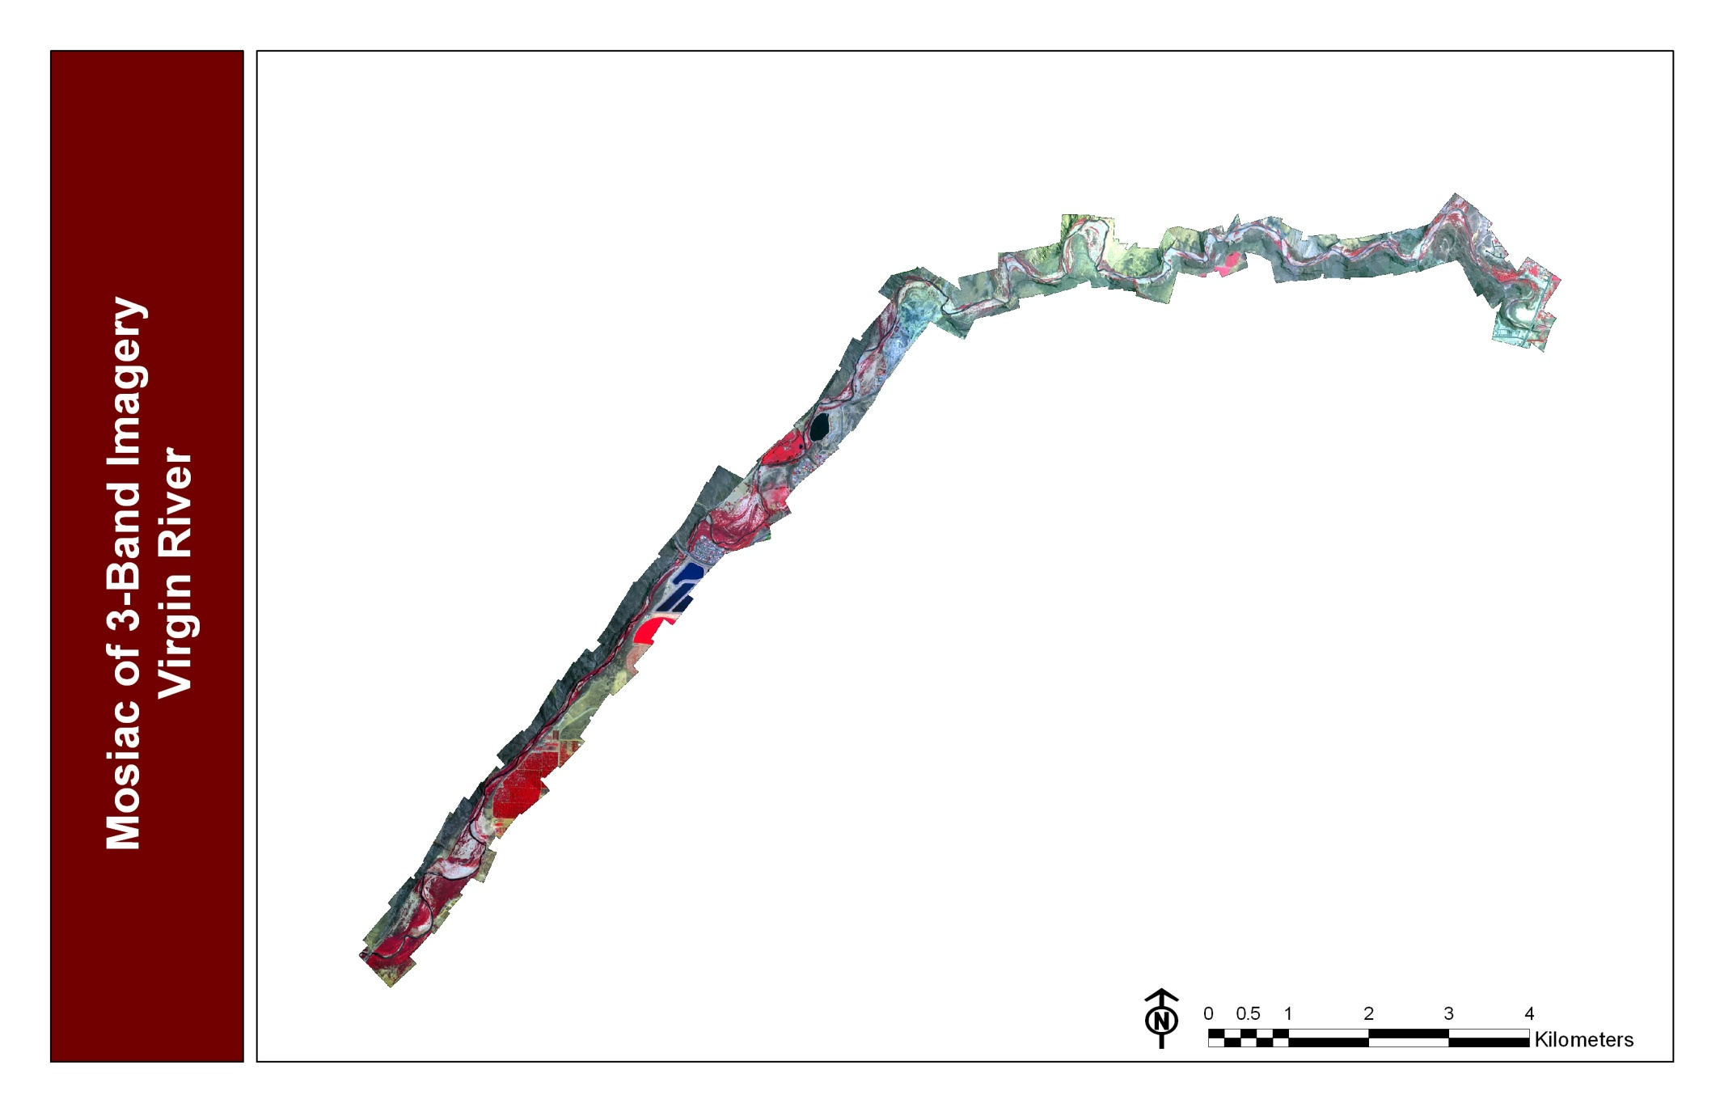
3-Band Mosaic

Slide 8
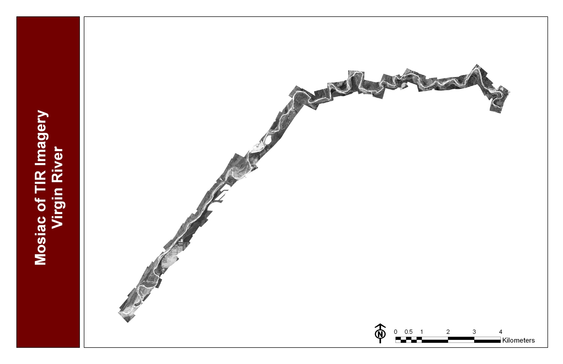
TIR Mosaic

Slide 9
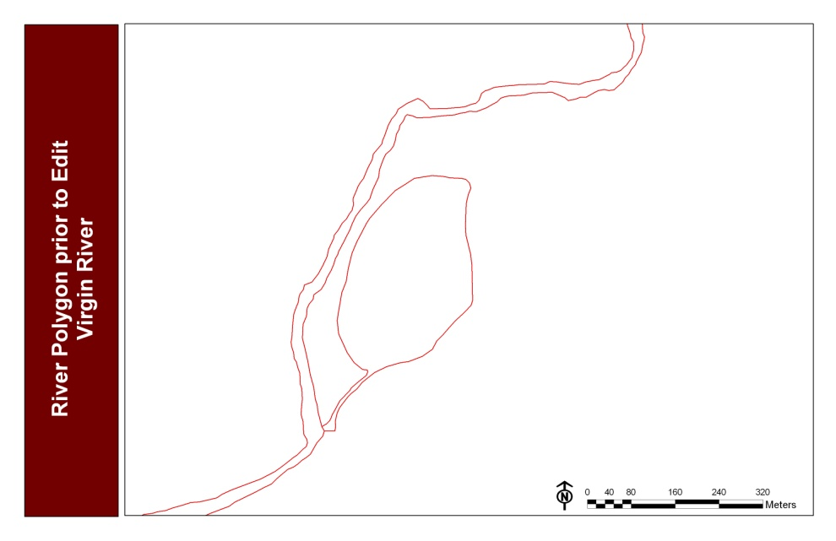
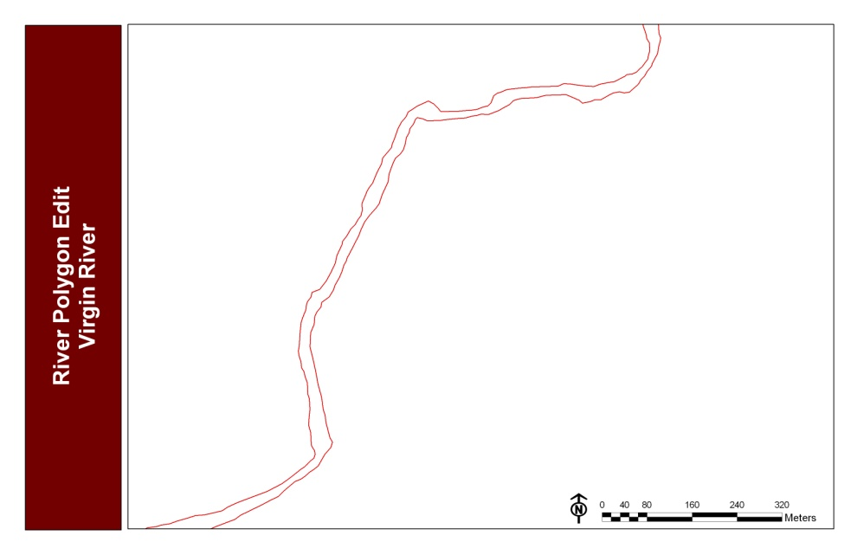
River Polygon
Polygon of river was generated using a mask of the river.
Edits necessary

Slide 10
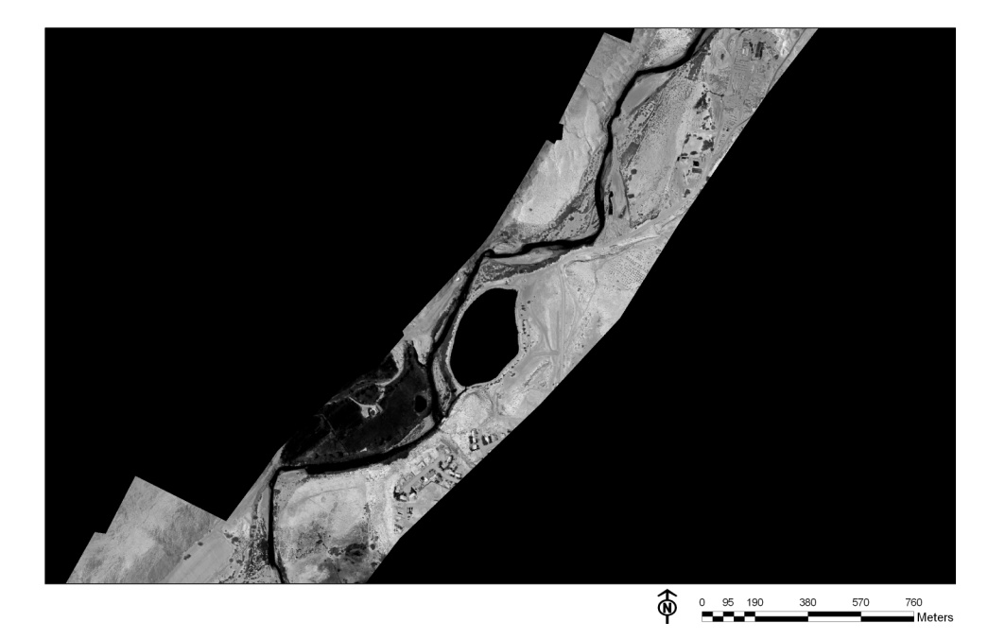
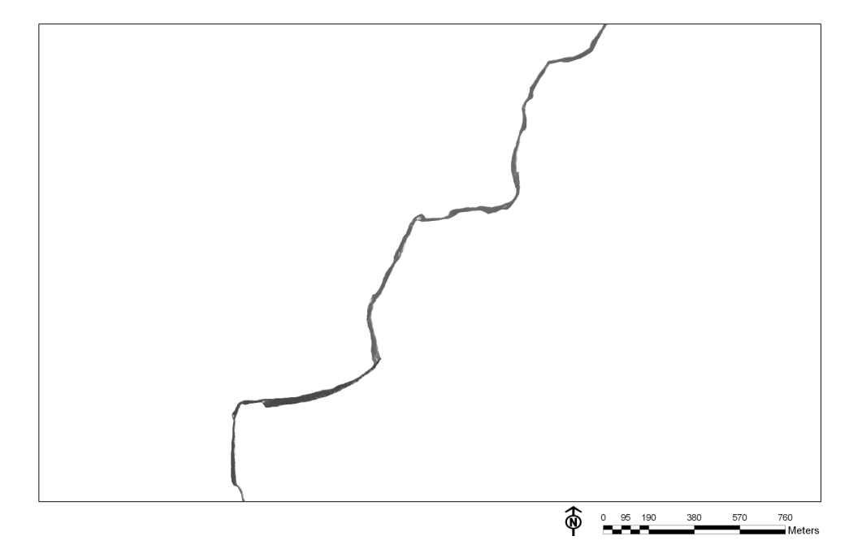
Clip TIR Imagery & Segment River
River Polygon was used to clip TIR imagery
3 River Segments (Upper, Middle, & Lower)

Slide 11
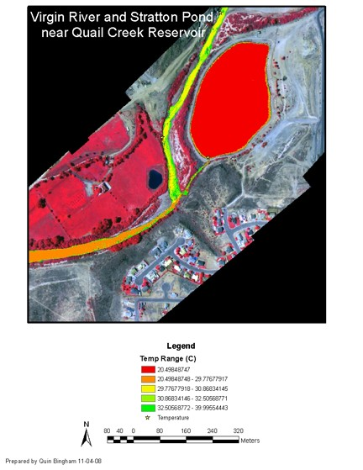

Slide 12
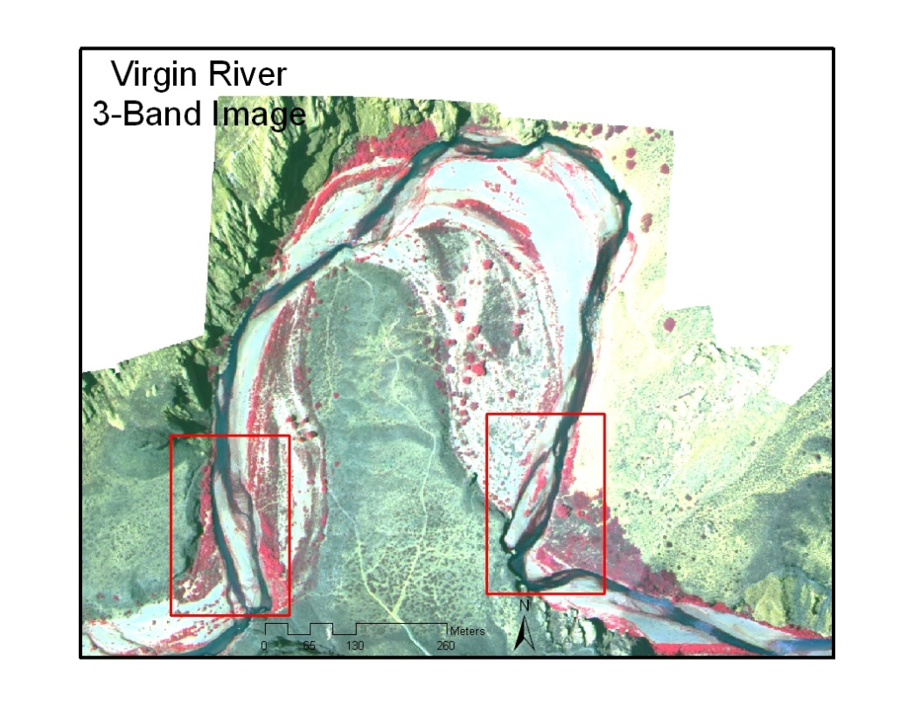
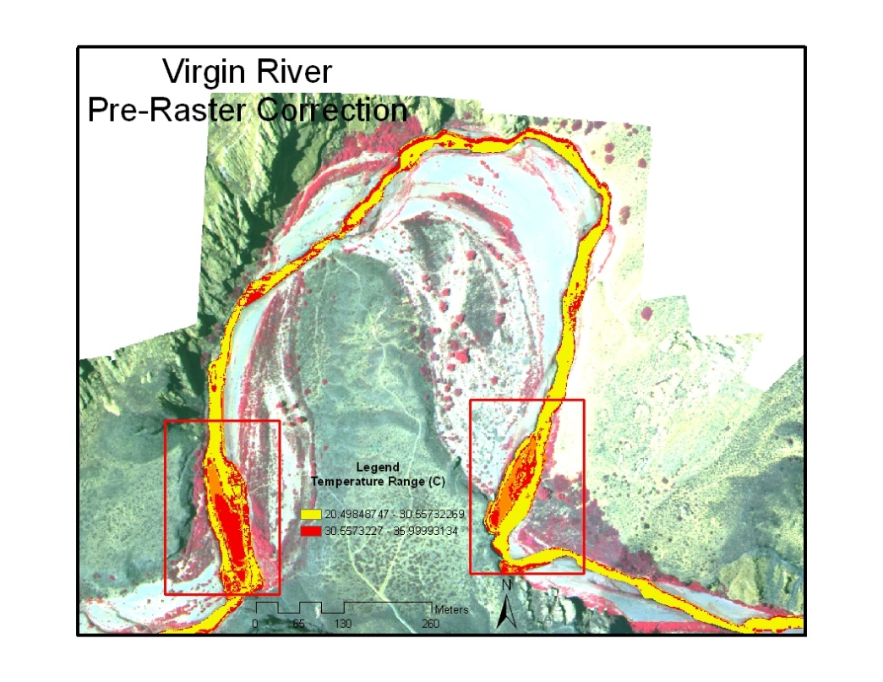
Raster Calculation
con([raster]>36,0,[raster])

Slide 13
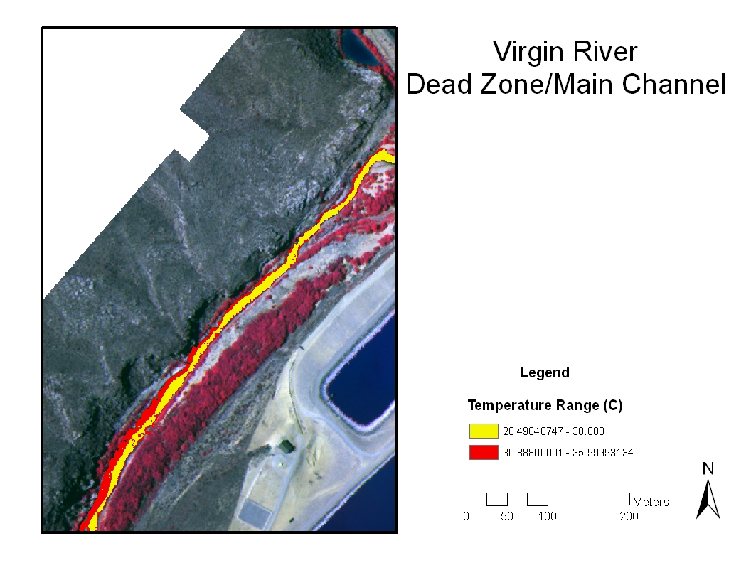
Dead Zone Area
Instream Temperature data used to determine temperature break between the main channel and dead zone.

Slide 14
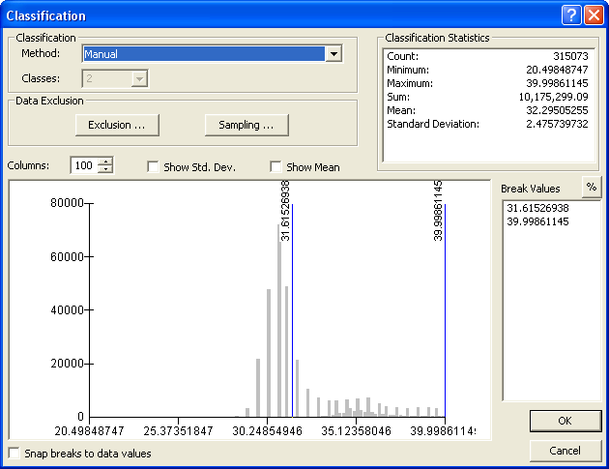
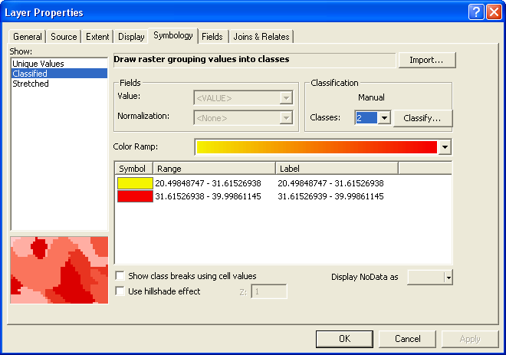
Dead Zone Area
Sub-Reach | DZ Area (m^2) | MC Area (m^2) | % DZ | % MC
Lower | 104423 | 74878 | 27 | 73
Middle | 45932 | 67491 | 40 | 60
Upper | 59435 | 94951 | 38 | 62

Slide 15
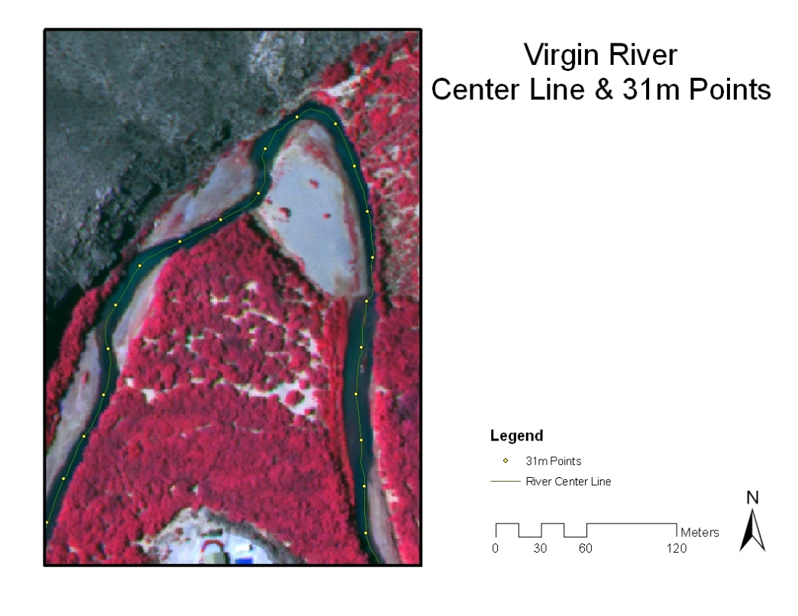
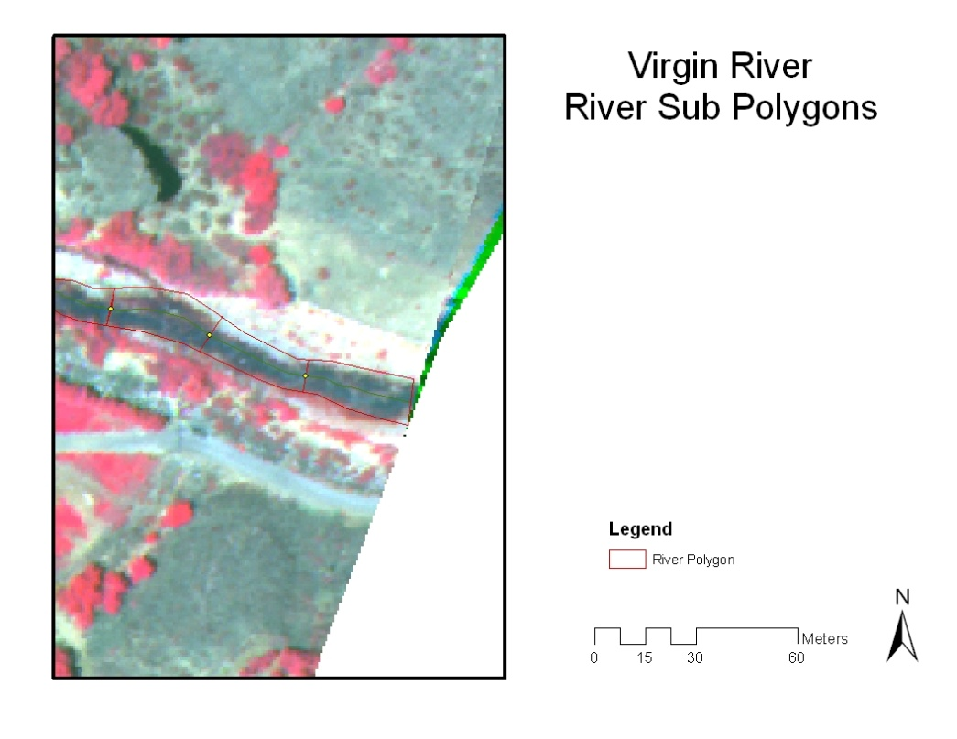
Centerline/31m Points/Sub-Polygons

Slide 16
Conclusion
Total River Surface Area & Dead Zone Areas may be calculated with TIR imagery
The area & width calculation appear promising
Modeling results still pending

Slide 17
Questions?

