Slide 1
Bear River Range Groundwater Recharge and Discharge Estimate Map
By
Greg Parry
GIS in Water Resources
UTAH STATE UNIVERSITY

Slide 2
OUTLINE
INTRODUCTION
  BACKGROUND
  SETTING
PROJECT OBJECTIVE
DATA ACQUISITION
RESULTS
ADDITIONAL WORK
CONCLUSION

Slide 3
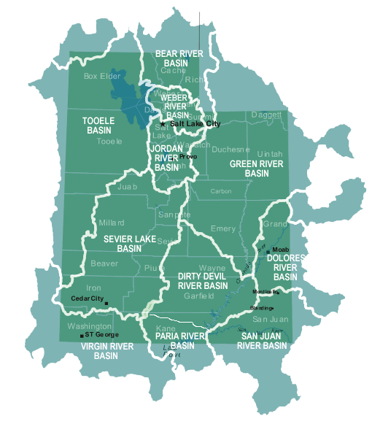
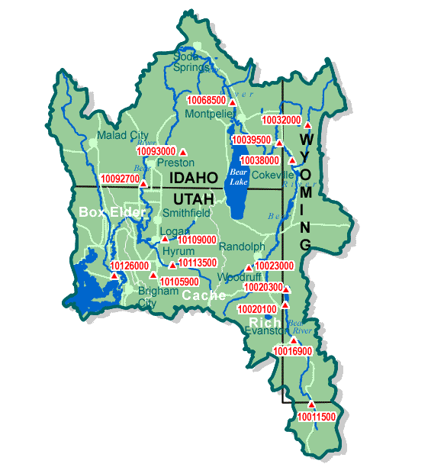
INTRODUCTION
BEAR RIVER BASIN
USGS Water Resources of the United States: Utah Water Science Center; Interactive Basin Map of Utah

Slide 4
INTRODUCTION
CACHE VALLEY, UTAH
NORTH-SOUTH TRENDING Northern portion in Idaho
Southern portion in Utah
EASTERN BOUNDARY
Bear River Range
WESTERN BOUNDARY
Bannock Range
Malad Range
Wellsville Mountains
ENTIRE VALLEY WITHIN BEAR RIVER DRAINAGE

Slide 5
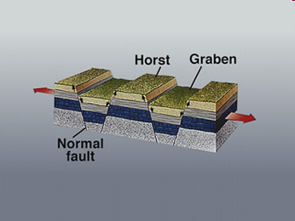
INTRODUCTION
GEOLOGY IN CACHE VALLEY
        Graben: a down-dropped block of the earth's crust resulting from extension, or pulling, of the crust.
U.S. GEOLOGICAL SURVEY: Visual Glossary

Slide 6
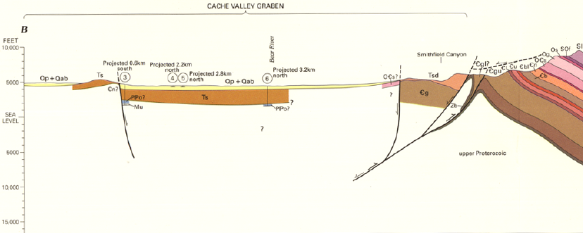
INTRODUCTION
BEDROCK GEOLOGY IN CACHE VALLEY
    Top Layer
        Provo Formation (Pleistocene)
        Alpine and Bonneville Formations (Pleistocene)
    Bottom Layer
        Salt Lake Formation (Pliocene and Miocene)
?
1996 UTAH GEOLOCICAL SURVEY

Slide 7
INTRODUCTION
GROUND-WATER RECHARGE IN CACHE VALLEY

Slide 8
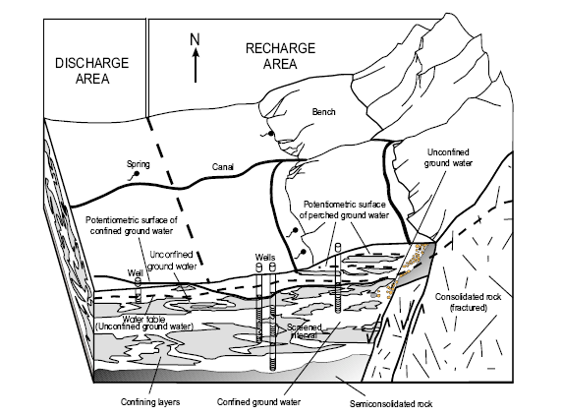
INTRODUCTION
GROUND-WATER CONDITIONS IN CACHE VALLEY
Kariya, K.A., Roark, D.M., and Hanson, K.M., 1994, Utah Department of Natural Resources Technical Publication No. 108, 102 p.

Slide 9
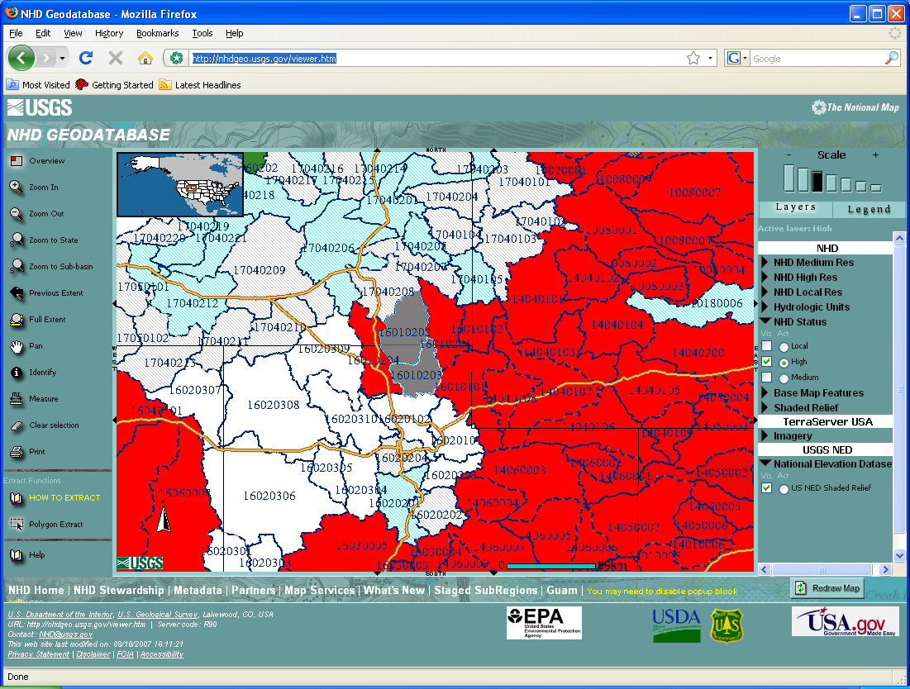
INTRODUCTION
NHD SUBBASIN 16010202 & 16010203

Slide 10
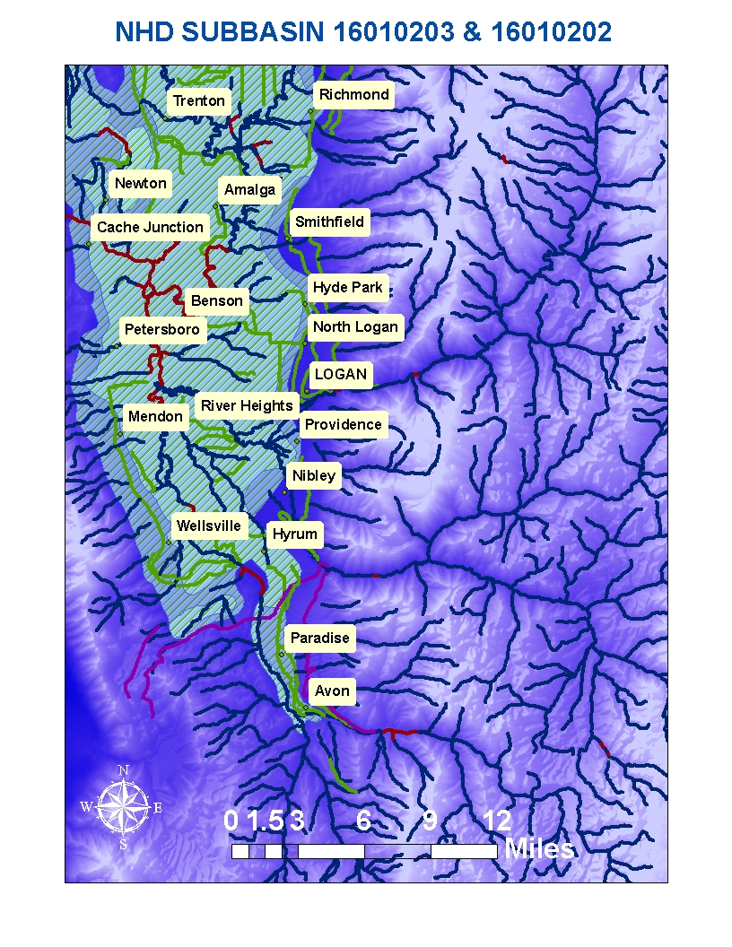
INTRODUCTION
NHD SUBBASIN 16010202 & 16010203

Slide 11
PROJECT OBJECTIVE
BETTER UNDERSTANDING OF THE HYDROLOGICAL CYCLE OF THE BEAR RIVER RANGE
COMPUTER SIMULATION MODELS CAN PREDICT THE CONSEQUENCES THAT WILL RESULT FROM CONTINUING CURRENT PUMPING RATES

Slide 12
PROJECT OBJECTIVE
PRO-GRADE: (Pattern Recognition Organizer and Groundwater Recharge and Discharge Estimator)
  Geographical Information System (GIS) plug-in tool package for recognizing patterns for raster data
    PATTERN RECOGNITION ORGANIZER FOR GIS (PRO-GIS)
    GROUNDWATER RECHARGE AND DISCHARGE ESTIMATOR FOR GIS
    (GRADE-GIS)
http://www.isws.illinois.edu/gws/sware/prograde/

Slide 13
PROJECT OBJECTIVE
PRO-GRADE
  Identifies recharge and discharge zones from existing ancillary data
  pattern recognition plug-ins for ArcMap to estimate recharge and discharge more efficiently
2008 Illinois State Water Survey

Slide 14
PROJECT OBJECTIVE
Pattern Recognized by Image Processing and Segmentation in GIS (PRO-GIS)
  Organizes several images into one graphical user interface (GUI) to extract patterns according to set parameters

Slide 15
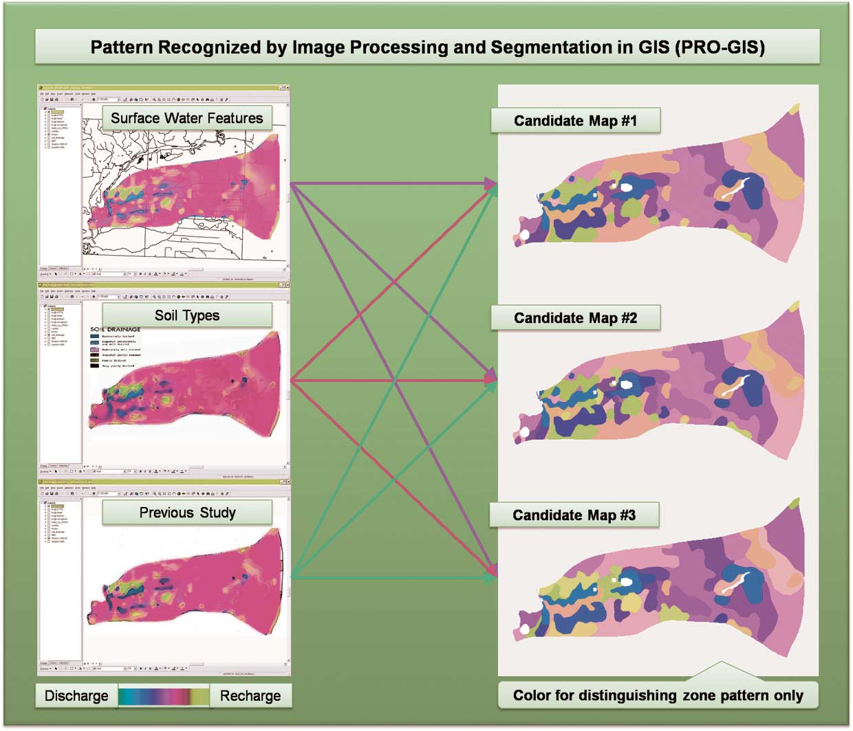
PROJECT OBJECTIVE
Pattern Recognized by Image Processing and Segmentation in GIS (PRO-GIS)
  2D Moving Average: ArcGIS Spatial Analyst extension
  Normalization: FORTRAN code
  TVLA Low Pass Filter: Medical Magnetic Resonance Imaging (MRI) scan analysis.
2008 Illinois State Water Survey

Slide 16
PROJECT OBJECTIVE
Groundwater Recharge and Discharge Estimator in GIS (GRADE-GIS)
  ASSUMPTIONS:
  HORIZONTAL 2-D FLOW
  NO SOURCE OR SINK,
  JUST RECHARGE AND DISCHARGE
  WATER TABLE ALWAYS HIGHER THAN BOTTOM ELEVATION
Stoertz and Bradbury (1989)

Slide 17
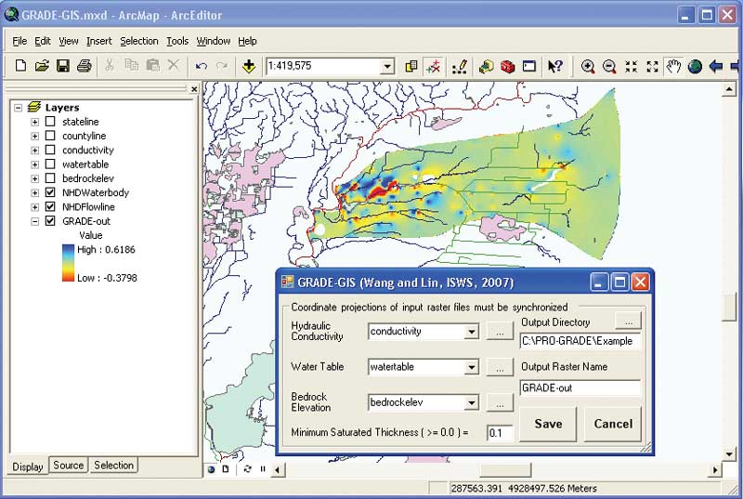
PROJECT OBJECTIVE
Groundwater Recharge and Discharge Estimator in GIS (GRADE-GIS)
  Hydraulic Conductivity
  Water Table
  Bedrock Elevation

Slide 18
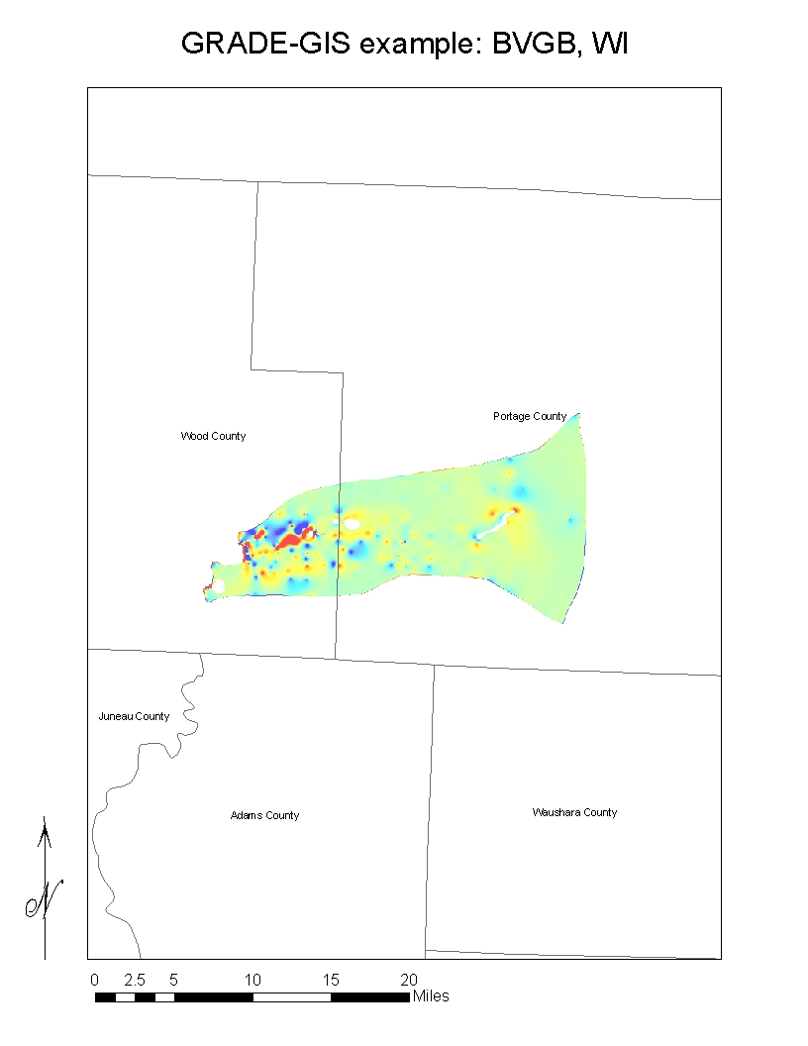
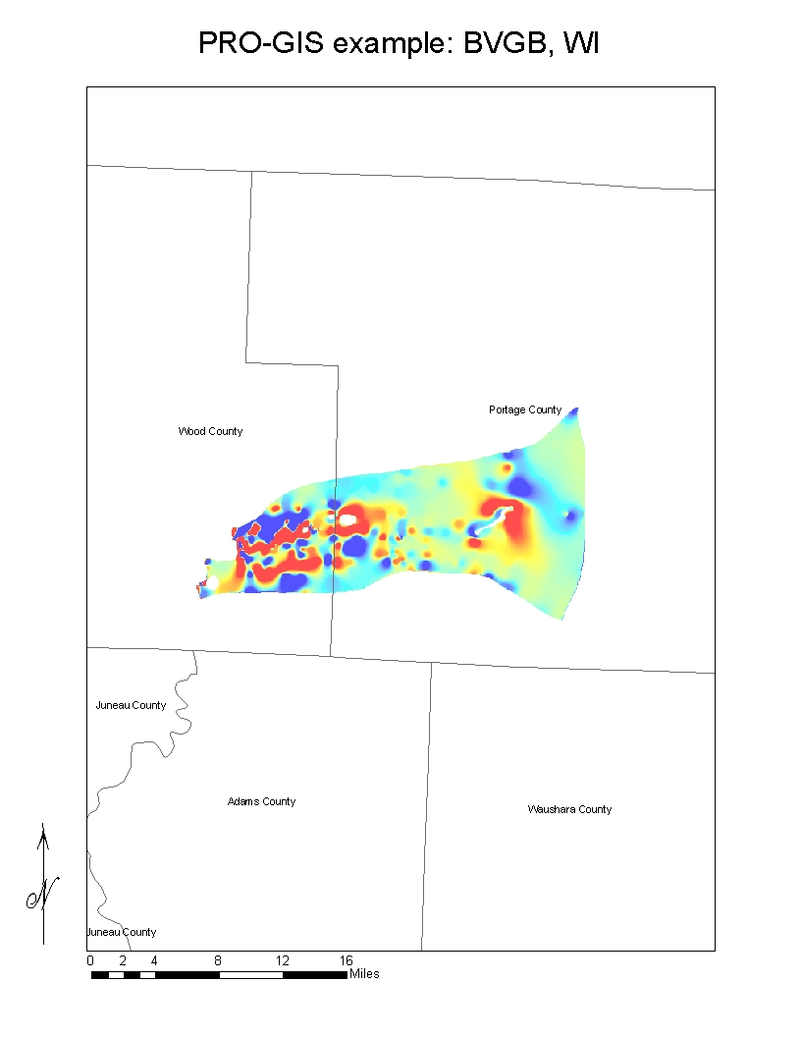
PROJECT OBJECTIVE
GRADE-GIS & PRO-GIS EXAMPLES

Slide 19
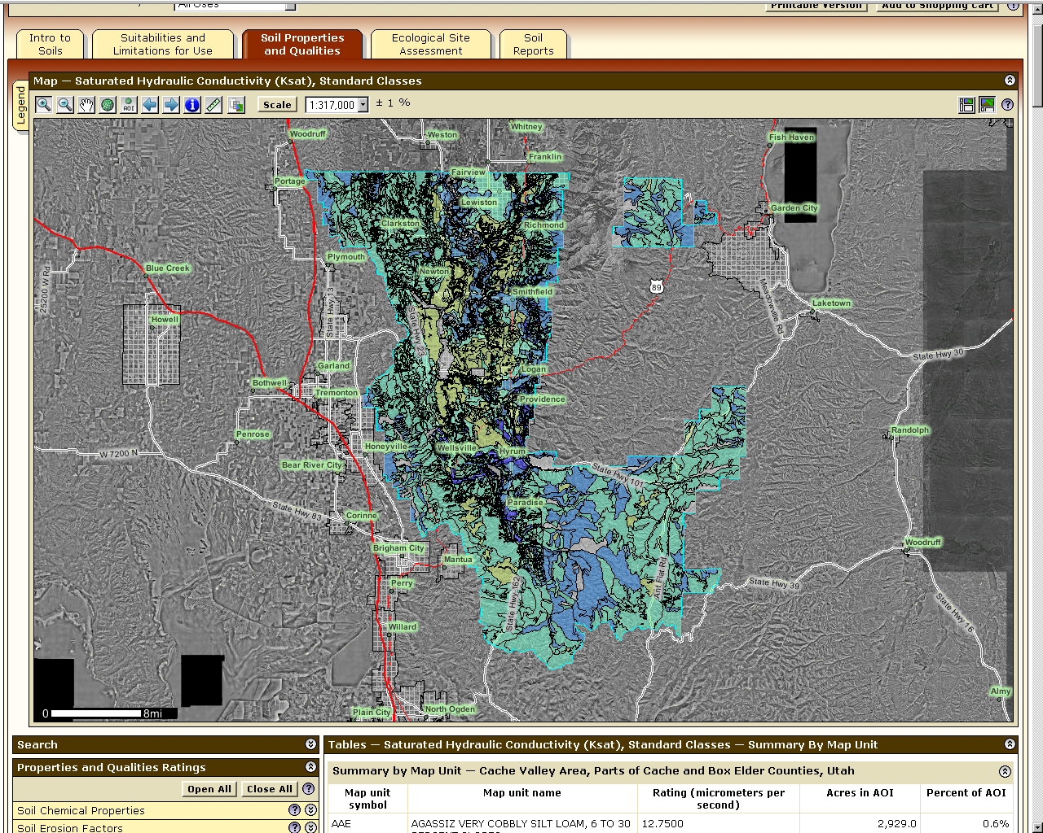

DATA ACQUISITION
HYDRAULIC CONDUCTIVITY

Slide 20
DATA ACQUISITION
HYDRAULIC CONDUCTIVITY RASTER FILE

Slide 21
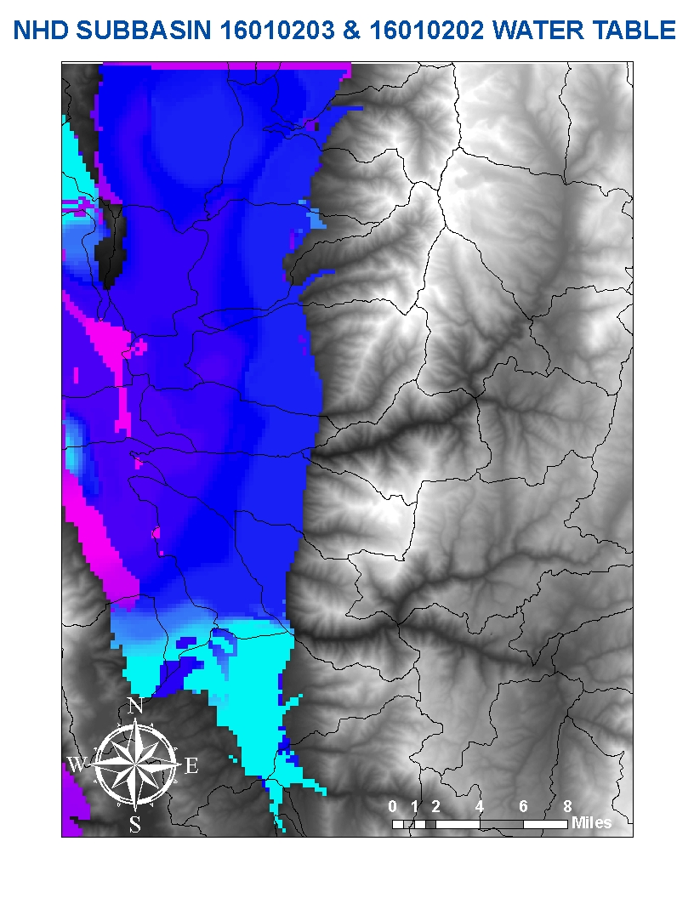
DATA ACQUISITION
WATER TABLE

Slide 22
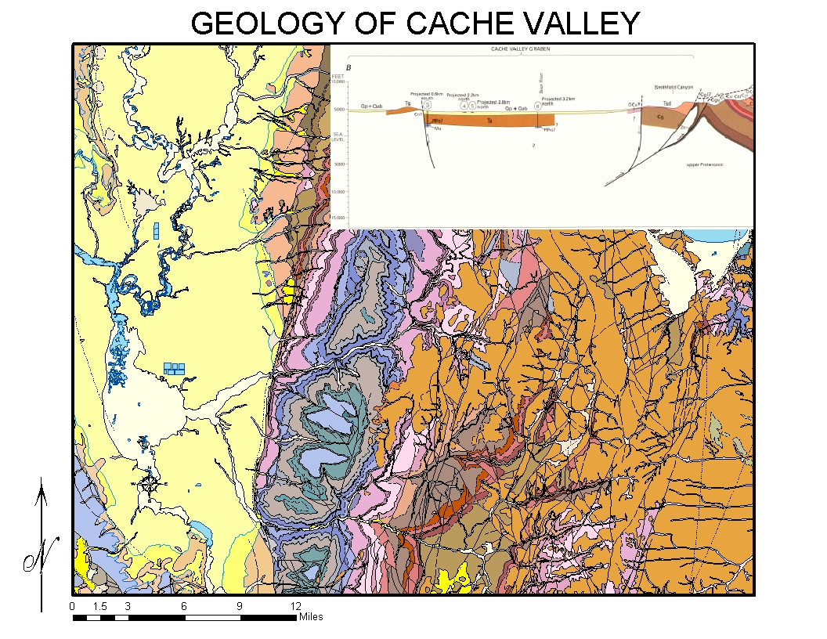
DATA ACQUISITION
BEDROCK ELEVATION

Slide 23
DATA ACQUISITION
LAUNCHING PRO-GIS
  All feature layers must be converted to raster files
  Import at least one file into ArcMap before launching PRO-GIS icon from tool bar
  GUI interface prompts input raster layer for the pattern recognition process

Slide 24
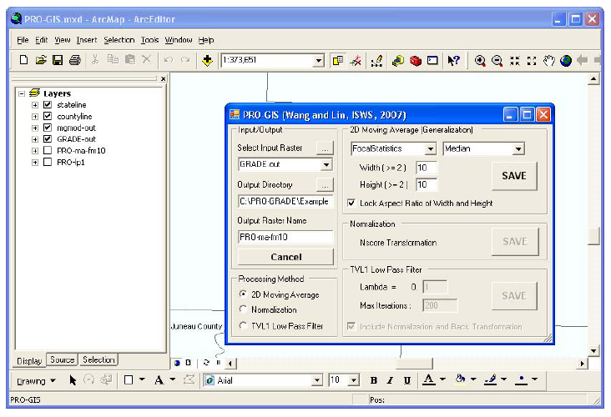
DATA ACQUISITION
LAUNCHING PRO-GIS

Slide 25
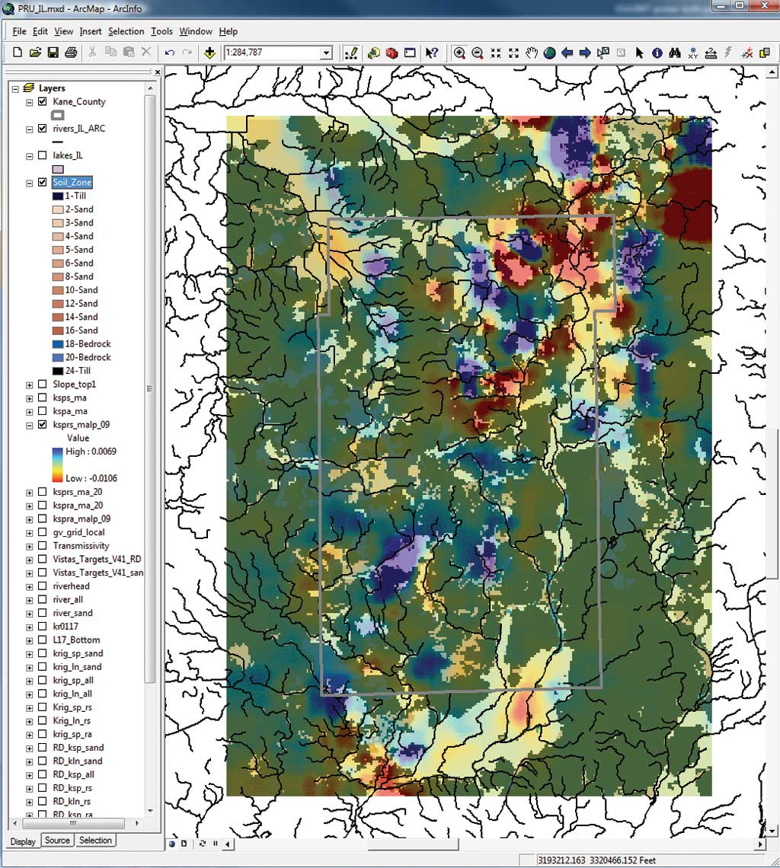
RESULTS
RECHARGE AND DISCHARGE PATTERNS
2008 Illinois State Water Survey

Slide 26
ADDITIONAL WORK
PRO-GRADE
  CREATING AND MODIFYING MASK TO DEFINE BEAR RIVER RANGE
  REGISTRATION AND MASKING
    REGISTERING ALL RASTER DATASETS TO FORM A STACK
        SPATIAL RESOLUTION
        GEOGRAPHIC PROJECTION

Slide 27
CONCLUSION
GRADE-GIS:
        OUTPUT FORMAT-READY FOR PRO-GIS
        GENERATE AS MANY ALTERNATIVE MAPS AS NECESSARY
        USED AS INITIAL CONDITIONS FOR MORE DETAILED ANALYSIS
PRO-GIS:
        PRO-GIS DEMONSTRATES THE BENEFITS OF ORGANIZING DIFFERENT SENERIOS OF ONTO GUI
        WORKS WITH ARCOBJECTS
        NOT LIMITED TO PATTERN RECOGNITION OF GROUNDWATER RECHARGE AND DISCHARGE

Slide 28
QUESTIONS?

