Slide 1
Statistical Downscaling of GCM Simulations to Future Temperatures: A Regression-Based Approach
Dumindu Jayasekera
GIS in Water Resources
Fall 2008
Utah State University

Slide 2
Introduction
Global warming became one of the biggest scientific issues during the 1980s. It has continued to attract scientific attention and also political and public concern.
Based on extensive scientific research, there is a confidence that human induced greenhouse gas concentrations are responsible for most of the global warming observed during the past 50 years.
Since pre-industrial times, CO₂, the most important greenhouse gas, has increased by 31% (IPCC, 2001). Water vapor is the other most important greenhouse gas. Increasing in temperature has a positive feedback effect on water vapor content. Other gases present in the atmosphere in small amounts also contribute to the greenhouse effect.
Collectively, this increase in greenhouse gases has altered the radiative balance of the earth to the point that it is now having a distinct influence on the global climate (IPCC, 1996).

Slide 3
Climate Change in Western US
It is also stated that most of the western United States is warming faster than the global average (IPCC report, 2007). In western US, daily minimum temperatures are rising faster than maximum temperatures, and the temperature trends are much larger during 1947–2003 (Hamlet, et al., 2007).
Utah average minimum temperature during the past decade was higher than that observed during any comparable period of the past century.

Slide 4
Objectives
Estimate the average minimum temperatures at the end of this century (2059-2099) by downscaling the large scale simulated predictor variables from the global models.
Develop average minimum temperature maps for all seasons at the end of the century across Utah.

Slide 5
Data Sources
Statistical Downscaling Model (SDSM) predictors by data portal maintained by the Canadian Climate Impacts Scenarios Group.
(http://www.cics.uvic.ca/scenarios/sdsm/select.cgi)
Utah climate data was downloaded from Utah Climate Center maintained by Utah State University.
(http://climate.usurf.usu.edu/products/data.php)
Utah shape files from Utah GIS portal (AGRC).
(http://gis.utah.gov)

Slide 6
Methods and Analysis…
To quantify the impacts of climate change on temperature, the
outcomes of general circulation models (GCMs) which are known as
one of the credible scientific techniques to simulate the impacts of
increased greenhouse gases on climatic variables was used.
GCM Scenario Selection
HadCM3 (Hadley Center for Climate and Prediction and Research, UK) was used.
Emission Scenario Selection
Global emission scenario A2 was chosen for this study because it is the most widely simulated global emission scenarios in all models. Emissions scenario A2 is based on the assumption that future economic and population growth will not be constrained and there will be no future limitations on global emissions. The A2 global emission scenario projects global average CO₂ concentrations will reach 850 ppm by 2100.

Slide 7
Methods and Analysis…
Weather Stations Selection for GCM Grid Location
HadCM3 grid size: 2.5° lat x 3.75° long
Length along the meridian:
Length along the parallel:
159.68 km
319.37 km

Slide 8
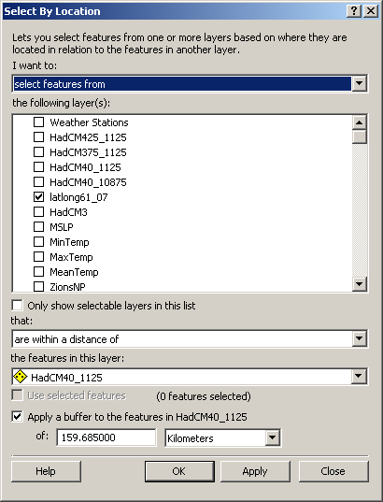
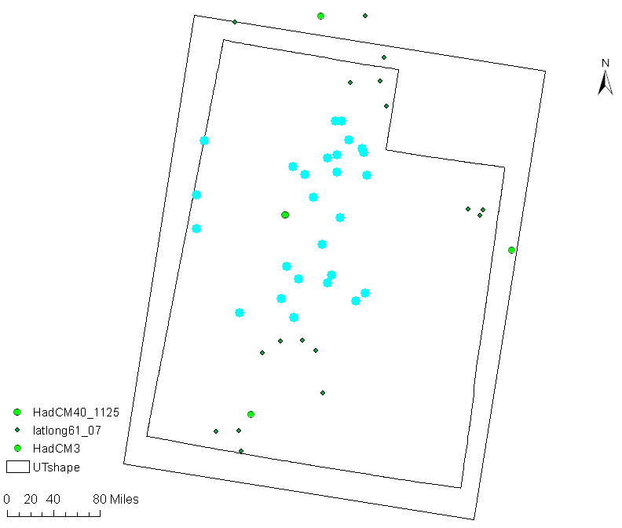
Methods and Analysis…
ArcGIS was used to select the weather stations for a GCM grid location.

Slide 9
Downscaling Methods
Two fundamental approaches exist for the downscaling of large-scale
GCM output to a finer spatial resolution.
Dynamical downscaling – (computationally intensive)
Statistical downscaling – (computationally efficient)
This study uses statistical downscaling method based on regression
models. Fundamental concept is that regional climates are largely a
function of the large-scale atmospheric state.

Slide 10
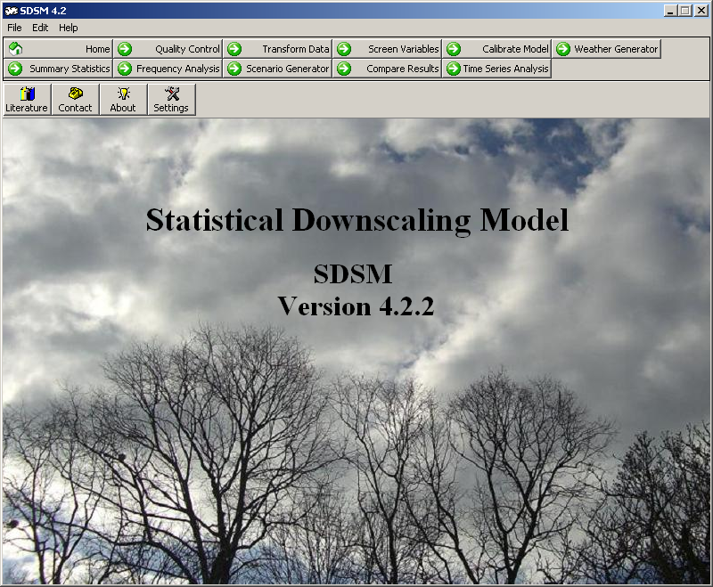
Methods and Analysis
The Statistical Downscaling Model (SDSM) empirical-statistical downscaling (ESD) tool is developed by Rob Wilby and Chris Dawson in UK. This first downscaling model is a multiple regression based method and is referred to as Statistical Down-Scaling Model (SDSM) (Wilby, et al., 2002). This software is freely available at https://copublic.lboro.ac.uk/cocwd/SDSM/.

Slide 11
Downscaling using SDSM
In this study, the ‘observed’ large scale atmospheric predictors from the National Centers for Environmental Prediction (NCEP) reanalysis data sets were used for calibration and validation of the downscaling models, and then the derived predictors of the HadCM3
were used in simulating daily minimum temperature for the current period (1961-2001).
Ten weather stations having daily minimum temperatures (T_{min}) from 1/1/1961 to 12/31/2001 were used as the predictand variable. The ten weather stations are LoganUSU, Jensen, SaltLakeCity airport, WendoverAwos, Tooele, Oakcity, CastleDale, BlackRock, Boulder, and Zions National Park.
LoganUSU will use as an example.

Slide 12
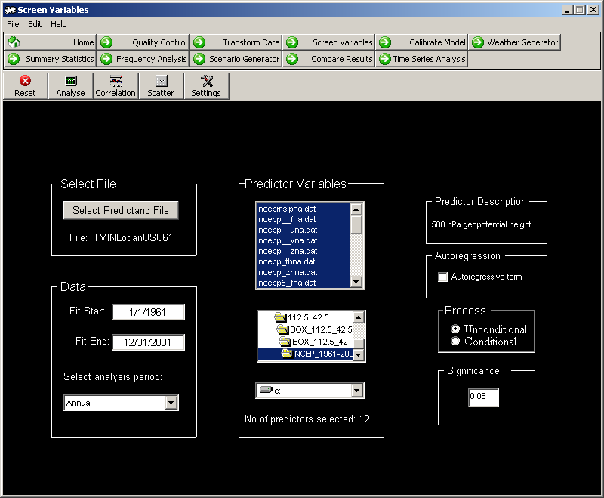
Screen Variables
The NCEP large scale atmospheric predictor variables are,
Mean Sea Level Pressure
Surface Airflow Strength
Surface Zonal Velocity
Surface Meridional Velocity
Surface Vorticity
Surface Wind Direction
Surface Divergence
500hPa Airflow Strength
500hPa Zonal Velocity
500hPa Meridional Velocity
500hPa Vorticity
500hPa Geopotential Height
500hPa Wind Direction
500hPa Divergence
850hPa Airflow Strength
850hPa Zonal Velocity
850hPa Meridional Velocity
850hPa Vorticity
850hPa Geopotential Height
850hPa Wind Direction
850hPa Divergence
Relative Humidity at 500hPa
Relative Humidity at 850hPa
Near Surface Relative Humidity
Surface Specific Humidity
Mean Temperature at 2m

Slide 13
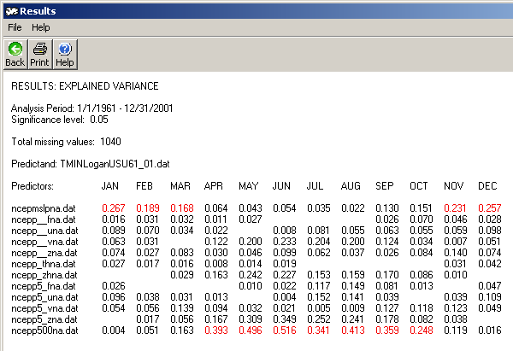
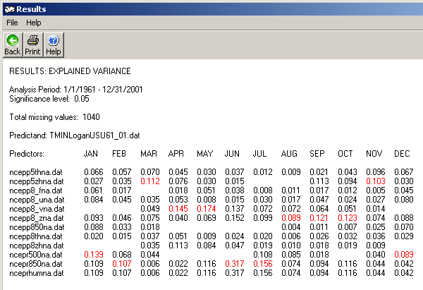
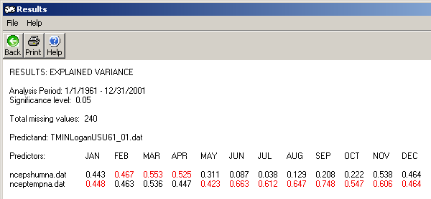
Screen Variables…
Screening variables were based on the variance explained, partial
correlation, and scatter plots between predictor variable and
predictand.

Slide 14
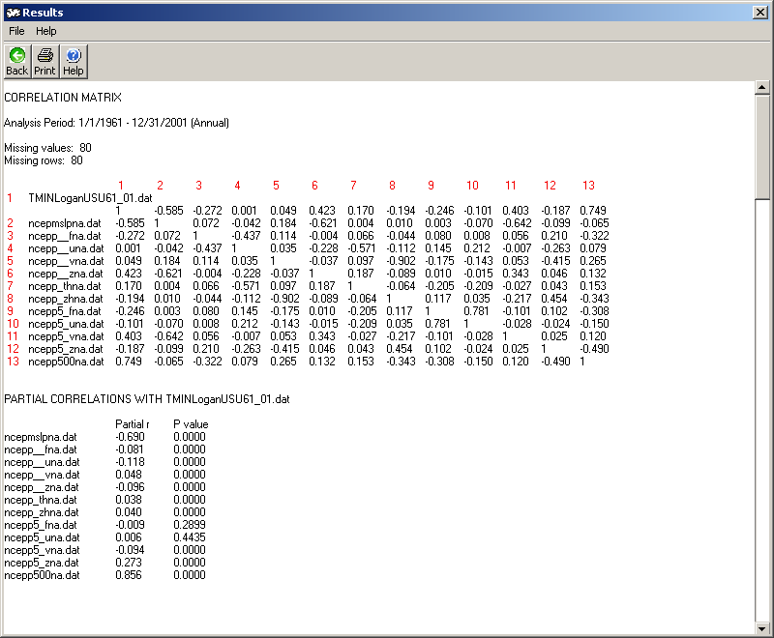
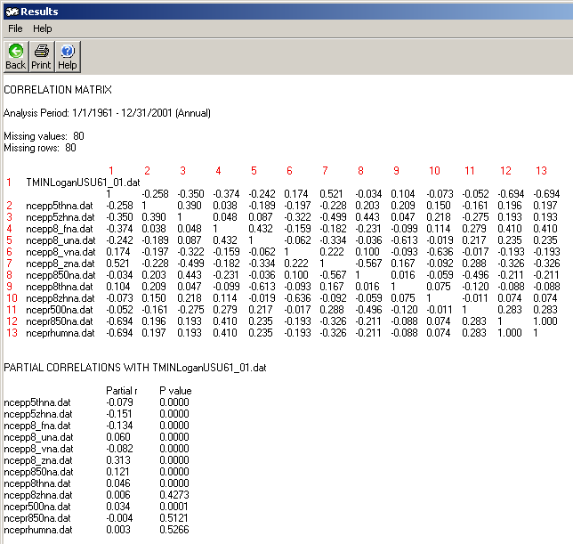
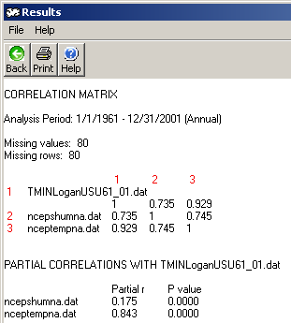
Partial Correlation Analysis

Slide 15
Scatter Plot Analysis

Slide 16
Scatter Plot Analysis…
The predictor variables have a better correlation with the predictand (T_{min}) are,
Mean sea level pressure, 500hPa vorticity, 500hPa geopotential height, 850hPa vorticity, surface specific humidity, and mean temperature at 2m.

Slide 17
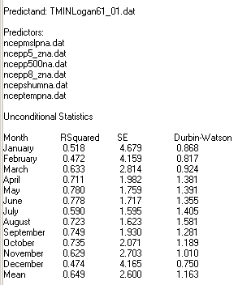
Model Calibration
Model was calibrated for the period from 1/1/1961 to 12/31/1981 (21
yrs) and validated for the period from 1/1/1982 to 12/31/2001 (20 yrs).

Slide 18
Model Validation
1982-2001 | OBSERVED | SIMULATED
Month | Mean | Mean | (Error)²
January | -9.0480 | -8.5942 | 0.2059
February | -6.3497 | -6.5753 | 0.0509
March | -2.9124 | -1.7340 | 1.3886
April | 1.7106 | 2.2526 | 0.2939
May | 6.5814 | 6.7715 | 0.0362
June | 10.7753 | 10.7691 | 0.0000
July | 15.0771 | 14.6664 | 0.1687
August | 14.1256 | 14.7388 | 0.3760
September | 8.9221 | 9.2363 | 0.0987
October | 3.5548 | 2.9890 | 0.3201
November | -1.9503 | -2.5214 | 0.3261
December | -7.4477 | -8.2891 | 0.7081
 |  | SUM | 3.9732
 |  | MSE | 0.3311
 |  | RMSE | 0.5754

Slide 19
Frequency Analysis
This quantile-quantile plot shows the simulated minimum temperatures for the current climate period (1961-2001) using HadCM3 plotted against the observed minimum temperatures from 1961-2001.

Slide 20
Future Climate Condition (2059_2099)
 | Winter | Spring | Summer | Fall | Annual
1961_2001 | -7.629 | 2.335 | 13.537 | 3.619 | 3.033
2059_2099 | -7.509 | 1.825 | 14.718 | 3.157 | 3.048

Slide 21
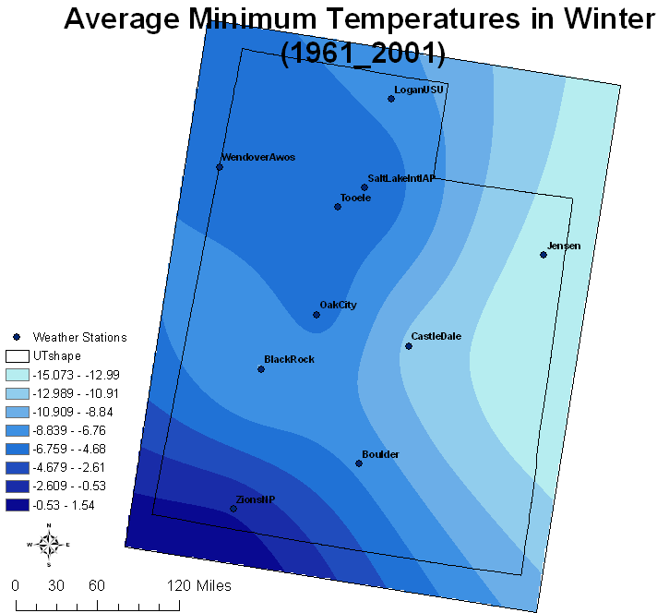
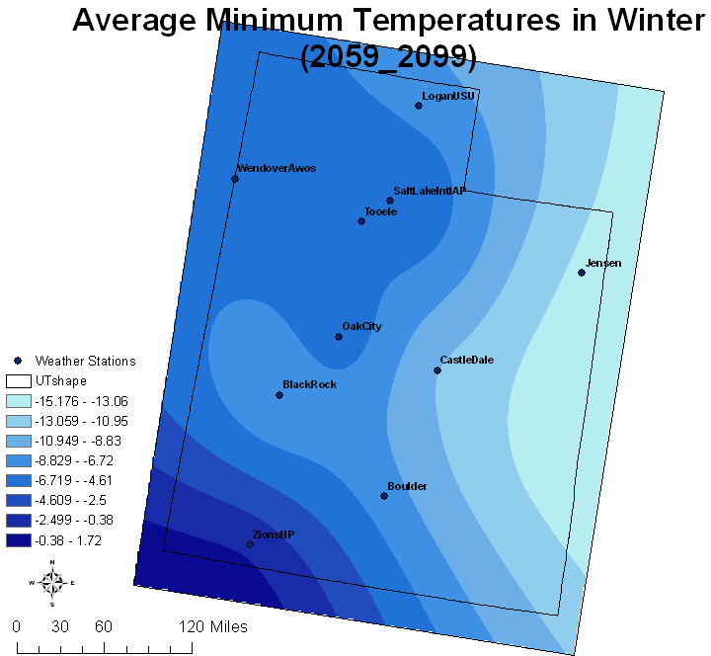
Minimum Winter Temperatures

Slide 22
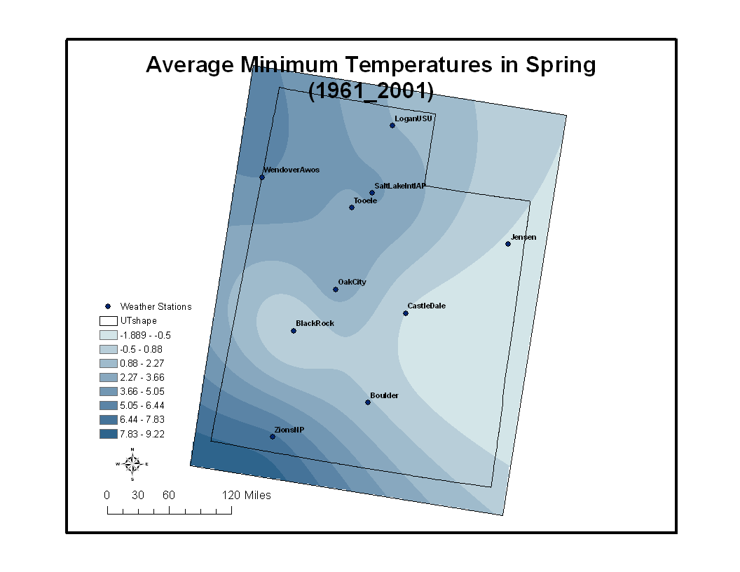

Minimum Spring Temperatures

Slide 23
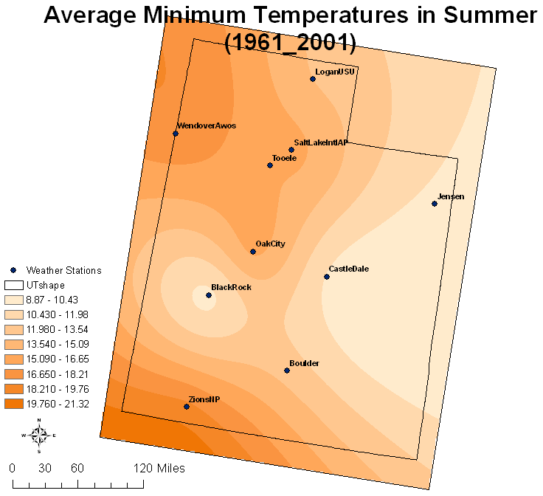
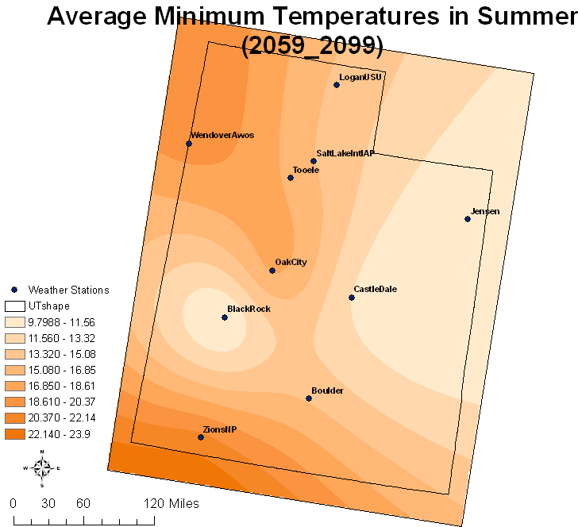
Minimum Summer Temperatures

Slide 24
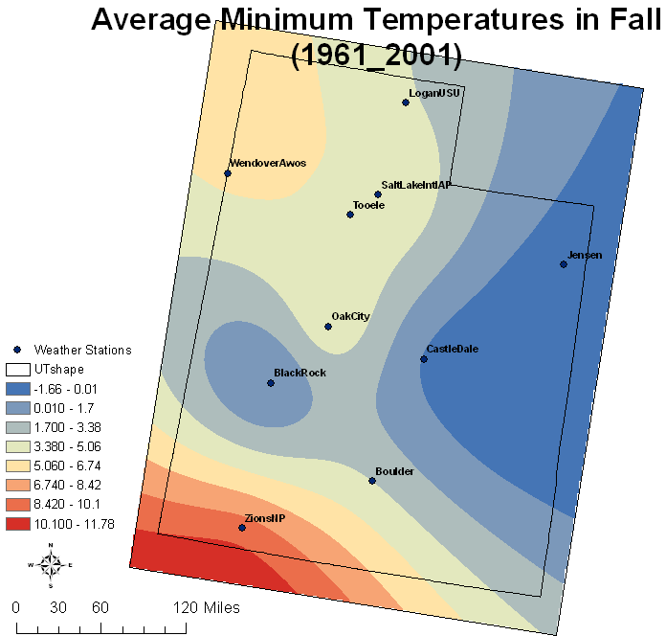
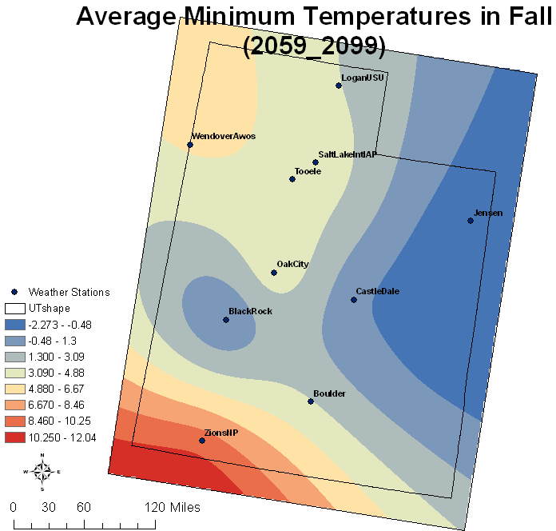
Minimum Fall Temperatures

Slide 25
Summary and Conclusions
Average annual minimum temperatures will be increased at the end of this century (2059_2099).
Summers will be significantly warmer across Utah.
At the end of this century, southern part of Utah is warmer during Winter, Summer and Fall seasons.
On average, winter seasons average minimum temperatures will increase. Spring and Fall seasons average minimum temperatures will be decreased in Utah.

Slide 26
Questions or Suggestions?

