Slide 1
The Yellowstone River
Flooding in Glendive, MT
By: Clay Woods

Slide 2
Yellowstone River
Longest un-dammed river in continental U.S.
Main tributary to the Missouri River
Drainage area of 70,000 square miles
Used for irrigation and recreation

Slide 3
Glendive, MT

Slide 4
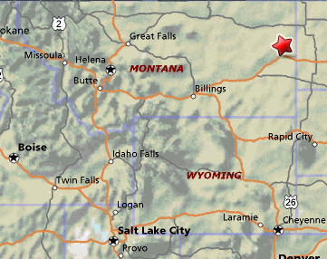
Glendive, MT
Located in Eastern Montana
Agricultural hub of the area
Population of 4,700 in the city

Slide 5
Project Goal
Build base map of Dawson County
DEM and NHDPlus Flowlines
Obtain stream gage information
Obtain flooding information
Integrate data into a GIS system

Slide 6
Base Map

Slide 7
Base Map

Slide 8
Base Map

Slide 9
Stream Gages
Datum for gage changed in 2002
Approved data started in 2003

Slide 10
Gage Data

Slide 11
Gage Data

Slide 12
Flooding in Glendive

Slide 13
Flooding in Glendive
Flood stage is 53.5 ft (NWS)
Highest recorded stage 66.0 ft in 1920
Recently 60.49 ft in 2003

Slide 14
Remaining tasks
Integrate Gage data with base map
Determine floodplain for given flood
Show floodplain on GIS map

Slide 15
References
USGS website - www.usgs.gov
Google Earth
Mapquest – www.mapquest.com
Wikipedia

Slide 16
Questions

