Slide 1
GIS for Water Resources Cee 6440
Utah State University – Fall 2008
Bryan Heiner
Term Project Presentation

Slide 2
Pineview REservoir
Runoff Prediction for

Slide 3
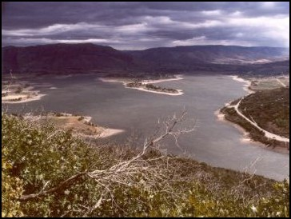
Introduction
Background
Data acquisition and Creation of Basemap
Using Model Builder
Results
Conclusion

Slide 4
Background
Notes:
Pineview Reservoir is located Utah 6 miles up Ogden Canyon.

Slide 5
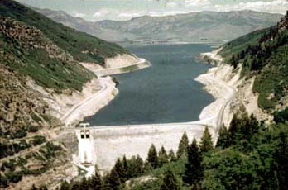
Background
Dam Characteristics
Crest Elev: 4908.0 ft
Dam Height: 137 ft
Crest Length: 600 ft
Outlet Works: 2300 cfs
Spillway: 10,000 cfs
Storage Capacity: 110,150 ac-ft
Notes:
Some of the dam characteristics are as follows:

Slide 6
Background
Notes:
Below Pineview Reservoir is a USGS gauging station that has been in operation since 1988 is used to monitor the discharge from the reservoir. There is also a small stream that adds from a tributary canyon but the majority of the flow is from Pineview’s release.

Slide 7
Data Acquisition and BaseMap
Data was Collected from:
NADPlus – Flowlines, Stream Gauges, Catchments, Subbasins and their attributes
Utah Division of Water Rights – Waterbodies
NOAA & DayMet - Precipitation
USGS Seamless – DEM

Slide 8
Data Acquisition and BaseMap
BaseMap Layout
Notes:
Here is the BaseMap with all the data added and cropped as we did in our assignments. First: Selected the Contributing subbasins, then selected by location and exported into a Geodatabase.

Slide 9
Data Acquisition and BaseMap
Extract by Mask to Size DEM
Notes:
To crop the DEM to contain just the area within the Subbasin an Extract by Mask was used

Slide 10
Data Acquisition and BaseMap
Creation of Precipitation Data
Notes:
Precipitation was added with 12 proposed rain gauge stations

Slide 11
Data Acquisition and BaseMap
Creation of Precipitation Data
Notes:
Precipitation was added from an excel spreadsheet with 12 proposed rain gauge stations and the lat, lon, and precipitation data. After adding as a object class a feature class was created by adding X Y coordinates.

Slide 12
Model Builder
The model builder was used to create a raster of precipitation
Notes:
Using the model builder allowed precipitation rasters to be created in one step.

Slide 13
Model Builder
Spline
then
Extract by Mask
Notes:
The Precipitation raster was used to determine the average rainfall over the entire watershed

Slide 14
Results
Ration Method (q=CiA)
&
National Resources Conservation Services (NRCS)
Dimensionless Unit Hydrograph
Notes:
Using the Rational Method and the NRCS Dimensionless Unit Hydrograph the rainfall was routed through Pineview reservoir.

Slide 15
Results
My Routing: 1171 cfs.
May 05, 1997: 1230 cfs.

Slide 16
Conclusions:
Reservoir operations – doesn’t remain constant
Model Builder – would not save
QUESTIONS?

