Slide 1

Summit Creek
Flow Measurement
Brian M. Crookston
25th of November, 2008
CEE 6440 – GIS in Water Resources
Logan, Utah

Slide 2


Presentation Summary
Introduction
Flow Measurement Devices
Project Objectives
Device accuracy
ArcGIS
Conclusions

Slide 3
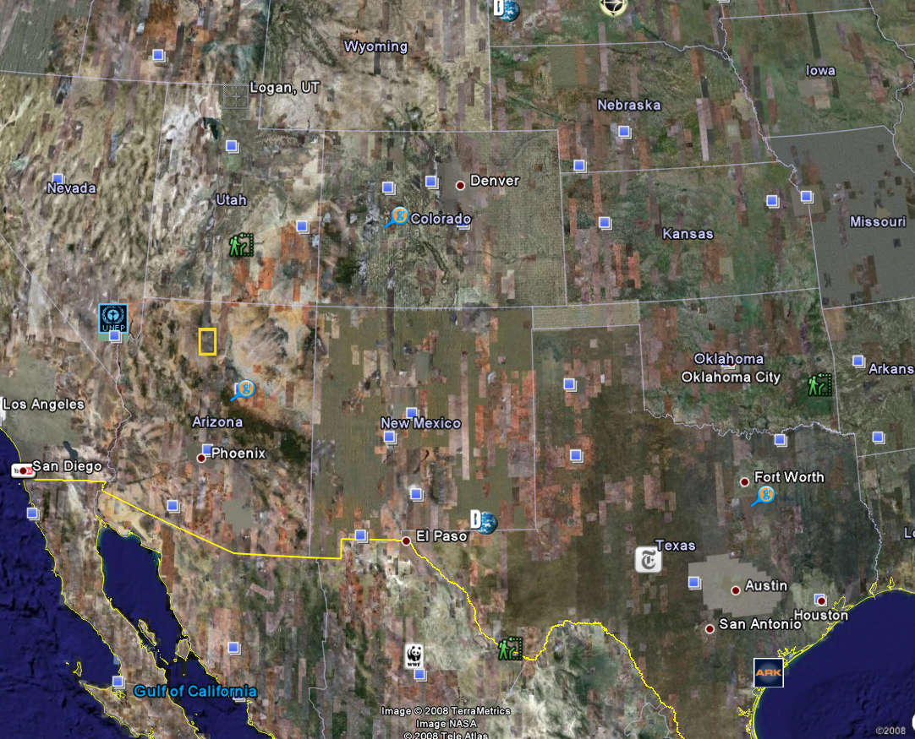
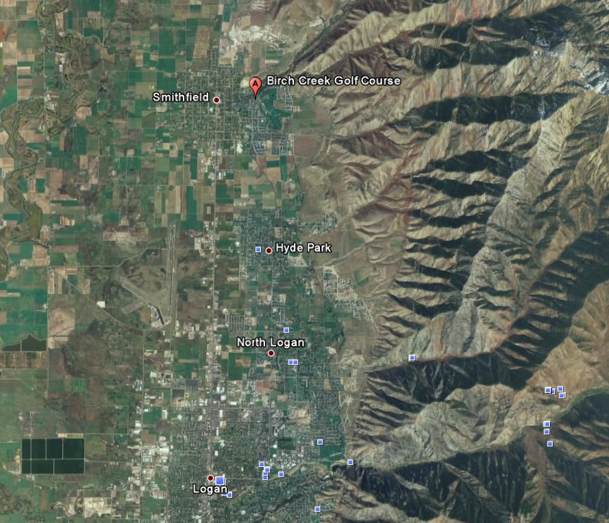
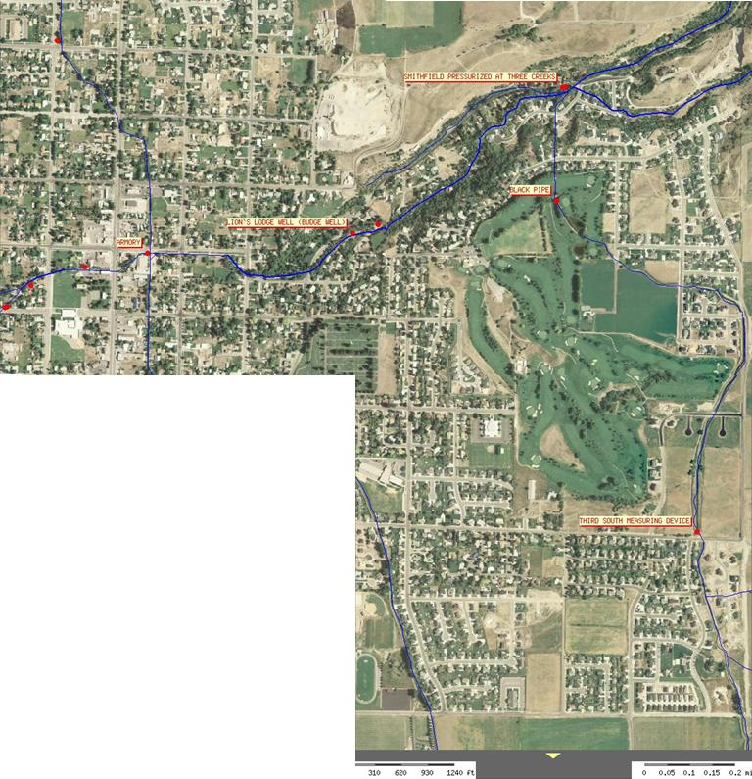
Summit Creek
Presentation
Introduction
  Summit Crk
Flow Devices
Proj. Objective
Device Accur.
Flow Rate Data
Use of ArcGIS
  Images
  Water Req.
Conclusions
Utah Division of
Water Rights
http://www.waterrights.
utah.gov/distinfo/realtime_info.asp
  300 South
  Black Pipe
  3 Creeks
  Armory
  Big Ditch

Slide 4
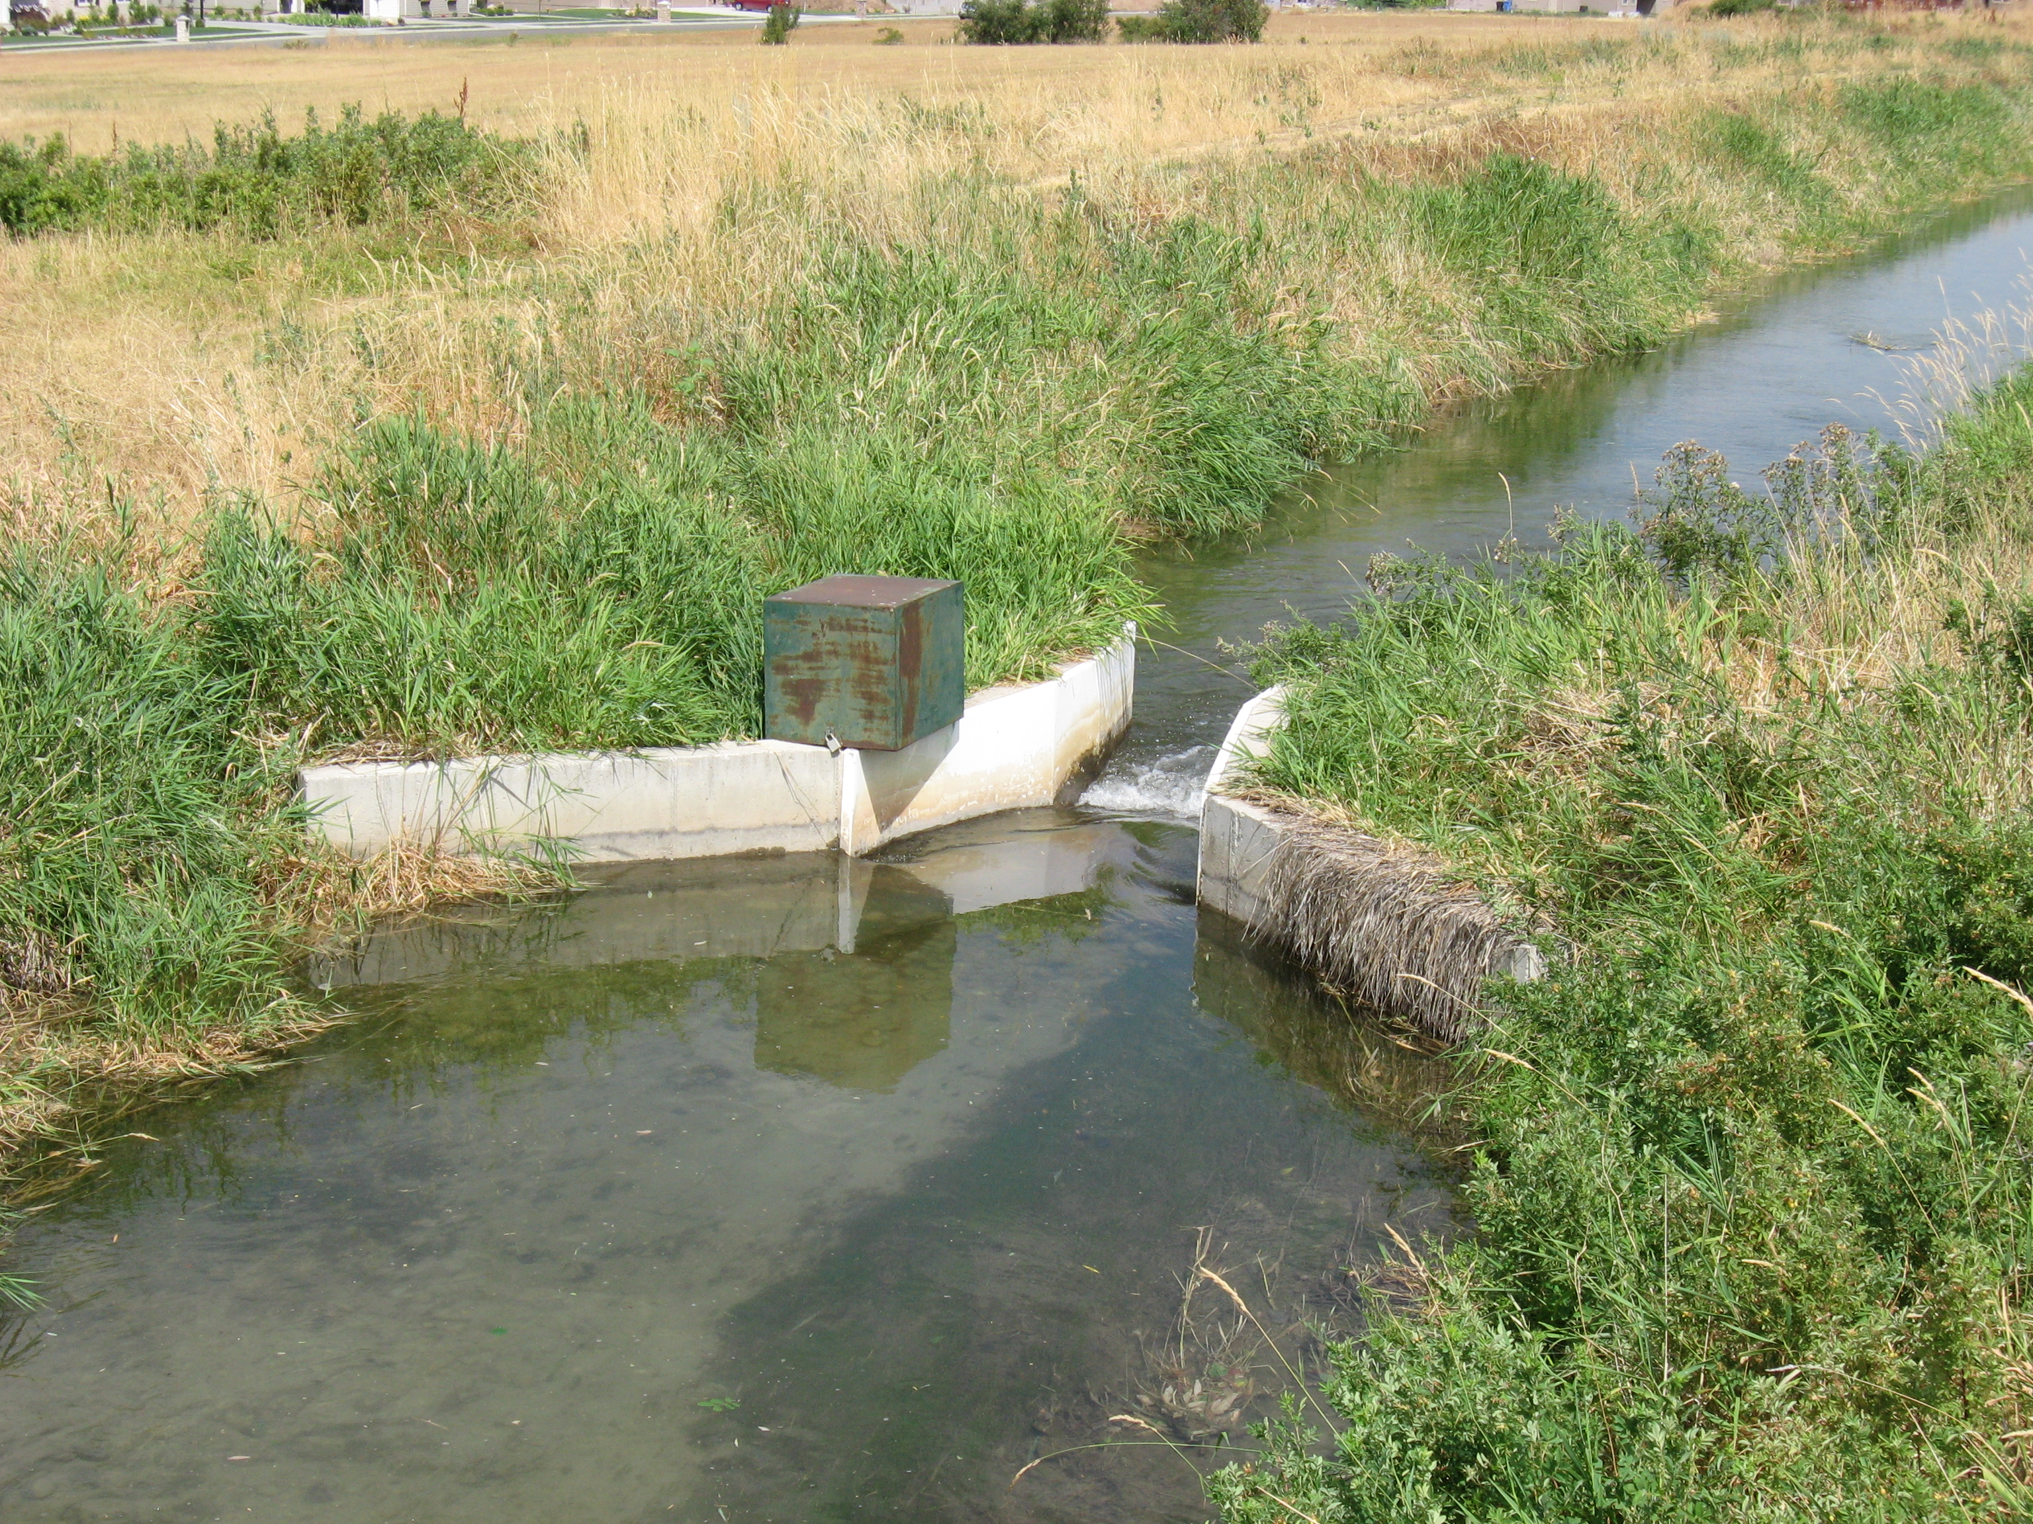
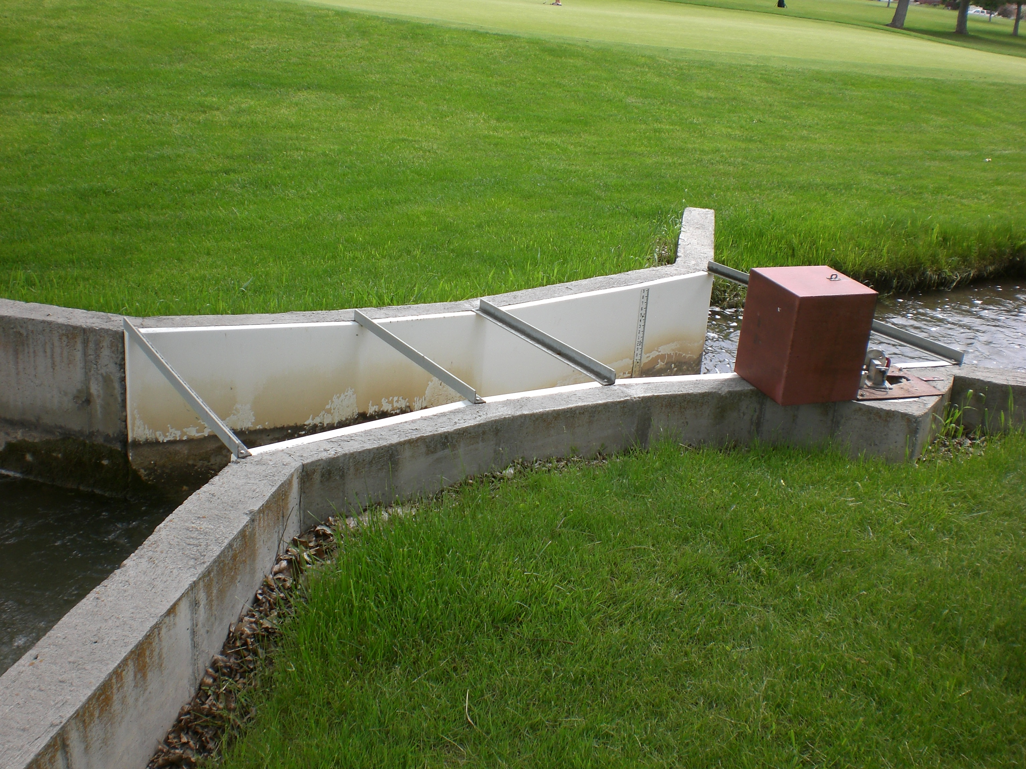
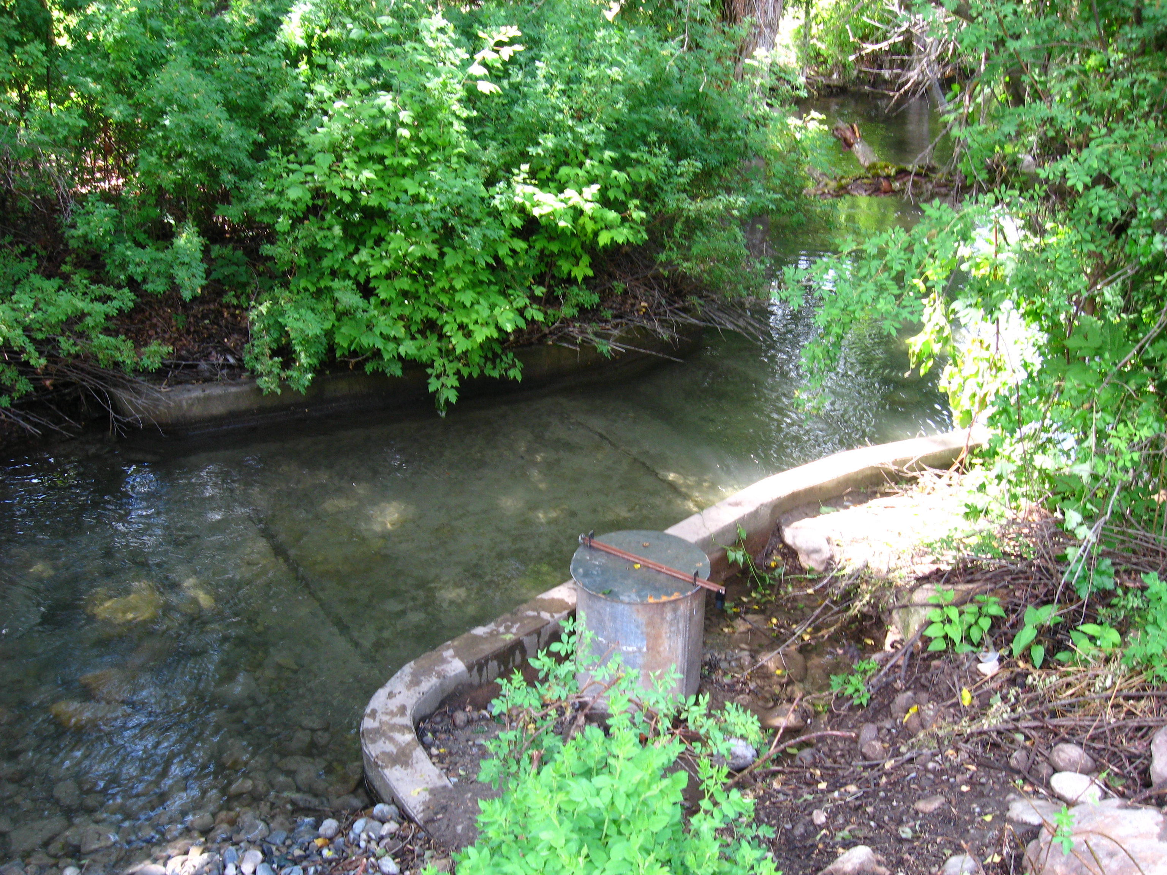
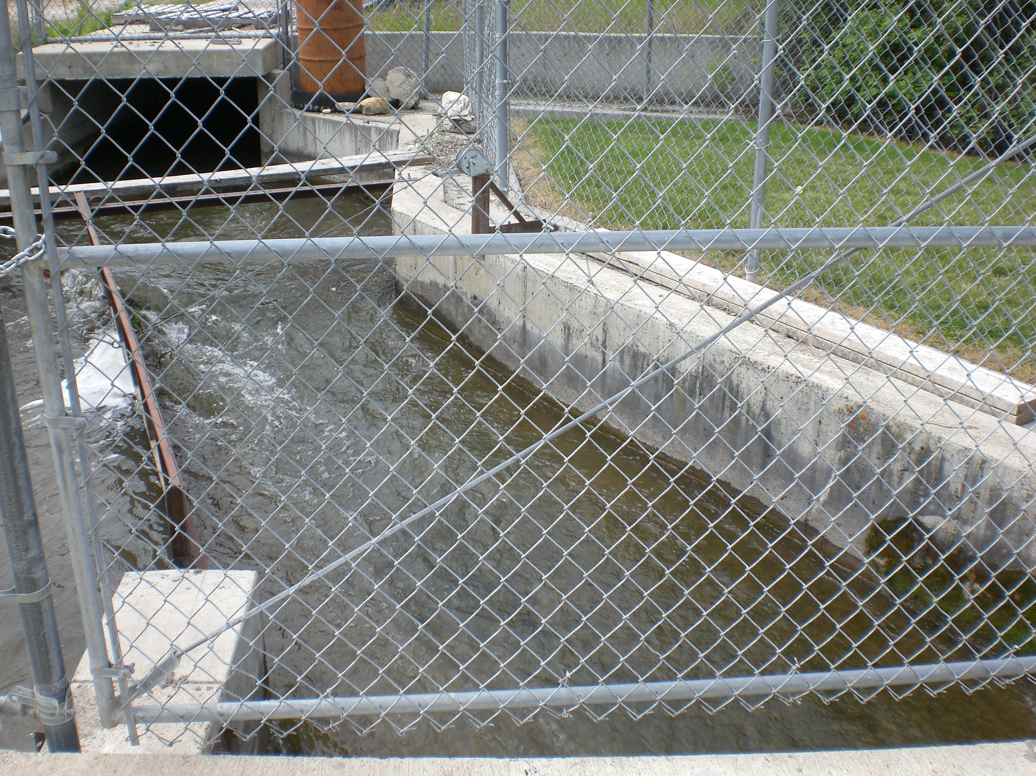
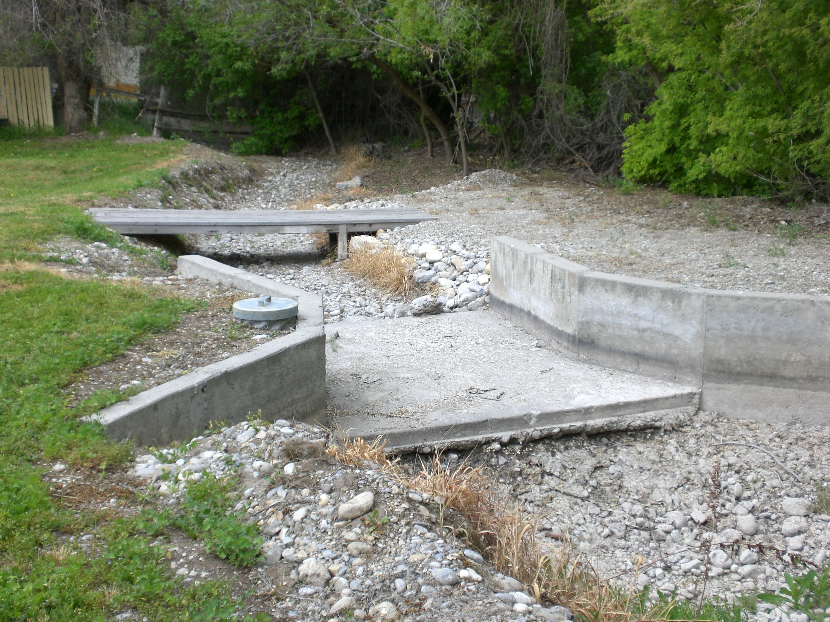
5 Flow Measurement Devices
Presentation
Introduction
  Summit Crk
Flow Devices
Proj. Objective
Device Accur.
Flow Rate Data
Use of ArcGIS
  Images
  Water Req.
Conclusions
  .
300 South
  Parshall Flume – 3 ft width
Black Pipe
  Parshall Flume – 3 ft width
3 Creeks
  Parshall Flume – 8 ft width
Armory
  Sharp Crested Weir – 7 ft width
Big Ditch
  Cutthroat Flume – 6 ft width

Slide 5
Project Objectives
Presentation
Introduction
  Summit Crk
Flow Devices
Proj. Objective
Device Accur.
Flow Rate Data
Use of ArcGIS
  Images
  Water Req.
Conclusions
Utilize Arc GIS and field data to:
Create useful images
Determine water requirements of Birch Creek Golf Course
Determine water consumption
Analyses of data
Conclusions

Slide 6
Device Maintenance
Presentation
Introduction
  Summit Crk
Flow Devices
Proj. Objective
Device Accur.
Flow Rate Data
Use of ArcGIS
  Images
  Water Req.
Conclusions
Average Error 2.3% to 81.5%
Out of level
Staff gage reference error
Sedimentation/approach conditions
2 of 5 devices have telemetry

Slide 7
Flow Rate Data
Presentation
Introduction
  Summit Crk
Flow Devices
Proj. Objective
Device Accur.
Flow Rate Data
Use of ArcGIS
  Images
  Water Req.
Conclusions
Aaron Hunt
  State of Utah
  Div. Water Rights
Clean-up
Estimate Losses
Determine approximate use

Slide 8
ArcGIS Images
Presentation
Introduction
  Summit Crk
Flow Devices
Proj. Objective
Device Accur.
Flow Rate Data
Use of ArcGIS
  Images
  Water Req.
Conclusions
Compilation of Data for Basemap
GPS Field Data
DEM from USGS seamless server
NHD Plus
Utah Division of Water Rights
Utah SGID – Water related Land Use
Utah GIS Portal

Slide 9
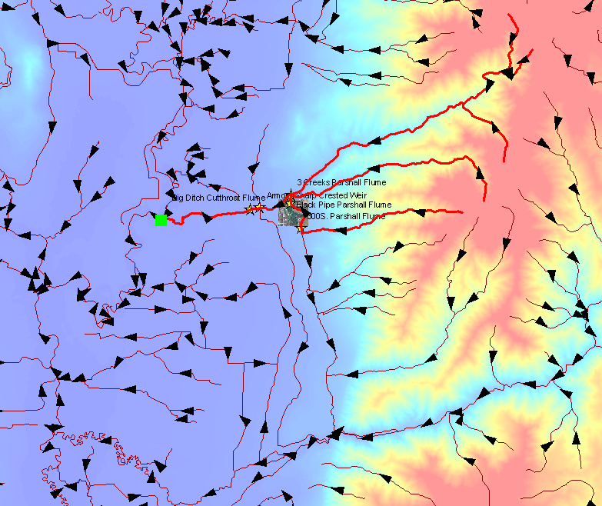
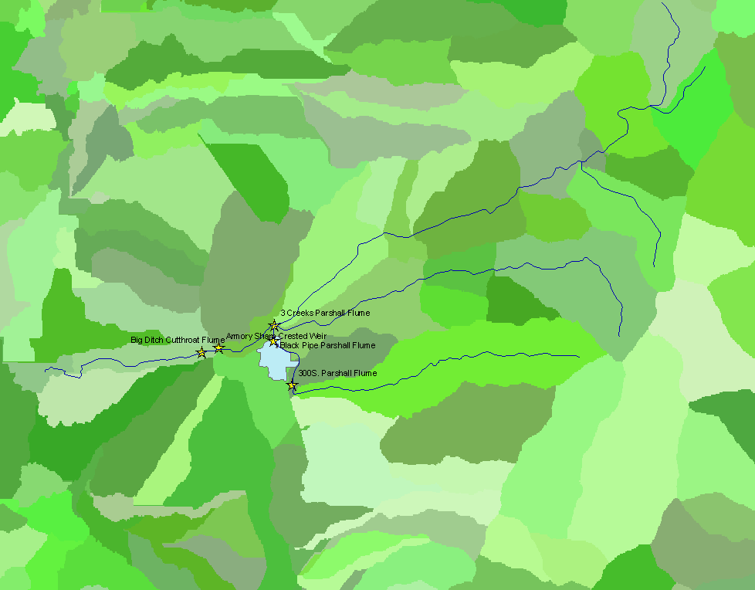
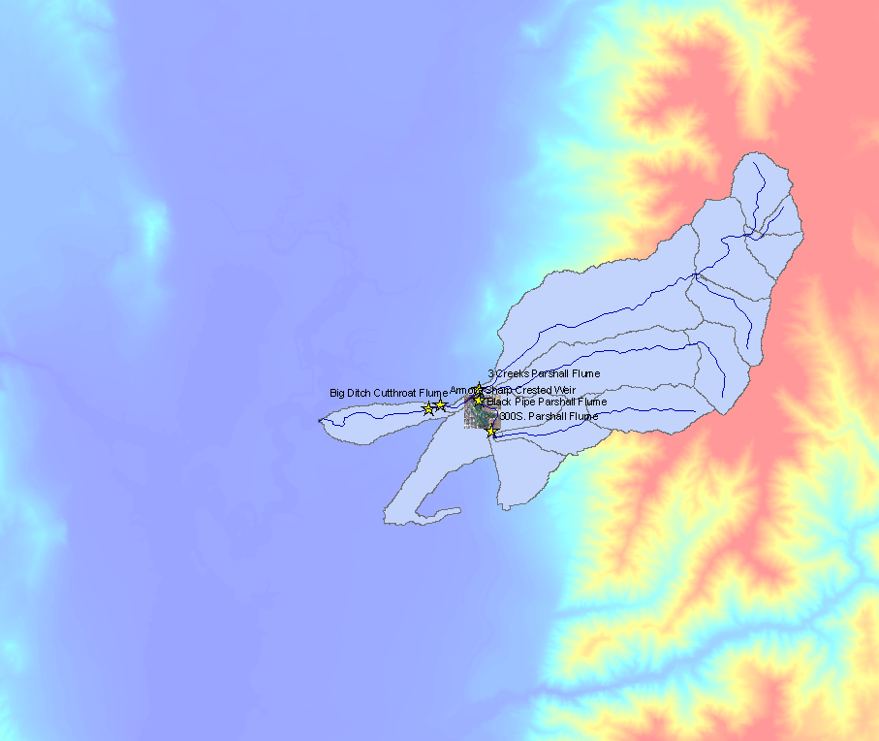
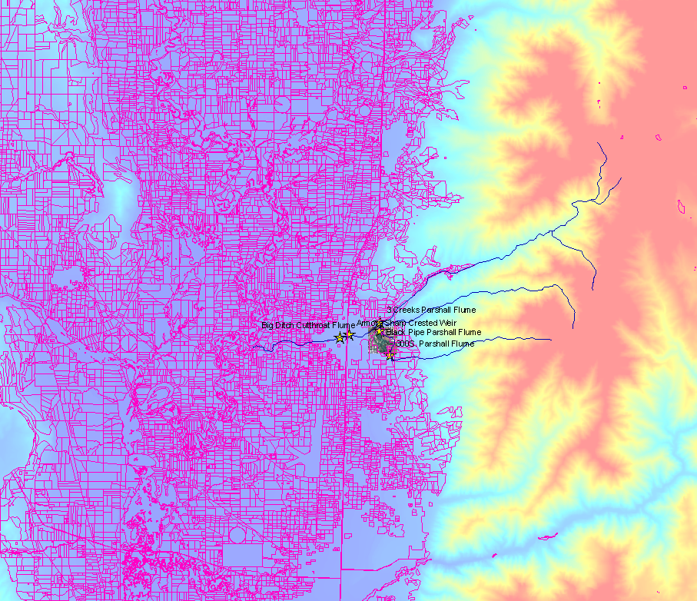
ArcGIS Images
Presentation
Introduction
  Summit Crk
Flow Devices
Proj. Objective
Device Accur.
Flow Rate Data
Use of ArcGIS
  Images
  Water Req.
Conclusions

Slide 10
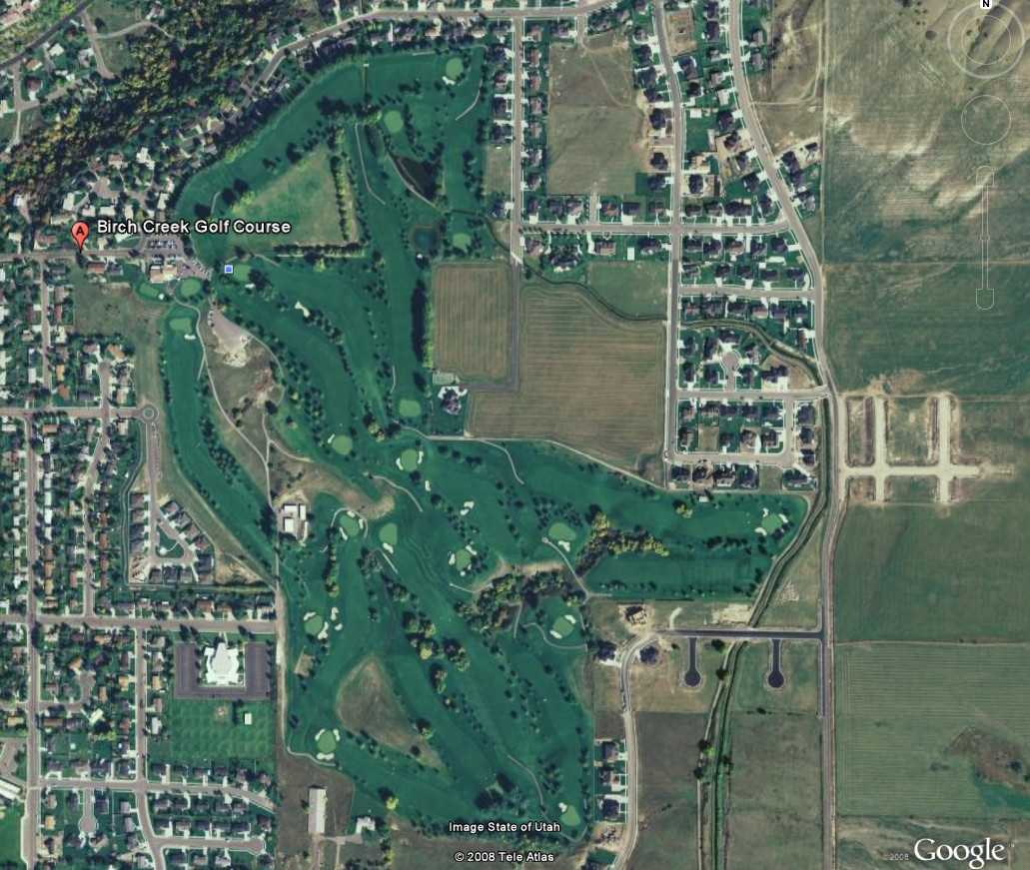
Water Requirements
Presentation
Introduction
  Summit Crk
Flow Devices
Proj. Objective
Device Accur.
Flow Rate Data
Use of ArcGIS
  Images
  Water Req.
Conclusions
Estimate fraction of vegetation cover
Determine crop requirements
Compare to telemetry analyses

Slide 11
Conclusions
Presentation
Introduction
  Summit Crk
Flow Devices
Proj. Objective
Device Accur.
Flow Rate Data
Use of ArcGIS
  Images
  Water Req.
Conclusions
Develop images in ArcGIS
Demonstrate importance of Flow Accuracy
  Larger significance in error
ArcGIS as an analysis tool
Steps to improve water management

Slide 12
Questions?
Aisenbrey, A. J. Jr., Hayes, R. B., Warren, H. J., Winsett, D. L., Young, R. B. (1978). Design of small canal structures. Denver, CO: U.S. Government Printing Office, 243-258.
Genovez, A., Abt, S., Florentin, B., Garton, A. (1993, November/December). Correction for settlement of parshall flume. Journal of Irrigation and Drainage Engineering, 1081-1091.
Johnson, M. C. (2000). Discharge coefficient analysis for flat-topped and sharp-crested weirs. Irrigation Science, 133-137.
Utah Water Measurement Pocket Reference – Irrigation Water Measurement for Agriculture.
(2000). Salt Lake City, Utah: Utah Association of Conservation Districts.
Water Measurement Manual – A Water Resources Technical Publication. (1997). Denver CO: U.S. Government Printing Office. 7-1 to 10-40.
Personal Contact. Aaron Hunt, State of Utah Division of Water Rights. Nov. 25, 2008.
Personal Contact. Dr. Blake Tullis, Utah Water Research Laboratory and Utah State University. Nov. 25, 2008.
Personal Contact. Dr. David Tarboton, Utah State University. Nov. 24, 2008.
http://gis.utah.gov/sgid-vector-download/utah-sgid-vector-gis-data-layer-download-index
http://seamless.usgs.gov/website/seamless/viewer.htm
http://www.horizon-systems.com/nhdplus/

