Slide 1
Flood Predictions in Smithfield and Birch Creek Canyons resulting from 100 year Precipitation events in Cache County, Utah.
GIS in Water Resources Presentation
By: Zac Sharp

Slide 2
Project Outline
Project Description
Objective
Base Map Construction
Catchment Attributes
Rain Fall Data
Rational Flood Prediction
HEC HMS Flood Prediction
Results

Slide 3
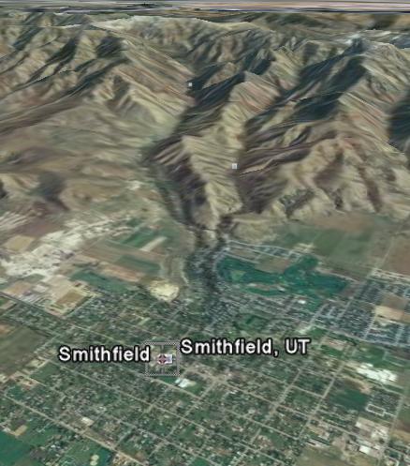
Project Description
Flood in 1983
Channel construction
New city offices
Catchment description
Two flood models

Slide 4
Objective
The objective of this study is to determine, with reasonable certainty, the flow in summit creek through the city of Smithfield during design precipitation events.

Slide 5
Base Map Construction
Sub basin information from NHDplus.
DEM from the USGS seamless server.
Soil attributes from the Utah GIS portal.
All flood model parameters come from the base map.

Slide 6
Catchment Attributes
Basin (#) | Area (sq. miles) | Soil/Curve No. (#) | L (mi) | Lc (mi) | S (ft/mile) | Lag (hrs)
1 | 1.69 | B/70 | 2.08 | 1.01 | 1173.7 | 0.72
2 | 0.56 | B/70 | 0.92 | 0.74 | 2024.8 | 0.45
3 | 0.87 | B/70 | 1.29 | 0.81 | 1456.3 | 0.55
4 | .052 | B/70 | .21 | .15 | 946.5 | 0.32
5 | 2.76 | B/70 | 1.90 | 1.17 | 348.5 | 0.89
6 | 1.91 | B/70 | 2.42 | 1.65 | 1261.9 | 0.87
7 | 2.01 | B/70 | 1.78 | 1.30 | 1295.6 | 0.73
8 | 8.21 | B/70 | 6.12 | 4.12 | 257.5 | 2.09
9 | 5.03 | B/70 | 5.29 | 3.78 | 437.1 | 1.77

Slide 7
Rain Fall Data

Slide 8
Rain Fall Data

Slide 9
Rational Flood Prediction
Q = C*i*A.
C is 0.17.
1 and 24 hour
storms.

Slide 10
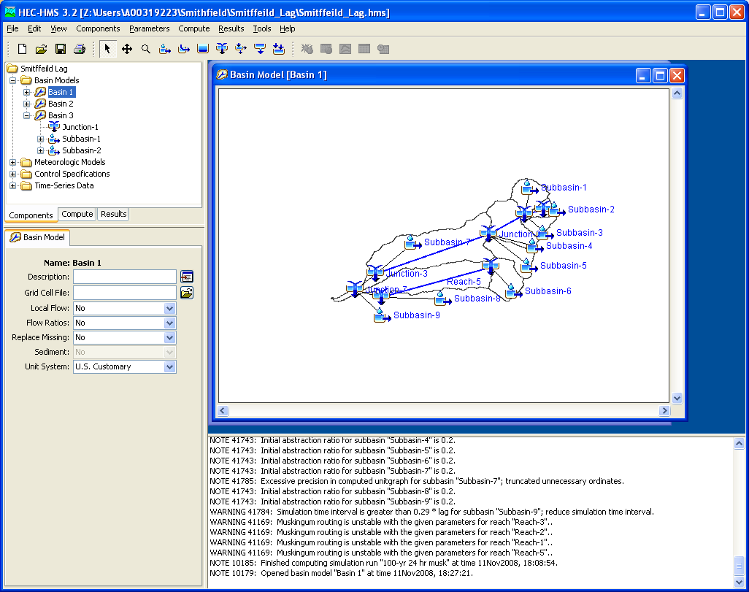
HEC HMS
Rain fall distributions for each catchment.
SCS curve number method to compute runoff hydrographs.
Muskingham method to route hydrographs through main channels

Slide 11
Results
Rational Method
HEC HMS
1 hr max flow = 715 cfs
24 hr max flow = 5580 cfs
1 hr linear max = 715 cfs
24 hr linear max = 610 cfs
1 hr max flow = 479 cfs
24 hr max flow = 5813 cfs
1 hr linear max = 483 cfs
24 hr linear max = 2372 cfs

Slide 12
Results
Culvert Master analysis shows max flow is 383 before flooding will occur.
Conclusion: Put the building somewhere else.

