Slide 1
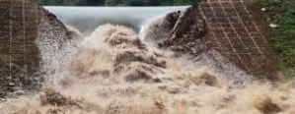
IS hand an effective way to model dam failures?
Tyler Withers

Slide 2
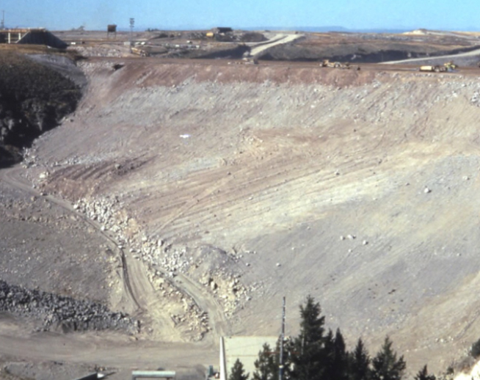
Teton dam
Located near Rexburg, Idaho
Total Height: 305 feet
Storage capacity: 200,000 Acre-feet

Slide 3
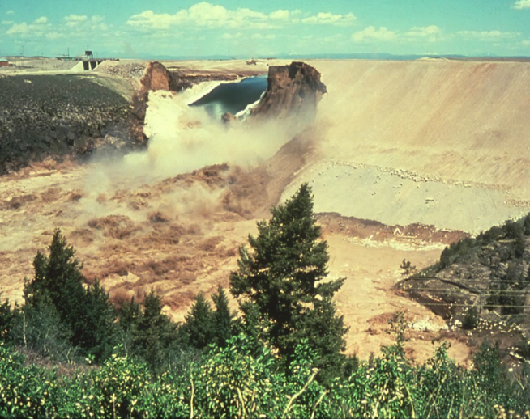
Teton Dam Failure
Peak discharge: 2,300,000 cfs

Slide 4
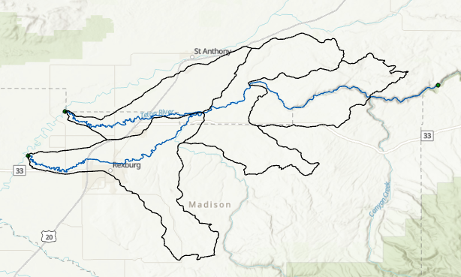
Hand Analysis
Teton Dam
 | Area | % | Flow
North | 18423.14 | 0.37 | 849758.1071
South | 31441.9 | 0.63 | 1450241.893
 | 49865.04

Slide 5
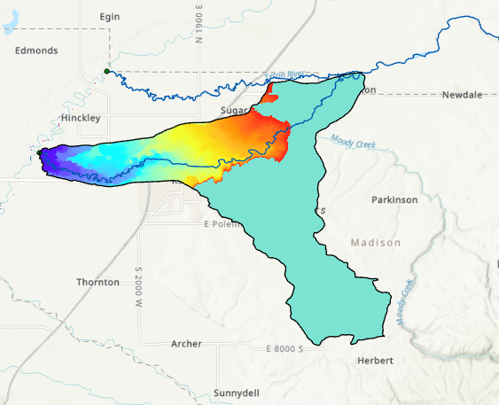
Hand Analysis

Slide 6
Hand using DEM derived catchments
Teton Dam

Slide 7
Hand using DEM derived catchments

Slide 8
Hand using DEM derived catchments

Slide 9
Hand using DEM derived catchments
Stage h (m) | 5 | 10 | 10.9 | 12 | 15
stage (ft) | 16.40 | 32.81 | 35.76 | 39.37 | 49.21
cell size (m^2) | 100 | 100 | 100 | 100 | 100
flooding cell num | 263621 | 374113 | 388076 | 400301 | 444522
sb | 1.000111 | 1.000127 | 1.000128648 | 1.00013183 | 1.000136663
As (m2 ) | 26362100 | 37411300 | 38807600 | 40030100 | 44452200
Ab (m2 ) | 26365023 | 37416064 | 38812592.54 | 40035377.3 | 44458274.98
Inundation depth (m) | 2.672986 | 6.306695 | 6.962580926 | 7.83265748 | 9.910620289
Depth (ft) | 8.77 | 20.69 | 22.84 | 25.70 | 32.52
V (m3) | 70465512 | 2.36E+08 | 270201055.6 | 313542062 | 440548875.2
L (m) | 18586.41 | 18586.41 | 18586.4084 | 18586.4084 | 18586.4084
z1 (m) | 1488.52 | 1488.52 | 1488.52 | 1488.52 | 1488.52
z2 (m) | 1468.7 | 1468.7 | 1468.7 | 1468.7 | 1468.7
A = V/L (m2 ) | 3791.2 | 12694.3 | 14537.6 | 16869.4 | 23702.7
P=Ab/L (m) | 1418.51 | 2013.09 | 2088.22 | 2154.01 | 2391.98
R=A/P (m) | 2.673 | 6.306 | 6.962 | 7.832 | 9.909
S | 0.001066 | 0.001066 | 0.001066371 | 0.00106637 | 0.001066371
n | 0.05 | 0.05 | 0.05 | 0.05 | 0.05
𝑄 = 1 /𝑛*𝐴𝑅^2/3*𝑆o^1/2 (m3 /s) | 4768.7 | 28298.1 | 34616.7 | 43449.6 | 71418.4
Q (ft3 /s) = Q (m3 /s) x 35.3 | 168334.1 | 998923.8 | 1221968.3 | 1533770.5 | 2521071.0

Slide 10
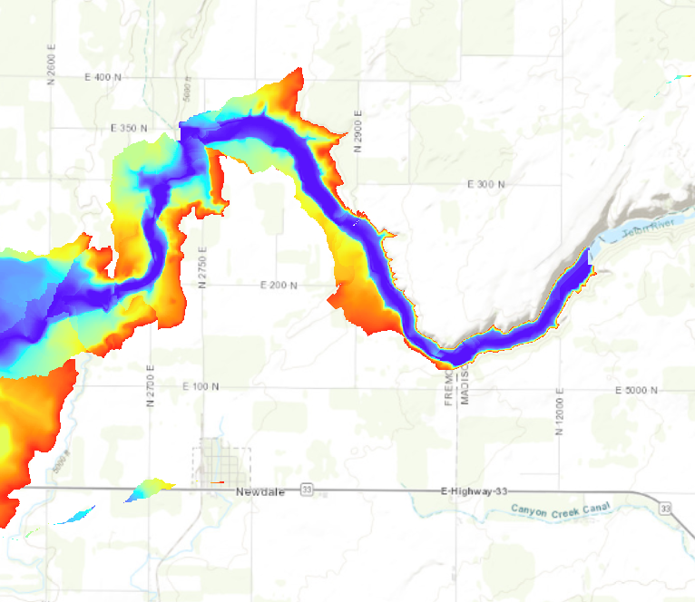
Comparing results with Actual Flood Event
Teton Dam flood of June 1976, Pingree quadrangle, Idaho
Hydrologic Atlas 581
By: Larry L. Hubbard and John H. Bartells

Slide 11
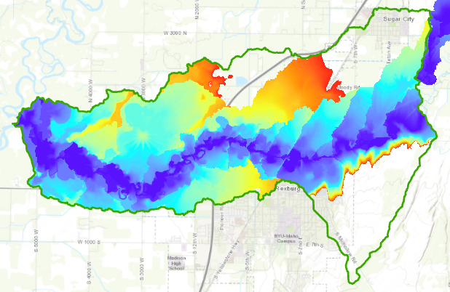
Comparing results with Actual Flood Event
Teton Dam flood of June 1976, Pingree quadrangle, Idaho
Hydrologic Atlas 581
By: Larry L. Hubbard and John H. Bartells

Slide 12
conclusions
It worked well for the regions where the slopes surrounding the river are steep.
In flatter areas like in Rexburg.
Other programs in existence would be more effective.

Slide 13
Thank you!

