Slide 1
Scour Analysis on the west fork of the Duchesne River
By: Tanner Sweat
November 20, 2018
CEE 6440

Slide 2
Overview
Background
Design Project
Height Above Nearest Drainage (HAND)
Rating Curve

Slide 3
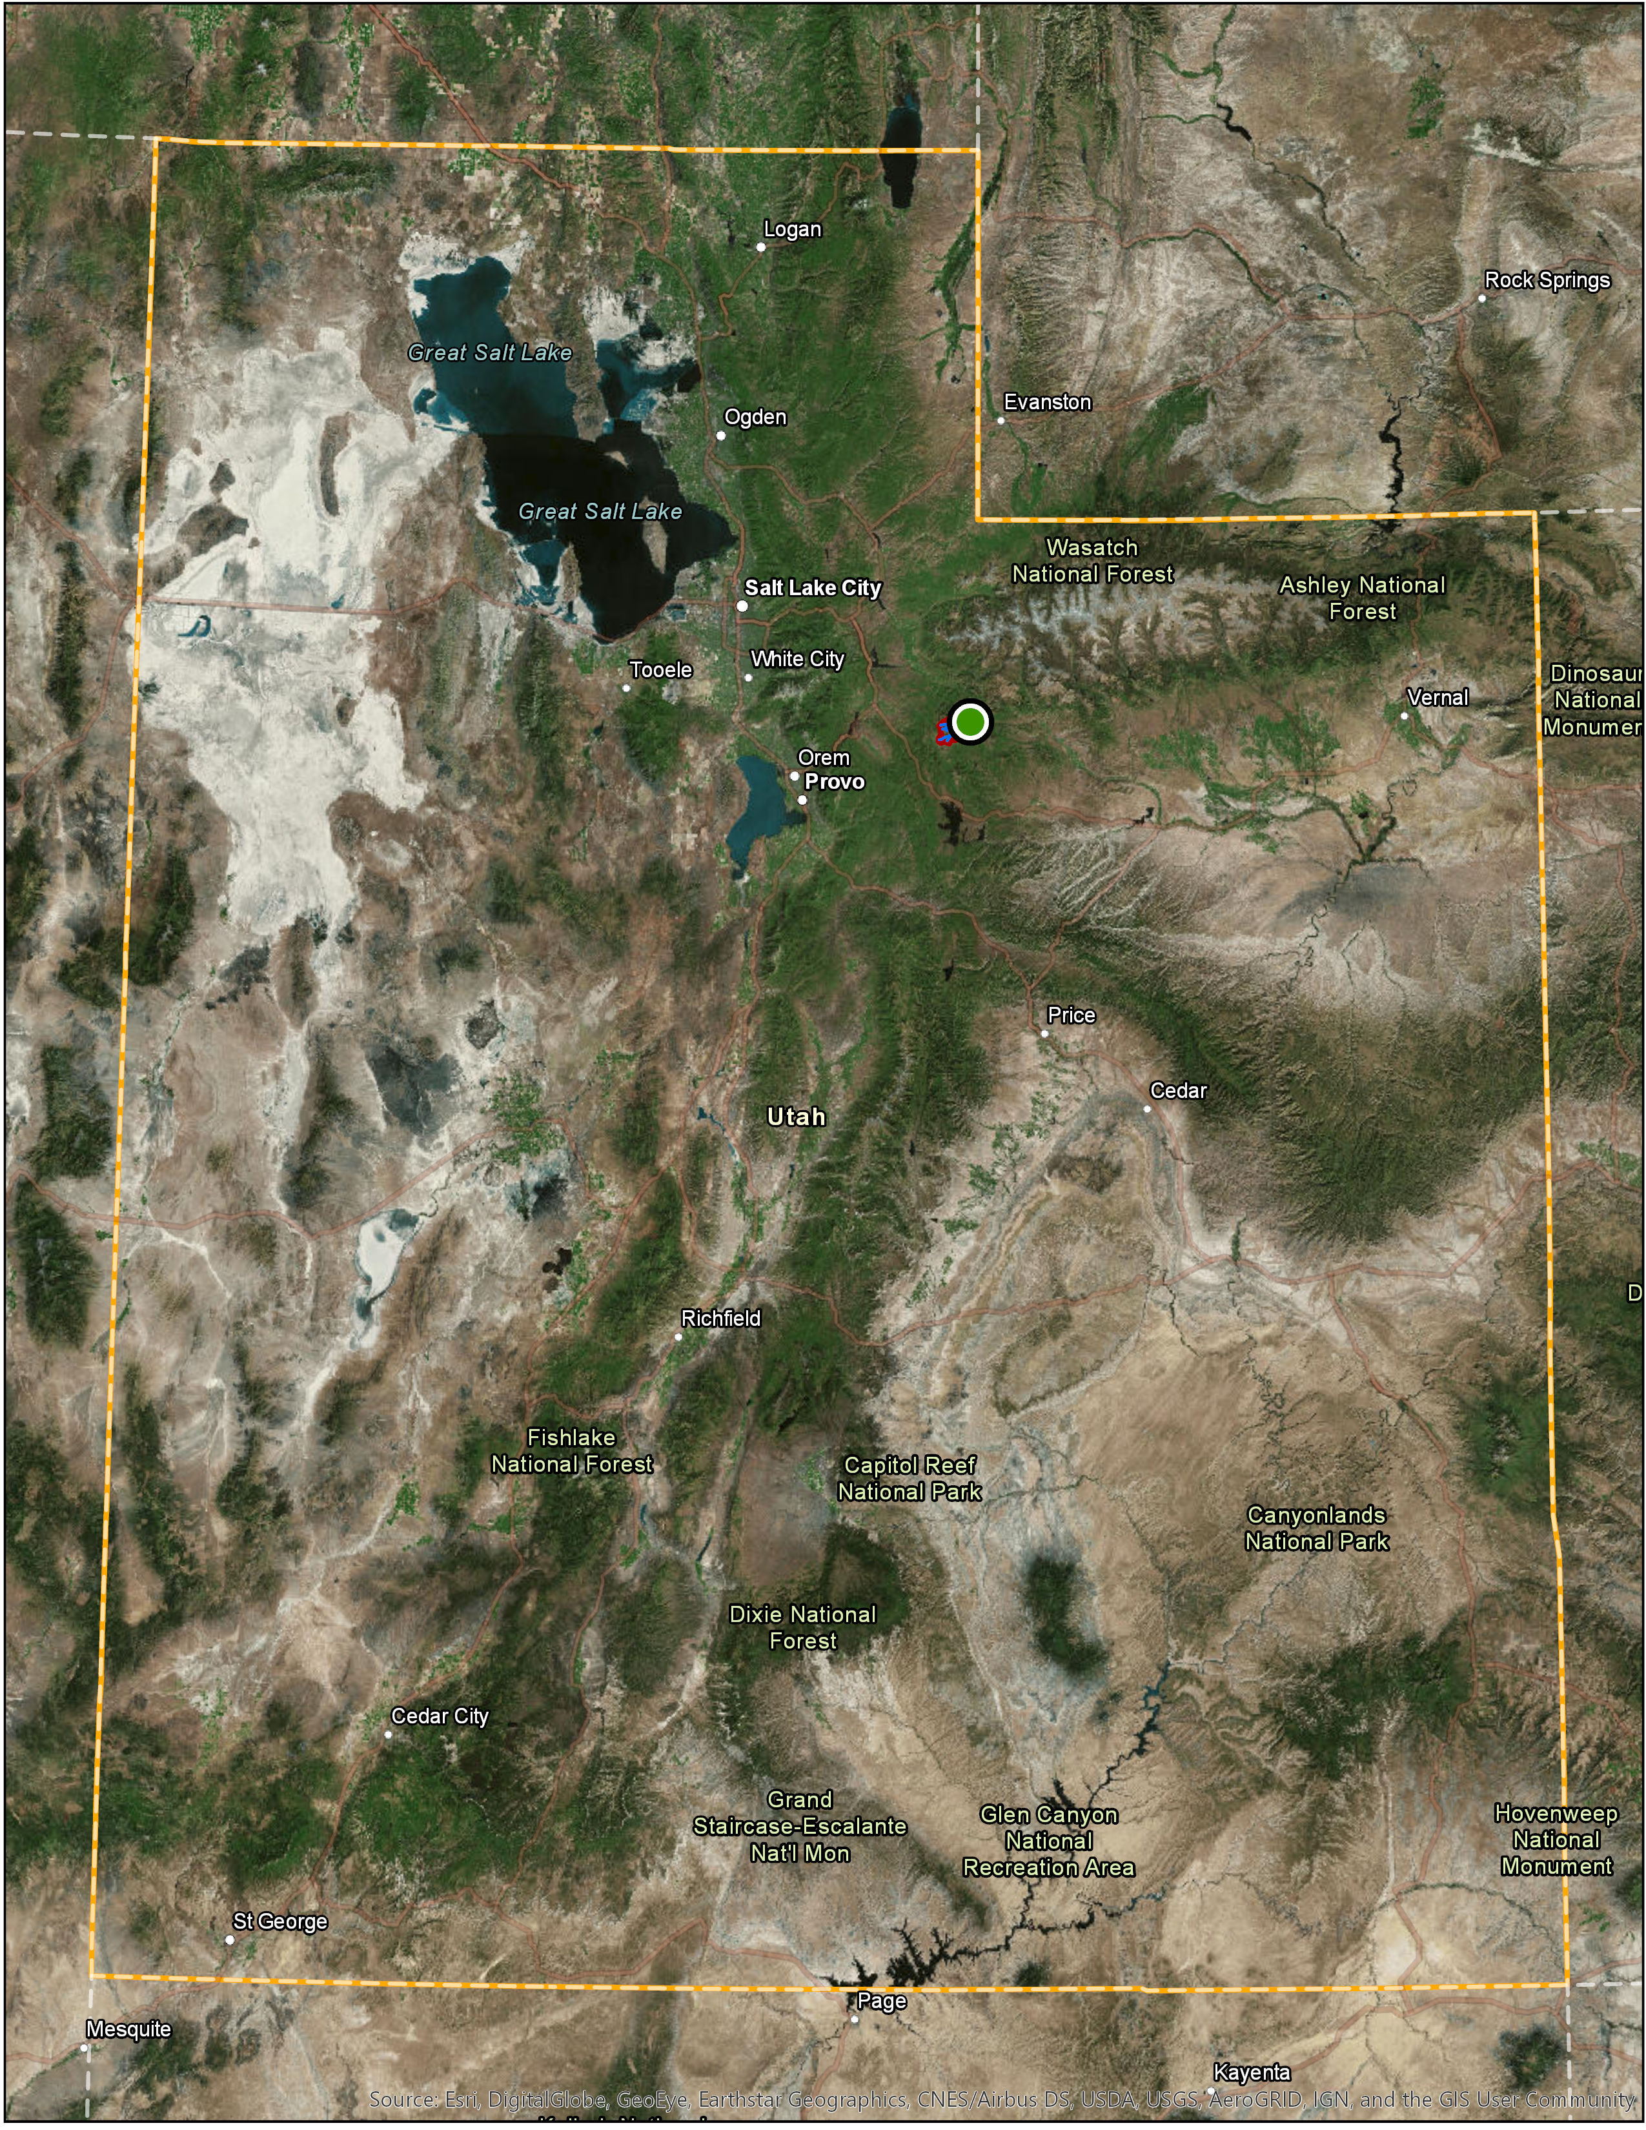
background

Slide 4
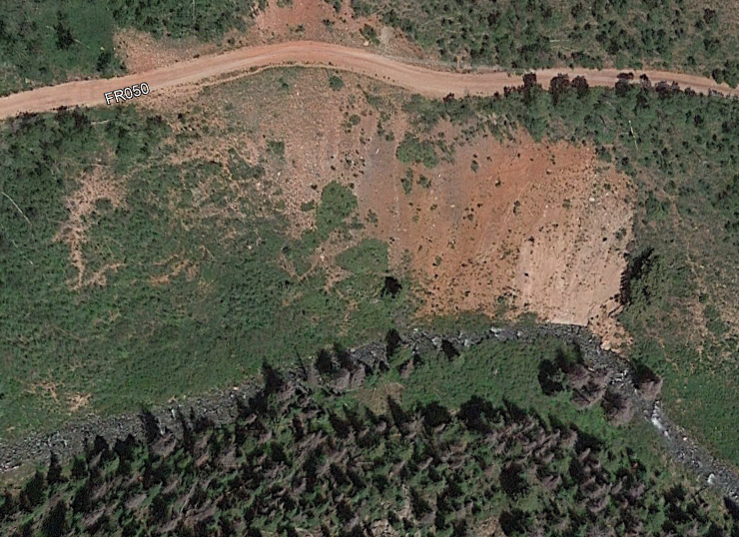
Background
Bank Erosion below the Dugway
Bank Erosion
Dugway
West Fork of Duchesne River

Slide 5
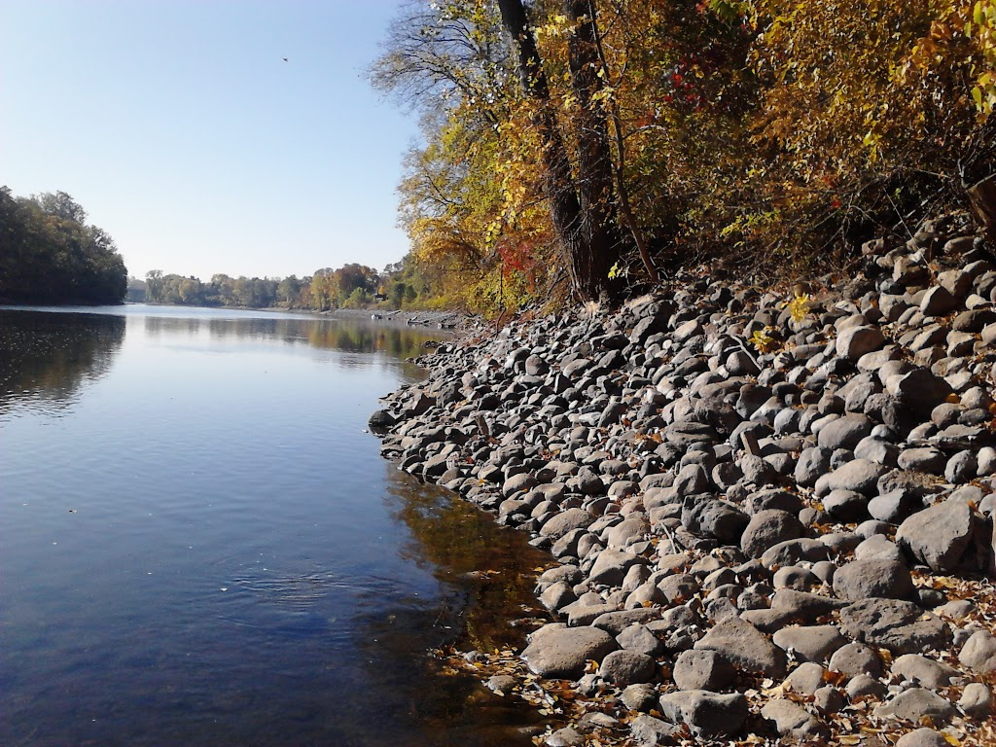
Design project
Design Riprap to Armor Stream Bank
Riprap Design Variables
Velocity
Depth
Flow
HAND Analysis
http://www.boulder-walls.com/?page_id=69

Slide 6
Design Flow
Needed a Design Flow
Stream Stats
5 years of flow data
Q = 165.6 cfs
25 Year Flood
Q = 518 cfs
http://www.boulder-walls.com/?page_id=69

Slide 7
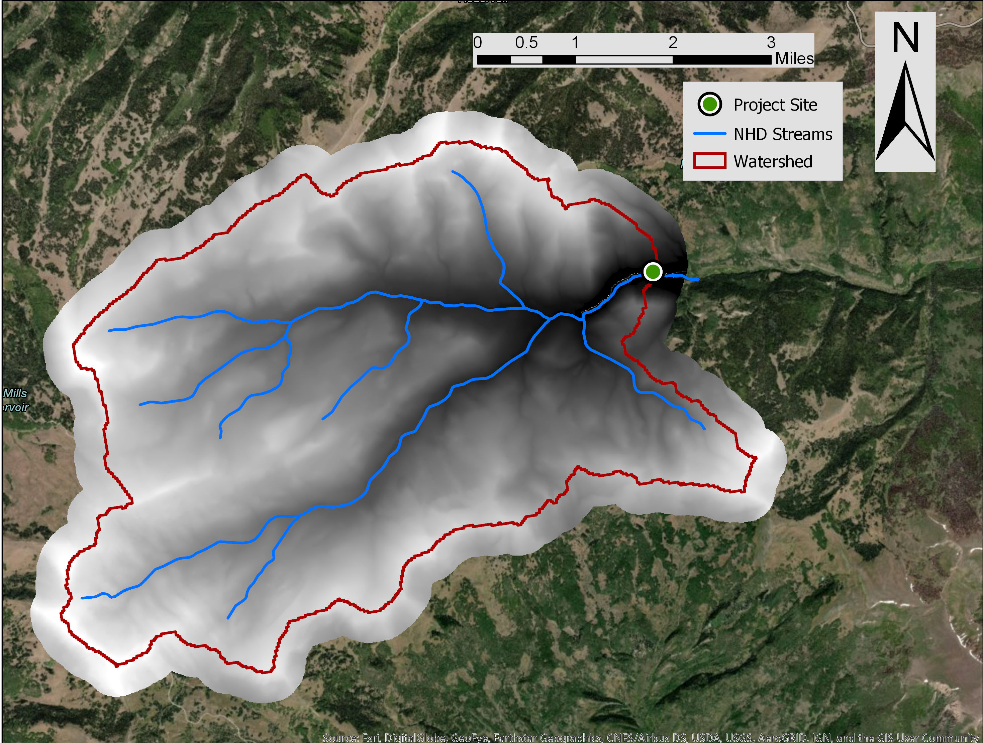
Hand Analysis
Used NHD Streams and DEM to perform Hand Analysis

Slide 8
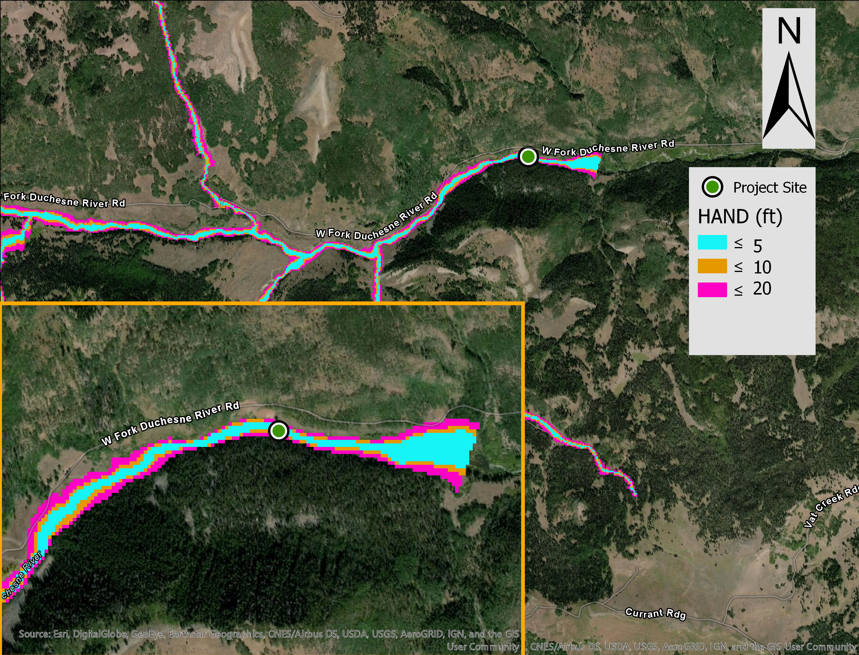

Slide 9
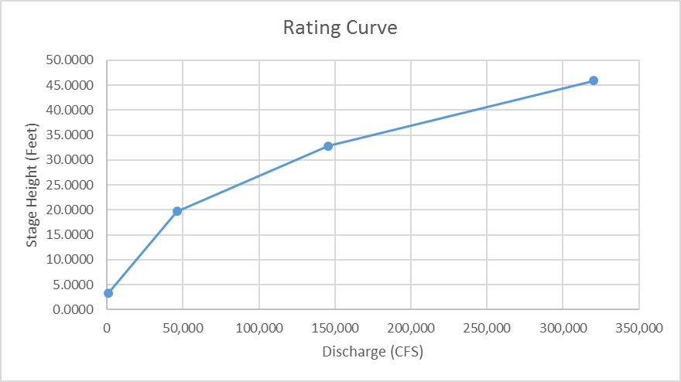
Rating curve
Stage Height (m) | y = | 1 | 6 | 10 | 14
Stage Height (ft) | y = | 3.2808 | 19.6850 | 32.81 | 45.93
Cell Size (m²) | A_{cell} = | 100 | 100 | 100 | 100
Flooding Cell Num | N_{cell} = | 455 | 1,327 | 1,977 | 2,638
Average Bed Slope | S_{b} = | 1.000985 | 1.0144 | 1.02234 | 1.02697
Area of Water Surface (m²) | A_{s} = | 45,500 | 132,700 | 197,700 | 263,800
Average Bed Area (m²) | A_{b} = | 45,544.8 | 134,608 | 202,117 | 270,915
Avg Inundation Depth (m) | d = | 0.674 | 3.683 | 5.7991 | 7.8342
Water Volume (m³) | Vol = | 30,648 | 488,794 | 1,146,485 | 2,066,652
Reach Length (m) | L = | 2,227 | 2,227 | 2,227 | 2,227
Reach Start Elev (m) | z₁ = | 2,547.8 | 2,547.8 | 2,547.8 | 2,547.8
Reach End Elev (m) | z₂ = | 2,512.4 | 2,512.4 | 2,512.4 | 2,512.4
Cross Sectional Area (m^2) | A = | 13.8 | 219.5 | 514.8 | 928.0
Wetted Perimeter (m) | P = | 20.5 | 60.4 | 90.8 | 121.7
Hydraulic Radius (m) | R = | 0.67 | 3.63 | 5.67 | 7.63
Channel Slope (m/m) | S = | 0.0159 | 0.0159 | 0.0159 | 0.0159
Mannings "n" | n = | 0.05 | 0.05 | 0.05 | 0.05
Flow (m³/s) | Q = | 26.6 | 1,307.5 | 4,128.9 | 9,067.9
Flow (cfs) | Q = | 941.07 | 46,174.63 | 145,809.7 | 320,231.3
 | Peak Recorded |  |  | 25 Year Peak Flood
Design Flow | Q = | 165.65 | cfs | Q = | 518 | cfs
Stage Height | y = | 2.99 | ft | y = | 3.13 | ft
Stage Height | y = | 0.911 | m | y = | 0.954 | m

Slide 10
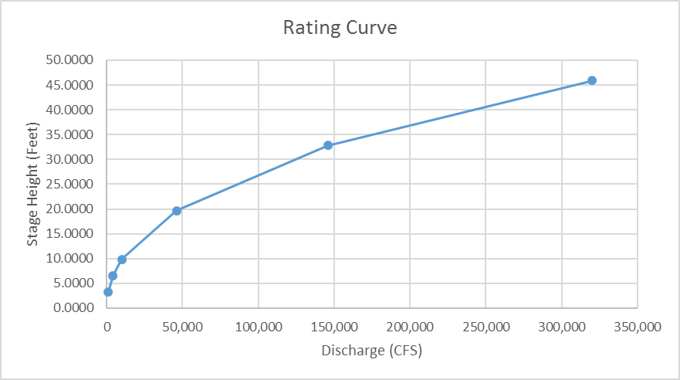
Rating curve
Stage Height (m) | y = | 0.5 | 1 | 2 | 3 | 6 | 10 | 14
Stage Height (ft) | y = | 1.6404 | 3.2808 | 6.56 | 9.84 | 19.68504 | 32.8084 | 45.9318
Cell Size (m²) | A_{cell} = | 100 | 100 | 100 | 100 | 100 | 100 | 100
Flooding Cell Num | N_{cell} = | 303 | 455 | 667 | 843 | 1327 | 1977 | 2,638
Average Bed Slope | S_{b} = | 1.000380 | 1.0010 | 1.00325 | 1.00620 | 1.0143748 | 1.0223397 | 1.026971
Area of Water Surface (m²) | A_{s} = | 30,300 | 45,500 | 66,700 | 84,300 | 132700 | 197700 | 263,800
Average Bed Area (m²) | A_{b} = | 30,311.5 | 45,545 | 66,917 | 84,823 | 134607.53 | 202116.56 | 270,915.0
Avg Inundation Depth (m) | d = | 0.385 | 0.674 | 1.3112 | 1.9265 | 3.6834502 | 5.7991164 | 7.834
Water Volume (m³) | Vol = | 11,672 | 30,648 | 87,460 | 162,402 | 488793.85 | 1146485.3 | 2,066,652
Reach Length (m) | L = | 2,227 | 2,227 | 2,227 | 2,227 | 2227 | 2227 | 2,227
Reach Start Elev (m) | z₁ = | 2,547.8 | 2,547.8 | 2,547.8 | 2,547.8 | 2547.8 | 2547.8 | 2,547.8
Reach End Elev (m) | z₂ = | 2,512.4 | 2,512.4 | 2,512.4 | 2,512.4 | 2512.4 | 2512.4 | 2,512.4
Cross Sectional Area (m^2) | A = | 5.2 | 13.8 | 39.3 | 72.9 | 219.48534 | 514.81154 | 928.0
Wetted Perimeter (m) | P = | 13.6 | 20.5 | 30.0 | 38.1 | 60.443436 | 90.757322 | 121.7
Hydraulic Radius (m) | R = | 0.39 | 0.67 | 1.31 | 1.91 | 3.6312518 | 5.6723968 | 7.63
Channel Slope (m/m) | S = | 0.0159 | 0.0159 | 0.0159 | 0.0159 | 0.0158958 | 0.0158958 | 0.0159
Mannings "n" | n = | 0.05 | 0.05 | 0.05 | 0.05 | 0.05 | 0.05 | 0.05
Flow (m³/s) | Q = | 7.0 | 26.6 | 118.4 | 283.5 | 1307.5188 | 4128.8667 | 9,067.9
Flow (cfs) | Q = | 247.02 | 941.07 | 4,180.5 | 10,012.7 | 46174.634 | 145809.69 | 320,231.27

Slide 11
Summary
USED DEM and NHD Streams Data to perform HAND Analysis
Determined Design Flows
Highest Recorded Q = 165.65 cfs
25 Year Flood Q = 518 cfs
Developed Rating Curve for Stream Reach
Use Hydraulic Properties of Stream Reach to Design Riprap

Slide 12
Questions?

