Slide 1
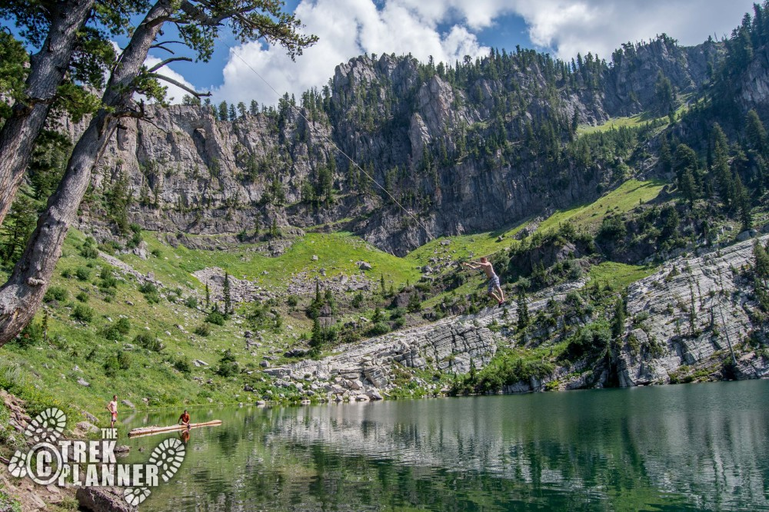
Flooding Potential in Bloomington, Idaho
By Taylor Stauffer
CEE 6440

Slide 2
Overview
Background information
Project objectives
Data sources
Height above nearest drainage (HAND)
Factors affecting flooding
Summary

Slide 3
Background
Popular recreation area because of the nearby Bear Lake and Bloomington Lake
Spring runoff is the main factor to potential flooding.
Increasing development, not to build in high flood potential areas

Slide 4
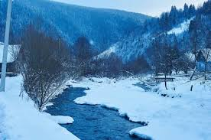
Objectives
Gather basin characteristics and map the DEM, streams and catchments.
Flooding potential factors such as precipitation, snowpack and temperature.
Map of HAND and rating curve for project area.

Slide 5
NHD Plus Streams and Catchments
The watershed area was measured to be 112.6 sq. Km
The total length of the NHD streams was 93.0 Km
Drainage density is 0.83 Km/sq Km

Slide 6
HAND

Slide 7
Rating Curve

Slide 8
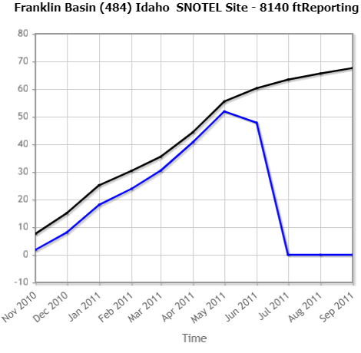
Snow Water equivalant
NRCS snowtel station located in the Franklin basin Idaho
Snow water equivilant (inches) period of record

Slide 9
Summary
Spring runoff is the largest factor for flooding
Snow accumulation and consistent warm temperatures
Work Remaining
Add address points and land parcels
Air temperature data to predict run off

Slide 10
Questions Or Comments

