Slide 1
A Case Study of Dissolve Oxygen Sampling in Utah’s Bonneville Cutthroat Trout Range
Assessing Spatial Representation of Large-Scale Environmental Datasets:
Greg Goodrum
Cee 6440 – Dr. david tarboton/dr. david maidment

Slide 2
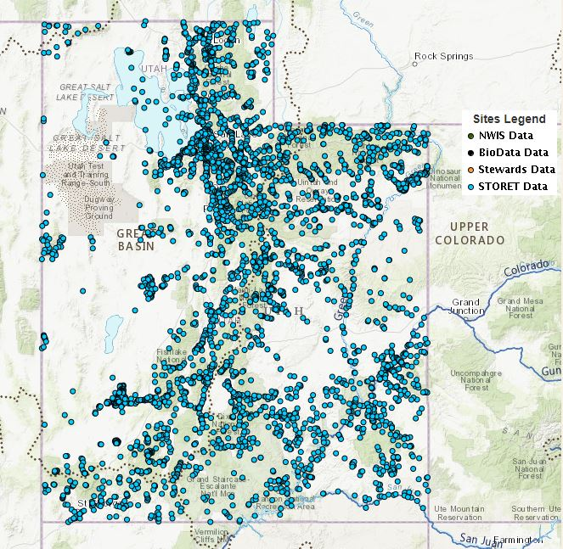
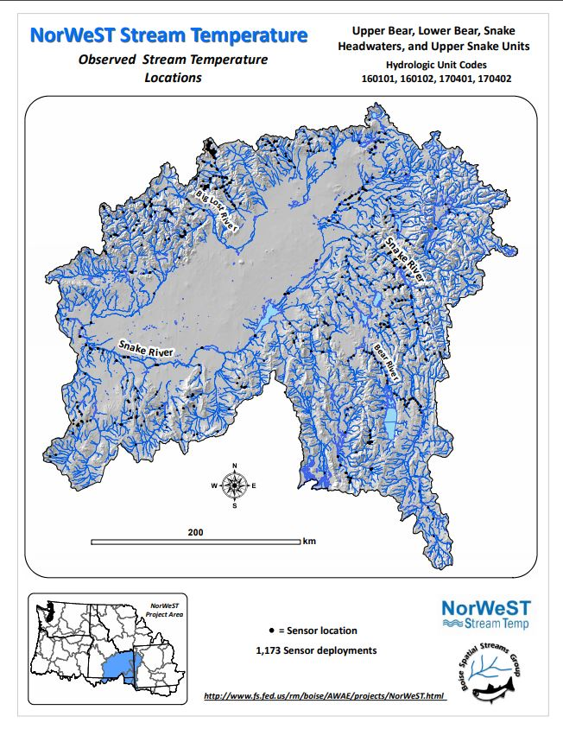
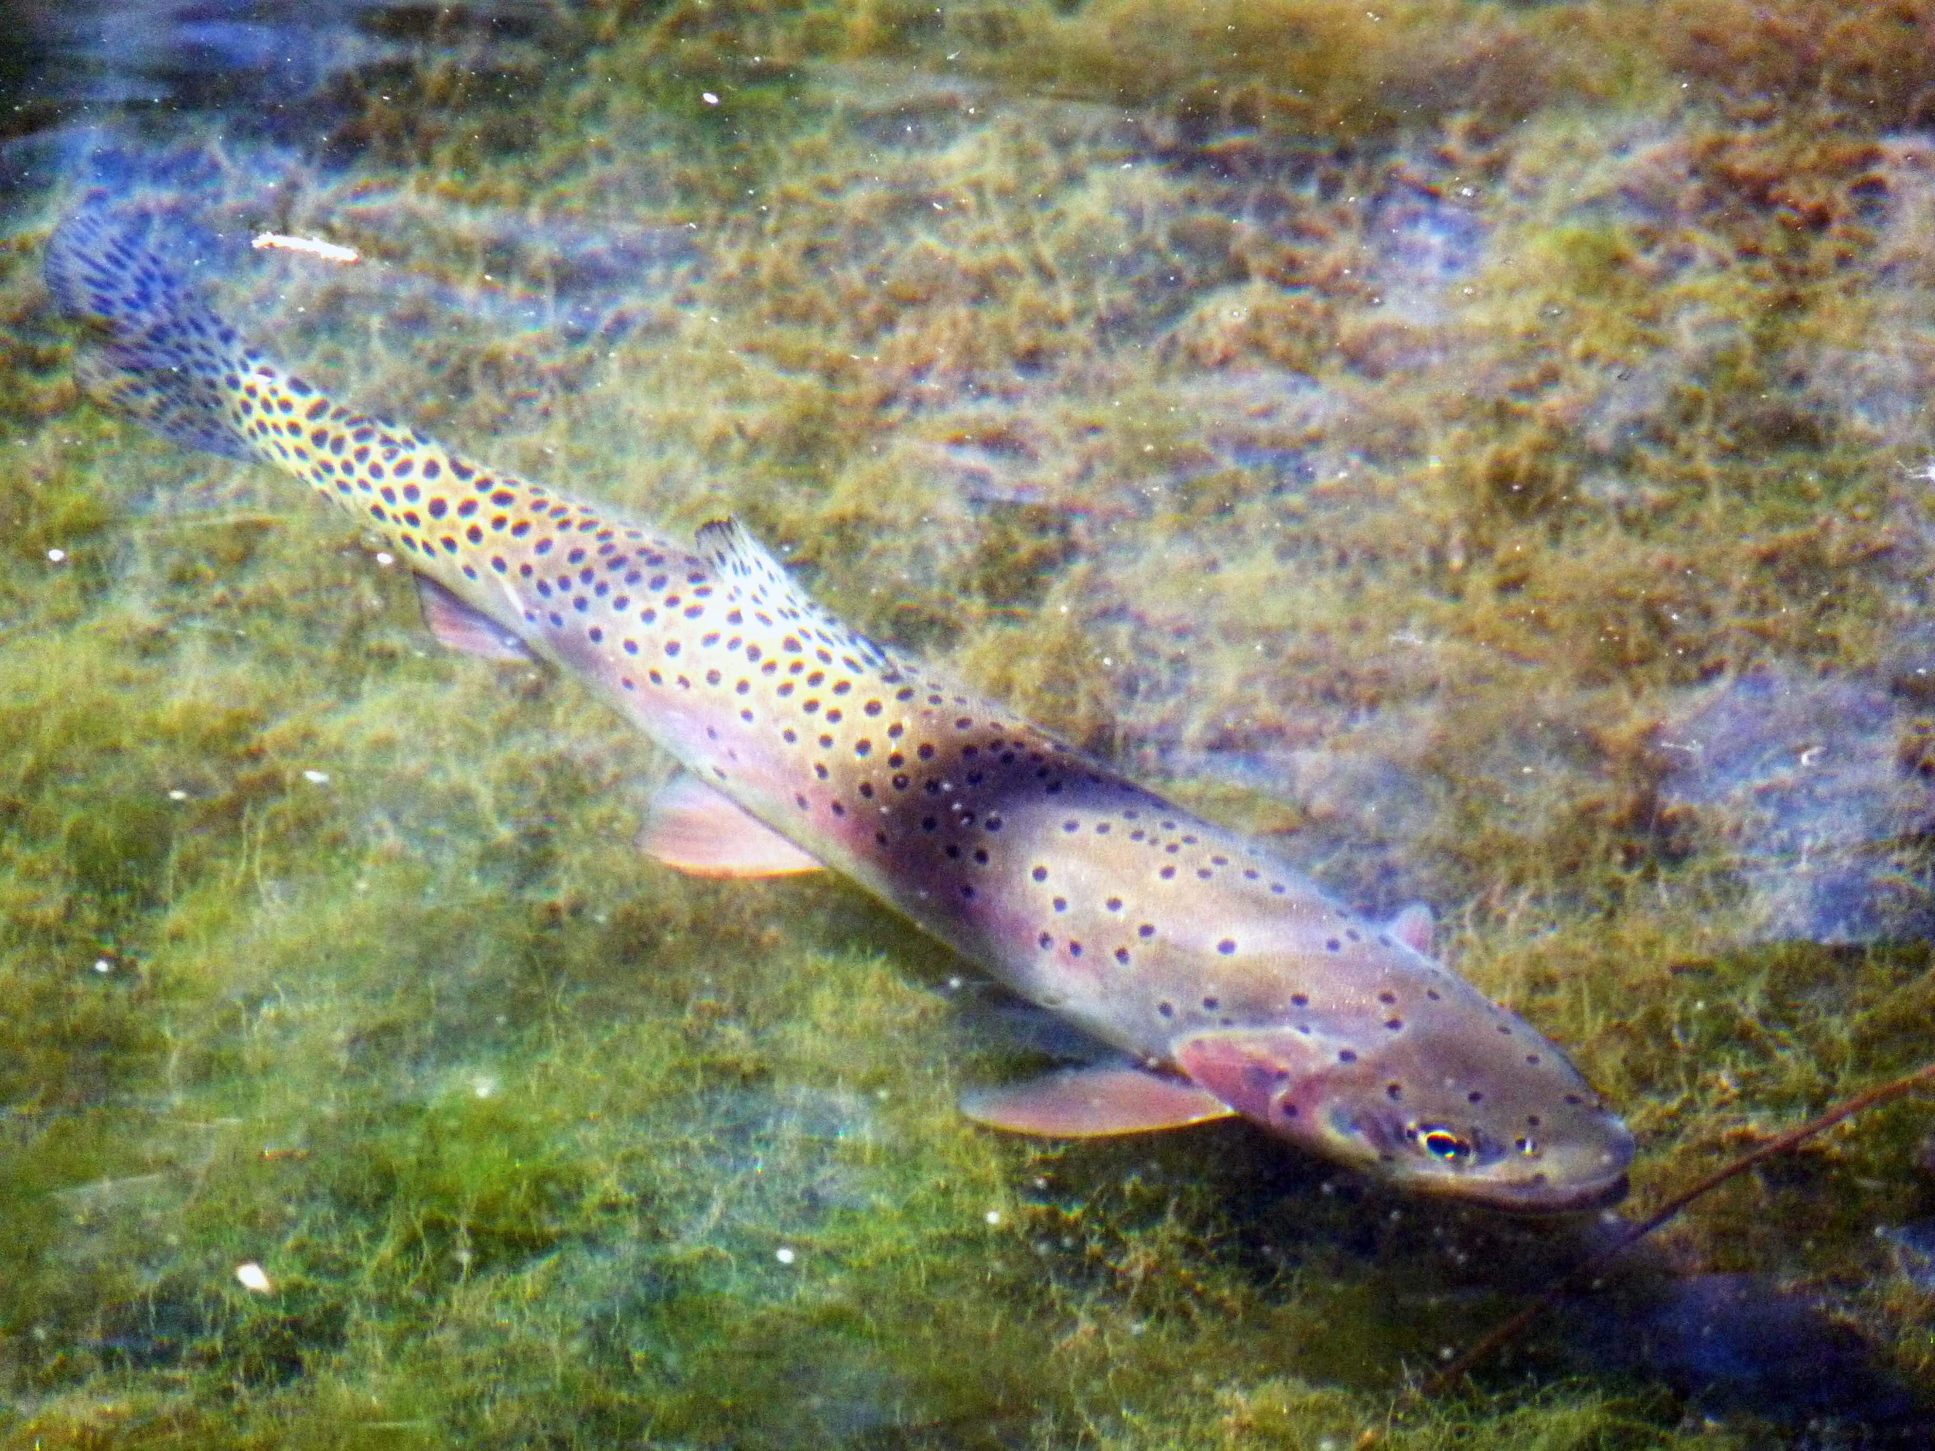
Introduction
UDEQ & EPA
Dissolved Oxygen
Data Collection Sites
My research involves modeling aquatic habitat at state-wide scales
Based on limiting factors such as temperature, dissolved oxygen, and turbidity
Datasets designed with different objectives in mind
Does this present a problem in representing streams?
Habitat Model
Photo: Utah Division of Wildlife Resources

Slide 3
How Does This Represent This?

Slide 4
Research Questions
How does the distribution of sample locations capture stream characteristics?
Can we use available
DO sensor data in modeling
streams in trout range?
What conditions are we missing?
Where to add new monitoring locations
to improve representation?

Slide 5
Study Area and Data Sources
Bonneville cutthroat trout (BCT) range
Dissolved oxygen (DO) sample locations
NHDPlus Stream Data

Slide 6
How to Characterize Streams?
Metrics Chosen:
Total Drainage Area (km²)
Velocity (fps)
Discharge (cfs)
Why These?
Important Aspect of Stream Character
Near-complete coverage of watershed stream segments

Slide 7
Methods
Import and process raw data
Snap sample locations to stream segments
Create population of sampled streams
Use Log10 function to generate normal-distribution classes for stream attributes
Compare sampled stream populations to full watershed

Slide 8
Sample Distribution
Results
Classes created by Log10 transformation
Trend to undersample attribute classes that contain most stream segments
How many attribute classes are completely unsampled?

Slide 9
Unsampled Classes
Results
13 Stream Attribute Classes Unsampled
Total Drainage Area and Velocity unsampled
All Discharge classes sampled
How does this apply to study area?
Unsampled Stream Attribute Classes
Stream Attribute | Class Definition
Total Drainage Area (km²) | 0.88495 - 1.10459317494942
 | 1.10459317494942 - 1.37875165566025
 | 2074.18679945422 - 2588.99706131816
 | 5034.80473477698 - 6284.43622632167
Velocity (fps) | <=0.3662
 | 0.3662 - 0.38939259508925
 | 0.38939259508925 - 0.414054265140453
 | 0.414054265140453 - 0.440277849766777
 | 0.440277849766777 - 0.468162270782314
 | 0.468162270782314 - 0.497812715084699
 | 0.6364206778077 - 0.676727547963407
 | 2.61303055145558 - 2.77852341933854
 | > 3.552159

Slide 10
What are we missing?
Results
9% of Stream Segments have one attribute that falls into an unsampled class
Widespread throughout range
Only 13 classes need additional samples

Slide 11
Where to Add Samples?
Analysis
Segment within 1km of road
Close to access point
Part of segment on Public Land
Ease of identifying administrator and acquiring access

Slide 12
Where to Add Samples?
Analysis
Result: 188 Possible Sites meet location criteria
Priority: Sites where we can add multiple unsampled attribute classes

Slide 13
Where to Add Samples?
Analysis
Maximum of 2 sites can add multiple unsampled classes (i.e. 2 sites add 4 classes)
9 unsampled classes remain
11 total sites required to sample in all stream attribute classes

Slide 14
Conclusions
DO sensors currently capture 91% of stream segments
Currently missing 13 classes of velocity and total drainage area
11 sites to represent 100% of stream segments
Continued Work
Optimize site selection from possible locations

Slide 15
Questions?

