Slide 1
Exploring the Relation Between Palmer Drought Severity Index (PDSI) and Wildfire Activity in Western United States
November 9th 2018
Hydrology
Name: | Rui Gao
November 20, 2018

Slide 2
Content
Why this topic?
Data
Method
Future steps

Slide 3
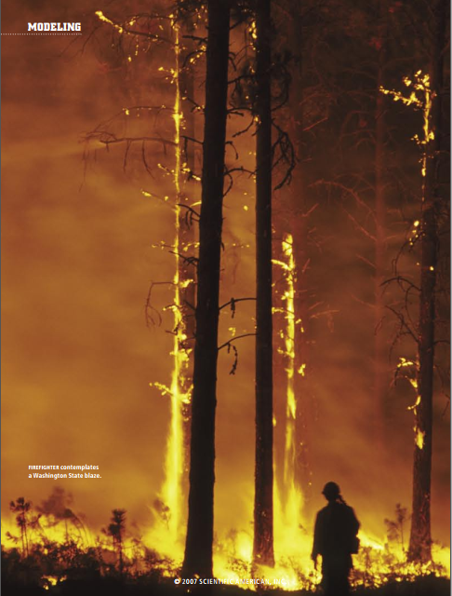
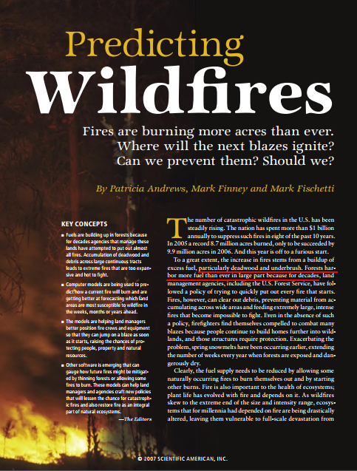
Why?
Magazine;
News;
Trees;

Slide 4
Data
Mete-hydrological data - LDAS (Land Data Assimilation Systems)
Precipitation
Potential evapotranspiration
Evapotranspiration
Soil moisture
Runoff
unit is mm/month
Wildfire data – National Fire and Aviation Management (https://fam.nwcg.gov/fam-web/)
Latitude & Longitude (sites)
Time of occurrence (monthly scale)
Data has been downloaded from
2014 January to 2017 December.
The resolution is 0.125 °×0.125°.

Slide 5
Method
Tools
ArcGIS Pro
ArcMAP 10.6.1
SPI
Matlab
Calculation
PDSI
Statistic
To confirm the research grids& All the grids contain latitude, longitude, column number and row number.
To confirm relationship between PDSI and wildfire activity.

Slide 6
Method – research area
Tools
ArcGIS Pro
ArcMAP 10.6.1
Wildfire activity concentrate on western part of USA.
How to confirm the exact research area in the western part?
Lake
Gobi

Slide 7
Method – research area
Tools
ArcGIS Pro
ArcMAP 10.6.1
From 2014 January to 2017 December, more than 11011 wildfire events have been reported.
Wildfire activity concentrate on western part of USA.
How to confirm the exact research area in the western part?
Lake
Gobi

Slide 8
Method – research area
Based on the geographic information of meteorological-hydrological data, the resolution of each grid is 0.125 °×0.125°.
There are totally 11011 grids occurred wildfire events during 2014 to 2017.
PDSI ^{relation} Wildfire activity
HOW?

Slide 9
Method - PDSI
i denotes the month in the research period; j ranges from 1 to 12; c is 0.103; const2 is an empirical value, -39.76.
Z is called the moisture anomaly indexK is an empirical value; d is the precipitation deviation from the CAFEC (Climatically Appropriate For Existing Conditions).
P is the precipitation (mm/month); PE is the potential evapotranspiration (mm/month); PR is the potential recharge (mm/month); PRO is the potential runoff (mm/month); PL is the potential soil moisture loss (mm/month);
$α,β,γ,δ$ are means for each month averaged over the base period.
$${MPDSI}_{i}=\left(1−c\right){MPDSI}_{i−1}+Z_{i}/3$$
$$Z=dK$$
$$K={const2}/{D_{drought}}$$
$$d=P−CAFEC$$
$$CAFEC=α_{j}PE+β_{j}PR+γ_{j}PRO−δ_{j}PL$$
$$α_{j}=\overline{{ET}_{j}}/\overline{{PE}_{j}}$$
$$β_{j}=\overline{R_{j}}/\overline{{PR}_{j}}$$
$$γ_{j}=\overline{{RO}_{j}}/\overline{{PRO}_{j}}$$
$$δ_{j}=\overline{L_{j}}/\overline{{PL}_{j}}$$

Slide 10
Method - relation
PDSI
(2014 Jan – 2016 Dec)
Statistical relation
Wildfire events sites
(2014 Jan – 2016 Dec)
Predict the wildfire sites
(2017 Jan – 2017 Dec)
V.S.
PDSI
(2017 Jan – 2017 Dec)
Wildfire events sites
(2017 Jan – 2017 Dec)

Slide 11
Future steps
Addressing the problem in calculating PDSI
Statistic analyzing
Predict the wildfire sites in 2017 based on the relation

Slide 12
Thanks for watching! Suggestions!

