Slide 1
Using ArcGIS Pro to Evaluate the Impacts of In-Stream Barriers on Fish Habitats Case study: Bonneville cutthroat trout (BCT) habitats in the Bear River watershed, Utah
Ali Farshid, Ph.D. student, Dept. of Watershed Sciences
CEE 6440: GIS in Water Resources (Term Project)
Professor: Dr. David Tarboton
Fall 2018

Slide 2
Outline
Background
Project region & species
Assumptions
Methods & Results (so far)
Conclusion

Slide 3
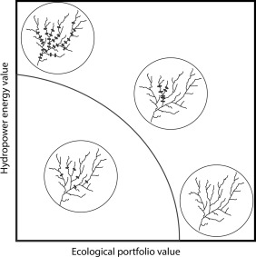
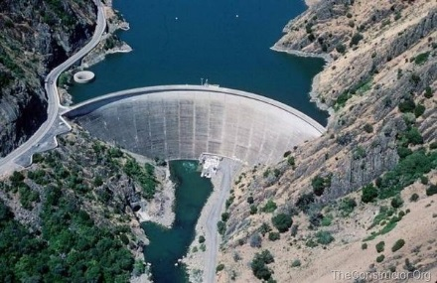
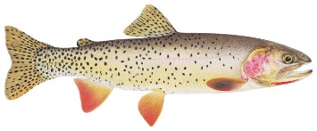
1/5 – Research background
Analyze the trade-offs between fish habitats and hydroeconomic activities
$
Jager, H. I., Efroymson, R. A., Opperman, J. J., and Kelly, M. R. (2015). “Spatial design principles for sustainable hydropower development in river basins.” Renewable and Sustainable Energy Reviews, 45, 808–816. https://www.sciencedirect.com/science/article/pii/S1364032115000775

Slide 4
2/5 – Project region
Bear River Watershed
~ 7,500 mi²
Bear River: ~ 500 mi
Elev.: 13,000 ft to 4,200 ft
Shared among 3 states
https://www.bearriverinfo.org
Bear River Watershed Stream Structures
41 barriers
≤ 10 feet = barriers
≤ 50 feet = impoundments
≤ 165 feet = small dams
https://hub.arcgis.com/
Data source: https://hub.arcgis.com/
Data source: https://hub.arcgis.com/

Slide 5
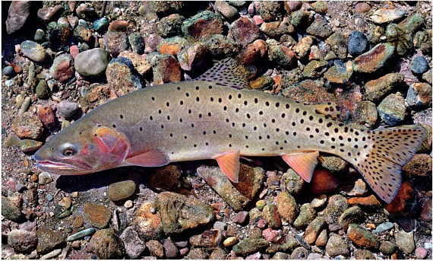
2/5 – Project species
Bonneville cutthroat trout (BCT)
subspecies native to the Bonneville basin
evolved as a lake-dwelling population
became restricted to stream-dwelling
Symbol and State Fish of Utah
https://wildlife.utah.gov/cutthroat/BCT/index.html
https://www.utah.gov/about/symbols.html
http://www.southerntrout.com/
Data source: Trout Unlimited
https://www.tu.org/

Slide 6
3/5 - Assumptions
Suitable fish (BCT) habitat is a complex function of:
Stream connectivity
Hydraulic variables (Q, V, d,…)
Geomorphologic variables (S₀ , streambed materials,…)
Environmental variables (Temp, DO, pH, pollution,…)
Other variables (food source, cover, shelter, channel complexity,…)
But, in the watershed scale we need a simpler model:
Discharge -Q > 1.5 m³/s
Channel bed gradient -S₀ < 5%
Temp -T < 15 deg C
Then, what is the limiting factor???
Stream connectivity → can be affected by impoundments & dams
GIS
GIS selected many stream segments
The Bear River watershed is potentially a SUITBALE habitat for BCT

Slide 7
4/5 – Methods & Results
Bear River in its original state (no man-mad barriers)
Total length of streams = 15,800 km
Bear River in its current state (with man-mad barriers)
Total length of defragmented (dammed) streams = ?

Slide 8
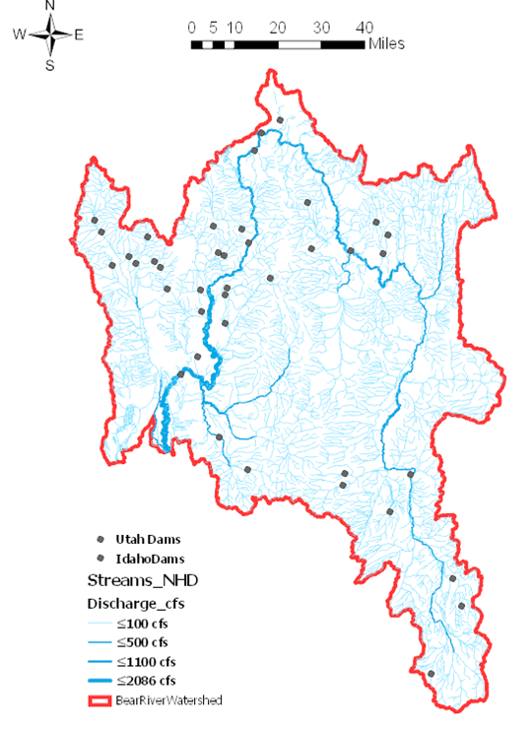
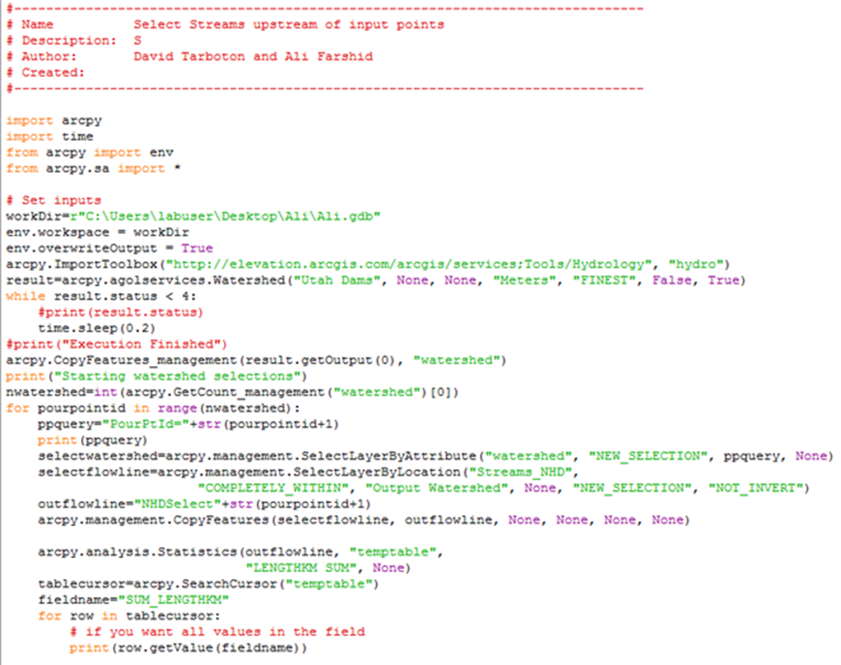
4/5 – Methods & Results (Cont.)
For 41 dams in the watershed, I needed to automate the process
Calculated stream segments length
for 6 sub-watersheds using ArcGIS tools
Total stream length U.S. of dam (km) | Drainage area (mi²) | Normal storage (ac-ft) | Height (ft) | Dam Name
23.9 | 17 | 2,256 | 97 | Brich Creek No.2
96.8 | 58 | 4,350 | 103 | Woodruff creek
115.6 | 72 | 12,800 | 165 | Porcupine
56.8 | 28 | 4,050 | 82 | Montpelier creek
73.59 | 30 | 1,713 | 39 | Strongarm 1
$\frac{Total fragmented streams}{Total area of dammed WS}=\frac{km}{km2}= ?$

Slide 9
5/5 - Conclusions
Fish habitats - dams trade-offs
One of the major risks to the habitats is defragmentation
Using GIS+Python to analyze and quantify defragmentation
Will introduce some metrics to roughly predict the effects of dams on habitat loss in the Bear River watershed

Slide 10
Thank you!
Questions

